Slide 1
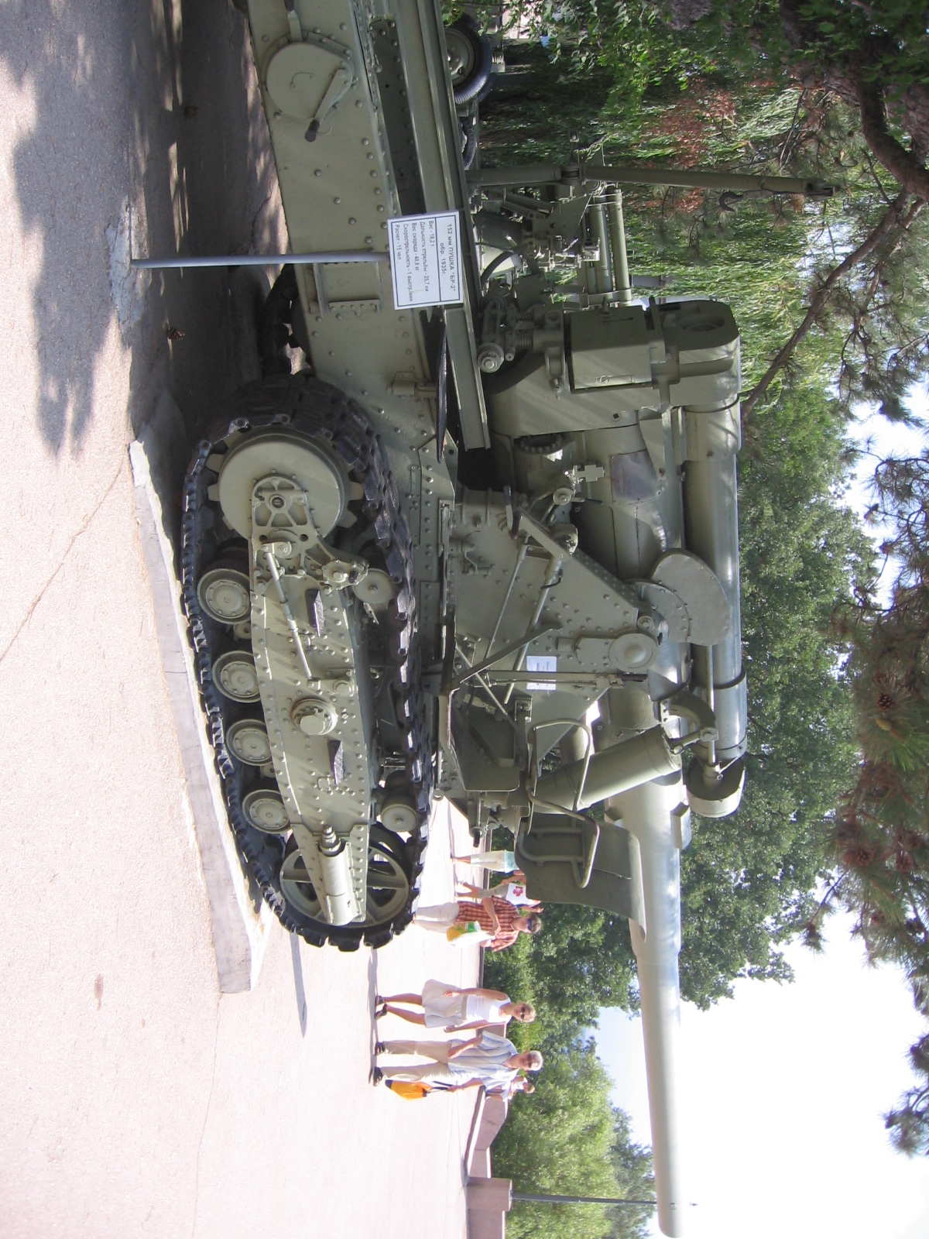
WWII Time Capsule
Jacob Struble
Block 3 w
Sept 12
#1

Slide 2
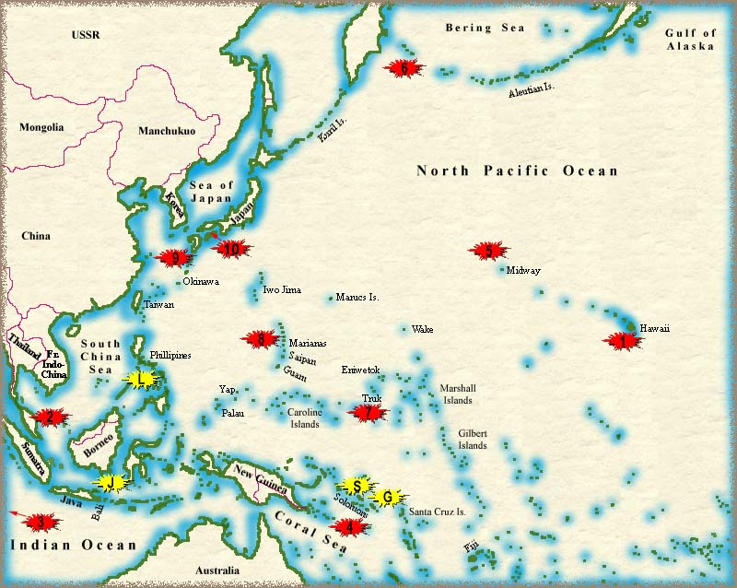
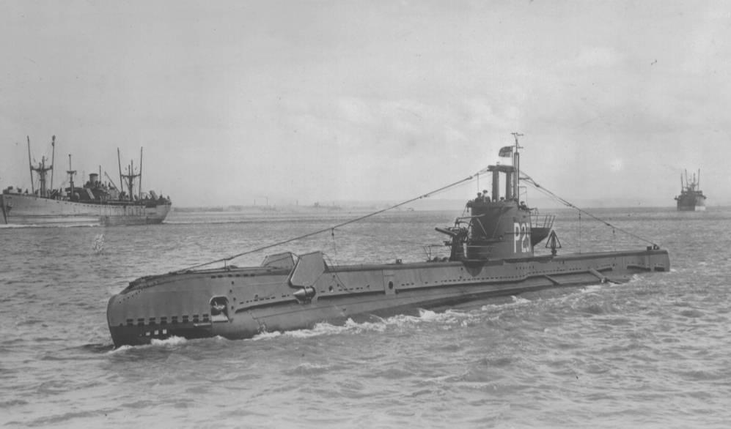
The Pacific Campaign
Pearl Harbor
Iwo Jima
Midway
Marianas
Hawaii
Okinawa

Slide 3
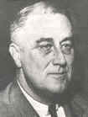
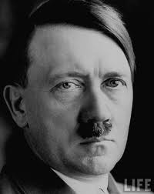
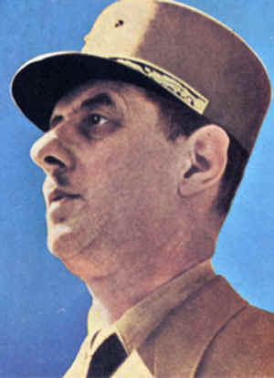
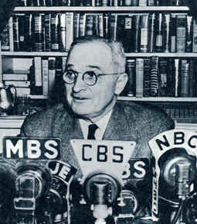
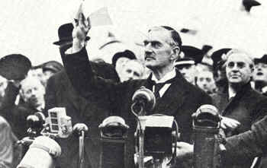
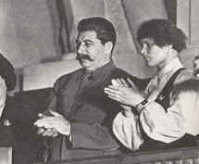
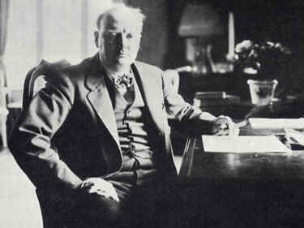
Political Leaders
name | country | Side
Neville Chamberlain | Great Britain | allies
Winston Churchill | Great Britain | allies
Charles de Gaulle | French | allies
Adolf Hitler | Nazi Germany | axis
F D Roosevelt | America | allies
Joseph Stalin | Russia | axis
Hideki Tojo | Japan | axis
Harry Truman | America | allies

Slide 4
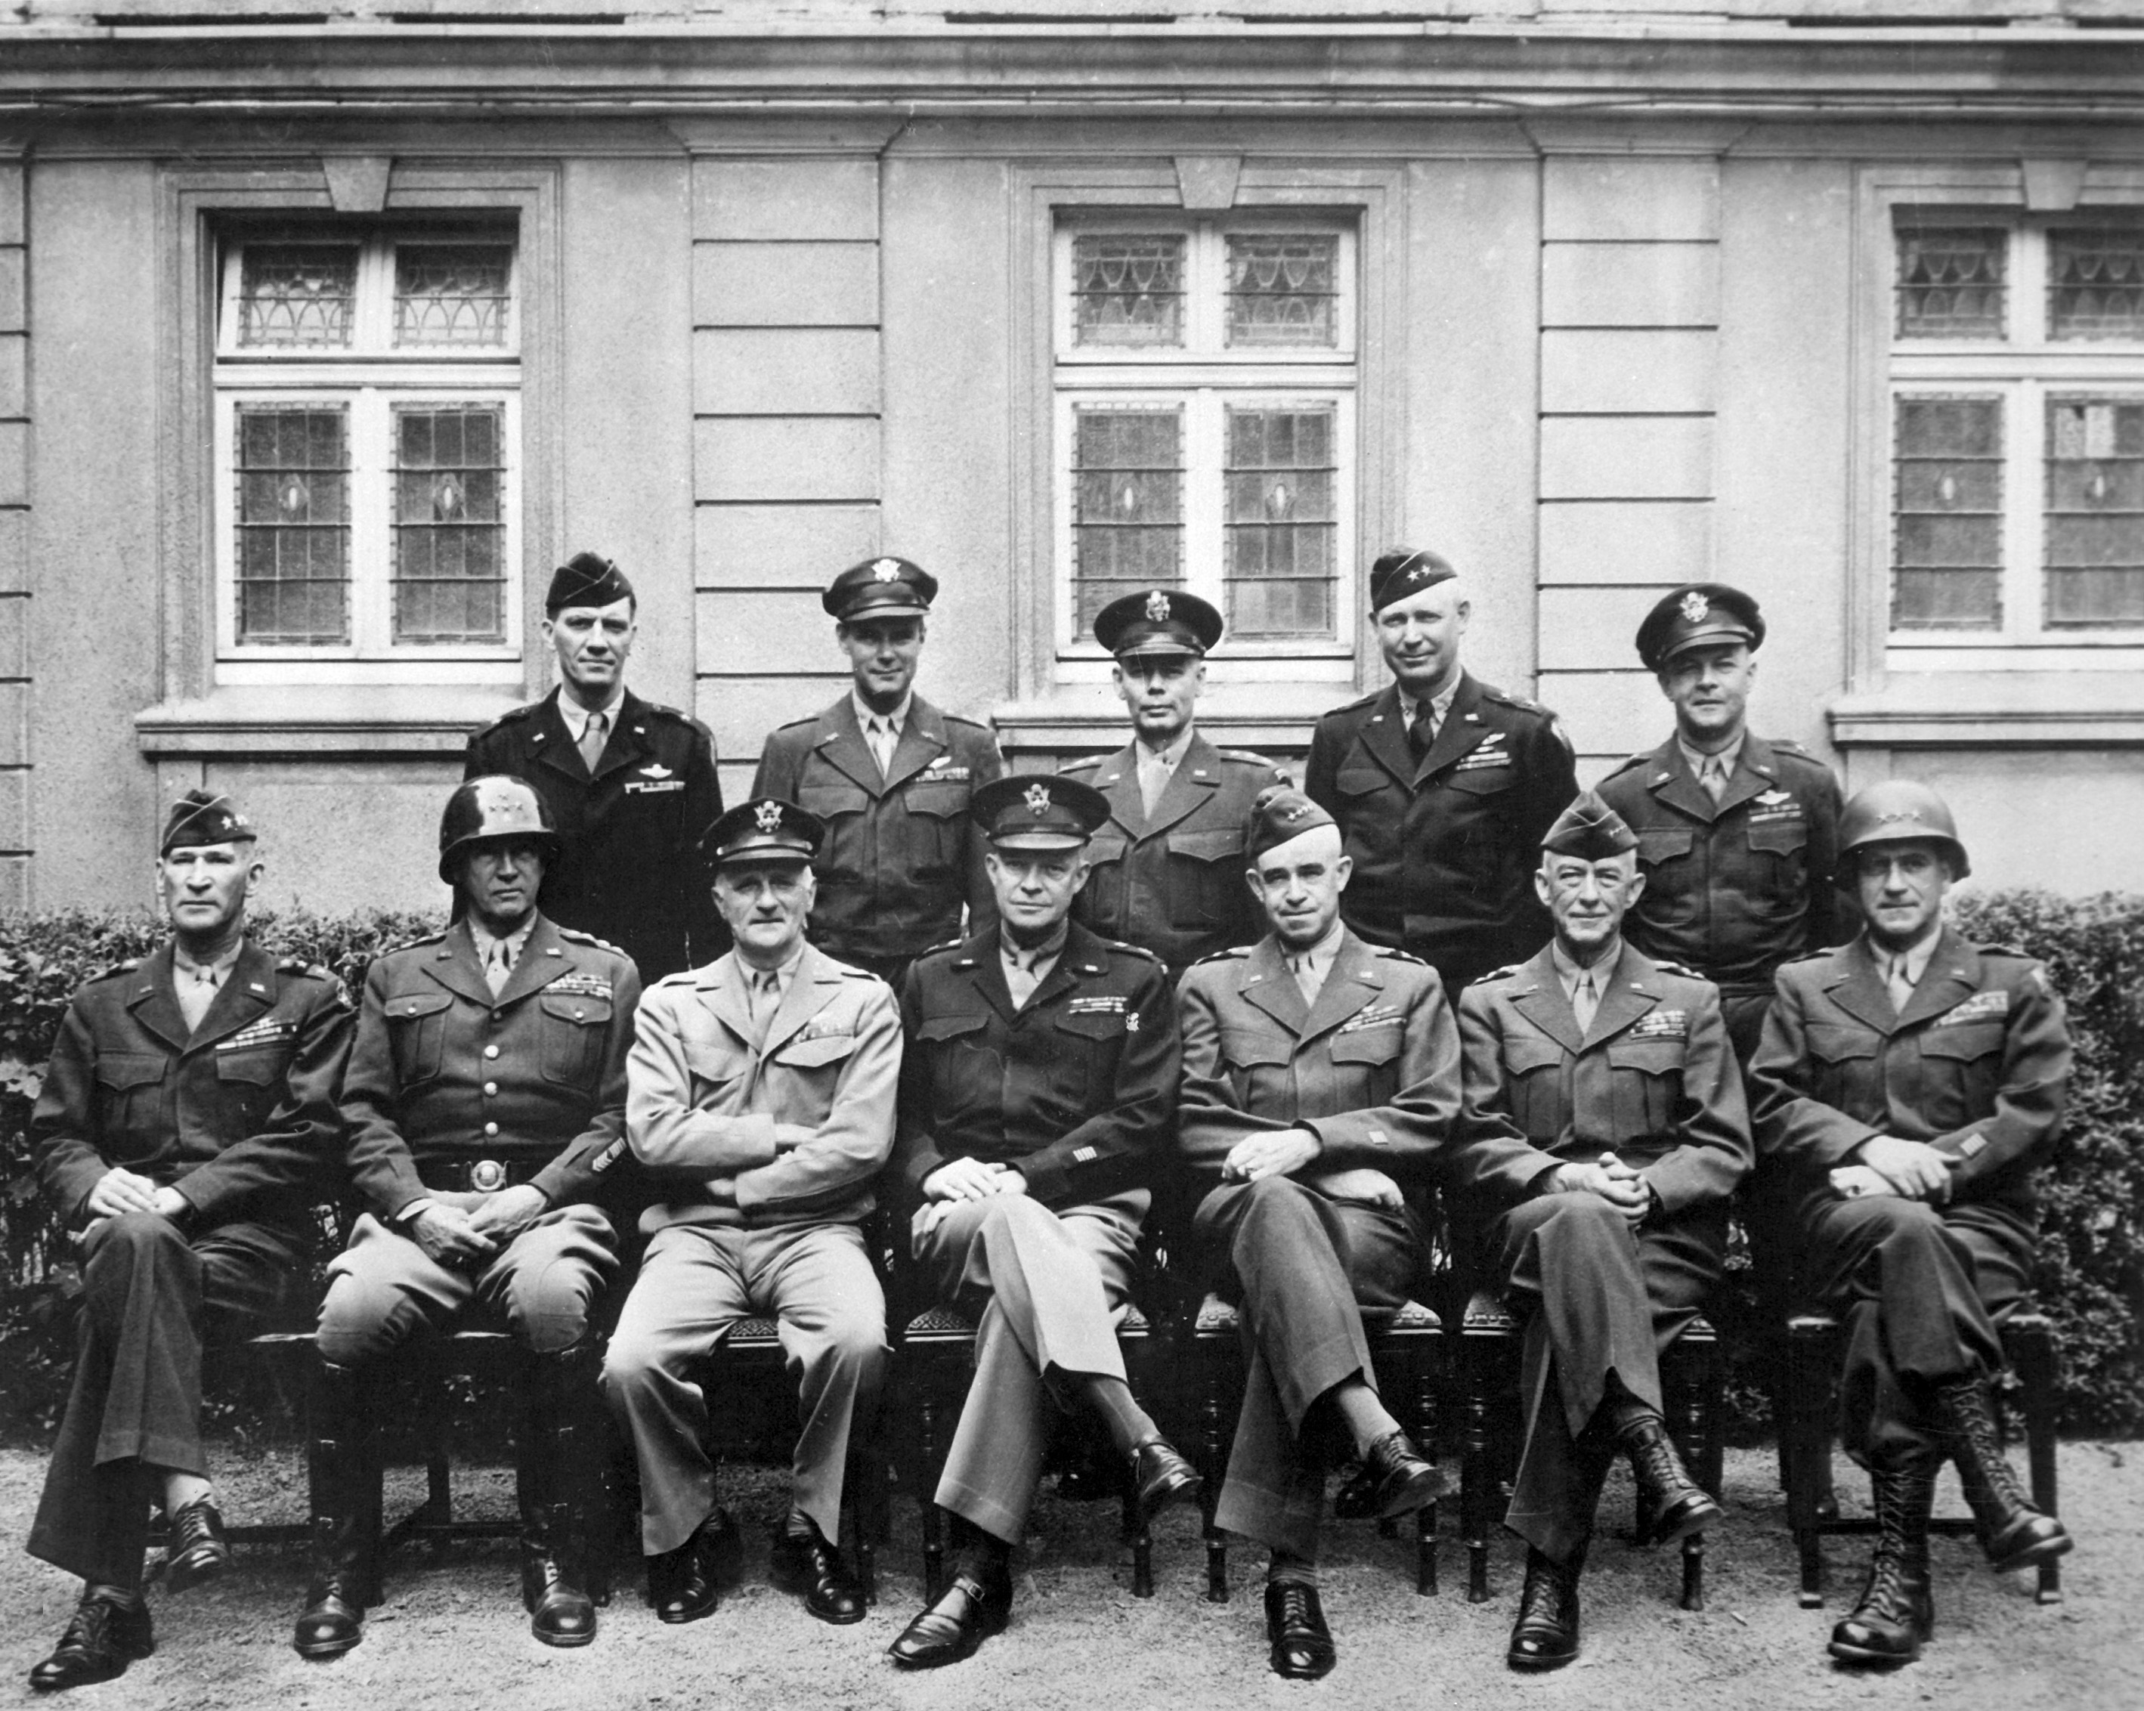
Many War Officials of the Allies

Slide 5
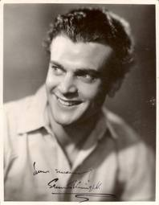
Top Songs
"A Lovely Way To Spend An Evening", "A Nightingale Sang in Berkeley Square", Vera Lynn voc. "Ac-cent-tchu-ate The Positive", Johnny Mercer Hit vocal. "Amapola", Jimmy Dorsey Orch. Bob Eberly and Helen O'Connell vocal. "As Time Goes By", Dooley Wilson vocal (soundtrack: 'Casablanca') "Auf Wiedersehen Sweetheart", Vera Lynn vocal. "Boogie Woogie Bugle Boy", Andrews Sisters vocal "Coming In On A Wing And A Prayer", The Song Spinners. "Deep In The Heart of Texas", Johnny Mercer voc. "Don't Get Around Much Anymore (aka: Never No Lament)", Duke Ellington Orch.
"Do Nothing Till You Hear From Me", Duke Ellington Orch. "Elmer's Tune", Glenn Miller Orch. "G. I. Jive", Johnny Mercer vocal. "Idaho", Benny Goodman Orch. "Juke Box Saturday Night", Glenn Miller Orch.
"I Can't Begin To Tell You", Sammy Kaye Orch.

Slide 6
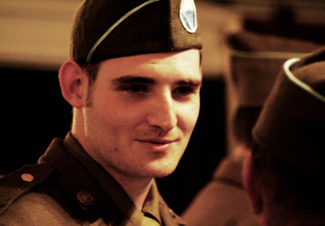
Popular Authors, Singers, and Actors
Don Adams
John Agar
Gene Autry
Ossie Davis
Charles Durning
Douglas Fairbanks Jr
Anthony Quayle
Charles Schultz
Rod Serling

Slide 7
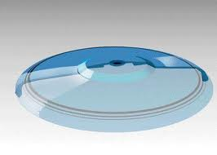
New inventions of WW 2
The Frisbee was invented 1948.
Penicillin was invented.
The first computer – ENIAC was invented in 1946.
Metal vacuum tubes were invented.

Slide 8
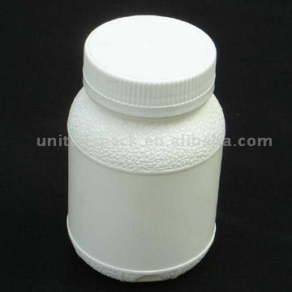
Medical Advancements
advances were made in the management of pregnancy and childbirth
More vaccines
advances were also made in birth control
the discovery of DNA
ultrasound and magnetic resonance
successful heart lung machine
Hip replacement
research linked smoking to lung cancer

Slide 9
Fashion coupon chart
Item of clothing | Women | girls
Lined mackintosh or coat over 28" | 14 | 11
Under 28" short coat or jacket | 11 | 8
Frock, gown or dress of wool | 11 | 8
Frock, gown or dress of other fabric | 7 | 5
Bodice with girls skirt or gym tunic | 8 | 6
Pajamas | 8 | 6
Divided skirt or skirt | 7 | 5
Nightdress | 6 | 5
Dungarees or overalls | 6 | 4
Item of clothing | Women | girl
Blouse, shirt, sports top, cardigan or jumper | 5 | 3
Pair of slippers, boots or shoes | 5 | 3
Other garments including corsets | 5 | 2
Petticoat or slip, came knickers or combinations | 4 | 3
Apron or pinafore | 3 | 2
Scarf, gloves, mittens or muff | 2 | 2
Stockings per pair | 2 | 1
Ankle socks per pair | 1 | 1
1 yard wool cloth 36"wide | 3 | 3

Slide 10
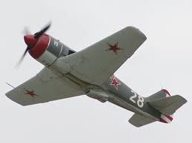
Major Battles
Battle of the River Plate
Battle of Britain
The Battle of Gazala
The Battle of El Alamein
The Battle of Moscow
The Battle of Stalingrad
The fall of Singapore
The Battle of Kursk
The Battle of Brittany
The Battle of Arnhem
The Battle of the Bulge
The Battle of Berlin
The Battle of Coral Sea
The Battle of Midway
The Battle of Guadalcanal
The Battle of the Philippine Sea
The Battle of Iwo Jima
The Battle of Okinawa

Slide 11
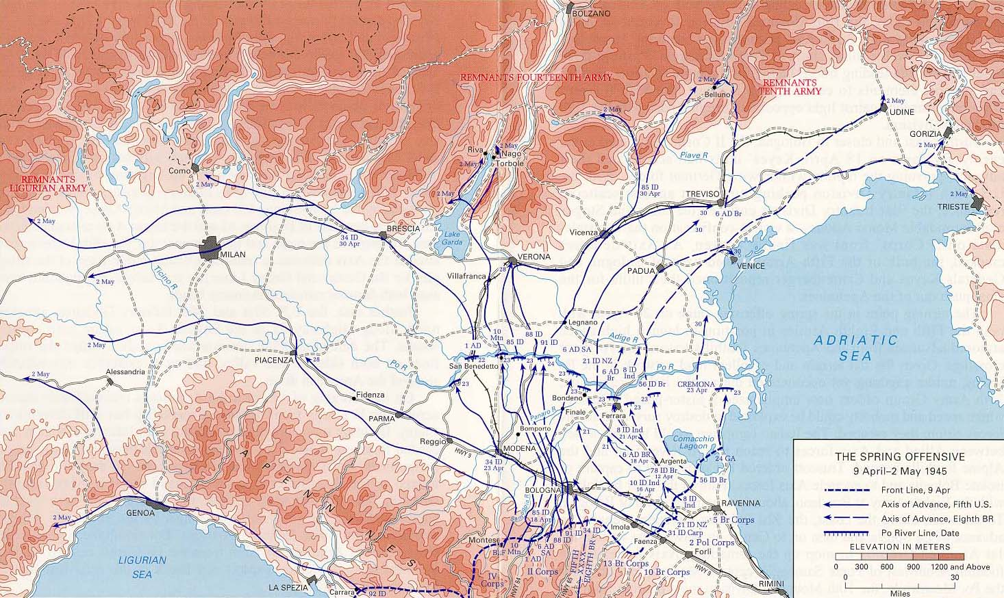
World war 2 map

Slide 12
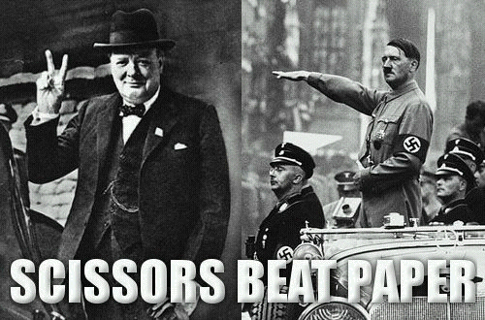
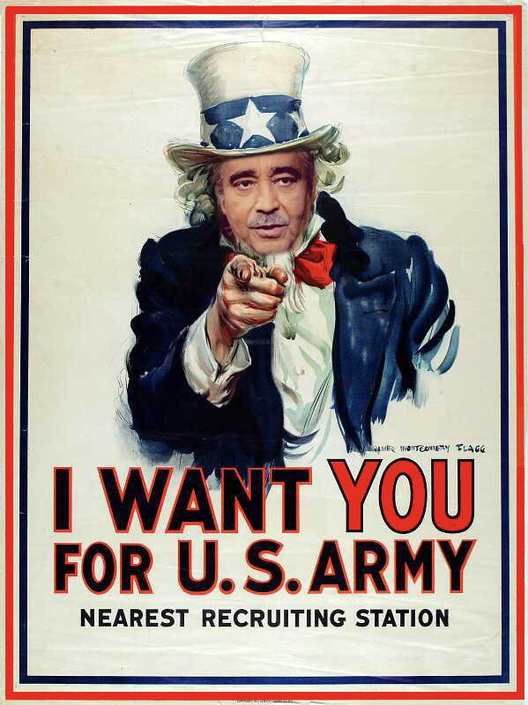
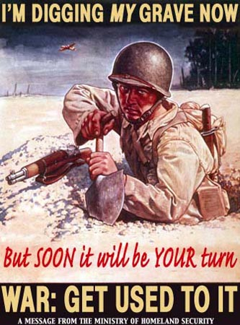
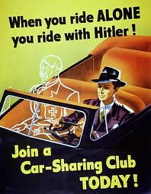
Propaganda
#4

Slide 13
Web sites I used
ww2f.com
sligocameraclub.org
http://combinedfleet.com/battles/
cheekymax.blogspot.com
stubbornfacts.us
flickr.com
http://www.historylearningsite.co.uk
http://nfo.net/usa/ww2.html

Slide 14
Web sites I used
arts-autographs.co.uk
http://www.kyrene.org/schools/brisas/sunda/decade/1940.htm
http://www.fashion-era.com/utility_clothing.htm#Clothing, Cloth And Footwear Rationing
ojb.co.nz
commons.wikimedia.org

Slide 15
Web sites I used
gimmiethescoop.com
http://www.jodavidsmeyer.com/combat/military/actors_in_wwii.html
http://nfo.net/usa/ww2.html
gimmiethescoop.com

