Slide 1
The Era of World War 2
3.
Propaganda
1.
2.
Hitler
Ww2 airplane
Chandler Carroll
Mrs. Paschall 3W

Slide 2
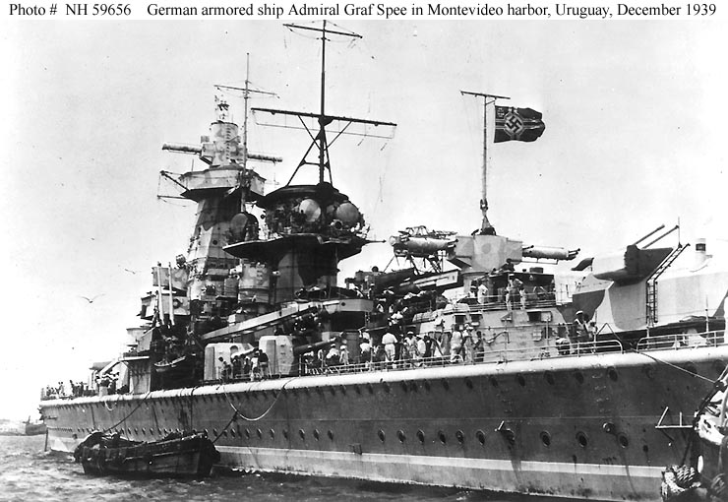
WWII Battles
The Battle of the River Plate
Renowned battle took place on December 13^{th,} 1939
First naval battle of importance of World War II
Ships from the Royal Navy’s South American Division were the opponents of Germany’s Graf Spee which was successfully attacking merchant shipping in the South Atlantic .
Graf Spee successfully reached the River Plate with minor damages.
Grif Spee
4.
1.

Slide 3
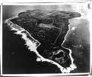
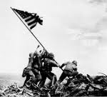
WWII Battles in the Pacific
Battle of Iwo Jima
5.
7.
6.
Took place in February 1945 between America and Japan.
Great tactical importance, contained 22,000 Japanese soldiers
Americans utilized bombings and amphibious attacks by the Marines.
Americans took heavy casualties, 6,891 men killed and 18,070 men wounded.
All resistance had ceased by March 26th.
Influenced the use of atomic bombs on Hiroshima and Nagasaki because of patriotism.
2.

Slide 4
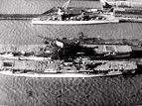
Final Destruction
for Imperial Japan
Japanese battle ships
Destruction occurred July 24th and 28^{th,} 1945
Nihon Kaigun was almost extinct before the battle.
Japanese fleets were outnumbered, damaged, and low on fuel.
The U.S. Navy seeked revenge for the attack of Pearl Harbor.
The battle was only a few minutes which truly marked the end for the Imperial Japanese Navy.
8.
3.

Slide 5
The Battle of Berlin
Battle took place between April and May in 1945.
It was fought between Russians and Germans as the Russians attempted to capture the city of Berlin.
Russians outnumbered Germans in soldiers and equipment.
Russians lost 80,000 men and 275,000 were wounded.
150,000 Germans were killed.
Russians took over the city, and on May 7th, 1945, Germany surrendered.
 | Germany | Russians
Soldiers | 1,000,000 | 2,500,000
Artillery | 10,400 | 41,600
Tanks | 1,500 | 6,250
Aircraft | 3,300 | 7,500
Battle of Berlin chart
4.
9.

Slide 6
Propaganda
“Rosie the Riveter”
American propaganda
A feminist icon in the United States.
Represented the women who worked in the factories during World War II.
“Rosie the Riveter” was used in a song of the same name made in 1942 by Redd Evans and John Jacob Loeb.
Many women worked in the manufacturing plants that constructed munitions and war supplies.
10.
5.

Slide 7
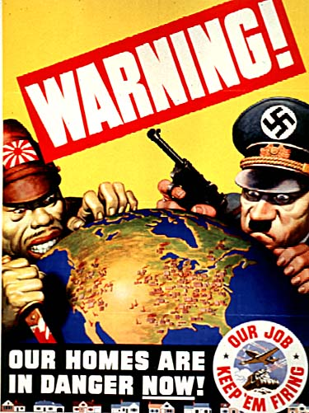
Propaganda
American propaganda
11.
This American propaganda poster dehumanizes the Germans and Japanese.
Both characters contain weapons (Japanese-bloody knife, German-Luger).
They are hovering over the United States.
During the 1940s, posters were made to persuade the public to show hate toward a specific country.
The United States produced more propaganda posters than any other country fighting in World War II.
6.

Slide 8
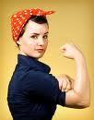
American propaganda
American propaganda
We Can Do It!
12.
13.
The song, “We can do it,” was the basis for the saying in the American propaganda poster (we can do it).
The song was made in 1942 by Redd Evans and Jacob Loeb.
It was recorded by multiple artists, including the famous band leader Kay Kyser, and became popular throughout the nation.
The song displays “Rosie” as being a hard-working assembly line worker, in order to help the soldiers in the war:
All day long,
Whether rain or shine
She’s part of the assembly line.
She’s making history,
Working for victory
Rosie the Riveter
7.

Slide 9
Shirley Jackson
Shirley Hardie Jackson was born on December 14^{th,} in 1916 in San Francisco, California.
In 1941, she published her first short story My Life with R.H. Macy, in The New Republic for twenty-five dollars.
Jackson’s writing career was successful with publishes in The New Yorker, Mademoiselle, Fantasy and Science Fiction, Charm, The Yale Review, The New Republic, The Saturday Evening Post, and Reader's Digest.
Jackson died on August 8th in 1965
14.
Shirley Jackson
8.

Slide 10
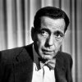
Humphrey Bogart
16.
15.
Humphrey Bogart
Humphrey Bogart
Humphrey DeForest Bogart was born on December 25th, 1899 in New York City, New York.
He was taught at Trinity School in New York City, sent to Phillips Academy in Andover, Massachusetts, in preparation for medical studies at Yale.
He finally had his breakthrough role in The Petrified Forest (1936) from Warner Bros.
Bogart emerged in 28 films, usually as a gangster, twice in Westerns and even a horror film, from 1936 to 1940.
He died on January 14^{th,} 1957 after battling throat cancer.
9.

Slide 11
Frank Sinatra
19.
18.
17.
Frank Sinatra
Francis Albert Sinatra was born on December 12^{th,} 1915 in Hoboken, New Jersey.
He started his solo singing career in 1942 which he immediately found success as the king of the bobbysoxers (young women and girl fans) becoming the most famous singer of the era among adolescent music fans.
Sinatra was also a popular actor who starred in many memorable films such as “The Man with the Golden Arm” (1955).
He died on May 14th in 1998 in Los Angeles, California
10.

Slide 12
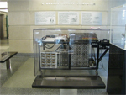
Electronic Digital
Computer
The world’s first electronic digital computer was the Atanasoff-Berry Computer (ABC).
It was invented by John Atanasoff and Clifford Berry at Iowa State in the year 1942.
It contained many new computing functions such as the use of binary arithmetic, regenerative memory, parallel processing, and separation of memory and computing functions.
20.
First Electronic Digital Computer
11.

Slide 13
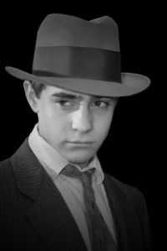
Apparel of the 1940s
Knickers were beginning to become less and less popular.
Young men began to wear zoot suits.
They also wore high-cut trousers with short, wide ties.
Fedora hats were also very prevalent for young men in the 1940s.
21.
Young man wearing a fedora and a zoot suit.
12.

Slide 14
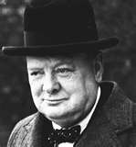
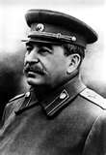
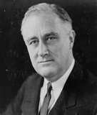
“The Big Three”
Primary Leaders of Allies
Winston Churchill
Joseph Stalin
Franklin D. Roosevelt
24.
23.
22.
Winston Churchill was the prime minister of Great Britain and major leader of the Allies during World War II.
Joseph Stalin was the brutal Communist dictator of Russia during the war.
Franklin Delano Roosevelt was the president of the United States during the war.
13.

Slide 15
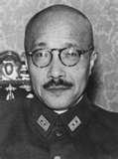
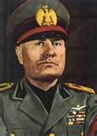
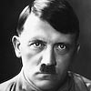
Axis Leaders
General Hideki Tojo
Benito Mussolini
Adolf Hitler
25.
27.
26.
General Hideki Tojo was the prime minister of Japan and controlled Japan until the end of World War II.
Benito Mussolini was the prime minister of Italy and a friend of Germany’s leader, Adolf Hitler.
Adolf Hitler was the Nazi dictator of Germany who planned and started World War II.
14.

Slide 16
The Draft
Registration card
The draft during World War II selected a variety of people to help fight for the United States.
A total of 10,110,104 men were drafted between November 1940 and October 1946, drawing from the pool of men born on or before 1927.
28.
15.

Slide 17
The Draft
During World War II, there were seven draft registrations:
October 16, 1940- all men 21-31 years residing in the U.S.-whether native born, naturalized, or alien.
July 1, 1991- men who reached age 21 since the first registration.
February 16, 1942- men 20-21 and 35-44 years of age.
April 27, 1942- Men 45- 64 years of age. Not liable for military service.
June 30, 1942- Men 18- 20 years of age.
December 10- 21, 1942- Men who reached the age of 18 since the previous registration.
November 16- December 31, 1943- American men living abroad, aged 18-44.
16.

Slide 18
Works Cited (pictures)
http://www.google.com/images?um=1&hl=en&safe=active&rls=com.microsoft%3Aen-us&biw=1420&bih=717&tbs=isch%3A1&sa=1&q=ww2+planes&aq=f&aqi=g10&aql=&oq=&gs_rfai=
http://www.google.com/images?um=1&hl=en&safe=active&rls=com.microsoft%3Aen-us&biw=1420&bih=717&tbs=isch%3A1&sa=1&q=hitler&aq=f&aqi=&aql=&oq=&gs_rfai=
http://en.wikipedia.org/wiki/Rosie_the_Riveterus&biw=1420&bih=717&tbs=isch%3A1&sa=1&q=ww2+we+can+do+it&aq=f&aqi=&aql=&oq=&gs_rfai=
http://www.historylearningsite.co.uk/battle_of_the_river_plate.htm
http://www.google.com/images?q=battle+of+Iwo+jima&rls=com.microsoft:en-us&oe=UTF-8&startIndex=&startPage=1&um=1&ie=UTF-8&source=og&sa=N&hl=en&tab=wi
http://www.google.com/images?q=battle+of+Iwo+jima&rls=com.microsoft:en-us&oe=UTF-8&startIndex=&startPage=1&um=1&ie=UTF-8&source=og&sa=N&hl=en&tab=
http://www.google.com/images?q=battle+of+Iwo+jima&rls=com.microsoft:en-us&oe=UTF-8&startIndex=&startPage=1&um=1&ie=UTF-8&source=og&sa=N&hl=en&tab=wi
http://www.google.com/images?um=1&hl=en&rls=com.microsoft%3Aen-us&tbs=isch%3A1&sa=1&q=final+destruction+for+Imperial+Japanese+Navy&aq=f&aqi=&aql=&oq=&gs_rfai=
http://www.historylearningsite.co.uk/battle_for_berlin.htm
http://en.wikipedia.org/wiki/Rosie_the_Riveter
http://www.bing.com/images/search?q=american+propoganda+during+ww2&FORM=BIFD#focal=a208ed7b5cb6c0bffc04332ed5fb8f4a&furl=http%3A%2F%2Fwww.members.shaw.ca%2Fdekon%2Fmedia%2Fposters%2Fhomes.jpg
http://en.wikipedia.org/wiki/Rosie_the_Riveterus&biw=1420&bih=717&tbs=isch%3A1&sa=1&q=ww2+we+can+do+it&aq=f&aqi=&aql=&oq=&gs_rfai=
http://www.google.com/images?hl=en&source=imghp&q=we+can+do+it+song&gbv=2&aq=f&aqi=g10&aql=&oq=&gs_rfai=
http://www.courses.vcu.edu/ENG-jkh/PW/biography.htm
http://www.courses.vcu.edu/ENG-jkh/
http://www.courses.vcu.edu/ENG-jkh/
http://www.imdb.com/name/nm0000069/
http://www.imdb.com/name/nm0000069/
http://www.imdb.com/name/nm0000069/
http://www.wwwk.co.uk/culture/inventions/40s/digital-computer.htm
http://mens-fashion.lovetoknow.com/Mens_Fashion_in_the_1940's
http://www.bing.com/search?q=joseph%20stalin&form=HPNTLB
http://www.bing.com/images/search?q=franklin+d+roosevelt&form=QBIR&qs=AS&sk=&pq=franklin+d+ro&sp=1&sc=8-13#
http://www.bing.com/images/search?q=winston+churchill&form=QBIR&qs=AS&sk=&pq=winston+church&sp=1&sc=8-14#
http://www.bing.com/search?q=adolf+hitler&form=QBRE&qs=n&sk=&sc=8-9
http://www.bing.com/images/search?q=benito+mussolini&FORM=BIFD#
http://www.bing.com/images/search?q=hideki+tojo&form=QBIR&qs=n&sk=&sc=8-11#
http://www.bing.com/images/search?q=draft+ww2+registration+cards&form=QBIR&qs=n&sk=#

Slide 19
Works Cited (resources)
http://www.historylearningsite.co.uk/battle_of_the_river_plate.htm
http://www.historylearningsite.co.uk/battle_of_iwo_jima.htm
http://www.google.com/images?q=battle+of+Iwo+jima&rls=com.microsoft:en-us&oe=UTF-8&startIndex=&startPage=1&um=1&ie=UTF-8&source=og&sa=N&hl=en&tab=wi
http://www.historylearningsite.co.uk/battle_for_berlin.htm
http://en.wikipedia.org/wiki/Rosie_the_Riveter
http://en.wikipedia.org/wiki/American_propaganda_during_World_War_II
http://en.wikipedia.org/wiki/Rosie_the_Riveter
http://www.courses.vcu.edu/ENG-jkh/
http://www.imdb.com/name/nm0000007/bio
http://www.imdb.com/name/nm0000069/bio
http://www.wwwk.co.uk/culture/inventions/40s/digital-computer.htm
http://mens-fashion.lovetoknow.com/Mens_Fashion_in_the_1940's
http://www.2worldwar2.com/leaders.htm
http://www.2worldwar2.com/leaders.htm
http://www.nndb.com/event/807/000140387/
http://genealogy.about.com/od/records/p/wwii_draft.htm

