Slide 1
1942 Time Capsule
By Ally O’Brien

Slide 2
Table of Contents
Movies
Actors/Actresses
Songs
Books
Political Leaders
Clothing
Invention
Propaganda
Battle of Pearl Harbor
D-Day
Works Cited

Slide 3
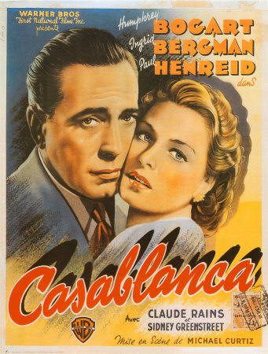
Movies
Bambi
Casablanca
http://thisdistractedglobe.com/2007/02/02/bambi-1942/
http://legendsrevealed.com/entertainment/2009/05/15/movie-legends-revealed-5/
Bambi was the first Disney movie where all the characters were animals.
Casablanca has anti-Nazi propaganda and is one of the most popular films of all time.

Slide 4
Actors/Actresses Oscar Winners
JAMES CAGNEY in "Yankee Doodle Dandy”
GREER GARSON in "Mrs. Miniver"
http://www.npg.si.edu/exhibit/ballyhoo/lessons_ballyhoo.pdf
http://classicfilm.about.com/od/oscarwinningclassics/tp/Best_Actress_Oscars_1940s.htm
James Cagney was most famous for his gangster roles.
Greer Garson worked at an advertising agency before she decided to become an actress.

Slide 5
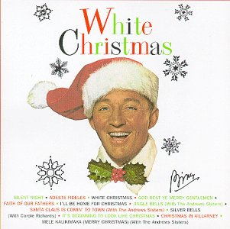
#1 Song White Christmas – Bing Crosby
I'm dreaming of a white Christmas Just like the ones I used to know Where the treetops glisten, and children listen To hear sleigh bells in the snow
I'm dreaming of a white Christmas With every Christmas card I write May your days be merry and bright And may all your Christmases be white
I'm dreaming of a white Christmas With every Christmas card I write May your days be merry and bright And may all your Christmases be white
http://www.irvinehousingblog.com/blog/comments/white-christmas/

Slide 6
#2 Song
Paper Doll – The Mills Brothers
#3 Song
Salt Peanuts - Dizzy Gillespie
http://www.amazon.com/Paper-Doll/dp/B000W0167Y
http://www.maniadb.com/search.asp?sr=LO&q=Midnight+Walk
This song spent twelve weeks on the top charts and sold six million copies.
This song was one of Dizzy Gillepsie’s first major recordings.

Slide 7
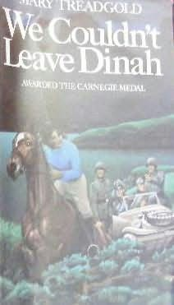
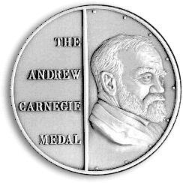
We Couldn’t Leave Dinah by Mary Treadgold
http://www.fantasticfiction.co.uk/t/mary-treadgold/we-couldn-t-leave-dinah.htm
http://www.ala.org/ala/mgrps/divs/alsc/awardsgrants/bookmedia/carnegiemedal/index.cfm
We Couldn’t Leave Dinah takes place in 1941, and is about an island under threat of Nazi invasion.
The Carnegie Medal is given each year to an outstanding children’s book.

Slide 8
Political Leaders
http://www.solarnavigator.net/history/winston_churchill.htm
http://thebsreport.wordpress.com/2010/01/06/quote-of-the-day-dwight-eisenhower/
Sir Winston Leonard Spencer Churchill
Dwight D. Eisenhower
Famous British Prime Minister that won a Nobel Prize. He had a large role in the D-Day Invasion.
Eisenhower led the Allies in Europe. Also helped plan the D-Day Invasion.

Slide 9
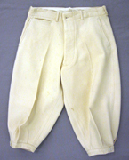
Boys Clothing
http://museumcollections.in.gov/detail.php?record=0&v=2&s=knickers&type=browse&t=objects&f=object_type&d=
http://blog.lulusvintage.com/childrens_clothing/
A boy’s blue and plaid suit, worn in the 1940s.
Theses are white wool knickers, worn by boys.

Slide 10
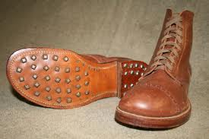
Shoes
http://www.usmilitariaforum.com/forums/lofiversion/index.php/t57160-200.html
http://www.los-list.com/blog/boots-4-boys/
These boots are boots worn by soldiers in 1942
These are 1940’s soft toe hunting boots.

Slide 11
Duct Tape
Was first manufactured in 1942
First created to keep water out of ammunition cases
Was discovered to be versatile and could be used to fix many things, including guns, jeeps, and aircrafts
Originally called “Duck Tape” because it’s waterproof, but later called “Duct Tape” because of its ability to connect duct work
Is now the most versatile tool in the household
http://normalteens.wordpress.com/category/library-events/

Slide 12
African Americans
This poster encouraged African Americans to join the Navy as messmen. This poster became popular after a black messman in the Navy took a great personal risk and shot down Japanese planes, even though he had no weapons training.
http://www.oddee.com/item_66536.aspx

Slide 13
Careless Talker
This poster warned people against sharing information on soldier movement. It says that if you share information about the soldier’s plans, soldiers will die. This poster was popular during World War II.
http://www.oddee.com/item_66536.aspx

Slide 14
The Attack On Pearl Harbor
December 7, 1941
Lasted just over two hours
2,403 people died; 88 planes were destroyed
Japanese planes dropped bombs
Attack came in two waves: first at 7:53 a.m., second at 8:55 a.m.; all over by 9:53 a.m.
Was the first attack against the Americans
This one event was what forced the Americans into the war
A day-long attack on American facilities in the Philippines began a few hours later
http://maryt.wordpress.com/2007/12/05/thursday-thirteen-6/

Slide 15
D-Day
June 4, 1944
160,000 Allies landed on the French coast to fight Nazi Germany on the beaches of Normandy, France
Sir Winston Churchill and Dwight D. Eisenhower helped lead
Allies had 5,000 ships and 13,000 aircrafts on their side
9,000 Allied soldiers were killed or wounded
Major turning point in favor of the Allies
http://www.nzhistory.net.nz/media/photo/british-commandos-scramble-ashore-on-d-day

Slide 16
Works Cited
Carnegie Greenaway. 15 September 2010 <http://www.carnegiegreenaway.org.uk/livingarchive/title.php?id=114>.
Eye Witness History. 1997. 15 September 2010 <http://www.eyewitnesstohistory.com/pearl.htm>.
Fantastic Fiction. 2010. 13 September 2010 <http://www.fantasticfiction.co.uk/t/mary-treadgold/we-couldn-t-leave-dinah.htm>.
Film Site. 13 September 2010 <http://www.filmsite.org/aa42.html>.
Filmsite. 13 September 2010 <http://www.filmsite.org/1942.html>.
Idea Finder. April 5 2006. 15 September 2010 <http://www.ideafinder.com/history/inventions/ducttape.htm>.

Slide 17
Works Cited
IrvineRenter. Irving Housing Blog. 25 December 2007. 13 September 2010 <http://www.irvinehousingblog.com/blog/comments/white-christmas/>.
Music Imprint. 13 September 2010 <http://www.musicimprint.com/Chart.aspx?id=C000110>.
Oddee. 2010. 15 September 2010 <http://www.oddee.com/item_66536.aspx>.
Oracle Think Quest. 14 September 2010 <http://library.thinkquest.org/10927/leadww2.htm>.
Singers. 15 September 2010 <http://www.singers.com/jazz/vintage/millsbrothers.html>.
U.S. Army. 15 September 2010 <http://www.army.mil/d-day/>.

