Slide 1
Electronic Time Capsule
By Bobby Cheng
9/14/10
B 4 W
Picture # 1

Slide 2
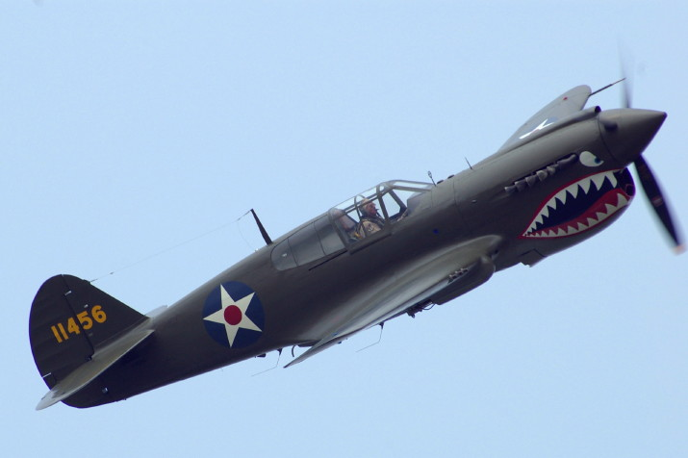
Important Battles of WWII
Battle of Britain
Between the German and the British. Britain won the battle. Very big air battles.
Battle of Moscow
Between the Germans and the Russians. Russia won the battle. Germans thought that if they took the Russian capital, they the nation would fall apart.
Battle for Stalingrad
Between the Germans and the Russians. Russia won the battle. The Germans were forced to surrender because of the cold winter and the lack of supplies.
Picture # 2 WWII Plane.

Slide 3
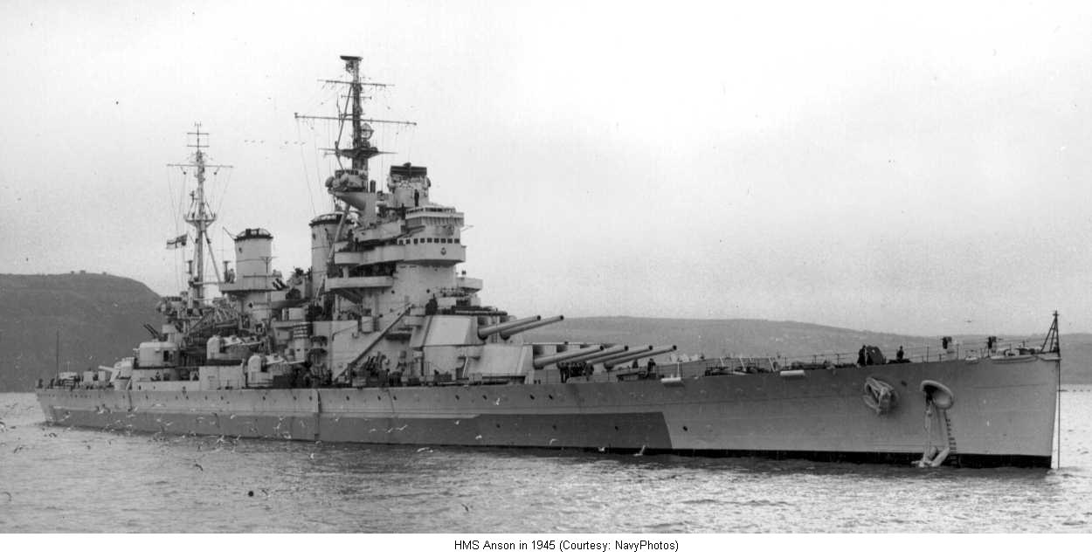
Important Battles of WWII in the Pacific
Battle of Midway
Between the U.S. and the Japanese. U.S. won. Many consider this battle to be the turning point in WWII.
Solomon Islands Campaign
Between U.S. and Japan. U.S. won. First outright defeat on Japanese land since 1939.
Guadalcanal Campaign
Between U.S. and Japan. The U.S. found Japan building a airbase at Guadalcanal so they landed and captured the base.
Picture # 3 WWII battleship.

Slide 4
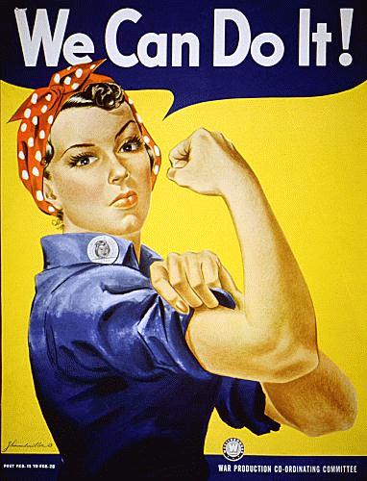
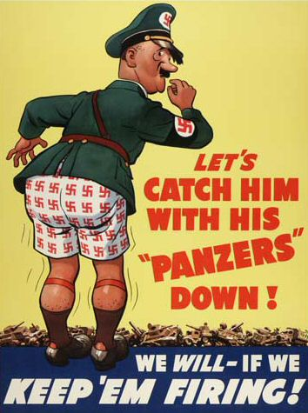
WWII Propaganda Posters
Picture # 4 says that if the U.S. stays in the war, then Hitler would go down.
Picture # 5 says that women has the same power as the men.

Slide 5
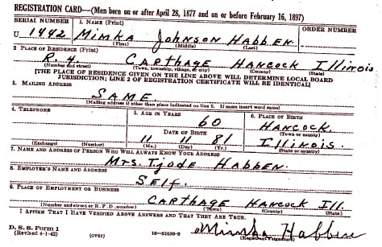
The Draft
Picture # 6 this is a draft card from WWII, the authors great-grandfather was the person that was drafted on this card.

Slide 6
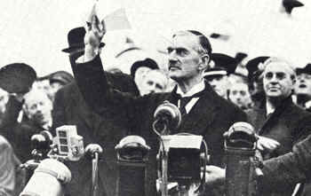
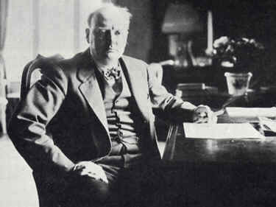
Political Leaders of WWII
Neville Chamberlin
Prime Minister of Great Britain.
Winston Churchill
Prime Minister of Great Britain for most of WWII.
Charles de Gaulle
Seen by many French people as their true leader for WWII.
Picture # 7 Neville Chamberlin.
Picture # 8 Winston Churchill.

Slide 7
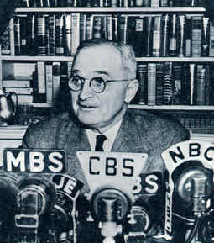
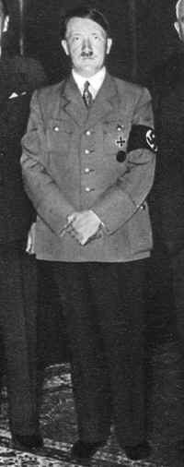
Political Leaders of WWII continued
Adolf Hitler
Led Germans through WWII
F D Roosevelt
President to the U.S. during WWII.
Joseph Stalin
Led Russia through WWII.
Hideki Tojo
Prime Minister of Japan during WWII.
Harry Truman
Became president of the U.S. after the death of F D Roosevelt.
Picture # 9 Harry Truman.
Picture # 10 Adolf Hitler.

Slide 8
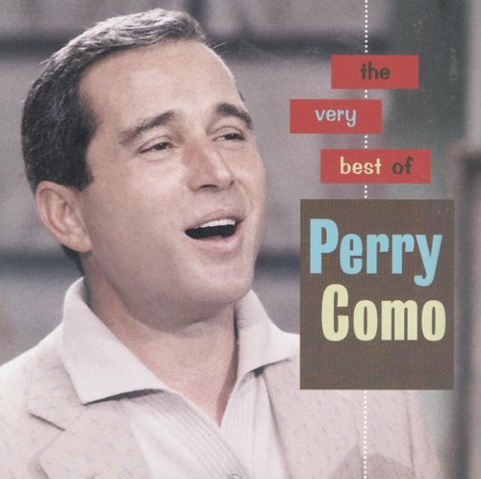
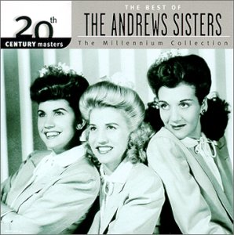
Songs and Singers
Rum and Coca-Cola by Andrews Sisters.
Chickery Chicken by Sammy Kaye.
Till the End of Time by Perry Como.
Candy by Jo Stafford.
Opus One by Tommy Dorsey.
Picture # 11 Andrews Sisters.
Picture # 12 Perry Como.

Slide 9
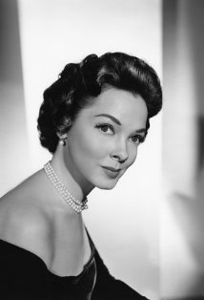
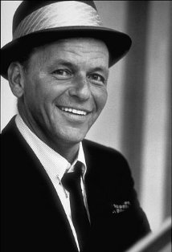
Actors
All actors listed below are from a movie called Anchors Aweigh.
Frank Sinatra- played as Clarence Doolittle.
Kathryn Grayson- played as Susan Abbott.
Gene Kelly- played as Joseph Brady.
Dean Stockwell- played as Donald Martin.
Picture # 13 Frank Sinatra.
Picture # 14 Kathryn Grayson.

Slide 10
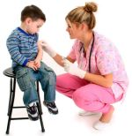
Invention and Medical Discoveries
Britain made a health care system called National Health Service so everyone could get health care.
Advances were made in birth control.
More vaccine were made to help with childhood diseases.
Picture # 15 a child getting a vaccine shot.

Slide 11
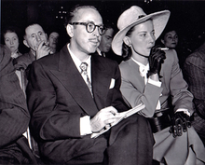
Fashion
Men grew their hair out and usually their hair had a wet look.
Guys usually wore suits and Gals usually wore dresses.
Picture # 16 he may not be the best looking dude in the world but he is wearing a suit and he was around in1945. But he didn’t grow his hair out for some reason.

Slide 12
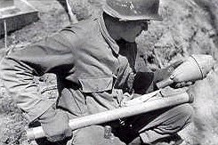
Weapons
M1 Garand- Standard American rifle.
MP43- First modern assault rifle.
Colt M1911- Pistol.
Bazooka- bazooka, anti-tank weapon.
Panzerfaust- anti-tank weapon.
Picture # 17 soldier from WWII with a panzerfaust.

Slide 13
Works Cited 1
http://www.historylearningsite.co.uk/famous_battles_of_world_war_two.htm
http://en.wikipedia.org/wiki/Pacific_War
http://www.historylearningsite.co.uk/political_leaders_of_world_war_t.htm
http://www.popularsong.org/1945.html
http://www.historylearningsite.co.uk/medical_changes_from_1945.htm
http://www.imdb.com/title/tt0037514/fullcredits
http://en.wikipedia.org/wiki/1945%E2%80%931960_in_fashion
http://www.newberry.k12.sc.us/mchs/WWIIWeapons.htm

Slide 14
Works Cited 2
Picture # 1 http://www.google.com/imgres?imgurl=http://photo.goodreads.com/books/1165517852l/5148.jpg&imgrefurl=http://www.goodreads.com/book/show/5148.A_Separate_Peace&usg=__GnXgvQq211gt6PqXxzBtu3X340E=&h=475&w=311&sz=35&hl=en&start=0&zoom=1&tbnid=b-IrR0_gkbKb9M:&tbnh=146&tbnw=94&prev=/images%3Fq%3Da%2Bseparate%2Bpeace%26hl%3Den%26biw%3D1362%26bih%3D618%26gbv%3D2%26tbs%3Disch:1&itbs=1&iact=hc&vpx=123&vpy=74&dur=2918&hovh=278&hovw=182&tx=97&ty=126&ei=SZKSTNGzG5SfnweBuamrBw&oei=SZKSTNGzG5SfnweBuamrBw&esq=1&page=1&ndsp=25&ved=1t:429,r:0,s:0
Picture # 2 http://www.google.com/imgres?imgurl=http://www.maam.org/wwii/photos/aircraft/Ball3.JPG&imgrefurl=http://theabrahamlincolnhotel.blogspot.com/2008/05/world-war-ii-weekend-and-airshow-june.html&usg=__Ho8aYg-67wqmrYA2oSUoafRZaUo=&h=476&w=715&sz=51&hl=en&start=0&zoom=1&tbnid=uZCFWkkB_eqJIM:&tbnh=139&tbnw=182&prev=/images%3Fq%3Dww2%2Bplanes%26hl%3Den%26biw%3D1362%26bih%3D618%26gbv%3D2%26tbs%3Disch:1&itbs=1&iact=hc&vpx=110&vpy=119&dur=16&hovh=183&hovw=275&tx=144&ty=113&ei=V5WSTM--DYHRngfPzZSIBw&oei=V5WSTM--DYHRngfPzZSIBw&esq=1&page=1&ndsp=18&ved=1t:429,r:0,s:0

Slide 15
Works Cited 3
Picture # 3 http://www.google.com/imgres?imgurl=http://www.naval-history.net/Photo01bbAnson45.JPG&imgrefurl=http://www.naval-history.net/WW2CampaignRoyalNavy.htm&usg=__zbvOnvgRy-XpJkV5-tKZ8OtRcMY=&h=639&w=1250&sz=73&hl=en&start=0&zoom=1&tbnid=6WgIEjOKD5rcaM:&tbnh=82&tbnw=160&prev=/images%3Fq%3Dww2%2Bbattleships%26hl%3Den%26biw%3D1362%26bih%3D618%26gbv%3D2%26tbs%3Disch:1&itbs=1&iact=hc&vpx=89&vpy=131&dur=328&hovh=160&hovw=314&tx=183&ty=90&ei=EpmSTL2zM8eRnwfCmo2XBw&oei=EpmSTL2zM8eRnwfCmo2XBw&esq=1&page=1&ndsp=18&ved=1t:429,r:0,s:0
Picture # 4 http://www.google.com/imgres?imgurl=http://upload.wikimedia.org/wikipedia/commons/7/77/Ww2_poster_oct0404.jpg&imgrefurl=http://commons.wikimedia.org/wiki/File:Ww2_poster_oct0404.jpg&usg=__zTkQIRiBL-Iwzuz_DS0KHewkm9o=&h=475&w=354&sz=40&hl=en&start=0&zoom=1&tbnid=PI_-6FE1Gg2IXM:&tbnh=139&tbnw=104&prev=/images%3Fq%3Dww2%2Bpropaganda%2Bposters%26hl%3Den%26biw%3D1362%26bih%3D618%26gbv%3D2%26tbs%3Disch:1&itbs=1&iact=rc&dur=2403&ei=1ZmSTPHTF4GanAfm1sSCBw&oei=1ZmSTPHTF4GanAfm1sSCBw&esq=1&page=1&ndsp=27&ved=1t:429,r:1,s:0&tx=89&ty=-3

Slide 16
Works Cited 4
Picture # 5 http://www.google.com/imgres?imgurl=http://www.propagandaposters.us/wecando.jpg&imgrefurl=http://www.propagandaposters.us/poster5.html&usg=__B7_Gu209eWur2zCGyWA2zbfCv1A=&h=500&w=382&sz=41&hl=en&start=27&zoom=1&tbnid=qGsdJ3H5-EY98M:&tbnh=133&tbnw=102&prev=/images%3Fq%3Dww2%2Bpropaganda%2Bposters%26hl%3Den%26biw%3D1362%26bih%3D618%26gbv%3D2%26tbs%3Disch:1&itbs=1&iact=rc&dur=640&ei=aJqSTPTCI8L9nAerht3HCA&oei=1ZmSTPHTF4GanAfm1sSCBw&esq=4&page=2&ndsp=26&ved=1t:429,r:24,s:27&tx=56&ty=49
Picture # 6 http://www.rootdig.com/draft/worldwartwo.html
Picture # 7 http://www.historylearningsite.co.uk/neville_chamberlain.htm
Picture # 8 http://www.historylearningsite.co.uk/winston_churchill.htm
Picture # 9 http://www.historylearningsite.co.uk/harry_truman.htm
Picture # 10 http://www.historylearningsite.co.uk/adolf_hitler.htm

Slide 17
Works Cited 5
Picture # 11 http://www.google.com/imgres?imgurl=http://www.queermusicheritage.us/APR2004/INT/andrews.jpg&imgrefurl=http://www.queermusicheritage.us/apr2004i.html&usg=__XS8JYlTuAVBgc5-1mmsaRl-fDTs=&h=300&w=298&sz=28&hl=en&start=0&zoom=1&tbnid=7G_NJQ8IlTq6eM:&tbnh=147&tbnw=161&prev=/images%3Fq%3Dandrews%2Bsisters%26hl%3Den%26biw%3D1362%26bih%3D618%26gbv%3D2%26tbs%3Disch:1&itbs=1&iact=rc&dur=390&ei=TaqSTOqxLIb9nAe7loimBw&oei=TaqSTOqxLIb9nAe7loimBw&esq=1&page=1&ndsp=21&ved=1t:429,r:0,s:0&tx=76&ty=88
Picture # 12 http://www.google.com/imgres?imgurl=http://images.uulyrics.com/cover/p/perry-como/album-the-very-best-of-perry-como.jpg&imgrefurl=http://www.uulyrics.com/music/perry-como/&usg=__9-KA39eBnk_f_ohhAy6l3ZuIBBQ=&h=498&w=500&sz=43&hl=en&start=0&zoom=1&tbnid=l2h2paWvWbMc0M:&tbnh=161&tbnw=160&prev=/images%3Fq%3DPerry%2BComo%26hl%3Den%26biw%3D1362%26bih%3D618%26gbv%3D2%26tbs%3Disch:1&itbs=1&iact=hc&vpx=425&vpy=74&dur=624&hovh=224&hovw=225&tx=114&ty=134&ei=t6qSTP6gINKlnQegoei9Bw&oei=t6qSTP6gINKlnQegoei9Bw&esq=1&page=1&ndsp=23&ved=1t:429,r:2,s:0

Slide 18
Works Cited 6
Picture # 13 http://www.imdb.com/name/nm0000069/
Picture # 14 http://www.imdb.com/name/nm0337113/
Picture # 15 http://www.google.com/imgres?imgurl=http://www.uwhealth.org/files/uwhealth/images/img/img_flushot.jpg&imgrefurl=http://www.uwhealth.org/news/getting-the-facts-about-flu-season/12557&usg=__xWR_3Q3poJqEZFnI917h238muMM=&h=154&w=150&sz=7&hl=en&start=0&zoom=1&tbnid=PD7igboNVVQw5M:&tbnh=123&tbnw=120&prev=/images%3Fq%3Dchild%2Bgetting%2Ba%2Bshot%26hl%3Den%26biw%3D1362%26bih%3D618%26gbv%3D2%26tbs%3Disch:1&itbs=1&iact=hc&vpx=582&vpy=123&dur=1950&hovh=123&hovw=120&tx=72&ty=87&ei=4a2STIz3DtOCnge-t7WNBw&oei=4a2STIz3DtOCnge-t7WNBw&esq=1&page=1&ndsp=21&ved=1t:429,r:3,s:0

Slide 19
Works Cited 7
Picture # 16 http://en.wikipedia.org/wiki/1945%E2%80%931960_in_fashion
Picture # 17 http://www.newberry.k12.sc.us/mchs/WWIIWeapons.htm

