Slide 1
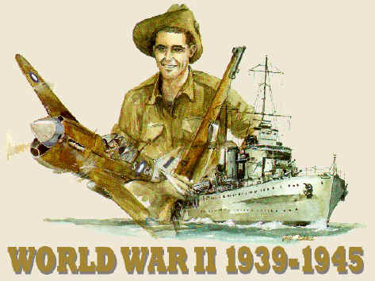
A Seperate Peace
Hannah Carpenter
1

Slide 2
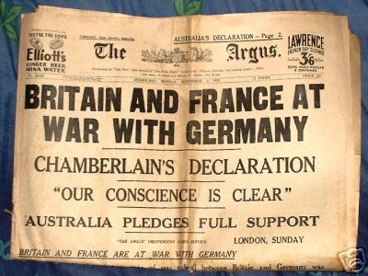
World War II
Bloodiest conflict in history
Fought predominantly in Europe and across the pacific and eastern Asia
The Axis, Nazi Germany, Fascist Italy, and Japan were against the allied nations of Great Britain, France, China, and the United States
Adolf Hitler led the Germany side of the war
50 to 70 million people lost their lives in all of WWII
Originally caused by nationalistic tensions, unresolved issues, and resentments from WWI
Radom facts:
Skilled female workers made a weekly salary of $32.21
In 1942 the female workforce grew by over 50%
Female employment in defense industries grew by 462%
2

Slide 3
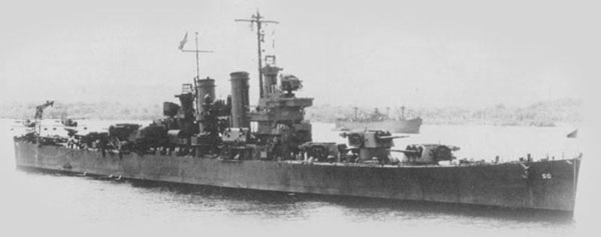
South Pacific Battles
Largest naval conflict in history
Began December 7, 1941
Sometimes called the Asia-Pacific War
After the bombing of Pearl Harbor, the U.S. engaged the Empire of Japan in several battles across the South Pacific
South Pacific battles include the battles of: Midway, Guadalcanal, Saipan, Philippine Seas, Iwo Jima, and Okinawa
Said to have been started after the bombing of Pearl Harbor by the Empire of Japan
3

Slide 4
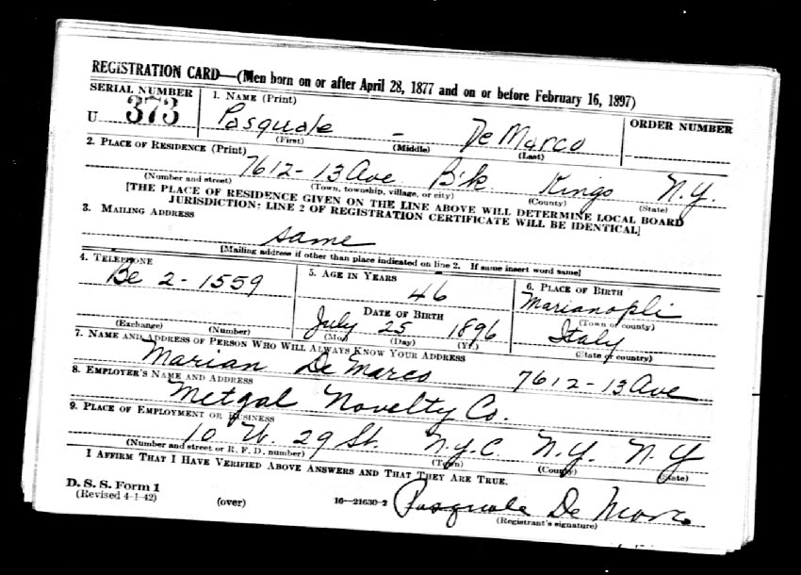
The Draft
4
The U.S. started its first peace time draft just months before the bombing of Pearl Harbor
Almost anyone could be drafted, unless they had health issues or a criminal background
The Navy and the Army were drafting freely
The Marine Corp. refused 2 draft and only used volunteers
Later on in the war the Marines needed more men for a possible invasion of Japan, and drafted for a short time
Britain, France, Germany, Italy, and Japan were all drafting
Soviets drafted men and women without regard to criminal backgrounds or health issues

Slide 5
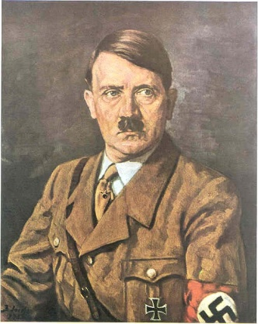
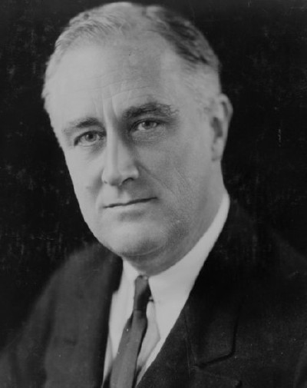
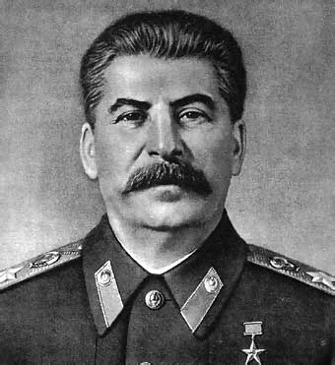
Political Leaders
Franklin D. Roosevelt was President in 1942 during WWII
Hitler was dictating Germany in 1942 during WWII
Neville Chamberlain was prime minister of Great Britain
Winston Churchill was another leader of Great Britain
Charles de Gaulle was seen by the French people to be their leader during the war
Joseph Stalin was the leader of Russia
Hideki Tojo was the prime minister of Japan
Harry Truman was the U.S president after Roosevelt during the end of WWII
6
7
5

Slide 6
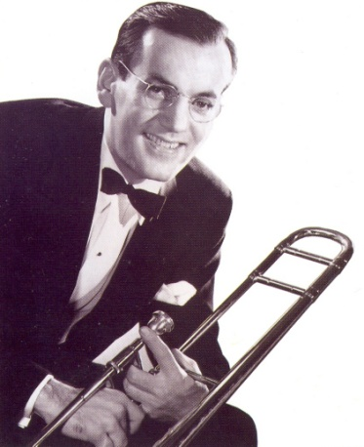
Top Songs
The top five songs in 1042:
White Christmas by Bing Crosby
Paper Doll by the Mills Brothers
Salt Peanuts by Dizzy Gillespie
Kalamazoo by Glenn Miller
A String of Pearls by Glenn Miller
The lyrics to “White Christmas” by Bing Crosby:
I'm dreaming of a white Christmas, Just like the ones I used to know. Where the tree-tops glisten, And children listen To hear sleighbells in the snow. I'm dreaming of a white Christmas, With every Christmas card I write, "May your days be merry and bright, And may all your Christmases be white". I'm dreaming of a white Christmas, Just like the ones I used to know. Where the tree-tops glisten, And children listen To hear sleighbells in the snow. I'm dreaming of a white Christmas, With every Christmas card I write, "May your days be merry and bright, And may all your Christmases be white
8

Slide 7
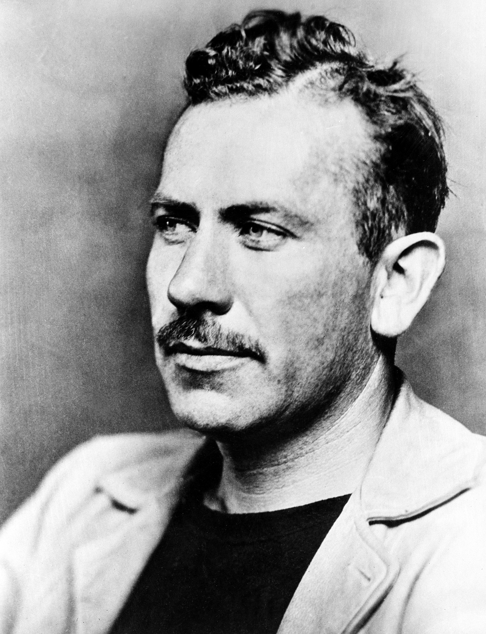
Popular Authors
Richard Wright wrote books about the war and life before and after the war
A Father’s Law
Native Son
Black Boy
John Steinbeck wrote books during the war, about the war
The Moon is Down
Of Mice and Men
The Pearl
9

Slide 8
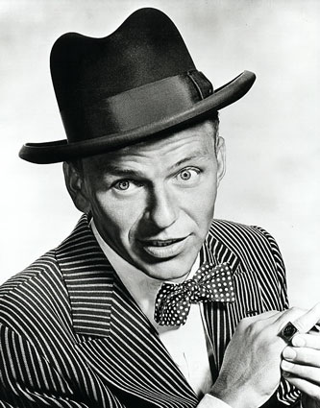
Popular Singers
Bill Crosby who sang:
White Christmas
Silver Bells
Jingle Bells
Frank Sinatra who sang:
Strangers in the Night
It Had to be You
Somethin’ Stupid
10

Slide 9
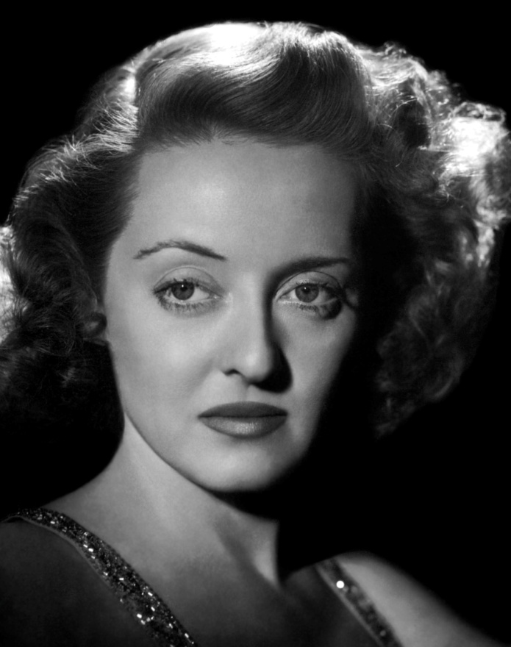
Popular Actors/Actresses
Gary Cooper who starred in:
Kipperbang
Vera Cruz
Dallas
Bette Davis who starred in:
The Petrified Forest
The Letter
Now, Voyager
11

Slide 10
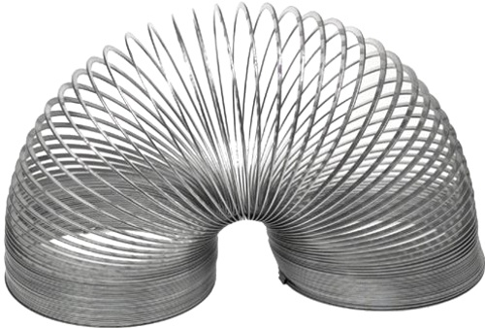
New Inventions
Electronic Digital Computer (1942 by Clifford Barry)
The Slinky (1943 by Richard and Betty James)
The Atomic Bomb (1945 by Robert Oppenheimer)
Army Jeep (1940 by Karl Pabst)
12

Slide 11
Medical Discoveries
13
In 1940 Howard Florey and Ernst Chain made a usable penicillin medicine
In 1944 Selman Waksman discovers streptomycin, and antibiotic fore TB
In 1947 Parke-Davis announces his discover of the antibiotic Chloromycetin

Slide 12
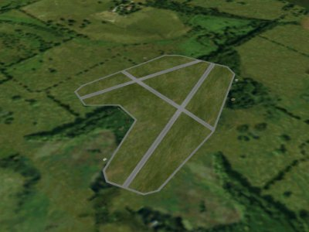
New Hampshire
The U.S army air force established air-fields in New Hampshire for training new pilots and air-crews working with bombers and fighters
2,287 total air-fields in NH
Used by the Military, Navy, Marines, and Army
14

Slide 13
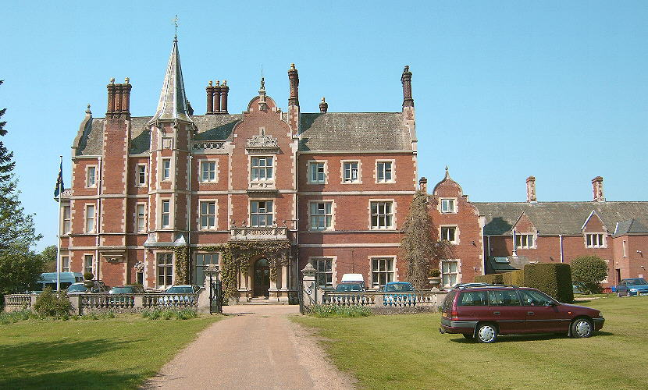
Preparatory School
Curriculum was disorganized and varied
Allowed any race or cultural backgrounds to attend
Offered no fewer than 274 subjects at the schools
You must go to school at least until the age of 16
Some traditional sports were allowed
15

Slide 14
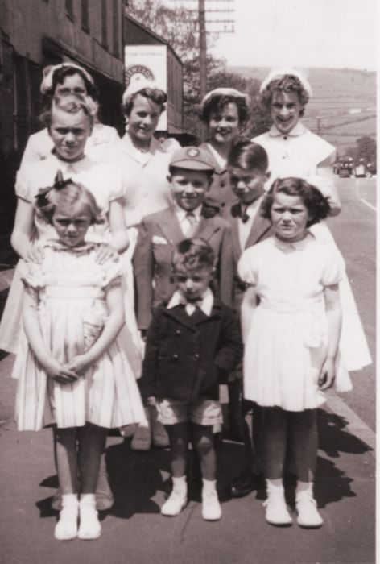
Girls Fashion
Said to be “drab and uniformity”
Girls wore skirts and with stockings
Buttoned shirts, blouses
Dresses were also common
16

Slide 15
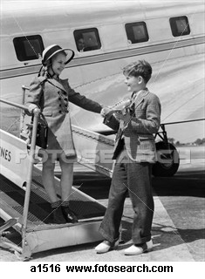
Guys Fashion
Said to be “drab and uniformity”
Normally wore slacks (pants)
A lot of denim also
Collared shirts, normally button downs
17

Slide 16
Sports
Note: sports were not as popular during the war, but were still occasionally played
American football
Baseball
Golf
Basketball
Horse racing
18

Slide 17
Works Cited (web sites)
http://militaryhistory.about.com/od/worldwarii/tp/wwii101.htm
http://www.buzzle.com/articles/world-war-2-facts.html
http://www.allabouthistory.org/world-war-2-facts.htm
http://www.everything.com/Major-WWII-Battles-in-the-South- Pacific/#axzz0zbiyHBjs
http://wiki.answers.com/Q/Was_there_a_draft_in_World_War_2
http://www.historylearningsite.co.uk/neville_chamberlain.htm
http://www.historylearningsite.co.uk/winston_churchill.htm
http://www.historylearningsite.co.uk/charles_de_gaulle.htm
http://www.historylearningsite.co.uk/joseph_stalin.htm
http://www.historylearningsite.co.uk/hideki_tojo.htm
http://www.musicimprint.com/Chart.aspx?id=C000110
http://www.stlyrics.com/lyrics/polarexpressthe/whitechristmas.htm
http://www.ilike.com/artist/search?artist_qp=bing+crosby
http://www.wwwk.co.uk/culture/inventions/40s/index.htm
http://library.duke.edu/digitalcollections/mma/timeline.html#1940
http://www.airfieldsdatabase.com/WW2/WW2.htm
http://www.thepeoplehistory.com/40sclothes.html

Slide 18
Works Cited (pictures)
http://www.anzacday.org.au/history/ww2/images/ww2.jpg
http://www.diggerhistory.info/images/asstd3/ww2-newspaper.jpg
http://www.modelwarships.com/reviews/ships/cl/cl-50/history/Helena-42.jpg
http://bonagura.com/docs/PasqualeDeMarco-WW2.jpg
http://historywarsweapons.com/wp-content/uploads/image/Hitler3(1).jpg
http://static.howstuffworks.com/gif/nazi-germany-conquers-france-40.jpg
http://logisticsmonster.com/wp-content/uploads/2010/01/JosephStalin.gif
http://free-pianosheetmusic.com/wp-content/uploads/2010/04/Glenn-Miller1.jpeg
http://blog.syracuse.com/shelflife/2008/02/steinbeck.jpg
http://2.bp.blogspot.com/_duAuTt2KJgk/TCU-k2R3O9I/AAAAAAAAAgg/zDmm_sBcMhE/s1600/Martini-Recipes-Frank-Sinatra.jpg
http://www.dvdbeaver.com/film/filmnoir/femmeweb/BetteDavis.jpg
http://mattogno.com/MattognoGirls/wp-content/uploads/2008/11/slinky2.jpg
http://www.pharmer.org/files/images/Penicillin%20VK%20500mg.jpg
http://vonoben.free.fr/Terrain/SummerAirfield.jpg
http://www.saturn-sound.com/images%20-%20norwich%20&%20recording/taverham%20hall%20prep%27%20school.jpg
http://comps.fotosearch.com/comp/CLT/CLT002/1940s-boy-girl_~a1516.jpg
http://images.faithclipart.com/images/3/f0925912aa/img_large_watermarked.jpg
http://www.google.imghp/basket-ball/large.htm

