Slide 1
The Adventures of Odysseus

Slide 2
The Story Begins…
Odysseus is leaving victorious from the Trojan war.
Poseidon decides to sweep him and his crew out to sea.

Slide 3
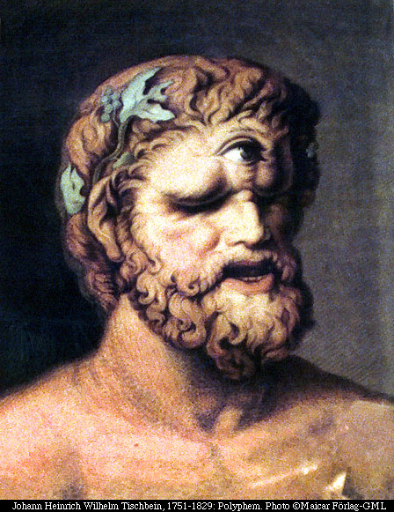
The Cyclopes
Odysseus beaches on island and attempts to trade with the local inhabitants.
The inhabitants turn out to be Cyclopes, and Odysseus and some of his men are trapped in the cave of Polyphemis.

Slide 4
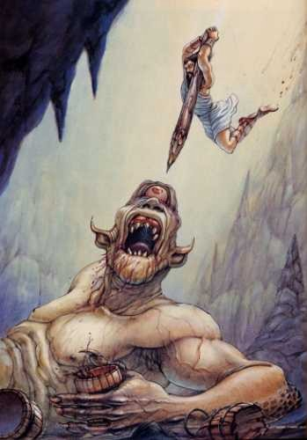
Odysseus tricked the cyclops into releasing him and his men by getting the cyclops drunk and stabbing him in the eye.

Slide 5
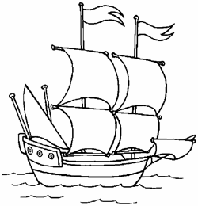
Back Steps
Oddyseus and his men stayed with Aeolus, master of the winds, who gave him a bag containing the winds.
As they gained sight of Ithaca, Odysseus’ men opened the bag sending them the opposite direction.

Slide 6
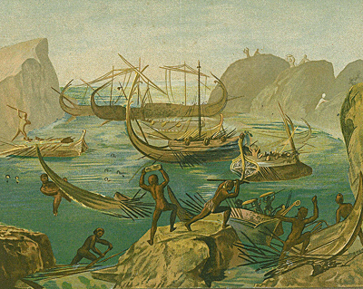
Cannibals!
Odysseus was then confronted with the Laestrygones, a cannibalistic group of men, Here he lost every ship but his own.

Slide 7
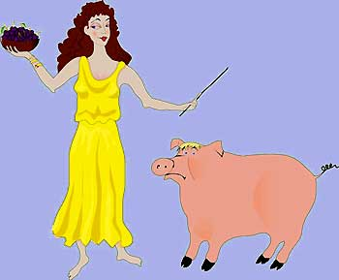
Another year gone…
Odysseus then sailed to Circe island where she turned half of his men into pigs after feeding them. Odysseus was immune to this do to Hermes who gave him a drug called moly.

Slide 8
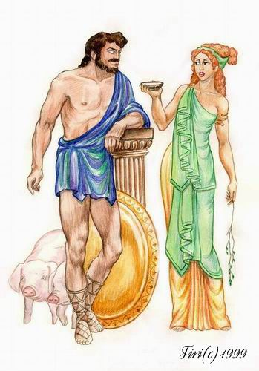
Because of his resistance to her spell, Circe fell in love with Odysseus, and released his men.

Slide 9
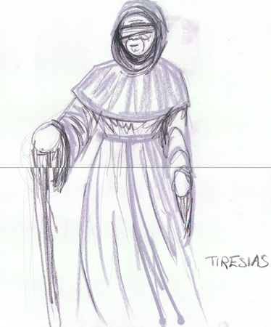
Looking for Help
After a year with Circe, Odysseus and his men left to summon Tiresias, an old prophet, while also meeting the spirits of many famous men and women.

Slide 10
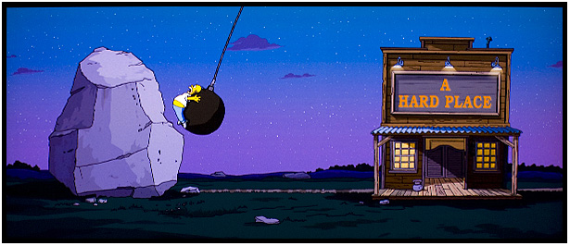
Odysseus returned to Circe to seek more advice on how to return home.
She told Odysseus that he was stuck between Scylla and Charybdis, also know as a rock
and a hard place.

Slide 11
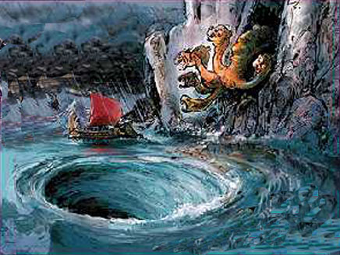
A Difficult Choice
Odysseus chose Scylla, where he would only lose six men opposed to his entire crew.

Slide 12
Was it worth it?
Odysseus then went to Thrinacia, and stole Helios’ sacred cattle.
Helios punished them by crashing their ship and killing everyone but Odysseus.

Slide 13
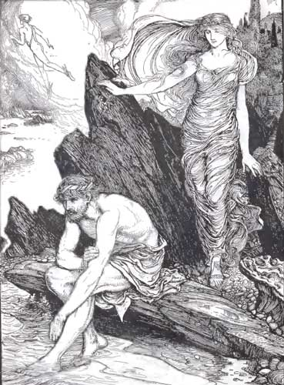
Some punishment…
Odysseus landed on the shores of Ogygia, Calypso’s island, were he remained for seven years as her lover.

Slide 14
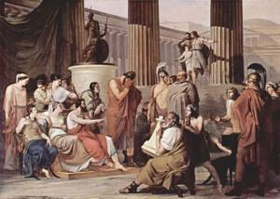
Foreign Sailors
After escaping, Odysseus meets with the Phaeacians who agree to help Odysseus get home.

Slide 15
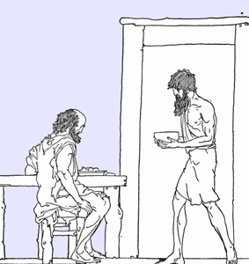
A Bit of Irony
When back home, Odysseus is disguised as a beggar to find out what has happened in his absence. As he travels he finds the hut of a former slave, Eumaeus, and spent time with him.

Slide 16
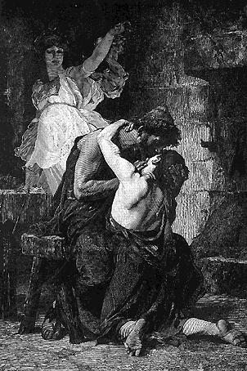
Father-Son Reunion
Soon after, Odysseus meets his son, Telemachus, and learns that there are a number of suitors for Penelope, Odysseus’ wife.
Odysseus and his son decide to kill them.

Slide 17
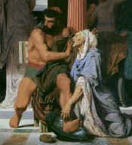
Boars are Deadly
When they arrive at Odysseus house a servant recognizes him by a scare on his leg. The servant tries to convince Penelope that the beggar is Odysseus but she doesn’t believe her.

Slide 18
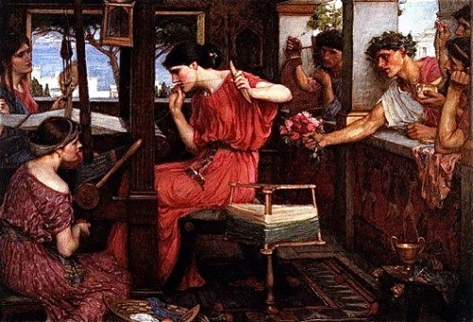
Love Game
As her test, Penelope promises to marry the man that can string Odysseus’ bow and shoot it though a dozen axe heads.

Slide 19
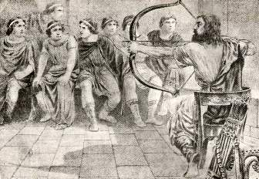
Odysseus strings the bow, makes the shot, and kills the suitors, hanged twelve of his housemaids and killed the goatherd Melanthius who mocked Odysseus.

Slide 20
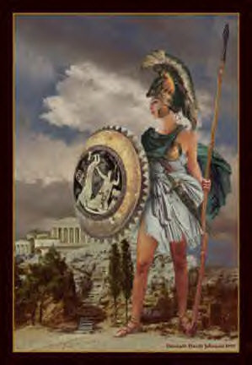
Welcome Home!
The people of Ithica are angry at oddyseus for killing two generations of men, but are callmed by Athena.

Slide 21
Fin

