Slide 1
The Adventures of Aeneas
By Kelcey Saunders, Chris Hilt, and Elizabeth Miller

Slide 2
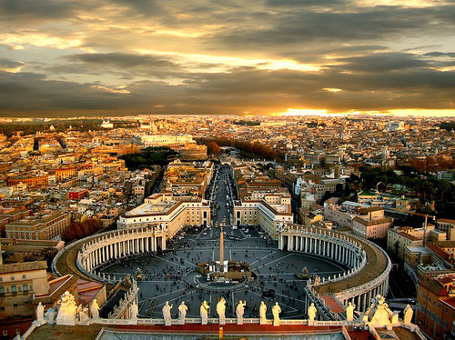
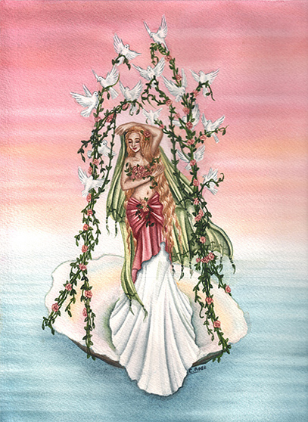
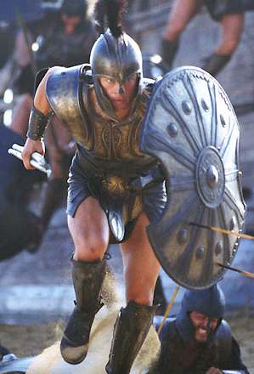
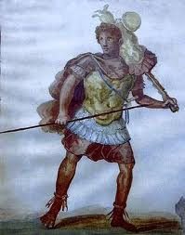
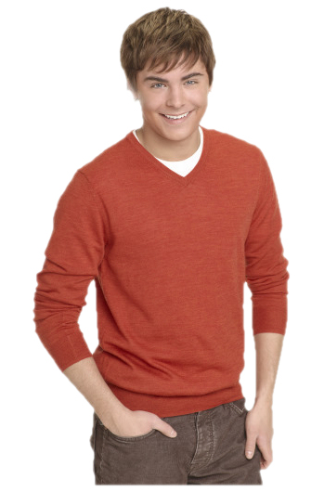
Hey Mom!
#2
#1
Aeneas was the son of Venus, a hero during the Trojan War, second only to Hector. He escaped from Troy, when it fell, with his son and eventually reached Italy where he founded Rome.

Slide 3
However, before he reached there, Aeneas and the Trojans who joined him faced many perils…

Slide 4
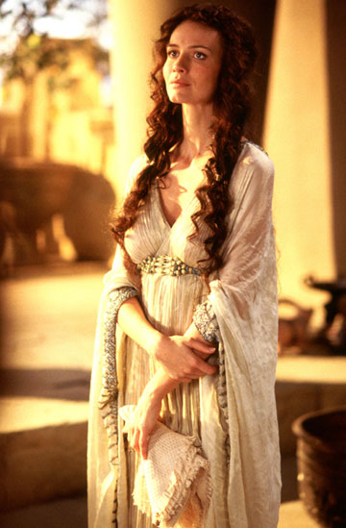
Hey Helenus says you should land on the west coast instead of the east
Hey! You should settle in the West of Italy, just saying
Aeneas was told he was destined to settle far to the west, in Italy. He met Hector’s wife, Andromache, who’s new husband, Helenus, told them to land on the west coast of Italy, and reach there by going south around Sicily

Slide 5
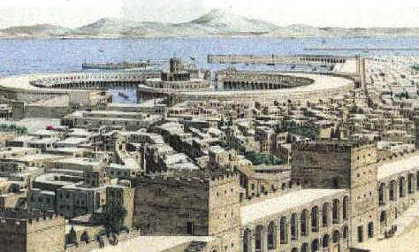
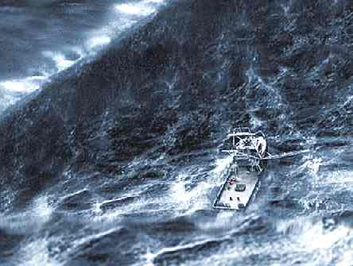
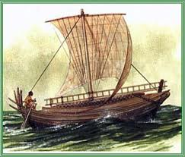
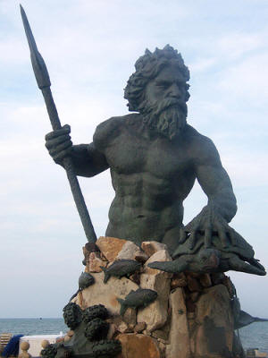
I EAT YOU FOR BREAKFAST, LUNCH, AND DINNER!
I’ll save you!
Aeneas and his men set off, landing on Sicily, unaware that the Cyclops now lived there. They were saved by one of Odysseus’s men who had been left behind. Soon after they left, a large storm struck them, courtesy of Juno. She hated Aeneas (Rome would one day conquer her pet city). They were saved by Neptune; however, and landed on the shore of Carthage

Slide 6
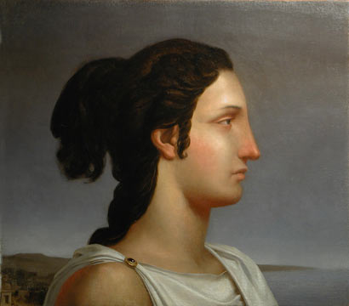
Carthage was ruled by a woman named Dido, who Juno intended Aeneas to fall for so he would never leave and find Rome. Aeneas’s mother Venus saved him from this fate by having only Dido fall in love, while Aeneas could still concentrate on leaving. She had Cupid shoot her with one of his arrows

Slide 7
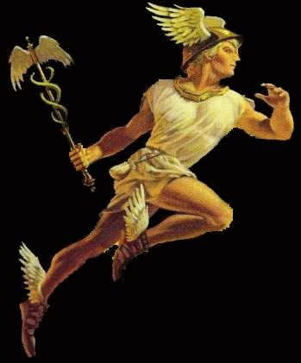
Jupiter said you need to leave and fulfill your destiny!
For a time Dido and Aeneas were happy together. Aeneas even began to grow less attracted to the idea of leaving. Eventually, Jupiter interfered. He sent Mercury directly to Aeneas, and commanded him to “depart and seek the kingdom which is your destiny”. At once Aeneas started to prepare to depart, although he tried to keep this secret from Dido. When she found out nothing would sooth her, even though he explained he had been commanded by Jupiter. As he sailed away, she killed herself.

Slide 8
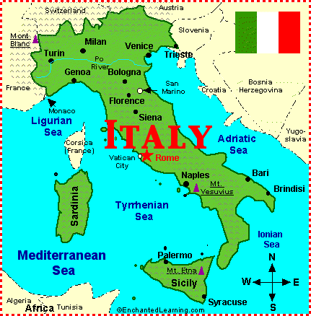
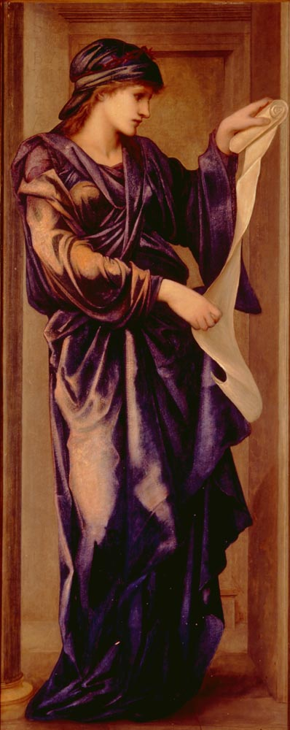
GO TO HADES!
When they arrived in Italy, Aeneas acted again on Helenus’s advice going first to the prophet Sibyl. She told him he would need to go to the underworld and talk to his father to find out what to do next.

Slide 9
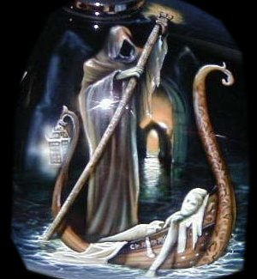
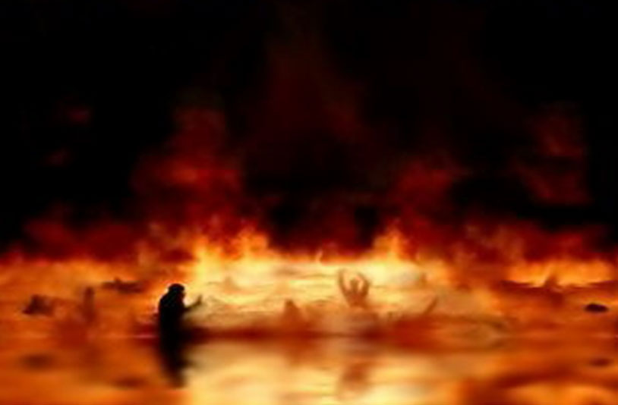
WAS I THE CAUSE OF YOUR DEATH!?!?!?
:’(
Accompanied by the prophet, Aeneas set off to Hades, first finding a golden bough that he would need to be admitted. They eventually reached the ferryman, Charon. Although reluctant to let them pass, he yield when he saw the golden bough. Upon reaching the Fields of Mourning, Aeneas saw Dido. While he wept and apologized, she stood cold as stone. She would not acknowledge him.

Slide 10
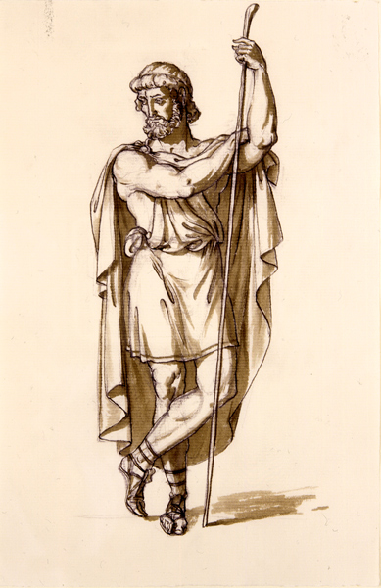
DADDY!
Next, the pair came to the Elysian fields where Aeneas finally saw his father. After showing Aeneas all the glorious things to come, he gave his son instructions on how to establish his place in Italy, and also how to deal or avoid whatever perils awaited him.

Slide 11
On coming up from Hades, Juno had more trials awaiting the Trojans…

Slide 12
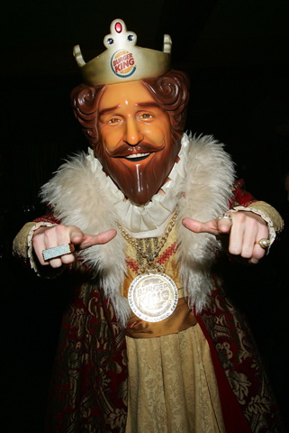
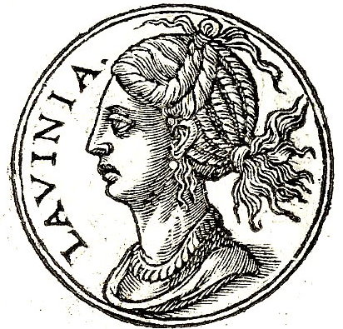
NO! wait how about that guy!
Hey Dad I want to get married!
The king of Latium had been told not to marry his daughter, Lavinia, to anyone but a stranger who would arrive. Latinus was convinced that this stranger was Aeneas.

Slide 13
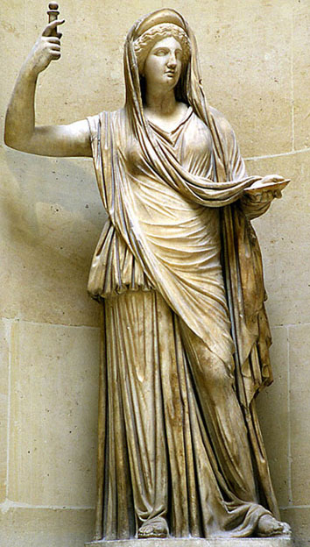
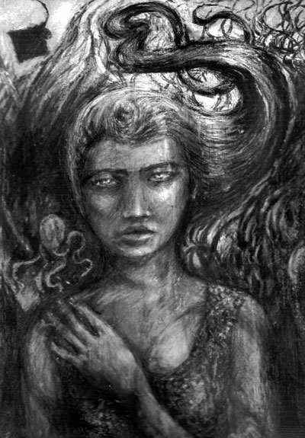
I’m going to make Latinus’s wife apposed to the marriage and turn Turnus against the Trojans! Mwahahahaha!
Everything would have been fine, but Juno interfered in three different ways through the Fury Alecto. First she made Latinus’s wife completely opposed to the marriage. Then she aroused the king of the Rutulians, Turnus, against the Trojans. He also wanted to marry Lavinia and immediately began to march to Latium to stop the marriage and any alliances that might occur as a result

Slide 14
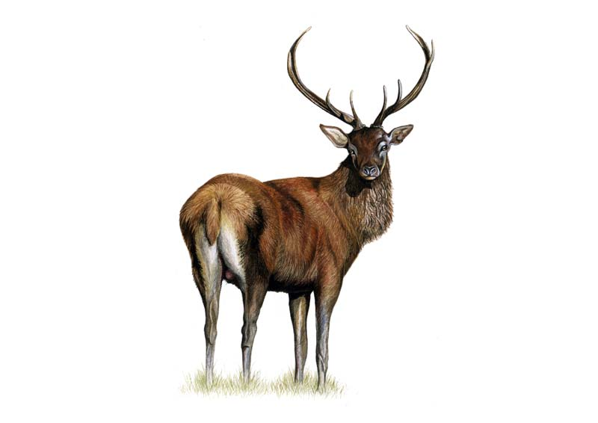
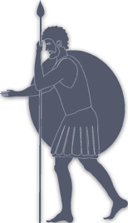
My plan is working!
The third effort joined Latium and Rutulian against the Trojans. There was a beautiful stag that everyone loved and protected. Aneas’s son was guided by the Fury to kill it.

Slide 15
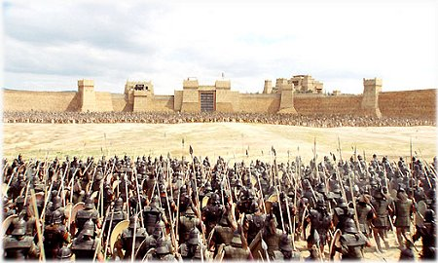
King Latinus was overwhelmed, shutting himself inside his palace, leaving the Trojans to face the two formidable armies banded together.

Slide 16
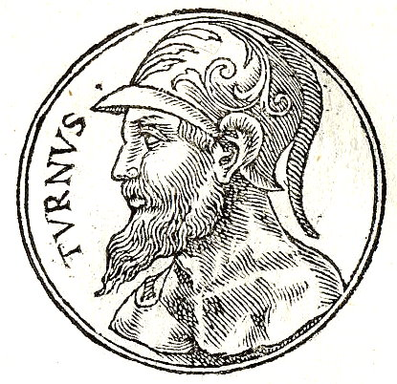
Aeneas saved the Trojans. All their enemies were killed, and when Turnus and Aeneas finally met face to face it is said that “it is as futile for Turnus to fight Aeneas as to fight the lightening or an earthquake.”

Slide 17
Lavinia
Aeneus
Aeneas marries Lavinia and finds the Roman race; they live happily ever after. Yay!

