Slide 1
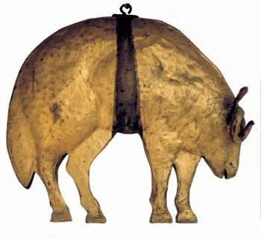
The Quest for the Golden Fleece
Caitlyn Lowe
Kirsten Nickoli
Alexa Voss

Slide 2
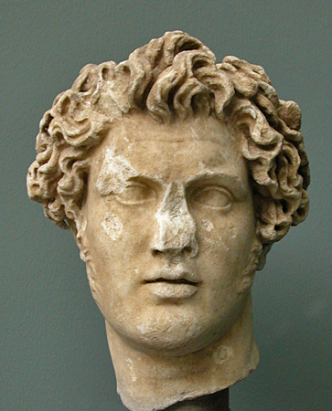
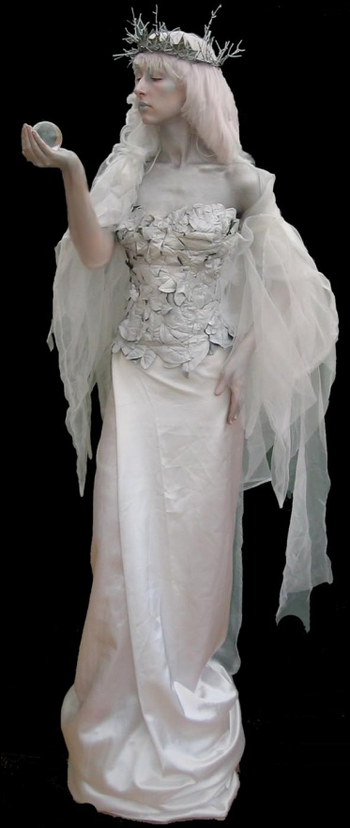
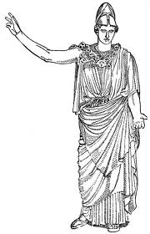
King Athamas and Nephele happily married, and had one son by the name of Phrixus
After King Athamas got tired of his wife, he remarried to Ino
Ino wanted to get rid of Phrixus so her son could inherit the throne

Slide 3
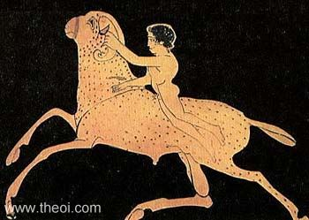
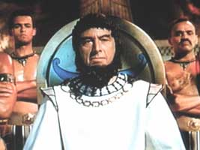
Phrixus and his sister Helle were saved by a golden ram sent by Hermes
They were carried off to Colchis, where Phrixus killed the ram (as a sacrifice to Zeus)
The fleece (the GOLDEN fleece) was given to King Aeetes, the king of Colchis

Slide 4
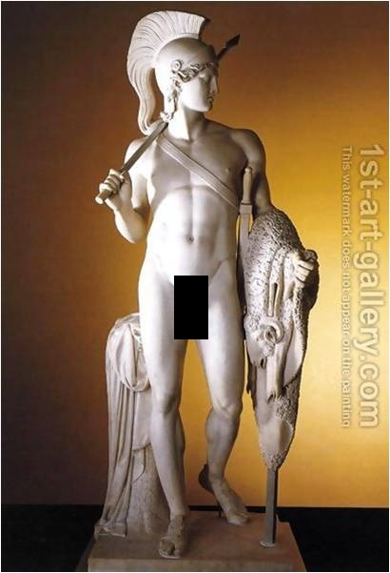
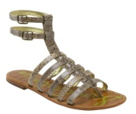
Meanwhile…
Jason (Phrixus’s Uncle) was replaced by Pelias
Pelias saw Jason walking without a sandal, and became afraid of him because an oracle told him a man with one sandal would over-throw him

Slide 5
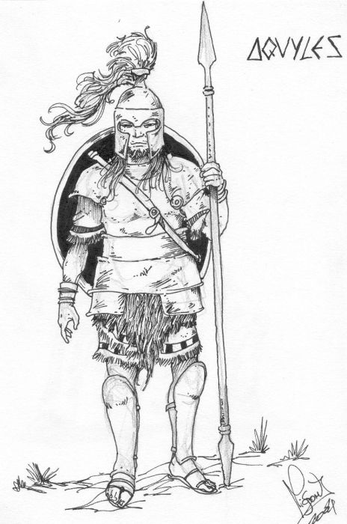
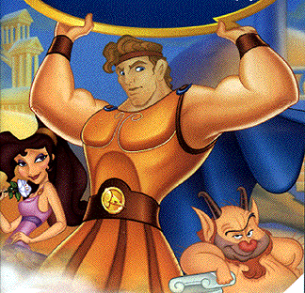
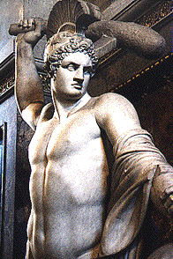
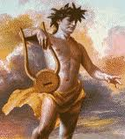
Afraid of Jason, Pelias told him a lie that the gods had told him he needed the Golden Fleece
  Pelias had assumed anyone going on this quest would never return
Jason formed the Argonauts
  Peleus, Hercules, Theseus and Orpheus
ARGONAUTS!

Slide 6
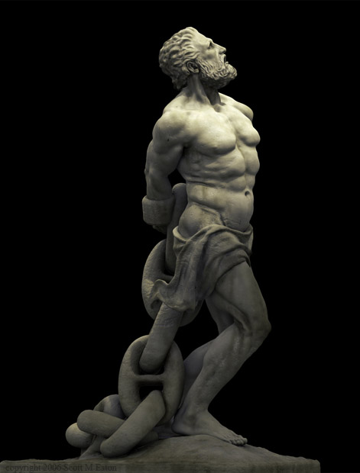
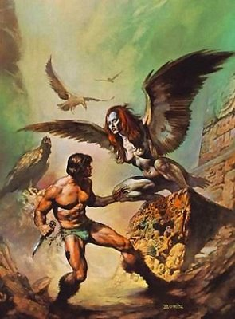
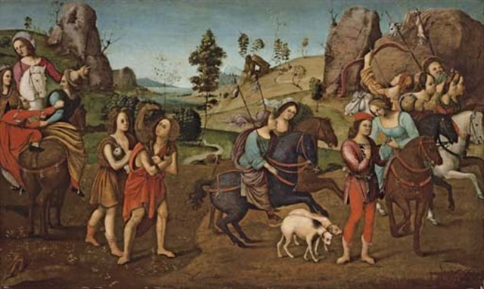
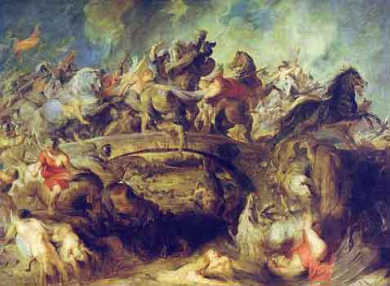
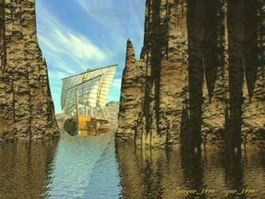
The Argonaut’s Adventures
The Argonaut’s Adventures
  1st- Met woman of Lemnos
  2nd-The North Wind helped to drive off Harpies, who spoiled Phineus’ food (Phineus was an oracle)
  3rd-Defeat giant rocks that squish ships (Sympleglades)
  4th- Avoided Amazons
  5th-Passed chained Prometheus
  FINALLY ARIVED! ☺
2
5
4
1
3

Slide 7
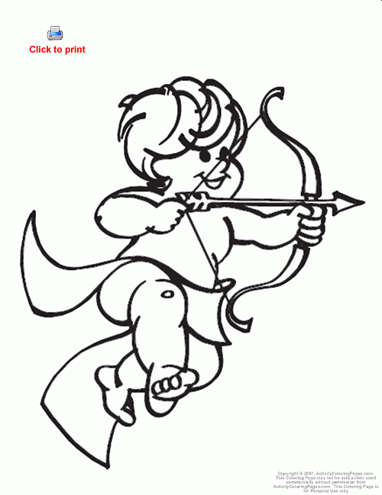
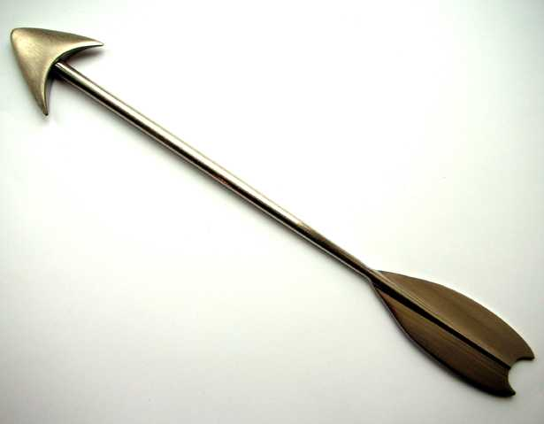
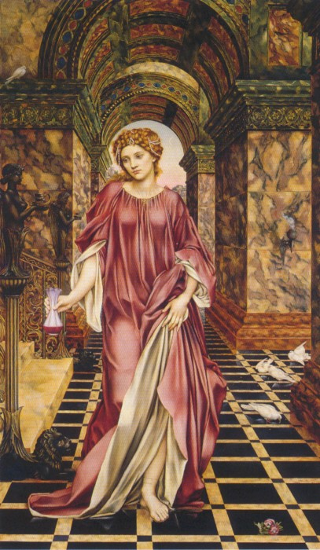
Aeetes designed two deadly challenges for Jason (he didn’t want to give up the fleece)
Hera & Aphrodite helped Jason
Cupid made Medea, Aeetes’s daughter, fall in love with Jason
Medea helped Jason

Slide 8
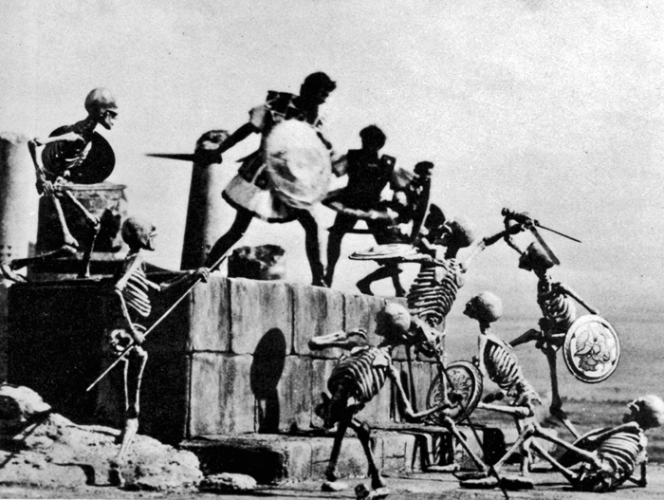
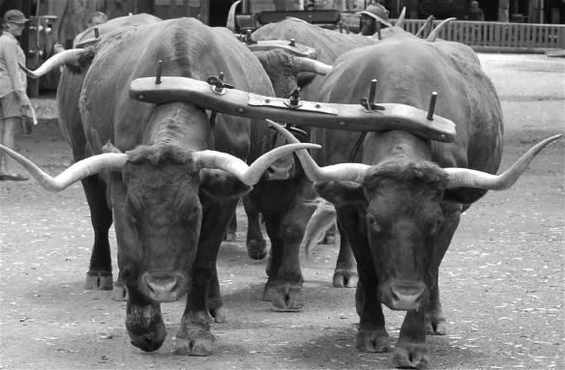
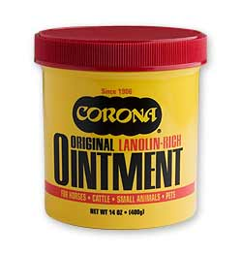

1st challenge- Yoke two magical bulls
  had breath of fire and hooves of bronze
  Medea gave him ointment
2nd challenge- Plow a field and sow it with dragon’s teeth using the bulls
  Medea told him to throw a rock in the middle of the soldiers that would spring up from the dragon’s teeth, so they would then attack each other

Slide 9
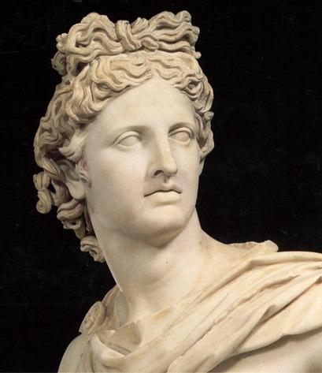
When Aeetes learned of Jason’s success he planned to kill him and the Argonauts
Medea found out and saved Jason by letting him steal the fleece and escape
On the way back to Greece, Medea accompanied the Argonauts and killed her brother to help escape

Slide 10
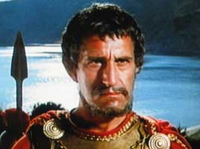
The Argonauts faced Scylla (the rock), Charbydis (the whirlpool), Talus (the giant bronze man)
After returning home Jason learned his parents were dead and plotted revenge against Pelias
Medea helped Jason by telling Pelias’s daughters that if they killed him, chopped him to pieces, and put the pieces in her magic pot it would return him to youth
Medea left before the daughters could put Pelias’s pieces into her magic pot, and brought back Jason’s father
Jason left Medea and their two children to marry the king of Cornith’s daughter

Slide 11
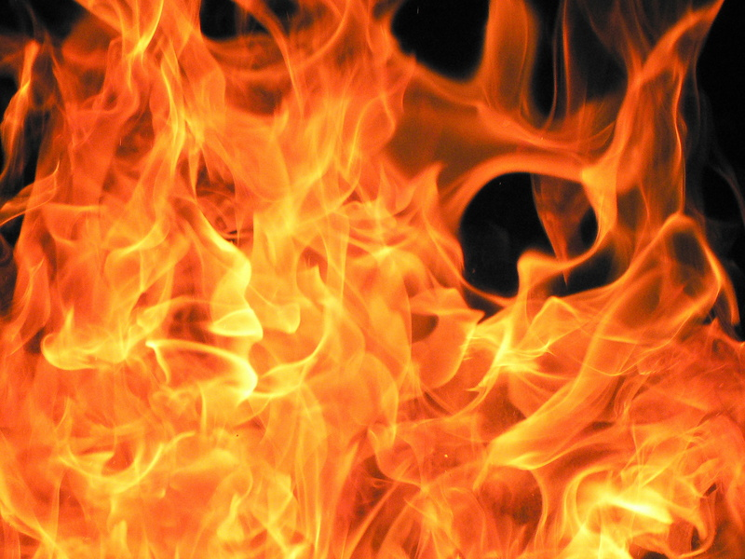
Jason’s new wife banished Medea and her children
Medea wanted revenge, and got it by sending her two sons with a robe to Jason’s wife’s home.
The robe burst into flames and killed Jason and his wife
Medea flew off in a magical chariot after killing her sons

