Slide 1
My 1940’s Time Capsule
Created By Katelyn Stevens

Slide 2
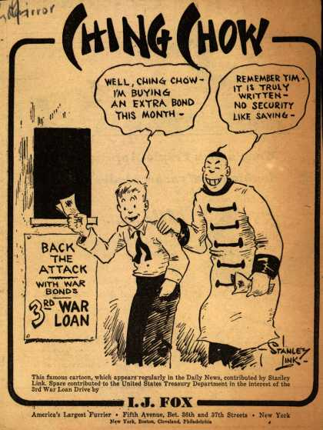
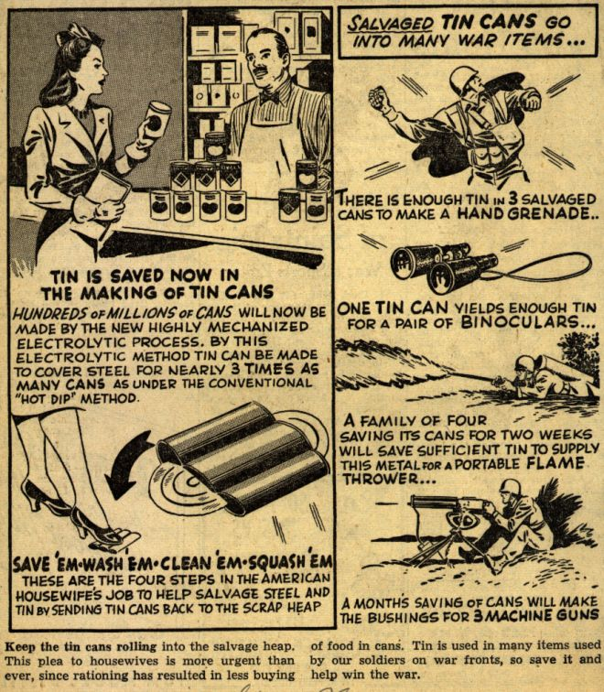
Early 1940’s War Propaganda
These images are clippings from the comic section of the newspaper. The one on the left is stressing the importance and usefulness of saving and donating your tin cans to the war effort. The image to the right hints to how heavily the forces depended on war bonds, which were a way to ‘back the attack’ and secure your savings (like regular bonds now).
Ching Chow Comic about War Bonds
Clipping from WWII newspaper about saving tin cans
1. (both from same website.)

Slide 3
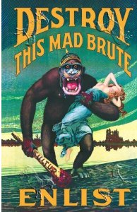
Propaganda Posters of WWII
This poster was designed to encourage men to enlist in the army during World War II. Little hints that are incorporated in this poster show that the gorilla represents a German man, as he is wearing a German style pickelhaube helmet with spikes, and is carrying a club with blood on it that says ‘Kultur’, which means (in German) culture or traditions. The lady he is carrying is thought to represent Lady Liberty, because of her familiar turquoise dress.
2.

Slide 4
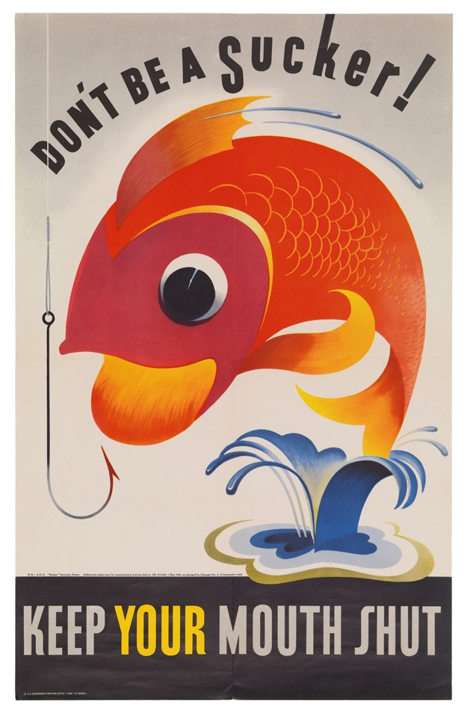
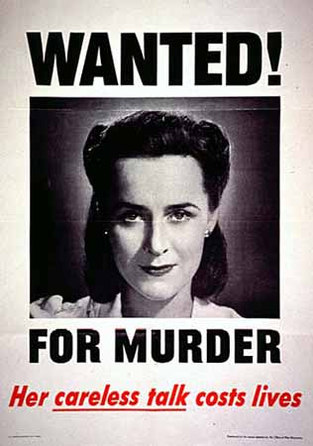
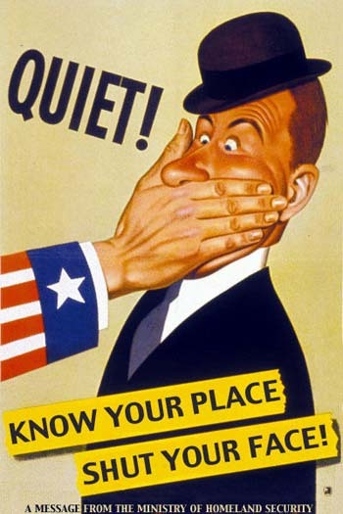
More Propaganda…
These posters were created to remind Americans to keep quiet about military plans and operations. There were many similar posters to this, often depicting a woman arrested for murder for spilling secret American military information.
4.
3.
5.

Slide 5
Fashion
During the war, fancy clothing was scarce because most of the silk, cotton, and wool was shipped to the war effort. Also, Paris (fashion capital of the world at that time) created more plain and uniform clothing. Clothes were made of sturdy fabrics, as all natural fabrics were also sent away. It was considered unpatriotic to wear clothing that was fancy, or flashy/colorful in any way. Men and women alike did away with all the frills and wore simple, drab-colored clothing that was sturdy and dependable. Rationing on clothing was also in effect, so clothing had to fit these characteristics. The saying “Make Do and Mend” was the mindset of civilian Americans during this time. Clothing was usually in darkly–saturated hues like navy, black, grey, maroon, and beige or brown.

Slide 6
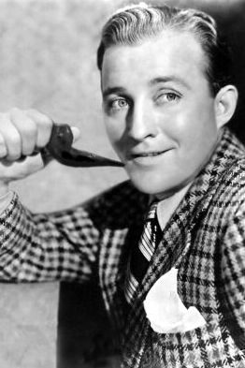
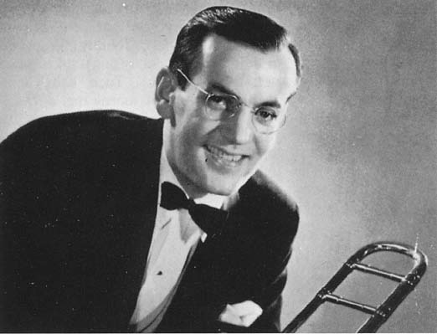
Popular Songs of 1942
White Christmas- Bing Crosby
“I’m dreaming of a White Christmas,
Just like the ones I used to know,
Where the treetops listen, and the children listen,
To hear sleigh bells in the snow…”
Moonlight Cocktail- Glenn Miller
Glenn Miller was a very famous jazz player,
well-known for many other songs he produced, like
‘Chattanooga Choo Choo’ and ‘I’ve Got a Gal
in Kalamazoo’.
Jingle Jangle Jingle- Kay Kyser
** Click this link to listen! **
7.
Bing Crosby
Glenn Miller and his prized trombone
6.
http://www.youtube.com/watch?v=osXyGGFlDqQ
http://www.popularsong.org/1942.html

Slide 7
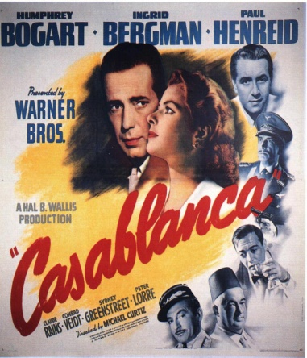
Famous Actors, Actresses, and Movies
Poster for Casablanca
Movies
Actors/ Actresses
Casablanca
Disney Classics:
Fantasia (1940)
Dumbo (1941)
Bambi (1942)
Oklahoma (1943)
Mrs. Miniver
Battle of Midway
Lifeboat
Best Years of Our Lives
Destination Tokyo
Gary Cooper
Humphrey Bogart
Katharine Hepburn
Cary Grant
Joan Crawford
Judy Garland
Elizabeth Taylor
Starred in There’s One Born Every Minute in 1942, Lassie Come Home in 1943, Jane Eyre in 1944, and National Velvet in 1944-1945
8.

Slide 8
Popular Books and Authors
Inexpensive paperbacks were created in 1940
The Naked and the Dead by Norman Mailer
Young Lions by Irwin Shaw
Black Boy by Richard Wright
Grapes of Wrath by John Steinbeck
Published in 1940
Common Sense Book of Baby and Child Care by Dr. Spock
The Human Comedy by William Saroyan
A Bell for Adano by John Hershey
Daniel Boone by James Daugherty
Won Children’s Book award

Slide 9
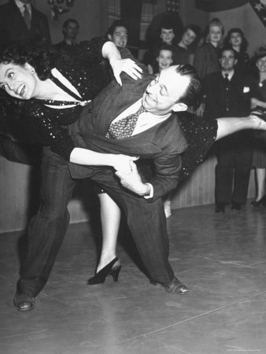
Dances of the 1940’s
Jitterbug
It was the first dance in nearly two hundred years that allowed individual expression.
Soldiers took it overseas and taught the people there the dance too.
Lindy Hop
Collegiate Shag
St. Louis Shag
Balboa
Lindy Charleston
East Coast Swing
Jive
Boogie- Woogie
9.
Two people doing the Jitterbug

Slide 10
New Inventions
First Digital Computer ENIAC
Created in 1945
It weighed thirty tons and was two stories high
Frozen dinners
Became known as TV dinners with the creation/improvement of television
Color Television
CBS researchers invented a mechanical color television system in 1940 based on the designs of John Logie Baird
Tupperware
It was invented in 1947 by Earl Tupper, a plastics innovator from New Hampshire.
Slinky
Invented by Richard and Betty James in 1943, it was originally supposed to function as a meter to measure horsepower, but it didn’t work.
Seventeen magazine
Established in 1944
Velcro
Invented in 1948 by George de Mestral, who came up with the idea when he noticed the burrs from plants that had stuck to his cotton jacket during a trip through the woods.

Slide 11
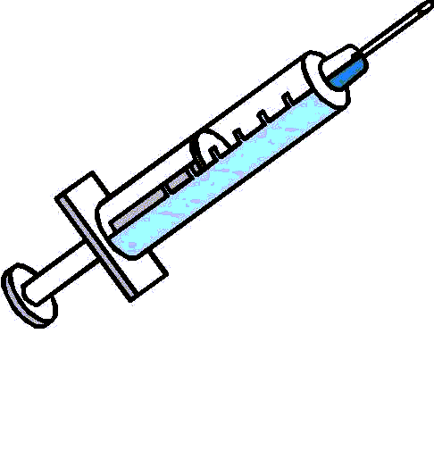
Medical Discoveries
Penicillin
First developed to help soldiers survive war wounds
Helped increase survival rates for surgery
Discovered by Sir Alexander Fleming
M+B
Created in 1936 by the firm May and Baker
First effective sulphonamides that could be used for a variety of infections
M+B 693
Used as a treatment for sore throats, pneumonia, and gonorrhea
M+B 760 was developed later from it
Blood transfusion services
Tetanus shot
Gas masks
Significant developments in the carbon used to absorb the poisonous gases
Whetlerite
Material developed by Americans that was highly effective in tests against known poisons
The beginning research of skin grafts
10.

Slide 12
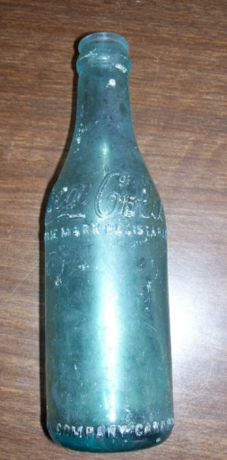
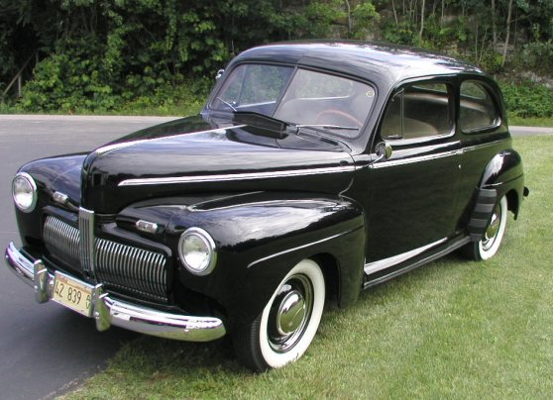
IT COSTED WHAT?!?!? IN 1942
Coca Cola Bottle
Average Cost of a New Home- $3,770
Average Wages Per Year- $1,880
Cost of a Gallon of Gas- 15 cents!
Bottle of Coca Cola- 5 cents
(PS- Did you know the Coca Cola bottles were blue during WWII? This was because the iron oxide that turns the glass green was needed for the war, so without it they were a shiny blue color.)
Average Price of a New Car- $920
11.
12.
1942 Ford Sedan

Slide 13
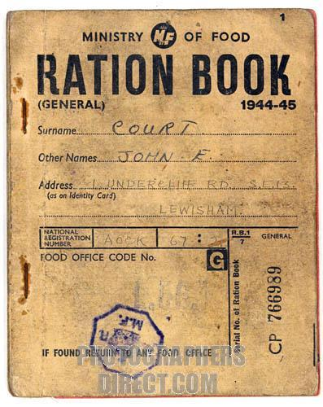
RATIONING
The government found it necessary in the spring of 1942 to start rationing, or portioning out, how much gasoline, food, and even clothing that Americans were allowed to buy. This was done to prevent public anger about shortages and so that both the rich and the poor could get what they needed. Civilians were given Ration Books that basically contained coupons that you would rip out when you bought that item. The number of coupons you got depended on the size of your family. However, the coupon didn’t make items discounted or free like you would think; it simply kept track of how many of a type of item you were allowed to buy. If you had used all your coupons for sugar that week, you were not allowed to buy any sugar and you were simply out of luck until next week, or whenever you were given your new set of coupons. Because of these food rations people were much healthier and fit, as they were hardly given any fats or sugars, and people did their best to stick to the guidelines and make do with what they had. It was considered patriotic at the time to sacrifice all these things for your men in arms.
13.

Slide 14
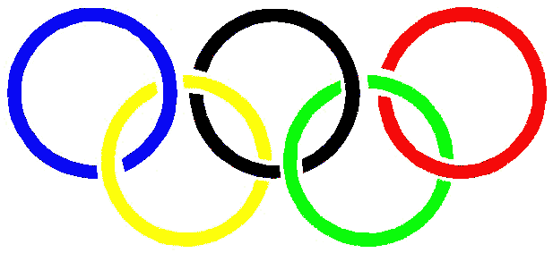
1944 Olympics
Due to World War II, both the Winter and Summer Olympics were canceled in 1944. The Summer Olympics were to be held in London, United Kingdom, and the Winter Olympics in Cortina d’Ampezzo, Italy.
Olympic Rings
14.

Slide 15
Exeter Academy
Population- 1000 students from 9th grade to post graduate level
Founded in 1781 by John Phillips
Over 450 courses are offered in 19 different subject areas
There are about five students to every one teacher
co-educational residential school (boarding school)
asks a great deal from every student - higher standards, greater expectations, and deeper engagement
Located in Exeter, New Hampshire
The classrooms are in the center of the campus, surrounded by dormitories, stores, a library, dining halls, cafes, music and health centers, athletic facilities, a theater, an art center, and much more
The academic calendar year is divided into three terms
Studying abroad is available
It costs about $40,000 dollars per year to attend Exeter (if you board)

Slide 16
Allies of the U.S in WWII
Big Four Powers:
England (Great Britain and the UK)
United States of America
Soviet Union (U.S.S.R. and Russia)
France
Other Allied Nations:
Australia
Belgium
Bolivia
Brazil
Canada
China
Denmark
Greece
Haiti
Mexico
Netherlands
New Zealand
Norway
Poland
South Africa
Yugoslavia

Slide 17
Enemies of the U.S in WWII (Axis Powers)
Major Powers:
Nazi Germany, Fascist Italy, and Imperial Japan
Minor Powers:
Hungary, Romania, and Bulgaria
“Puppet” States:
Japan’s Puppets- Manchuria, Mongolia, China, Burma, and India
Italian Puppets- Albania
Germany’s Puppets- Slovakia, Croatia, Norway, and Italian Social Republic
Other Belligerents and Sympathizers:
Finland, Thailand, Spain, and Argentina

Slide 18
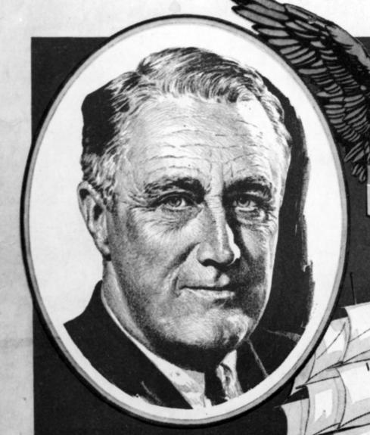
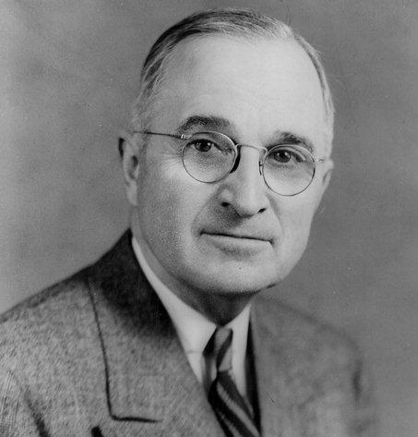
American Political Leaders
15.
President Roosevelt
Franklin D. Roosevelt
Served as president for twelve years since he was elected four times
Worked for better jobs and a better economy
Allowed research on atomic bombs
Declared war on Japan
Dwight David Eisenhower
Led the Ally forces in Europe
Planned Operation Overlord
Promoted to General of the Army
Elected president in 1952
General MacArthur
Became Commander of U.S. forces in the Far East in 1941
Led the defense of the Philippines
received the Congressional Medal of Honor for it
oversaw the Allied occupation of Japan after WWII
Harry S. Truman
Became 33rd president suddenly after President Roosevelt died
Gave the ‘okay’ to bomb Hiroshima and Nagasaki
This bombing basically ended WWII
16.
Harry Truman

Slide 19
Battles in the Pacific Ocean
Pearl Harbor- December 7, 1941
Battle of the Coral Sea- May 7-8, 1942
Battle of Midway- June 4, 1942
Battle of the Philippine Sea- June 19-20, 1944
Solomon’s Campaign:
The was a collection of battles that was the longest and most bitter campaign to occur during WWII
Occurred near Guadalcanal in a very small area during the night mostly
Java Campaign
The Japanese won these battles and so they got all the resources of the SW Pacific
They established an aggressive border to protect these resources
Guadalcanal Campaign
The Japanese had tried to build an airbase on the island so the Allies attacked with full strength and eventually wore the Japanese down.
Leyte Campaign
Japan lost nearly its entire navy during these battles and the Americans gained yet another military base

Slide 20
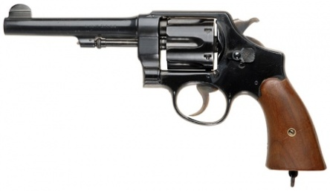
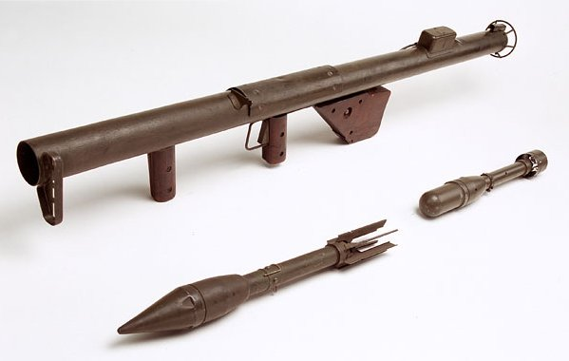
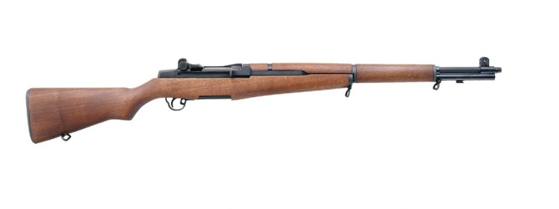
Weapons Used By the U.S in WWII
M1917 Revolver
Pistols and Handguns:
M1917 Revolver
Smith & Wesson M&P
Colt M1911/A1
Col General Officer’s Model (only available to General Officers)
Rifles
M1918 Browning Automatic
M1 Garand
M1 Carbine
M1903 Springfield
Machine Guns
Browning M1919 Medium
Browning M1917A1 Heavy
Browning M2 Heavy
Submachine Guns
Thompson M1928
Thompson M1928A1
Thompson M1
Thompson M1A1
M3/A1 Grease Gun
Anti-Tank Weapons
M1/A1 Bazooka
Grenades
Mk2 Fragmentation
17.
19.
M1 Garand Rifle
M1 Bazooka
18.

Slide 21
Work Cited Pictures
http://www.vintageadbrowser.com/propaganda-ads-1940s/3
http://www.google.com/imgres?imgurl=http://ecx.images-amazon.com/images/I/51C5SJ74R7L._SL500_AA300_.jpg&imgrefurl=http://www.amazon.com/Art-Poster-Destroy-this-Brute/dp/B000G9Z74E&usg=__mvtZaqp_HYLV_UxL5dHeY-6Rvcg=&h=300&w=300&sz=27&hl=en&start=0&zoom=1&tbnid=Y49ewwd0eHBDSM:&tbnh=153&tbnw=153&prev=/images%3Fq%3Ddestroy%2Bthis%2Bmad%2Bbrute%2Bposter%26um%3D1%26hl%3Den%26safe%3Dactive%26noj%3D1%26biw%3D1259%26bih%3D797%26tbs%3Disch:1&um=1&itbs=1&iact=rc&dur=235&ei=3q6PTOnrIcGC8ga81uSfDQ&oei=3q6PTOnrIcGC8ga81uSfDQ&esq=1&page=1&ndsp=31&ved=1t:429,r:10,s:0&tx=81&ty=107
http://www.google.com/imgres?imgurl=http://designrelated.tv/inspiration/wwII_posters/fish_sucker_propaganda_poster.jpg&imgrefurl=http://www.designrelated.com/inspiration/view/editor/entry/3570/vintage-us-wwii-propaganda-posters&usg=__Y8o0PzGjU27izari5H6fk53J9CY=&h=954&w=625&sz=404&hl=en&start=120&zoom=1&tbnid=ns2EQrN6A42reM:&tbnh=169&tbnw=111&prev=/images%3Fq%3Dworld%2Bwar%2B2%2Bpropaganda%2Bposters%255C%26um%3D1%26hl%3Den%26safe%3Dactive%26sa%3DN%26noj%3D1%26biw%3D1259%26bih%3D797%26tbs%3Disch:1&um=1&itbs=1&iact=hc&vpx=938&vpy=320&dur=63&hovh=277&hovw=182&tx=123&ty=161&ei=kq6PTKSCDMT7lwe2n5zEAg&oei=Na6PTJztLsP58AaptdCoDQ&esq=7&page=5&ndsp=29&ved=1t:429,r:20,s:120
http://www.google.com/imgres?imgurl=http://warnerbros.pbworks.com/f/murder.jpg&imgrefurl=http://warnerbros.pbworks.com/Now-Voyage-(1942)&usg=__LRVl6tlzJmGAZSuIU9QMNhpEX10=&h=450&w=316&sz=18&hl=en&start=0&zoom=1&tbnid=Y6DuKI7qDt0MvM:&tbnh=159&tbnw=104&prev=/images%3Fq%3Dwanted%2Bfor%2Bmurderpropaganda%2Bposters%2Bof%2Bww2%26um%3D1%26hl%3Den%26safe%3Dactive%26noj%3D1%26biw%3D1259%26bih%3D825%26tbs%3Disch:1&um=1&itbs=1&iact=hc&vpx=264&vpy=86&dur=359&hovh=268&hovw=188&tx=105&ty=143&ei=uAORTNSVNYWClAe80NHjAQ&oei=uAORTNSVNYWClAe80NHjAQ&esq=1&page=1&ndsp=30&ved=1t:429,r:1,s:0
http://andrikyrychok.files.wordpress.com/2008/11/propaganda_quiet.jpg
http://www.google.com/imgres?imgurl=http://www.smokersassociation.org/system/files/images/glenn_miller.jpg&imgrefurl=http://www.smokersassociation.org/images/glenn-miller&usg=__WrwBX4Srv8ODeldbGc2Y_CWAbXU=&h=350&w=253&sz=13&hl=en&start=14&zoom=1&itbs=1&tbnid=aAAQBoCvn95mdM:&tbnh=120&tbnw=87&prev=/images%3Fq%3Dglenn%2Bmiller%26hl%3Den%26gbv%3D2%26tbs%3Disch:1
http://www.google.com/imgres?imgurl=http://www.smokersassociation.org/system/files/images/glenn_miller.jpg&imgrefurl=http://www.smokersassociation.org/images/glenn-miller&usg=__WrwBX4Srv8ODeldbGc2Y_CWAbXU=&h=350&w=253&sz=13&hl=en&start=14&zoom=1&itbs=1&tbnid=aAAQBoCvn95mdM:&tbnh=120&tbnw=87&prev=/images%3Fq%3Dglenn%2Bmiller%26hl%3Den%26gbv%3D2%26tbs%3Disch:1
http://freeartlondon.files.wordpress.com/2010/08/movie-poster-casablanca.jpg
http://imagecache2.allposters.com/images/LIFPOD/570237.jpg
http://www.hfs-assn.org/graphics/needle.gif
http://imagecache2.allposters.com/images/LIFPOD/570237.jpg
http://americandreamcars.com/1942ford2dr0711.jpg
http://www.google.com/imgres?imgurl=http://img2.photographersdirect.com/img/16398/wm/pd716890.jpg&imgrefurl=http://scheong.wordpress.com/2009/12/11/blackouts-raids-and-rationing-the-blitz-and-the-home-front-of-wwii/&usg=__FaDfs6yIyL2qtOm_YTYjuWkkVDU=&h=500&w=397&sz=85&hl=en&start=19&zoom=1&um=1&itbs=1&tbnid=fifkK7mC0gTwiM:&tbnh=130&tbnw=103&prev=/images%3Fq%3Dhome%2Bfront%2Bww2%2Bclothing%26um%3D1%26hl%3Den%26sa%3DN%26rlz%3D1R2ADSA_enUS358%26ndsp%3D20%26tbs%3Disch:1
http://www.plaidkidscrafts.com/content/binary/olympics1.gif
http://photos.upi.com/topics-Franklin-D-Roosevelt/bc68e27cb3588dcb23b6af1e21e2a379/F_1.jpg
http://www.class.uh.edu/history/cox/1302album/slides/harry-truman.jpg
http://www.imfdb.org/images/thumb/4/4f/S%26W-Model-1917.jpg/450px-S%26W-Model-1917.jpg
http://www.capitanhipower.com/Photos/M1Rifle.jpg
http://historydocumented.com/wordpress/wp-content/uploads/2009/07/bazookasmithsonian.jpg

Slide 22
Work Cited Information
"Destroy This Mad Brute!" LEARN NC. The University of North Carolina at Chapel Hill. Web. 15 Sept. 2010. <http://www.learnnc.org/lp/multimedia/10612>.
Thomas, Pauline Weston. "C20th Fashion History 1940s - Utility Clothing 1940s." Fashion History Costume Trends and Eras, Trends Victorians - Haute Couture. Fashion Era. Web. 15 Sept. 2010. <http://www.fashion-era.com/utility_clothing.htm>.
Goodwin, Sue. "American History - Decade 1940 - 1949." Lone Star College-Kingwood Library Home Page. Twientieth Century Decades, 1999. Web. 15 Sept. 2010. <http://kclibrary.lonestar.edu/decade40.html>.
"Elizabeth Taylor at Reel Classics." Reel Classics: Elizabeth's Classic Movie Homepage. Web. 15 Sept. 2010. <http://www.reelclassics.com/Actresses/Liz_Taylor/liz.htm>.
"1940s Bestsellers." Cader Books Presents Publishers Lunch. Web. 15 Sept. 2010. <http://www.caderbooks.com/best40.html>.
"Swing (dance)." Wikipedia, the Free Encyclopedia. Web. 15 Sept. 2010. <http://en.wikipedia.org/wiki/Swing_(dance)#Early_forms_from_the_1930s_and_1940s>.
"Modern Inventions of the 20th Century: The 1940's." 20th Century Nostalgia: When We Were Kids. Web. 14 Sept. 2010. <http://www.wwwk.co.uk/culture/inventions/40s/index.htm>.
"Medicine and World War Two." History Learning Site. Web. 14 Sept. 2010. <http://www.historylearningsite.co.uk/medicine_and_world_war_two.htm>.
"1942 including Popular Culture, Prices, Events, Technology and Inventions." Where People, History and Memories Join Together from The People History Site. Web. 15 Sept. 2010. <http://www.thepeoplehistory.com/1942.html>.
"World War II Rationing." United States History. Web. 15 Sept. 2010. <http://www.u-s-history.com/pages/h1674.html>.
"Phillips Exeter Academy | About Us." Phillips Exeter Academy | Home. Phillips Exeter Academy, 2010. Web. 14 Sept. 2010. <http://www.exeter.edu/about_us/about_us.aspx>.
"Allies." World War II History Info. Web. 14 Sept. 2010. <http://worldwar2history.info/war/Allies.html>.
"Allied & Axis Powers of WWII." Missing In Action, MIA Recovery Experts: Moore's Marauders. Moore's Marauders, 2006. Web. 15 Sept. 2010. <http://www.mooresmarauders.org/allies_and_axis_powers_wwii.htm>.
"Biographies of Major Military and Political Leaders in World War II." Oracle ThinkQuest Library. Web. 13 Sept. 2010. <http://library.thinkquest.org/10927/leadww2.htm>.
"Pacific War Maps | Nihon Kaigun." Pacific Naval Battles in World War II. Web. 15 Sept. 2010. <http://combinedfleet.com/battles/>.
Whitney05. "World War 2 Weapons." HubPages. Web. 14 Sept. 2010. <http://hubpages.com/hub/World_War_2_Weapons>.

