Slide 1
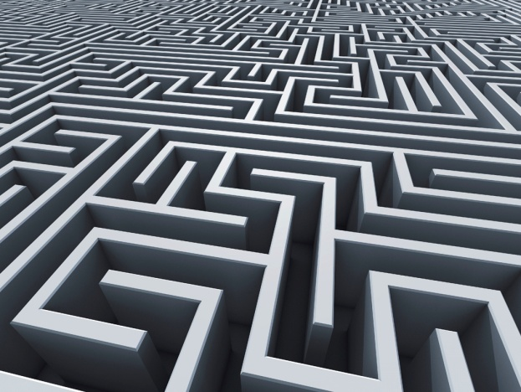
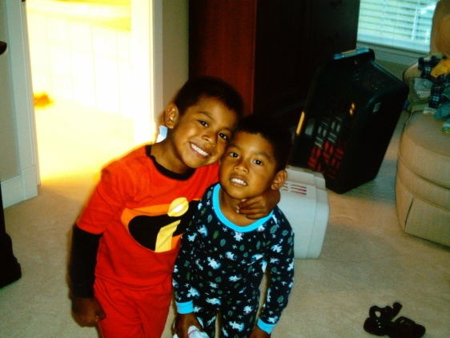
Four Great Adventures!
Isabel Vazquez, Emma Ulrich, and Alicia Ganion

Slide 2
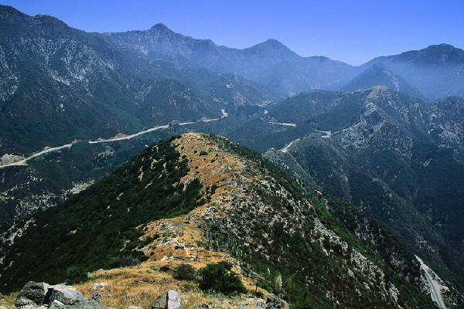
Phaethon
One day, a young boy named Phaethon approaches the sun god’s palace. The sun god is none other than the boy’s father.

Slide 3

Phaethon asks the sun god if he is his father. The god says yes, and to prove it, swears upon the River Styx to give the boy whatever his heart desires.
I swear upon the River Styx to give you your heart’s desire!
My heart’s desire? Hmmm….

Slide 4
Phaethon tells his father his request.
I want to drive your chariot across the sky!
Gasp!
The sun god does not want to grant this request, but he has made an unbreakable oath, so he must.

Slide 5
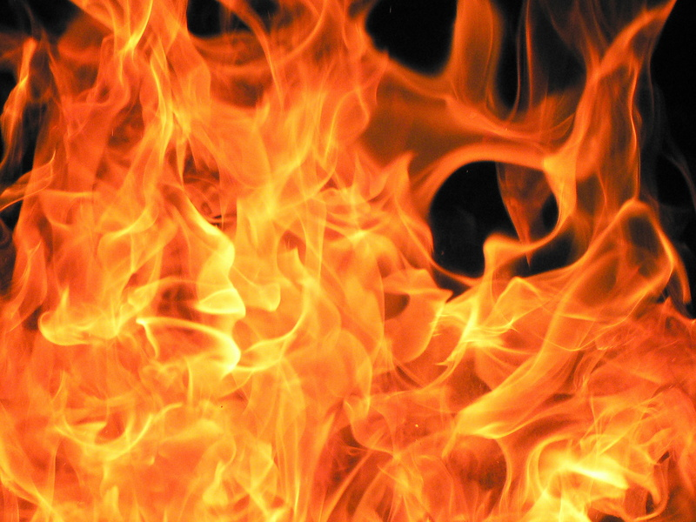
The boy is unable to handle the chariot’s wild horses. He accidentally sets the world on fire and dies.

Slide 6

Pegasus and Bellerophon
Bellerophon was a wise and handsome youth who wanted the winged horse, Pegasus, as his own.

Slide 7
He prayed to the gods and Athena gave him a golden bridle that tames the horse. Pegasus was his!

Slide 8

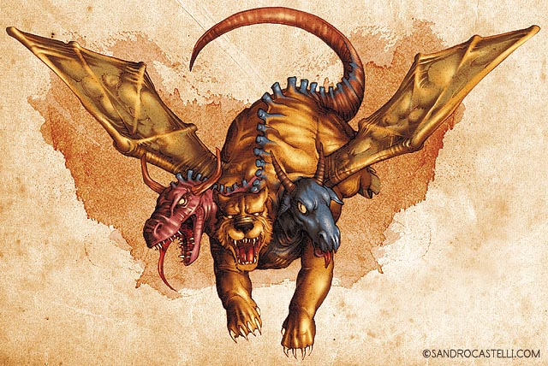
With his trusty steed, Bellerophon killed the Chimera!

Slide 9
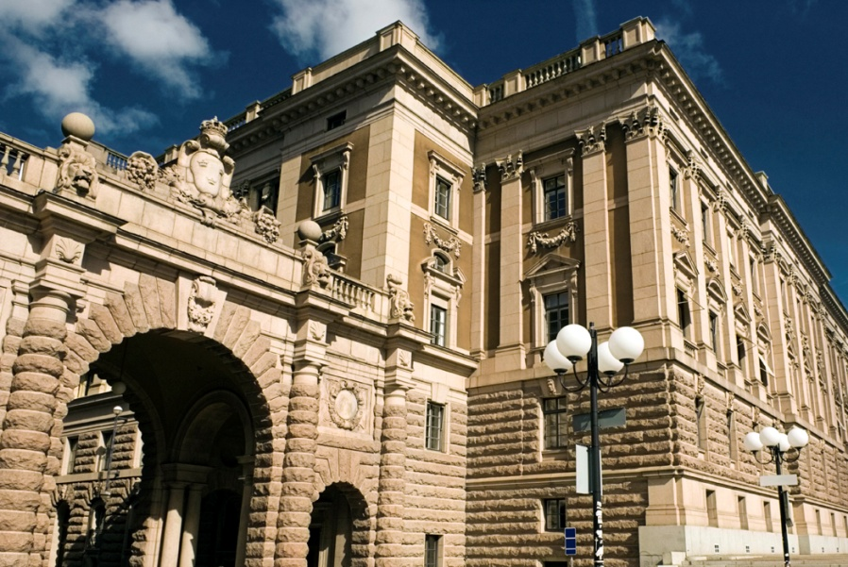
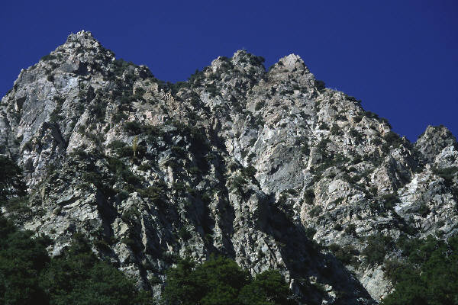
Bellerophon decides that he and Pegasus would fly up to Mount Olympus, but Pegasus knows better and bucks his master.
Bellerophon died and Pegasus went to live in Zeus’ stables.

Slide 10
Otus and Ephialtes
Otus and Ephialtes were handsome twin Giants.

Slide 11
They believed themselves to be greater than the gods and attempted to prove this.
First, they imprisoned Ares.

Slide 12
The two threatened to stack two mountains on top of each other in order to reach Olympus.
We are going to reach Olympus!!!!

Slide 13
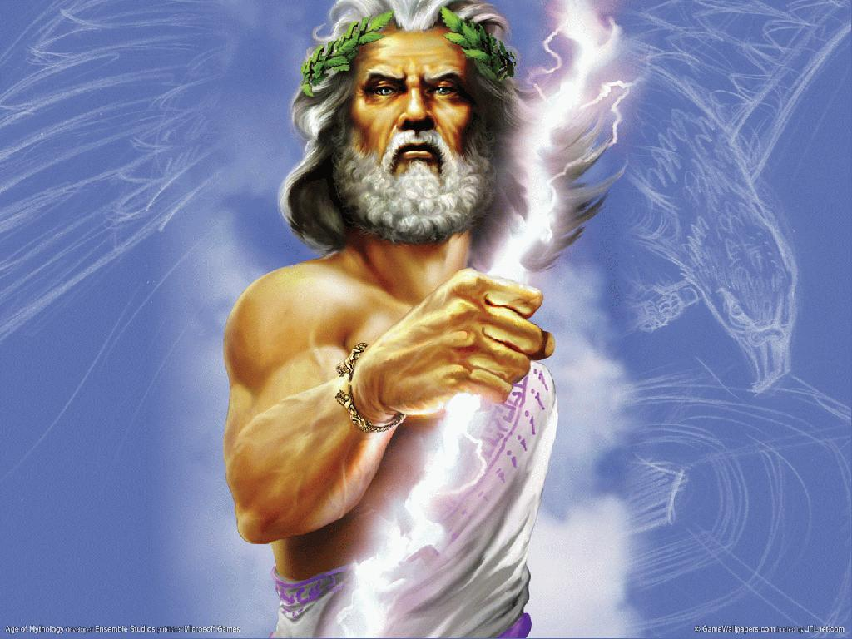

Zeus wanted to kill the boys, but their father Poseidon intervened.
Don’t ! I will control my sons!

Slide 14
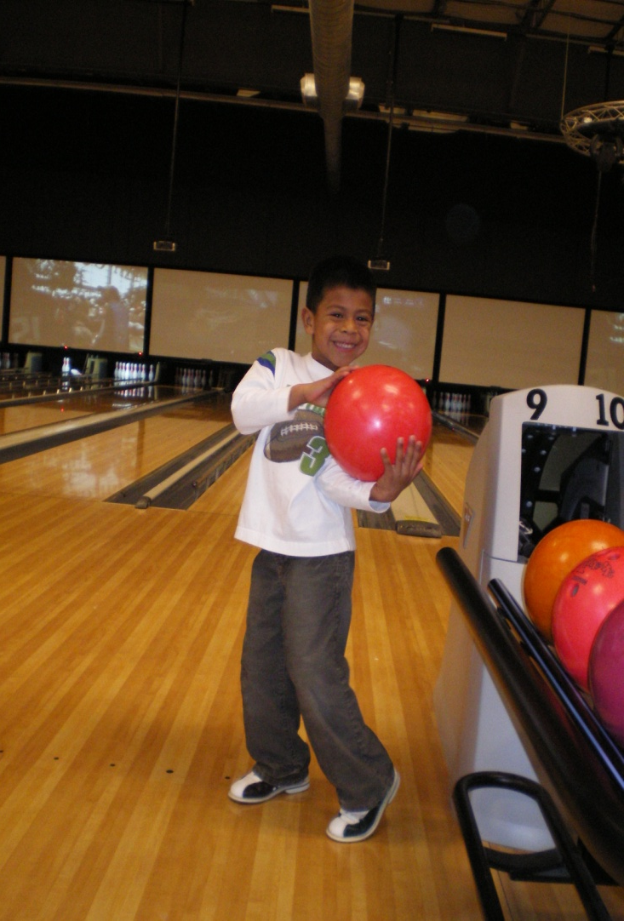
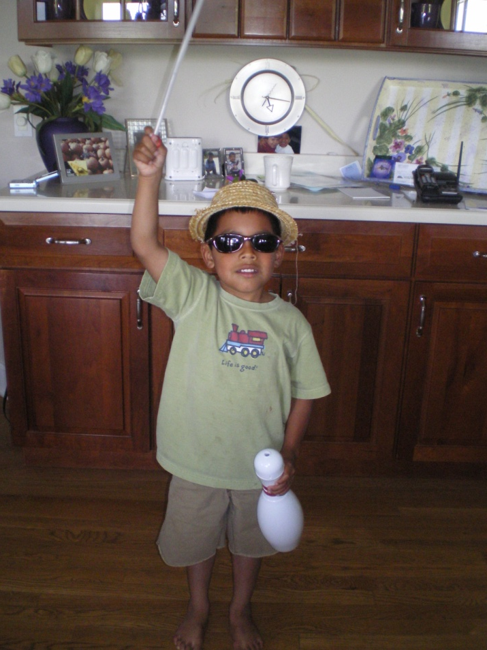
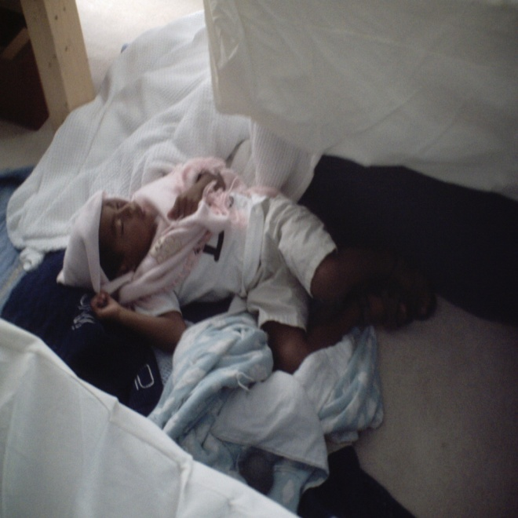
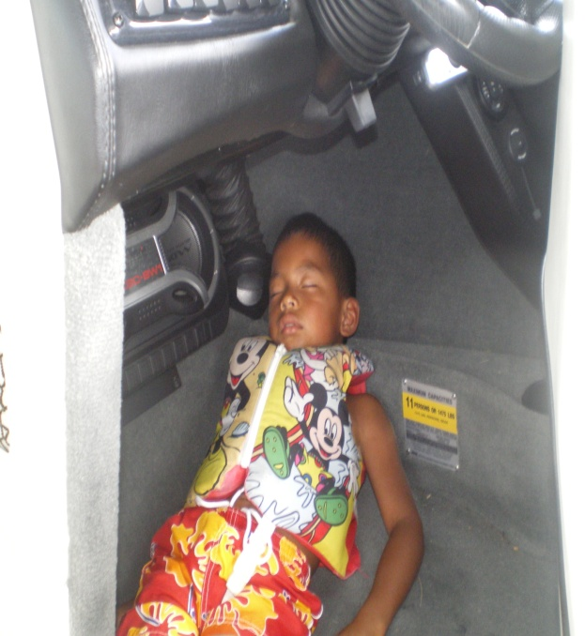
The boys decided to chase after Artemis. Artemis caused the two to kill each other.

Slide 15
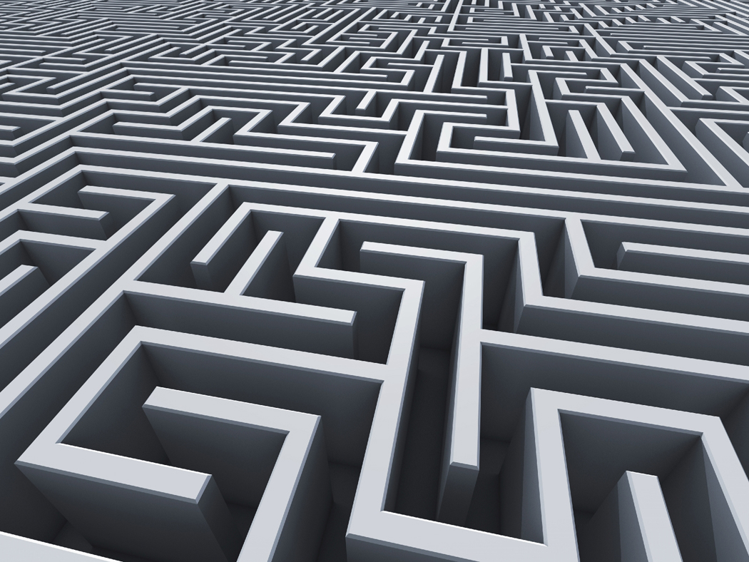
Daedalus
Daedalus, the architect of the Labyrinth, was banished with his son, Icarus, to his own creation after the king accused him of helping people beat the infamous maze.

Slide 16
Daedalus built wings so they could fly out of the Labyrinth.
Now, Icarus, don’t fly too close to the sun!

Slide 17

Icarus did not heed his father’s warning. He flew high and the wax holding his wings on melted. Icarus fell into the ocean.
Icarus!!!!!!!

