Slide 1
Gene’s 1942 Electronic Time Capsule
To help him remember his life as a sixteen-year-old at Devon Academy
Paige Swan

Slide 2
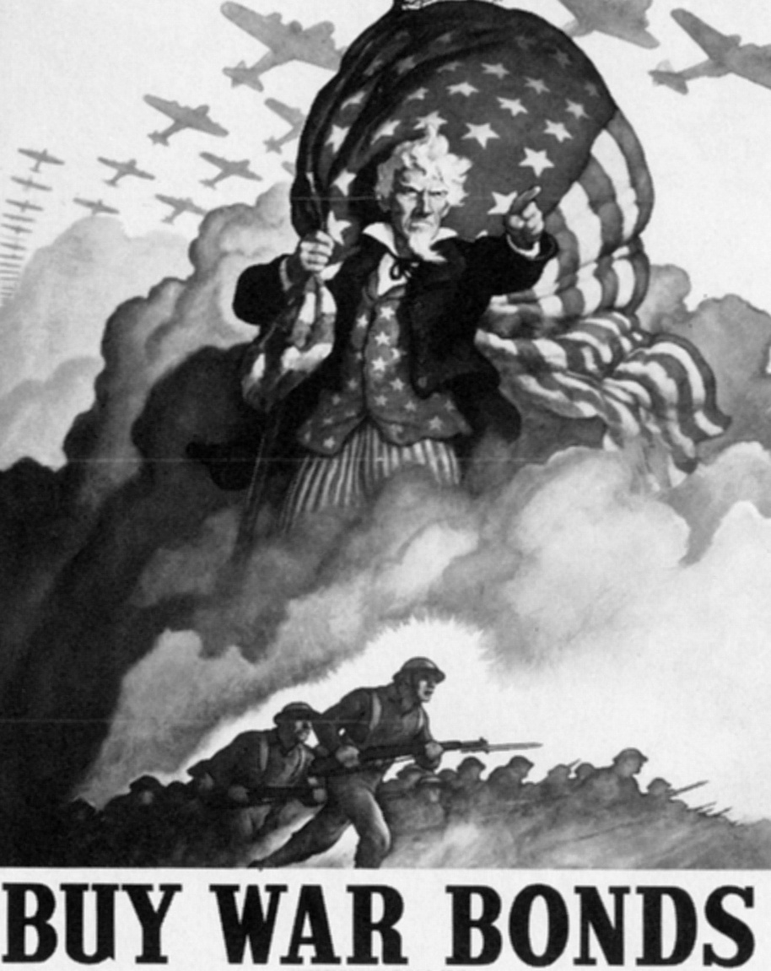
Propaganda Posters
2
1
While the men were at war, more than 6 million women had to take over their positions at industrial plants
War Bonds are issued by the government and are used to help finance the war. These bonds make civilians feel involved and boosts patriotism.

Slide 3
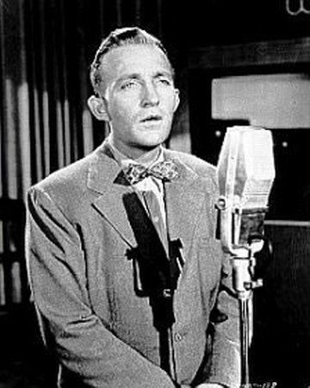
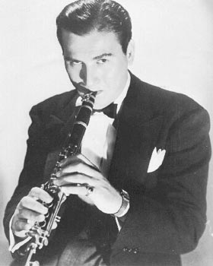
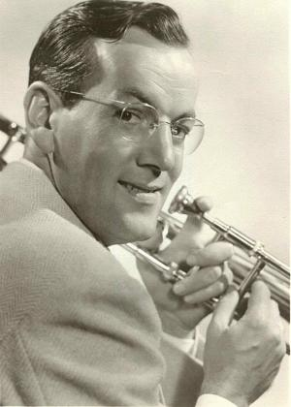
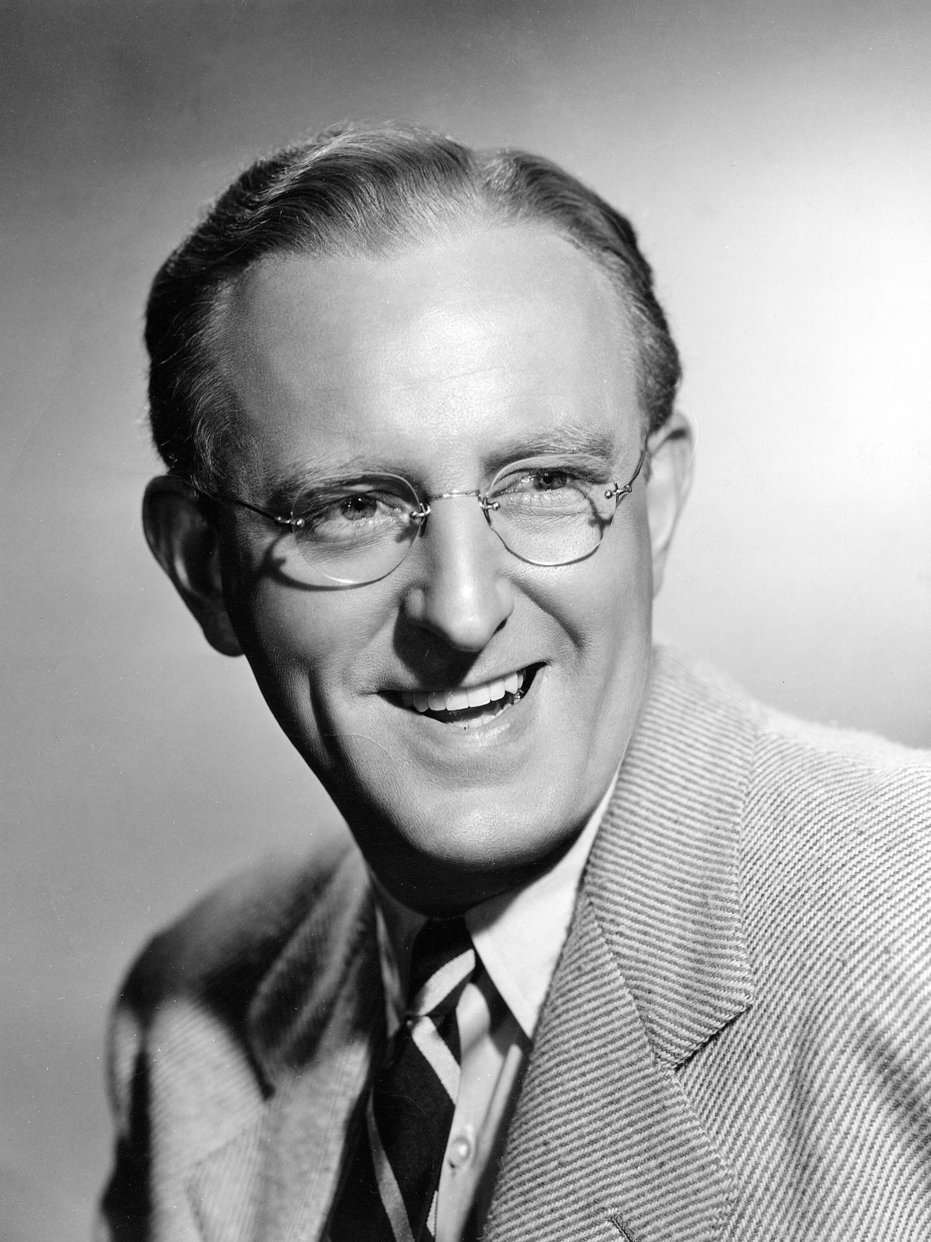
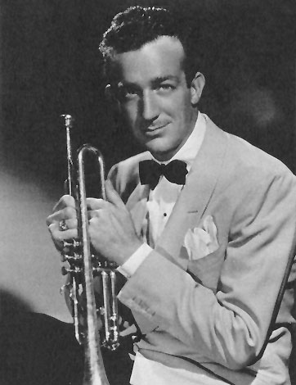
Top Songs of 1942
White Christmas
Blue in the Night
Challanooga Choo Choo
4
5
3
Woody Herman
Bing Crosby
Glenn Miller
Jingle Jangle Jingle
Sleepy Lagoon
6
7
Many listeners enjoyed simple-to-understand melodies, and swing music was very popular.
Kay Kyser
Harry James

Slide 4
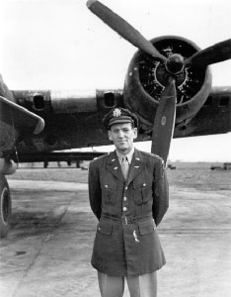
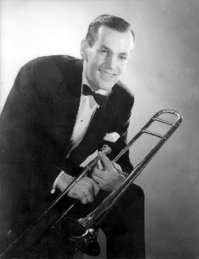
Glenn Miller: One the of Top Singers of the 1940s
8
Born in 1904 in Iowa
In 1942, enlisted in U.S. Air Force
Died in 1944 and a memorial is at Arlington National Cemetery
By 1940, Glenn was making around $20,000 a week
8
Moonlight Cocktail String of Pearls I’ve Got a Girl in Kalamazoo
Challanooga Choo Choo
http://www.bing.com/videos/watch/video/glenn-miller-orchestra-ive-got-a-gal-in-kalamazoo/02fee81174d6472e06ea02fee81174d6472e06ea-140058100484?q=I've%20got%20a%20Gal%20in%20Kalamazoo
"A band ought to have a sound all of its own. It ought to have a personality.“ –Glenn Miller

Slide 5
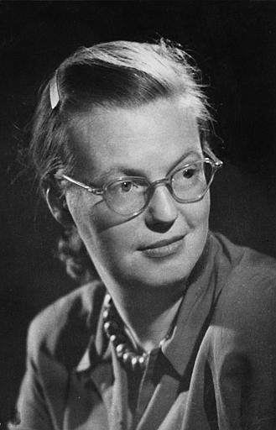
A Famous Author: Shirley Jackson
Famous for:
The Lottery,
The Haunting of Hill House, and We Have Always Lived in the Castle
9
10
Description of the Lottery:
A story about average citizens in a New England village who every year have a lottery picking ceremony. The winner of the lottery’s fate slowly is revealed and no one expects the ending.
Horror short story and novel writer

Slide 6
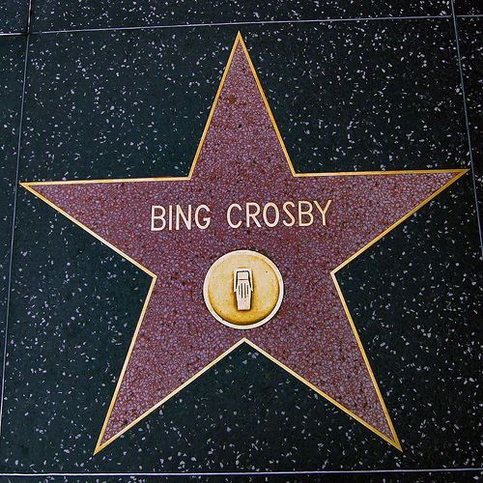
Bing Crosby
A
Famous for starring in movies such as Holiday Inn, Road to Utopia, and Welcome Strange. He was also a very popular artist.
C
T
O
R
11
He then went on to win a 1944 Academy Best Actor Award for the movie, Going My Way.
Clipart

Slide 7
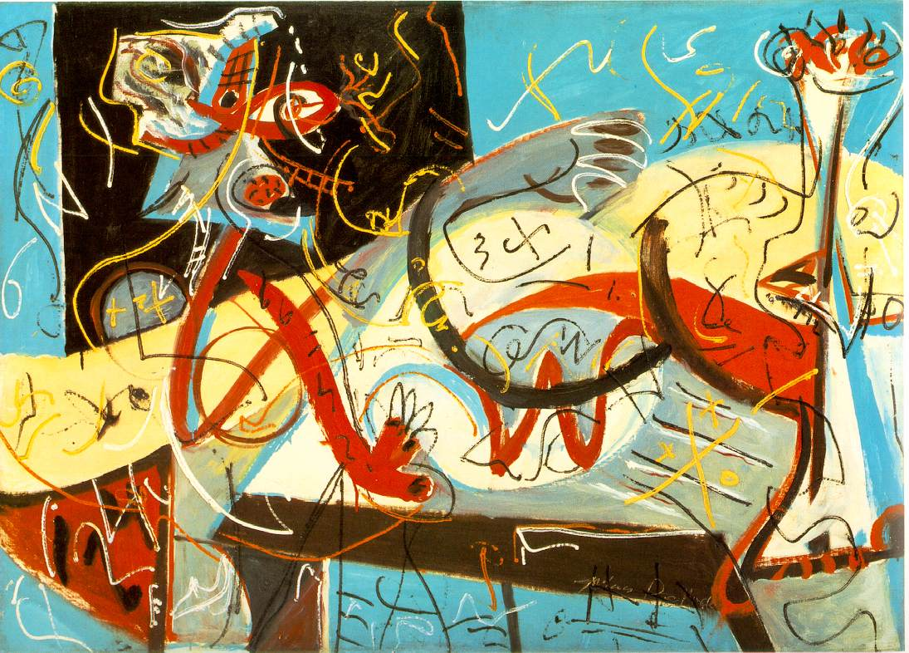
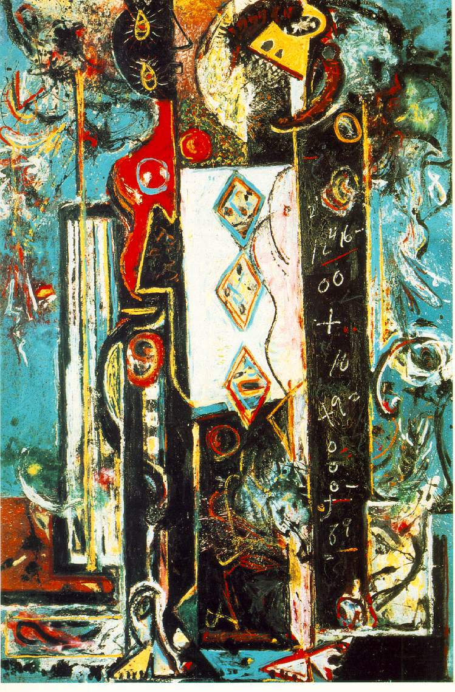
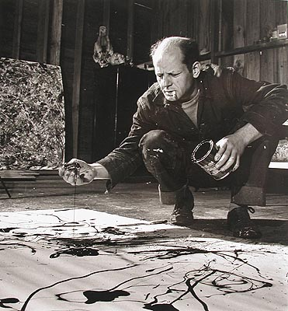
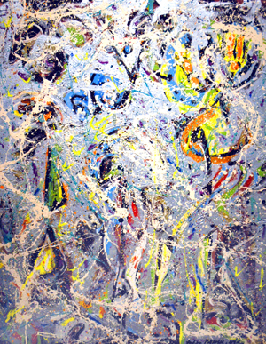
Abstract Expressionism Artist: Jackson Pollock
12
Jackson majored in action painting. Action painting is when a person slashes or dribbles paint on a canvas as opposed to using a paint brush. He specifically used sticks and knives and painted on walls and floors.
Stenographic Figure,
1942
12
Male and Female, 1942
He expressed his emotions and made the paintings “come to life.”
13
14
The Galaxy

Slide 8
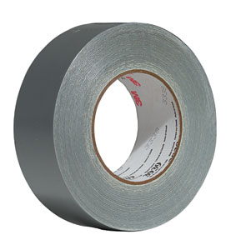
A Useful Invention: Duct Tape
Invented by Johnson and Johnson Permacel Division in 1942
Was used to keep moisture out of ammunition cases
First, it was army green, then was changed to silver to match ductwork when people started to use duct tape for that purpose
15
People used it to fix guns, jeeps, and aircrafts
Was waterproof so people called it Duck Tape

Slide 9
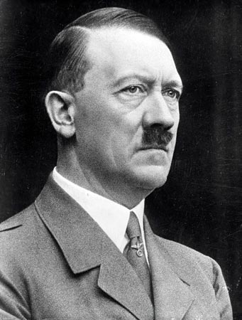
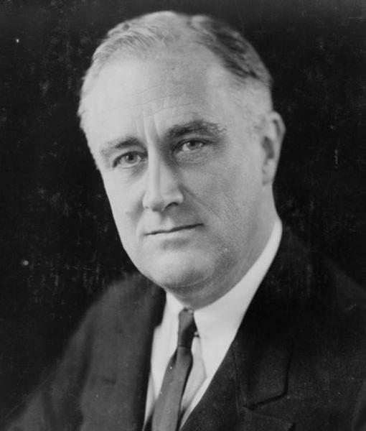
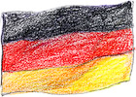
Important Political Leaders
Adolf Hitler and Franklin D. Roosevelt
17
18
16
27
“Any alliance whose purpose is not the intention to wage war is senseless and useless.”
“The only thing we have to fear is fear itself.”
1933- 1945
January 31, 1933: became Chancellor of Germany
Franklin thought that the future peace of the world depended on the affiliation between the USA and Russia. So, he dedicated much attention to the planning of a United Nations.
As a child he was admired for leadership qualities.
Leader of the Nazi Party
1940- sent all aid except military involvement to Great Britain.
Organized campaign to make Germany “pure.”

Slide 10
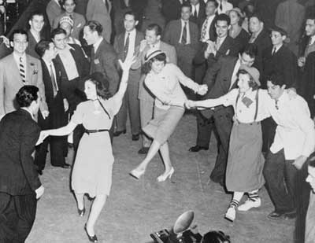
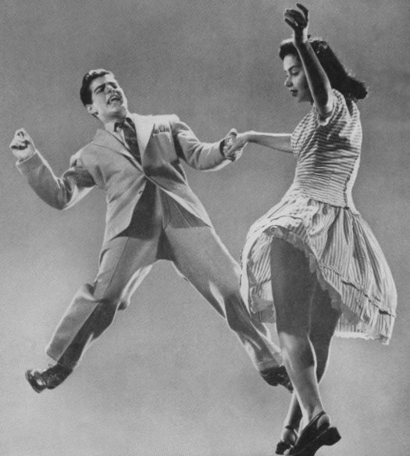
Popular New Thing: The Jitterbug
19
20

Slide 11
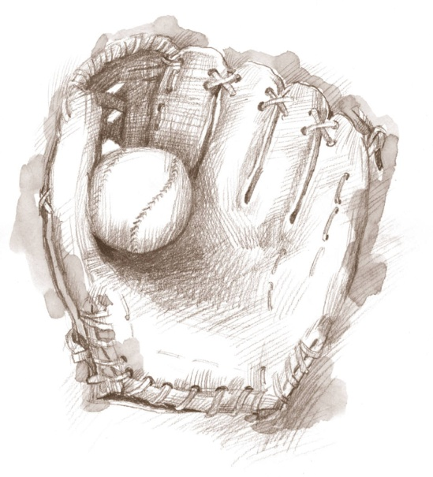
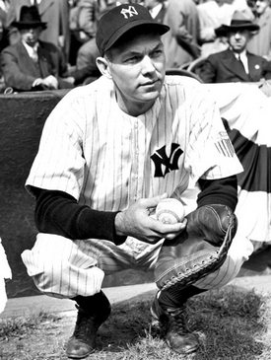
Bill Dickey
One of the top athletes: baseball
clipart
Their #1 Catcher
New York Yankees #8
By 1942: salary was around $20,000
21
22
clipart

Slide 12
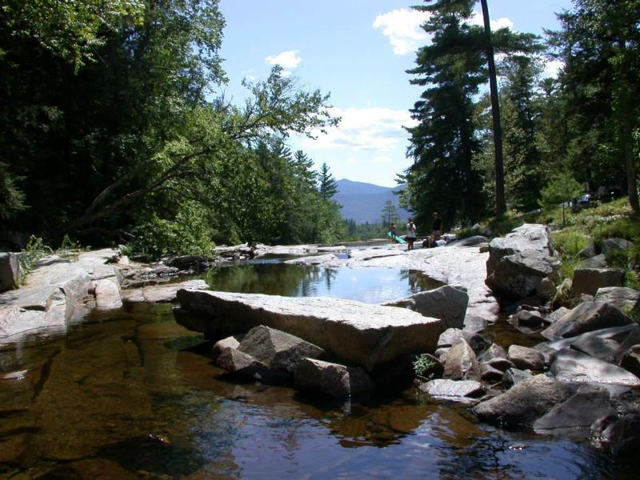
New Hampshire
Live Free or Die
23
24
25
Population as of 1942: approx 491,524
Nicknames: Granite State, White Mountain State, Switzerland of America, and Mother of Rivers
One of the original thirteen colonies
State Flower: Purple Lilac
A New England State
Animals: White-Tailed Deer, Muskrat, and Beaver
Trees: Elm, Maple, Pine, and Oak

Slide 13
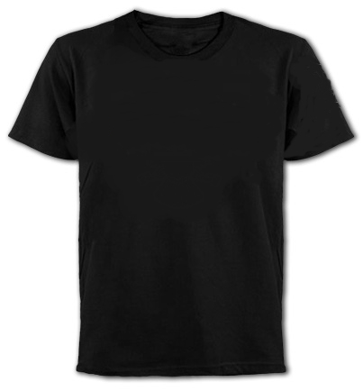
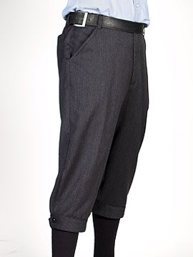
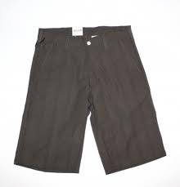
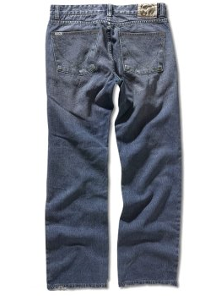
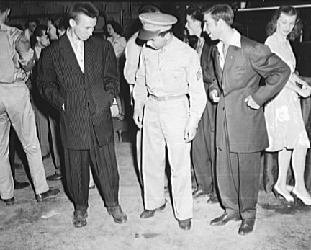
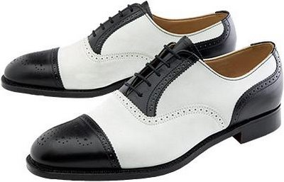
Ankle Socks
T-shirts
Knickers became less popular
32
33
34
Boy Fashion
Bermuda Shorts
Jeans
Zoot Suits
Spectators
28
31
31
28
30
30
29

Slide 14
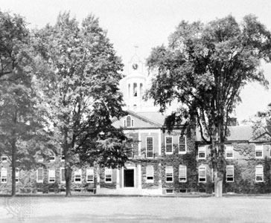
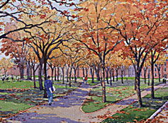
Preparatory Schools
Devon
A preparatory school or boarding school, preps or prepares students for entrance to a higher school such as college. It is usually private.
Devon was an all-boy school in New Hampshire.
First preparatory school was opened in 1822.
36
35

Slide 15
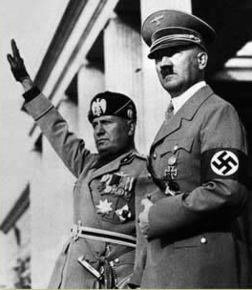
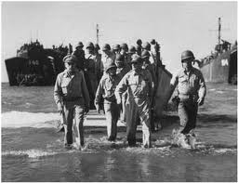
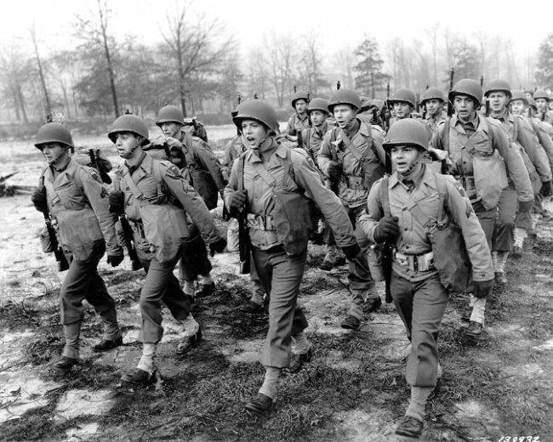
World War II
37
39
38
Sept. 1 1939-Sept. 2 1945
And some of its important battles
Started when Germany invaded Poland
Many world nations split into two opposing sides –
Allies: China, Russia, USA, and United Kingdom
Axis: Nazi Germany, Fascist Italy, and Imperial Japan
Around 72 million died
2/3 of the deaths- civilians

Slide 16
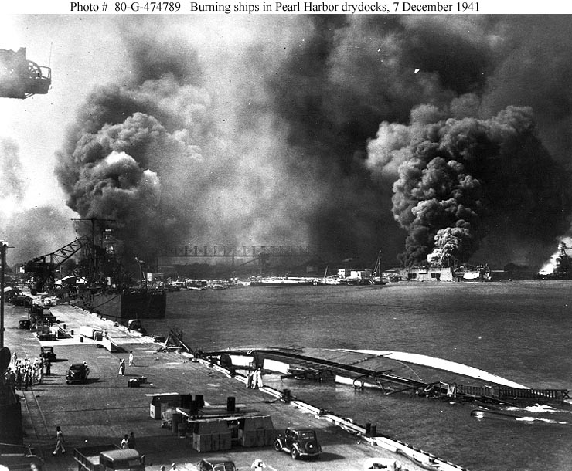
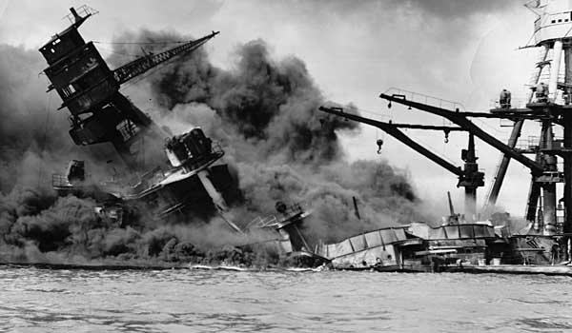
The Attack of Pearl Harbor
40
December 7, 1941
Navel base on O’ahu, HI
Brought U.S. into the war
Japan thought that battleships were a prime source for the U.S.
Was on a Sunday morning and many of the soldiers were asleep
Crashing of planes by Empire of Japan
41

Slide 17
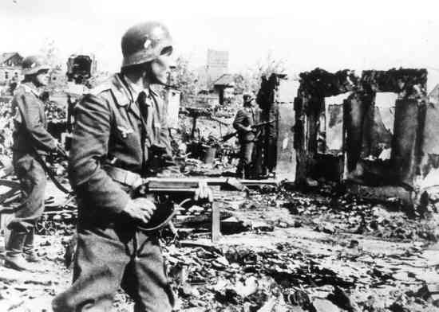
The Battle of Stalingrad
Nazi Germany Vs. The Soviet Union
Was a major battle of World War Two
August 21, 1942
Fought for control of Stalingrad, a city
Winning this was important to Hitler
Many say this was the “turning point” of the war in Europe
The Soviet Union won this battle
42

Slide 18
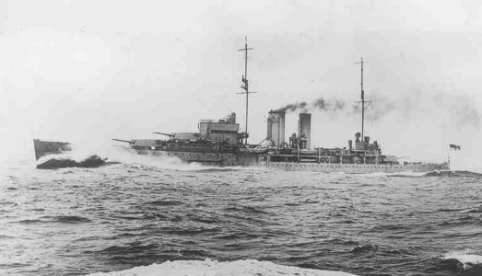
Battle of the Java Sea
A serious defeat for the Allied naval forces
February 27, 1942
43
An early naval engagement of the Pacific battles of World War II
Fought between the Allies and Japan
The Allie naval forces lost 5 ships
Next Day
Japan begin their invasion of Java

Slide 19
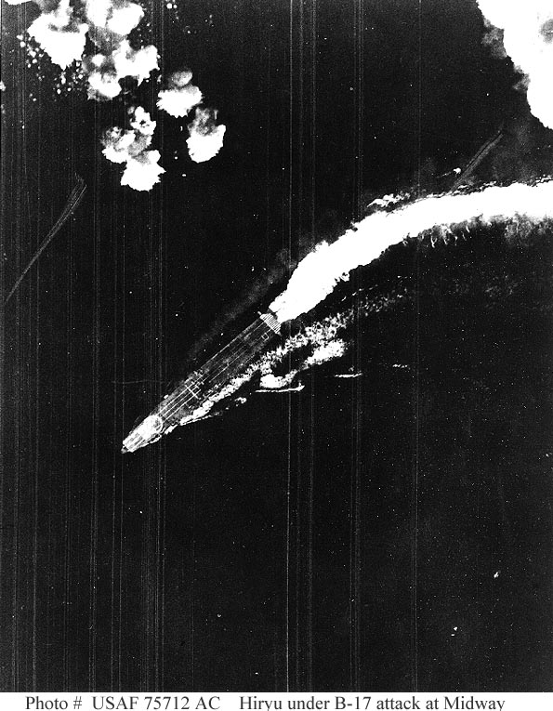
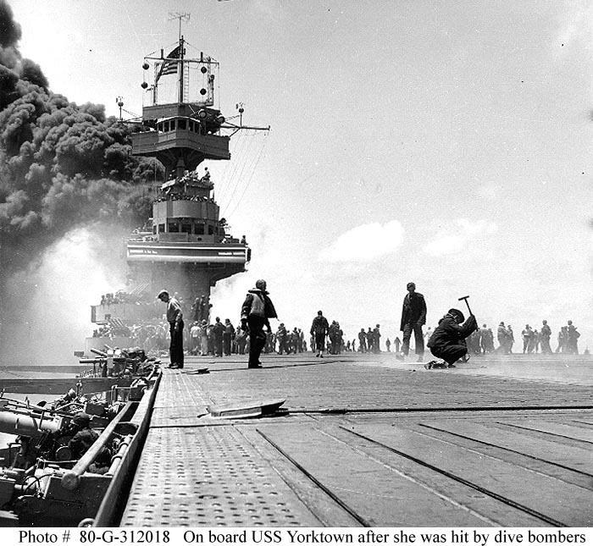
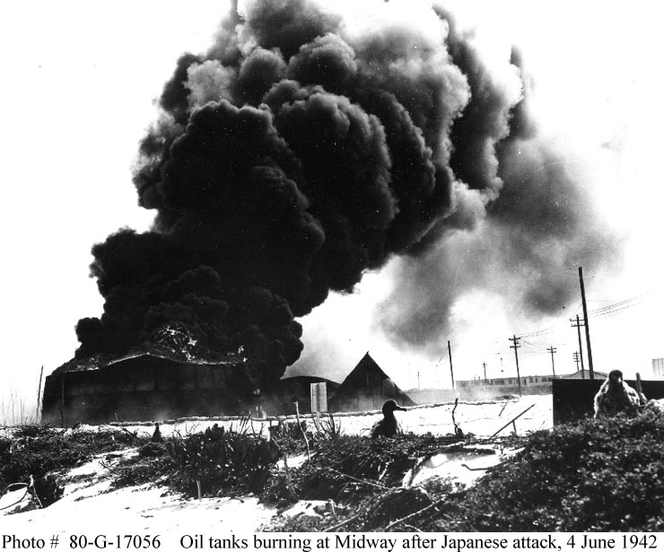
The Battle of Midway
June 4-7, 1942
Fought near the diminutive U.S. mid-Pacific base at Midway atoll
Japan vs. United States
A strategic battle in Japan’s Pacific Ocean war
Before this battle, Japan had general naval superiority over the U.S. But, after this battle Japan and the United States were basically equal.
This battle’s purpose was for the Japanese to destroy the U.S. Pacific Fleet’s aircraft carrier and striking forces.
44
44
44

Slide 20
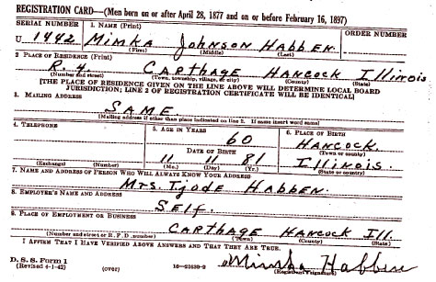
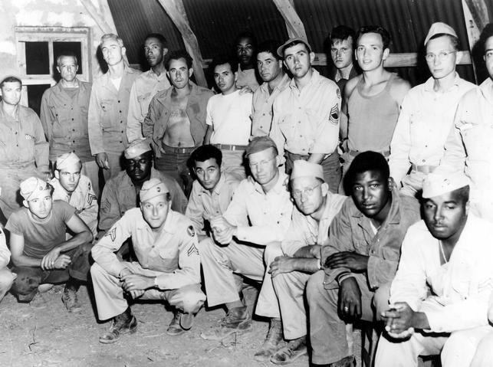
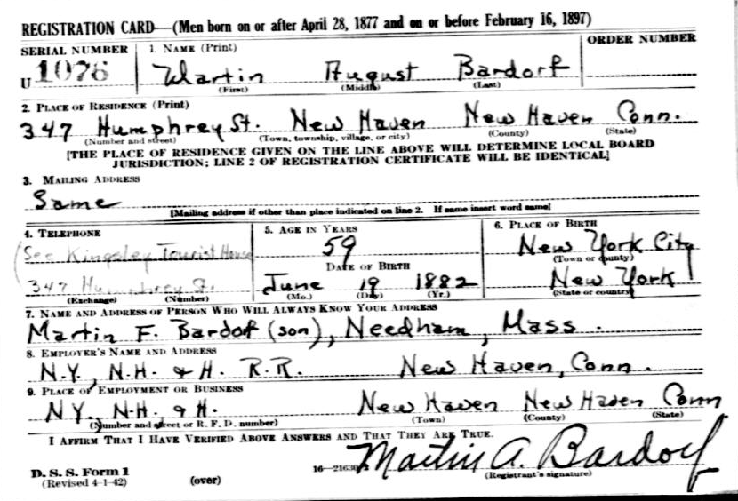
The Draft
10,110,104 men were drafted between November 1940 and October 1946
The men were chosen if they were born on or after 1927.
45
26
46

Slide 21
Picture Citations
Each citing corresponds to the number located on the picture
1
http://1.bp.blogspot.com/_ul8VgHojN7U/Sp6MmTHP3eI/AAAAAAAAYdQ/QiOEMgmQduo/s400/15.jpg
2
http://upload.wikimedia.org/wikipedia/commons/b/bb/BuyWarBonds.jpg
3
http://aj-images.com/magazine/?p=122
4
http://www.bigbandlibrary.com/bigbandnewsseptember2005.html
5
http://legendsrevealed.com/entertainment/2009/09/18/movie-legends-revealed-23/
6
http://electricka.com/etaf/muses/music/gone_but_not_forgotten/second_world_war_era/zoot_suit/zoot_suit.htm
7
http://www.harryjamesband.com/aboutharry.asp
8
http://www.glennmiller.com/index.php
9
http://flcenterlitarts.wordpress.com/page/2/
10
http://www.gradesaver.com/author/shirley-jackson/
11
http://www.flickr.com/photos/92447344@N00/2350061380
12
http://www.ibiblio.org/wm/paint/auth/pollock/
13
http://www.monroegallery.com/display.cfm?id=80
14
http://thecolorist.blogspot.com/2007/05/pollock-links-references.html
15
http://gracethespot.com/?p=293
16
http://waconner.vox.com/
17
http://ofwnow.com/special-report/dna-tests-reveals-adolf-hitlers-roots/6415
18
http://franklindrooseveltfacts.com/images/franklin_d_roosevelt_1632775744.JPG
19
http://www.vindicatrixboy.com/?cat=6
20
http://vintagelifenetwork.ning.com/profile/RicRogers?xg_source=activity
21
http://www.baseballinwartime.com/player_biographies/dickey_bill.htm
22
http://www.baseball-almanac.com/players/player.php?p=dickebi01
23
http://www.rentacomputer.com/rentals/States/New_Hampshire.asp
24
http://www.oilforimmigration.org/facts/?m=20090913

Slide 22
25
http://www.statesymbolsusa.org/New_Hampshire/flowerPurpleLilac.html
26
http://bardorfs.com/research-resources/
27
http://www.europe.org.uk/europlus/germany.html
28
http://fleck.com/beta3.php?hs=ab98e84df92eb8b3bf3fa3cc63c589858b62d1ec
29
https://wikis.otis.edu/modernart/index.php/Popular_Culture
30
http://readingparty.tumblr.com/
31
http://www.treehugger.com/files/2007/09/buygreen-mens-jeans.php
32
http://www.sodahead.com
33
http://picsdigger.com/keyword/black%20plain%20t%20shirt/
34
http://bicyclendesire.blogspot.com/2008/06/riding-pants-or-knickers.html
35
http://www.mvvainc.com/index.php#/PROJECTS/8/22/
36
http://www.britannica.com/EBchecked/topic-art/584820/10495/The-Phillips-Exeter- Academy-Exeter-New-Hampshire
37
https://wikis.nyu.edu/ek6/modernamerica/index.php/AmericanPowerAmpCulturalHegemony/African-AmericanMusic
38
http://www.buzzvines.com/world-war-ii
39
http://www.acepilots.com/ww2/pictures.html
40
http://staff.imsa.edu/socsci/jvictory/help_07/exexmplary_10/tu_09_4/overcoming.html
41
http://www.britannica.com/blogs/2007/12/pearl-harbor-remembered/
42
http://war.by-airforce.com/articles/Stalingrad-1942-1943.html
43
http://www.far-eastern-heroes.org.uk/alf_king/html/hms_exeter.htm
44
http://www.history.navy.mil/photos/events/wwii-pac/midway/midway.htm
45
http://www.rootdig.com/draft/worldwartwo.html
46
http://www.trumanlibrary.org/whistlestop/study_collections/desegregation/large/index.php?action=docs

Slide 23
Works Cited
A Brief History of WWII. 2003. 12 September 2010 <http://www.worldwariihistory.info/WWII/United-States.html>.
Adolf Hitler Quotes. 2010. 13 September 2010 <http://www.brainyquote.com/quotes/authors/a/adolf_hitler.html>.
Battle of Midway, 4-7 June 1942. 14 September 2010 <http://www.history.navy.mil/photos/events/wwii- pac/midway/midway.htm>.
Battle of Stalingrad. 2010. 13 September 2010 <http://www.absoluteastronomy.com/topics/Battle_of_Stalingrad>.
Bill Dickey Stats. 2010. 13 September 2010 <http://www.baseball- almanac.com/players/player.php?p=dickebi01>.
Boy's Clothing in the 1940's. 26 January 2001. 13 September 2010 <http://histclo.com/chron/c1940.html>.
CENSUS OF POPULATION AND HOUSING. 2010. 13 September 2010 <http://www.census.gov/prod/www/abs/decennial/1940.html>.
Facts About the Battle of Java Sea. 13 September 2010 <http://www.britannica.com/facts/5/250491/Battle-of- the-Java- Sea-as-discussed-in-Java-Sea-sea-Pacific-Ocean>.
Franklin D. Roosevelt. 2010. 2010 September 2010 <http://www.whitehouse.gov/about/presidents/franklindroosevelt>.

Slide 24
Popular Songs 1942. 2007. 12 September 2010 <http://www.popularsong.org/1942.html>.
Preparatory School. 2010. 13 September 2010 <http://www.merriam- webster.com/dictionary/preparatory+school>.
Reade, Candis. Facts on Pearl Harbor. 14 October 2008. 13 September 2010 <http://ezinearticles.com/?Facts- on-Pearl- Harbor&id=1582085>.
Smith, S.E. What are War Bonds. Ed. Bronwyn Harris. 3 AUgust 2010. Conjecture Corporation. 12 September 2010 <http://www.wisegeek.com/what-are-war-bonds.htm>.
Soylent Communications. Draft Deferment. 2010. 14 September 2010 < http://www.nndb.com/event/807/000140387/>.
State Facts. 2010. 13 September 2010 <http://www.visitnh.gov/welcome-to-nh/state-facts.aspx>.
The Great Idea Finder. Duct Tape. 2007. 12 September 2010 <http://www.ideafinder.com/history/inventions/ducttape.htm>.
The Offical Site of Glenn Miller. 10 November 2004. 12 September 2010 <http://www.glennmiller.com/index.php>.
The United States 1940's. 2005. 12 September 2010 <http://www.tqnyc.org/2005/NYC051918//index.htm>.
We Can Do It! 12 September 2010 <http://www.allposters.com/-sp/We-Can-Do-It-Rosie-the-Riveter- Posters_i1099871_.htm>.

