Slide 1
A Separate Peace 1942 Time Capsule Project
Hannah Paluch
9/14/10
4W

Slide 2
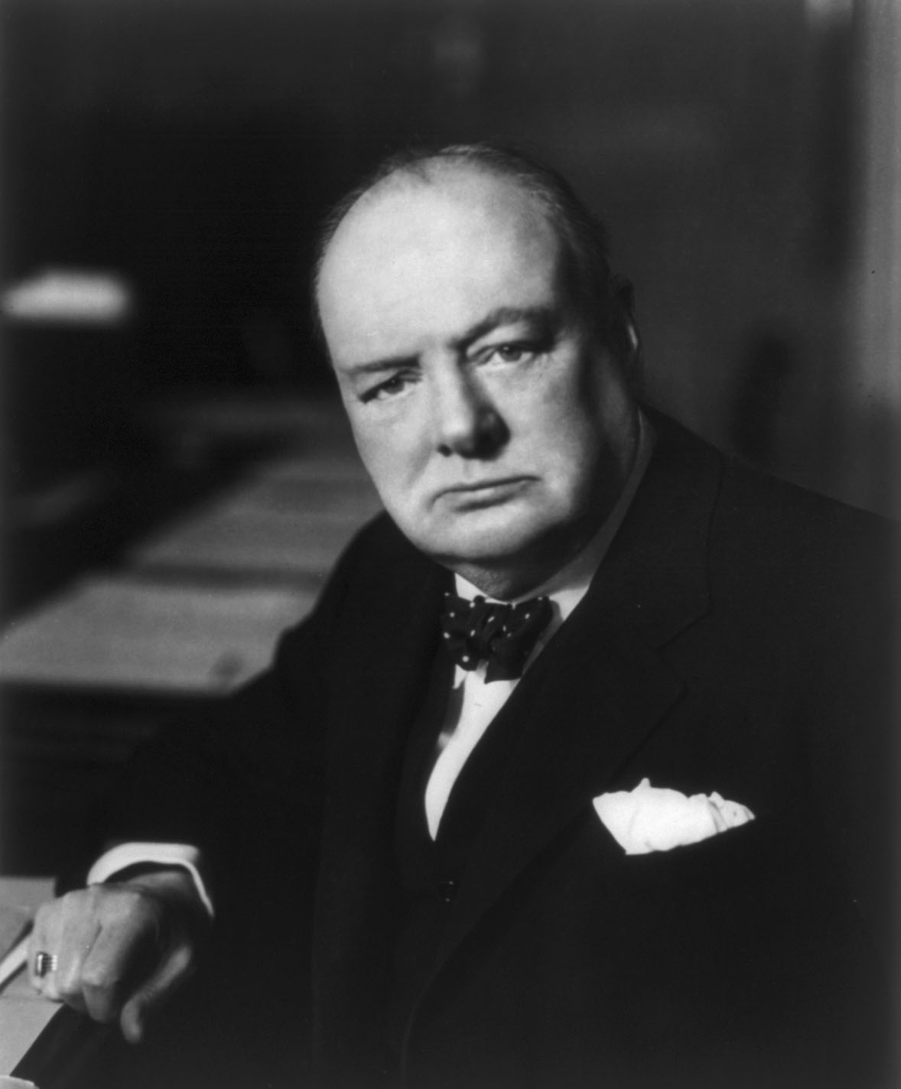
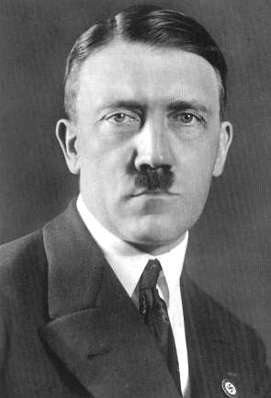
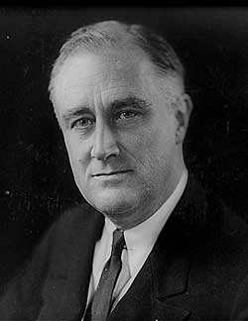
Political Leaders
Winston Churchill
British Prime Minister
Adolf Hitler
Chancellor of Germany
Franklin D. Roosevelt
32nd President Of United States

Slide 3
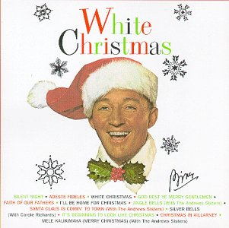
Top Songs
#1: White Christmas
Bing Crosby
#2: Paper Doll
The Mills Brothers
#3: Salt Peanuts
Dizzy Gillespie
#4: Kalamazoo
Glenn Miller
#5: A String of Pearls
Glenn Miller

Slide 4
Popular Books
#1: The Stranger
Albert Camus & Matthew Ward
#2: The Screwtape Letters
C.S. Lewis
#3: Mythology
Edith Hamilton
#4: The Boxcar Children
Gertrude Chandler Warner & L. Kate Deal
#5: Old Yeller
Fred Gibson

Slide 5
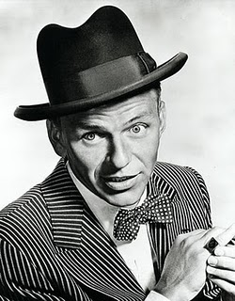
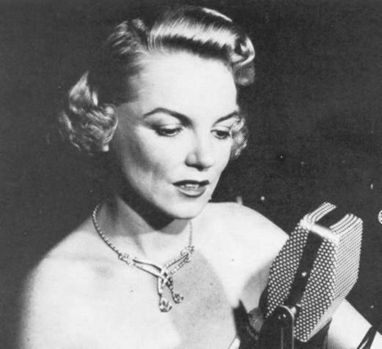
Popular Singers
Frank Sinatra Bing Crosby Louis Armstrong The Andrews Sisters Dick Haymes Helen Ward Ray Eberle Helen Forrest The Ink Spots Lee Wiley Ivie Anderson Bob Eberly Helen O'Connell Art Lund Frankie Lane
Frank Sinatra
Helen O’Connell

Slide 6
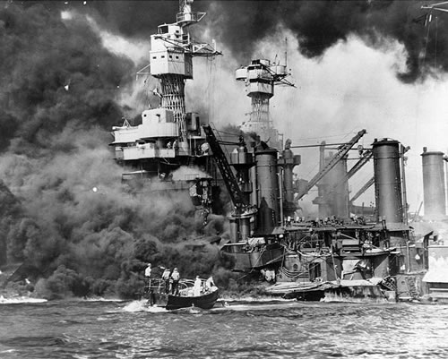
Major Battles in World War II
Iwo jima
Pearl harbor
February 19 – March 16, 1945
also called Operation Detachment
US fought to capture island of Iwo Jima from Japan
Almost 7,000 US soldiers died and about 20,000 were injured
US won the battle
December 7, 1941
also called Hawaii Operation or Operation Z
US ship in Hawaii was attack by Japanese
About 2,500 people died and 1,500 were wounded

Slide 7
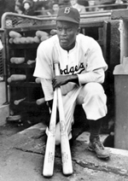
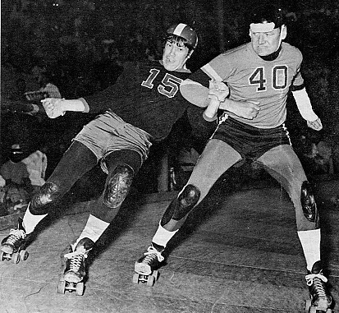
Sports
1947- Jackie Robinson became
first black man to play Major
League Baseball
1935- Roller Derby
was invented by Leo
Seltzer as “another way
of making a living”

Slide 8
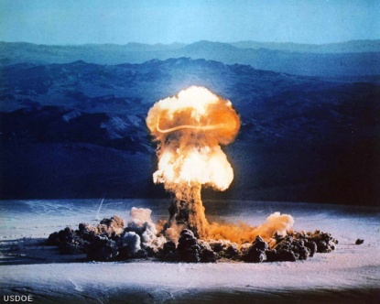
Major Disasters
1942- ammonium nitrate explosion in Cleveland, Ohio , 20 people killed
1944- liquefied natural explosion in Tesserendo, Belgium, 36 people killed, 4,300 cubic meters of confined gas exploded in a huge fireball, sweeping streets with burning gas
1943- Butadiene explosion, 79 homes and 2 factories destroyed, 57 people killed
1947- ammonium nitrate cargo ship exploded 532 killed, 300 wounded, 200 missing, city damaged severely
1948- dim ethyl ether explosion, Ludwig, Germany 245 killed, 3,800 wounded, damage within an 8 km. radius

Slide 9
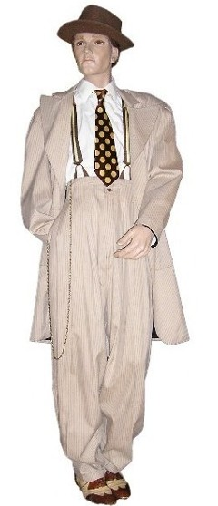
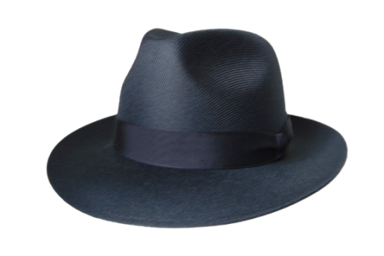
Clothing
Typical, Everyday Suits
In the early 40’s men wore them with no vest or ties
After the war, the suits became more eloquent and elaborate with long tails and silk ties
Most teenage boys wore collard shirts and khaki pants
Wide brimmed hats were popular

Slide 10
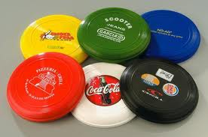
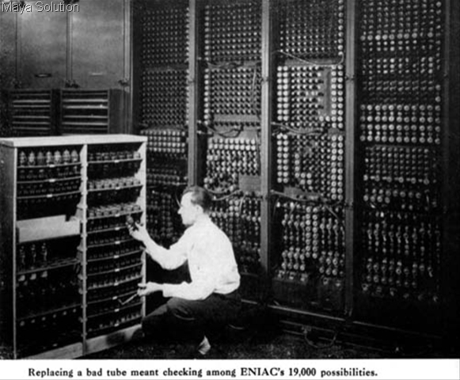
Inventions
Duck Tape
Frisbee
Manhattan Project Started
Instant Coffee Introduced
First Computer
First computer

Slide 11
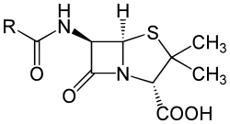
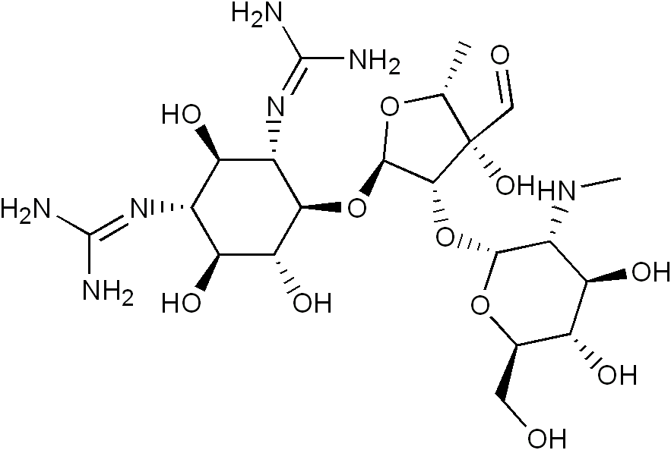
Medical Discoveries
Penicillin
Known as “wonder
drug”
Still used in many
medicines today
Streptomycin
discovered by
Selman Waksman

Slide 12
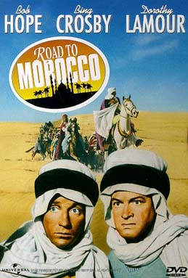
Popular Movies
Road to Morocco,
starring Bob Hope, Bing Crosby, and Dorothy Lamour
Casablanca
Bambi
Mrs. Miniver
Yankee Doodle Dandy
Holiday Inn

Slide 13
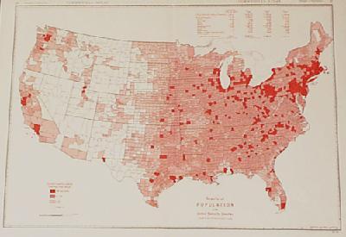
Population
United States Population
134,859,553
World Population
between 2 and 3 billion

Slide 14
Cost of Living
Average Cost of new house $3,770.00
Average wages per year $1,880.00
Cost of a gallon of Gas 15 cents
Average Cost for house rent $35.00 per month
Bottle Coca Cola 5 cents
Average Price for a new car $920.00

Slide 15
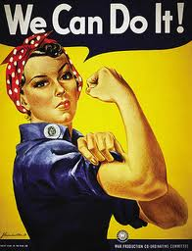
Propaganda
Every male was encouraged to serve his country in WWII. The poster to the left was a typical sign hanging in public places. While the men were at war, women had to take their jobs. The poster above was a very popular indicator which hung in places where women spent most of their time.

Slide 16
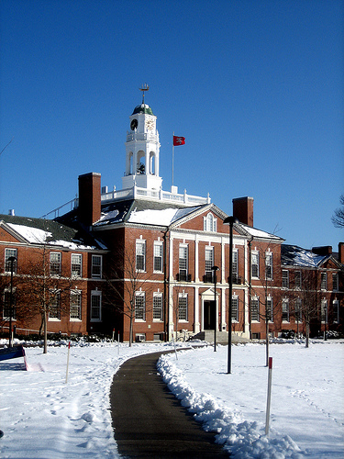
Education, Prep. Schools
Usually more expensive then standard
public and private school
Ages 14-18
Requires higher knowledge

Slide 17
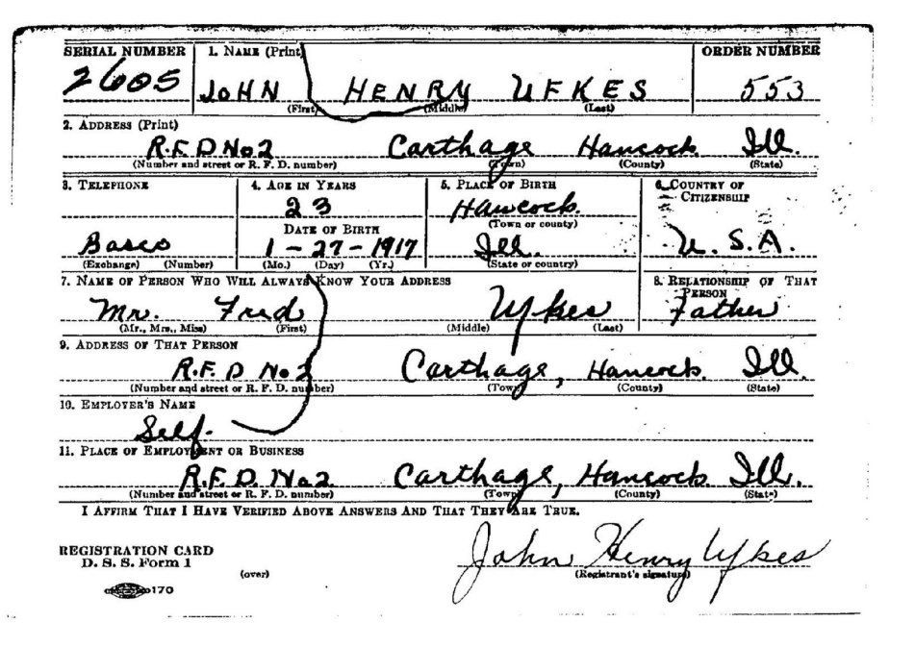
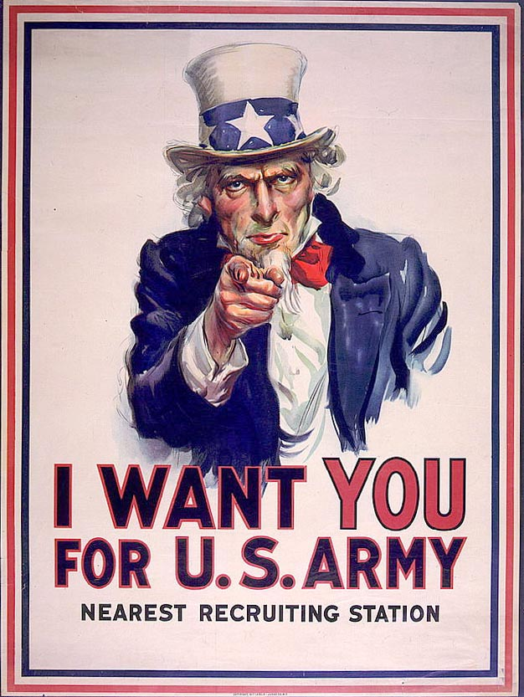
The Draft
All young men wanted to join the military. Some would even lie about their age to get in sooner.

Slide 18
Citations
Slide #1
http://photo.goodreads.com/books/1165517852l/5148.jpg
Slide #2
http://www.internationalposter.com/poster-details.aspx?id=USL15195
http://www.criticalflare.com/wp-content/uploads/2010/06/We_Can_Do_It.jpg
http://artofmanliness.com/2008/10/30/mens-fashion-well-dressed/
http://adolfhitlerinterestingfacts.com/images/adolf_hitler.jpg
“Winston Churchill.” Wikipedia. 2010. Wikimedia Foundation, Inc.. 15 September 2010 <http://en.wikipedia.org/wiki/Winston_Churchill>.
“Franklin D. Roosevelt.” Wikipedia. 2010. Wikimedia Foundation, Inc.. 15 September 2010 <http://en.wikipedia.org/wiki/Franklin_D._Roosevelt>.
“Adolf Hitler.” Wikipedia. 2010. Wikimedia Foundation, Inc.. 14 September 2010 <http://en.wikipedia.org/wiki/Adolf_Hitler>.
Slide #3
"Top Songs of 1942." Music Imprint - Interactive Album and Song Charts. Web. 16 Sept. 2010. <http://www.musicimprint.com/Chart.aspx?id=C000110>.
http://blog.beliefnet.com/gospelsoundcheck/Bing_Crosby_Christmas.jpg
Slide #4
http://bookcoverarchive.com/images/books/The_Stranger.large.jpg
"Most Popular Books Published in 1942." Share Book Recommendations With Your Friends, Join Book Clubs, Answer Trivia. Web. 16 Sept. 2010. <http://www.goodreads.com/book/popular_by_date?year=1942>.

Slide 19
Slide #5
http://martini-recipe.blogspot.com/2010/06/martini-recipes-frank-sinatra-martini.html
http://www.rosemaryclooney.com/4girls4/page4.htm
"WikiAnswers - Who Were Some 1940 Singers." WikiAnswers - The Q&A Wiki. Web. 16 Sept. 2010. <http://wiki.answers.com/Q/Who_were_some_1940_singers>.
Slide #6
“Battle of Iwo Jima.” Wikipedia. 2010. Wikimedia Foundation Inc,, 15 September 2010. <http://en.wikipedia.org/wiki/Battle_of_Iwo_Jima#Raising_the_flag>.
Rosenberg, Jennifer. "World War II Battles." 20th Century History. Web. 16 Sept. 2010. <http://history1900s.about.com/od/worldwarii/a/wwiibattles.htm>.
By. "Attack on Pearl Harbor." Wikipedia, the Free Encyclopedia. Web. 15 Sept. 2010. <http://en.wikipedia.org/wiki/Attack_on_Pearl_Harbor>.
http://maryt.files.wordpress.com/2007/12/pearl-harbor-uss-virginia.jpg
Slide #7
"The 1940's." Kyrene School District - Redirect. Web. 15 Sept. 2010. <http://www.kyrene.org/schools/brisas/sunda/decade/1940.htm>.
http://www.kyrene.org/schools/brisas/sunda/decade/1940.htm
http://www.rollerderbyfoundation.org/sitebuildercontent/sitebuilderpictures/GammonOConnell.jpg
Slide #8
"The 1940's." Kyrene School District - Redirect. Web. 16 Sept. 2010. <http://www.kyrene.org/schools/brisas/sunda/decade/1940.htm>.
http://www.inewscatcher.com/timages/72cef30d0c7a4f72598492ea93499e0e.jpg
Slide #9
"Mens Fashion in the 1940's - LoveToKnow Men's Fashion." Men's Fashion | Male Clothing | Big and Tall. Web. 16 Sept. 2010. <http://mens-fashion.lovetoknow.com/Mens_Fashion_in_the_1940's>.
http://www.hatcentre.co.uk/images/WebDralonWideBlack.png

Slide 20
http://arniesvintagecostumers.com/1930s1940smens/1930s1940sm09.jpg
Slide #10
"Industrial Revolution Inventions Timeline – 1712-1942 | American Pride & United States History for American Youth." America & Patriotism – American Patriotic Stories, Videos, Images & Icons | American Pride & United States History for American Youth. Web. 15 Sept. 2010. <http://storiesofusa.com/industrial-revolution-inventions-timeline-1712-1942/>.
http://www.golfequipment365.com/uploaded_images/frisbee-golf-equipment-705704.jpg
http://www.yorkblog.com/flipside/computer.jpg
Slide #11
http://en.wikipedia.org/wiki/Penicillin
"Timeline." Duke University Libraries - Home. Web. 16 Sept. 2010. <http://library.duke.edu/digitalcollections/mma/timeline.html>.
http://en.academic.ru/pictures/enwiki/83/Streptomycin_structure.png
Slide #12
"1942 including Popular Culture, Prices, Events, Technology and Inventions." Where People, History and Memories Join Together from The People History Site. Web. 16 Sept. 2010. <http://www.thepeoplehistory.com/1942.html>.
http://api.ning.com/files/UoeFoayJL1N561OYaWsoy3E*KAOtwoDfz8HPPGYAQR4zK*sSE-mqiYu4D3DM6LlvJMqcseJgpyPHFSt6i4Vs-yG1MFGW8FHD/BobHopeRoadtoMorocco.jpeg
Slide #13
"World Population Milestones — Infoplease.com." Infoplease: Encyclopedia, Almanac, Atlas, Biographies, Dictionary, Thesaurus. Free Online Reference, Research & Homework Help. — Infoplease.com. Web. 16 Sept. 2010. <http://www.infoplease.com/ipa/A0883352.html>.
"Information Please: 1942." Infoplease: Encyclopedia, Almanac, Atlas, Biographies, Dictionary, Thesaurus. Free Online Reference, Research & Homework Help. — Infoplease.com. Web. 16 Sept. 2010. <http://www.infoplease.com/year/1942.html#axzz0zfAO96GT>.
http://www.printsoldandrare.com/usa/013us.jpg

Slide 21
Slide #14
"1942 including Popular Culture, Prices, Events, Technology and Inventions." Where People, History and Memories Join Together from The People History Site. Web. 16 Sept. 2010. <http://www.thepeoplehistory.com/1942.html>.
Slide #15
http://www.youthedesigner.com/wp-content/uploads/2008/05/wwii-propaganda-postersusa1a.jpg
http://www.internationalposter.com/pimages/USL15195.jpg
Slide #16
http://blog.steffanantonas.com/wp-content/uploads/2009/05/exeter.jpg
http://upload.wikimedia.org/wikipedia/en/d/d7/Phillips_Exeter_Academy_Seal.png
Slide #17
http://www.rootdig.com/uploaded_images/draft_registration_john_ufkes_born_1917-781009.JPG
http://www.sonofthesouth.net/uncle-sam/images/uncle-sam.jpg

