Slide 1
A Taste of the Past
A LOOK BACK AT WORLD WAR II AND IT’S CULTURAL CHARACTERISTICS
BY
EMILY VISE

Slide 2
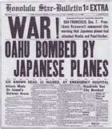
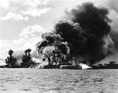
THE SOUTH PACIFIC BATTLES
JAPAN vs. AMERICA

Slide 3
PEARL HARBOR
December 7th, 1941, Japan attacks Pearl Harbor, Hawaii, in a surprise assault.
The planes come in two fleets, one at 8:00 a.m., the second about an hour later.
Over 1,000 people left dead, almost 200 American planes damaged.

Slide 4
THE BATTLE OF THE CORAL SEA
After the battle of Pearl Harbor, () the battles in the South Pacific were mostly fought by the American troops and the Japanese Empire.
The Battle of the Coral Sea, (early May, 1942) was a turning point in which the Japanese’ advance southward was stopped. General Chester Nimitz attempted to stop Japan’s attempt to cut off Australia, but the USS Lexington was sunk, and the USS Yorktown harmed.
But Japan retreats after a hard loss.

Slide 5
THE BATTLE OF MIDWAY
Japan was attempting to finish off the naval forces left over, but didn’t count on observation Air Force planes to be watching at a distance.
June, 1942, American forces assault and attach Japanese forces in their attempt to destroy American naval fleets on Midway Islands.
Four Japanese carriers were sunk and Japan lost hope in invading Hawaii.
The US now had the upper hand.

Slide 6
THE BATTLE OF GUADALCANAL
January, 1942, Japan takes hold of the Solomon Islands, located near Australia.
August 7, 1942, major fighting breaks out and the US marines launch their first attacks.
They fought in the jungles of Guadalcanal, the largest island, until February of 1943.
The US took control of the Solomon Islands in a victory.

Slide 7
BATTLE OF SAIPAN
An Island in the Northern Mariana Islands in the South Pacific.
Towards the beginning of 1944, American forces were really annihilating Japanese forces.
Then in June of the same year, America brought in marines and armed troops who conducted a two week series of battles*
Notes:
This is sometimes referred to as a campaigne

Slide 8
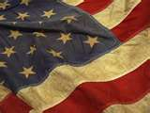
THE DRAFT
THE CALL OF THE WILD

Slide 9
DO YOUR PART
Schools would begin training boys around the age of 16 on until they were called to duty.
All men and teenage boys were required to enlist.

Slide 10
POLITICAL LEADERS
A TIME TO UNITE

Slide 11
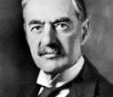
Neville Chamberlain
September, 1939 , Chamberlain was Britain’s Prime Minister, after appeasement was unsuccessful and Europe took its place in the war. He resigned after England’s defeat in Norway in mid 1940. Winston Churchill, one of the most recognizable of the Prime Ministers, took over.

Slide 12
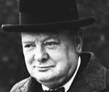
Winston Churchill
Churchill was Prime Minister for the bulk of WWII and used a method of high spirits as his approach to the War.

Slide 13
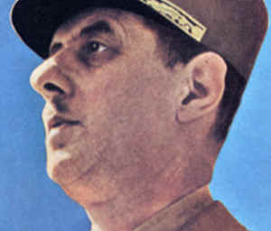
Charles de Gaulle
He was a military man, but became the leader of the Free French Movement in Britain. The French people say he was their real leader of this era.

Slide 14
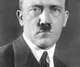
Adolf Hitler
Germany’s main leader during this era, he knew that Germany and the Nazis were close to defeat, and Berlin was soon to fall to Russia. He committed suicide on April 30, 1945, ten days before his 56th birthday, in avoidance of being put on trial in Russia.

Slide 15
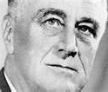
Franklin Delano Roosevelt “F D R”
When wall street crashed and the New Deal was struck, FDR was president. He was elected four times, this was before the law was passed that allowed only two terms per president. His crippling disease and courage to lead during such a trying time have struck America and stayed with us for decades after his time.

Slide 16
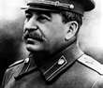
Joseph Stalin
Russia turned to Stalin during this trying time, who lead until his death in 1953.

Slide 17
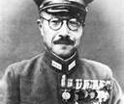
Hideki Tojo
Was Prime Minister of Japan during the attack on Pearl Harbor and the Hiroshima bombing. Tojo was executed on charges of being a war criminal, as he purposely put Japan into the war.

Slide 18
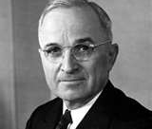
Harry Trumna
Lead America after FDR’s death in 1945. He gave order for Hiroshima and Nagasaki to be bombed. He was also present at Potsdam, the last big war meeting.

Slide 19
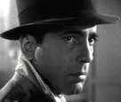
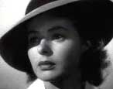
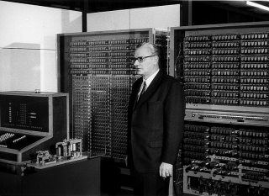
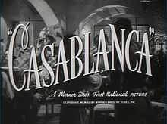
Pop culture and science
WHAT THE GRANDPARENTS ARE ALWAYS BABBLING ABOUT

Slide 20
MUSIC
Vern Partlow “Atomic Talking Blues”
Millard Lampell “Ballad of October 16th” “Billy Boy”
Agnes ‘Sis’ Cunningham “Belt Line Girl”
Woody Guthrie “Tom Joad” “Dust Bowl Blues”
Pete Seeger “Dear Mr. President”
Almanac Singers “Jim Crow”
Lee Hays “Plow Under”

Slide 21
The Almanac Singers
PETE SEEGER, vocal/banjo; LEE HAYS, vocal; MILLARD LAMPELL, vocal; JOSH WHITE, vocal/guitar; SAM GARY, vocal
Each member had a solo career, and some collaborated for a few duets, but they were all one band.

Slide 22
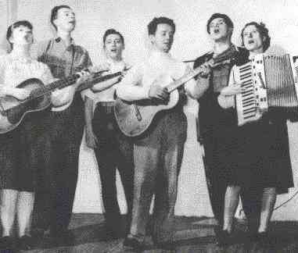
The Almanac Singers
THE ALMANAC SINGERS, 1942: BESS HAWES, PETE SEEGER, MILLARD LAMPELL, WOODY GUTHRIE, ARTHUR STERN, SIS CUNNINGHAM (from left to right)

Slide 23
Movies
Casablanca
Saboteur
Confessions of A Nazi Spy
Sherlock Holmes and

Slide 24
Casablanca
Made in 1942, directed by Michael Curtiz
Starring Humphrey Bogart, Ingrid Bergman and Paul Henreid, and featuring Claude Rains, Conrad Veidt, Sydney Greenstreet, and Peter Lorre.
About a man who has to decide between helping a married couple and staying with the wife of that couple, whom he loves.

Slide 25
Inventions and Medical Science
Penicillin was first mass-produced first during the war, so it would be available to treat disease.
It was used in WWII to treat venereal diseases, which were always huge problem for armies.
Penicillin was the starting block for other antibiotics we have today that treat simple diseases so they don’t become serious.
Meds that treat ‘tropical’ diseases (malaria) were so crucial, that way soldiers could fight in the Pacific and other warm areas without much trouble.
Blood transfusions and meds that aid with flying at high altitudes for long periods of time came with this mass production.

Slide 26
Z3
Invented in 1941 by German engineer Konrad Zuse
The ‘Z’ was used so that the computer wouldn’t be confused with the ‘V1’ ‘V2’ and ‘V3’ models, who get their ‘V’ from Versuchmodell, which were his experiment models.

Slide 27
Authors, Singers, and Actors
John Steinbeck, The Grapes of Wrath, 1940
W. Somerten Maugham, The Razor’s Edge, 1944
Betty Smith, A Tree Grows in Brooklyn, 1943

Slide 28
The Grapes of Wrath
Written by John Steinbeck in 1938, who also authored another piece of classic literature, Of Mice and Men, about George and Lenny, two friends trying to realize their dream of one day owning their own home.
The Grapes of Wrath is about Tom Joad, released from prison in Oklahoma after being charged with murder. He finds his family farm deserted, and everyone has gone to pick fruit in California.

Slide 29
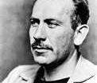
John Steinbeck
Steinbeck studied marine biology at Stanford University, but started his career as a journalist. His first novel, Cup of Gold (1949) was followed by his more popular second work, Tortilla Flat. He wrote mainly of Americans and their struggles and stories.

Slide 30
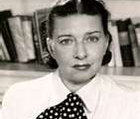
Betty Smith
1943, her novel A Tree Grows in Brooklyn is published.
Elizabeth, “Betty” admits that the novel is part autobiographical about her move to New York and her elopement and move to Ann Arbor.

Slide 31
Actors and Actresses
James Cagney
Gary Cooper
Joan Crawford
Bing Crosby
Bette Davis
Olivia De Havilland
Judy Garland
Katharine Hepburn
Bob Hope
Vivien Leigh
Fred MacMurray
Mickey Rooney
Barbara Stanwyck
Spencer Tracy
Loretta Young
Walter Huston

Slide 32
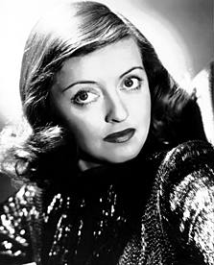
Bette Davis
Won awards for her work in Jezebel and Dangerous

Slide 33
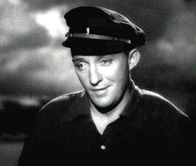
Bing Crosby
Known for his work in Man On Fire, White Christmas, Angels in the Outfield, and Best Actor in Going My Way. He was an actor and singer, and had his own TV show, The Bing Crosby Show.

Slide 34
Bob “Old Ski Nose” Hope
Road to Singapore, Road to Zanzibar, Road to Morracco, Road to Utopia, Road to Rio, Road to Bali, and Road to Hong Kong were his big comedic movies. He holds the world record for Most Honored Entertainer.

Slide 35
Fashion
During the World War II time period, everything and everyone revolved around the war effort.
Food and resources were rationed, and times were tough.
Luxuries like desert and nice shoes were not patriotic.
So fashion and material had to adapt to changing times.

Slide 36
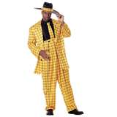
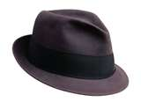
Men’s Fashion
France and Italy weren’t leaders anymore, because of the war. Rationing was important, so designers had the challenge of creating affordable, chic, and economically and patriotically practical. No one wanted to wear flashy things, they would be deemed as unpatriotic. Things like the Zoot Suit, Fedoras, Sweaters and ties, and sportswear were invented and popularized. Interesting fact: President FDR even wore a fedora. Gangsters, businessmen, normal men, they all wore the fedora.

Slide 37
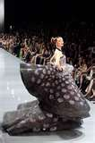
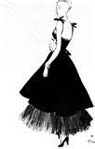
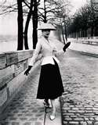
Women’s Fashion
Swing skirts, hats, platform pumps, menswear, sweaters, and glamour were in. The New Look was a more glamorous fashion, long skirts and gowns, curves, and feminine draping and silhouettes were praised by some, and opposed by others more used to showing skin. French Couture Designer Christian Dior mostly founded this new glamorous look in 1947

Slide 38
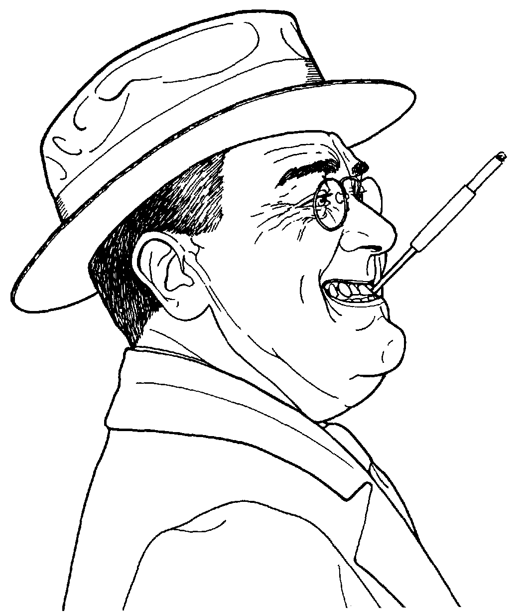
Propaganda, war posters, and funnies
IT’S NOT LYING. IT’S A PERSUASION TECHNIQUE.

Slide 39
WAR POSTERS AND SUCH
Posters were put up around America asking people to volunteer, join the service, donate, or just be aware of issues.
Some propaganda was used to persuade people to agree with Hitler and support Nazis.

Slide 40
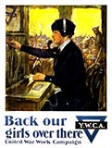
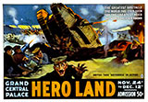
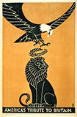
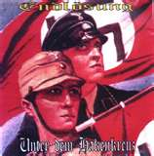
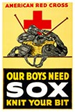
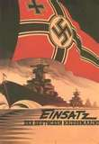
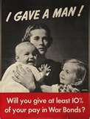
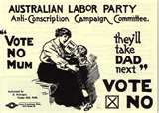
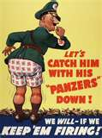

Slide 41
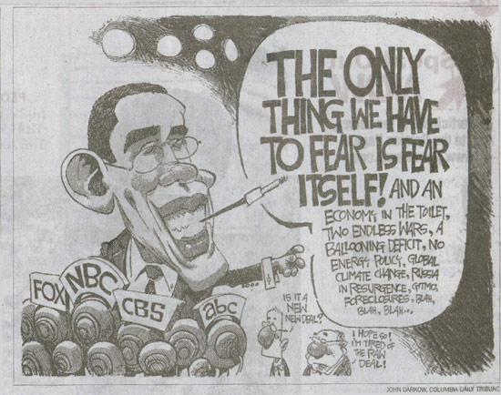
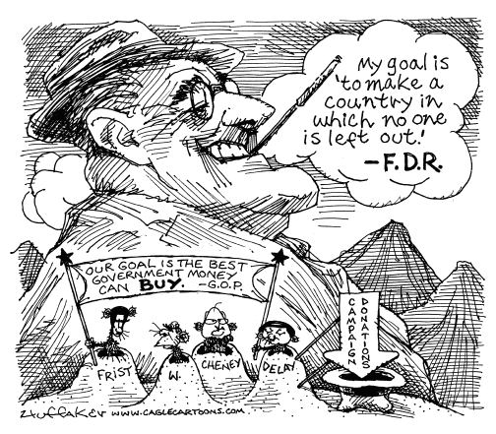

Slide 42
CITATIONS
MY ATTEMPT AT AVOIDING A LAW SUIT OVER COPYRIGHTS

Slide 43
CITATIONS
http://www.bing.com/images/search?q=American+flag&qpvt=American+flag&FORM=Z7FD#focal=fb7968a6db8365395b689189ddabf2b2&furl=http%3A%2F%2Fat-is.com%2FOld%2520American%2520Flag(1).jpg
http://www.bing.com/images/search?q=Pearl+Harbor&form=QBIR&qs=n&sk=&sc=8-12#focal=0beeb29d37f92f90d6ebb3332f623e20&furl=http%3A%2F%2Fpubsecrets.files.wordpress.com%2F2009%2F12%2Fpearl-harbor2a_uss_arizona.jpg
http://www.bing.com/images/search?q=Pearl+Harbor&form=QBIR&qs=n&sk=&sc=8-12#focal=856b4afd8e0061a2ad67d54b614b8bba&furl=http%3A%2F%2Fwww.rivervet.com%2Fimages%2FPearlHarbor%2FPearlHarbor.jpg
http://www.bing.com/images/search?q=Winston+Churchill&form=QBIR&qs=n&sk=&sc=8-17#focal=be941eec75b2d17a65b2942e62423892&furl=http%3A%2F%2Fafteramerica.files.wordpress.com%2F2009%2F11%2Fwinston-churchill.jpg
http://www.bing.com/images/search?q=Adolf+Hitler&form=QBIR&qs=n&sk=&sc=8-11#focal=71d00fde28dbc01bba909344fd671279&furl=http%3A%2F%2Fwww.museumsyndicate.com%2Fimages%2Fartists%2F12.jpg
http://www.bing.com/images/search?q=Franklin+Delano+Roosevelt&FORM=SSIR#focal=3b259225c02041b4242c6781dcd70d90&furl=http%3A%2F%2Fwww.ihavenet.com%2Fimages%2FFranklin-D-Roosevelt.jpg
http://www.bing.com/images/search?q=Neville+Chamberlain&form=QBIR&qs=n&sk=&sc=8-19#focal=64c1cc4047ca2fbff1d069ba93f6d97b&furl=http%3A%2F%2Fwww.born-today.com%2Fbtpix%2Fchamberlain_neville.jpg

Slide 44
CONTINUED
11http://www.bing.com/images/search?q=Joseph+Stalin&form=QBIR&qs=n&sk=&sc=8-13#focal=b36af403dba3f6c7e6d80b2ae721827e&furl=http%3A%2F%2Ftimesonline.typepad.com%2Fphotos%2Funcategorized%2F2009%2F02%2F25%2Fjoseph_stalin.jpg
http://www.bing.com/images/search?q=Hideki+Tojo&form=QBIR&qs=n&sk=&sc=8-11#focal=dafe4f8b363697f9bfb4f63d5da6645d&furl=http%3A%2F%2Fwww.ghettodriveby.com%2Fimages%2Ftojo.jpg
11http://www.bing.com/images/search?q=Harry+Truman&form=QBIR&qs=n&sk=&sc=8-12#focal=c1cbaee9694586e00c18cba6b236cfb5&furl=http%3A%2F%2Fwww.kids-iq-tests.com%2Fpresidents%2FHarry-Truman.jpg
http://www.bing.com/images/search?q=The+Grapes+of+Wrath&qpvt=The+Grapes+of+Wrath&FORM=Z7FD2#focal=cbcaebb655409fc6efd7be31e681e2ce&furl=http%3A%2F%2Fdanliterature.files.wordpress.com%2F2009%2F10%2Fjohn-steinbeck-the-grapes-of-wrath.jpg
http://www.bing.com/images/search?q=FDR+cartoons&form=QBIL&qs=n&sk=&sc=1-12#focal=df91a664b0a57c5b3230802688d9456b&furl=http%3A%2F%2Fwww.sitnews.us%2FCartoonists%2F041805%2Fhuffaker.gif
http://www.benzilla.com/uploads/2008/11/fdr_2.jpg
http://www.bing.com/images/search?q=WWII+propaganda+posters&qpvt=WWII+propaganda+posters&FORM=Z7FD1#focal=b1491cd66e4300de0ebbc3f7bc8c6f10&furl=http%3A%2F%2Fwww.cornellcollege.edu%2Fhistory%2Fcourses%2Fstewart%2Fhis260-3-2006%2F04%2520four%2Fimages%2FWWII%2520Pictures%2FIGaveAMan.jpg
http://www.bing.com/images/search?q=WWII+propaganda+posters&qpvt=WWII+propaganda+posters&FORM=Z7FD1#focal=4a34b3949380705ad4dd7cfc136b50bc&furl=http%3A%2F%2Fupload.wikimedia.org%2Fwikipedia%2Fcommons%2F7%2F77%2FWw2_poster_oct0404.jpg

Slide 45
CONTINUED
http://www.bing.com/images/search?q=WWII+propaganda+posters&qpvt=WWII+propaganda+posters&FORM=Z7FD1#focal=76a6351c91cc77452447b4ba3f989ba0&furl=http%3A%2F%2Fwww.ww2shots.com%2Fgallery%2Fd%2F2966-2%2FWWII%2B-%2BPROPAGANDA%2BPOSTER%2B-%2BFlying%2Bflag-ww2shots.jpg
http://www.bing.com/images/search?q=WWII+propaganda+posters&qpvt=WWII+propaganda+posters&FORM=Z7FD1#focal=ae806176f8fb74707f3e039e0f683d83&furl=http%3A%2F%2Fwww.ww2shots.com%2Fgallery%2Fd%2F3000-2%2FWWII%2B-%2BPROPAGANDA%2BPOSTER%2B-%2BNazi%2BPoster%2B-%2BEndl_sung-Unter-dem-Hakenkreuz-ww2shots.jpg
http://www.world-war-pictures.com/american-war-posters.htm
http://www.bing.com/images/search?q=Betty+Smith&qpvt=Betty+Smith&FORM=Z7FD#focal=e9bd4a0f01dc2484dd1276447a3a4aa5&furl=http%3A%2F%2Fmuseum.unc.edu%2Fstatic%2Fartifacts%2F13-BettySmith.jpg
http://www.johnsteinbeck.com/bio.shtml
http://www.bing.com/images/search?q=john+steinbeck&qpvt=John+Steinbeck&FORM=Z7FD#focal=ff32f616bbda79c4b8ee6aa6dcaf278d&furl=http%3A%2F%2Fblog.syracuse.com%2Fshelflife%2F2008%2F02%2Fsteinbeck.jpg
http://www.eyewitnesstohistory.com/pearl.htm
http://mens-fashiohttp://www.bing.com/images/search?q=Men%27s+Fahion%2C+1940%27s&form=QBIR&qs=n&sk=#focal=8d1474000c084ecad35b52ae89819d8a&furl=http%3A%2F%2Fi23.photobucket.com%2Falbums%2Fb367%2Fthunderw21%2Fme026.jpg

Slide 46
CONTINUED
http://ezinearticles.com/?Top-Ten-Fashion-Trends-From-the-1940s&id=1529787
http://www.bing.com/images/search?q=Christian+Dior%2c+1947&qpvt=Christian+Dior%2c+1947&FORM=Z7FD1#focal=434f85ee42bb614251752aef6c18a92b&furl=http%3A%2F%2Fwww.poshbot.com%2Fwp-content%2Ffashion-pics%2Fchristian_dior_haute_couture_2009_01.jpg
http://www.bing.com/images/search?q=Christian+Dior%2c+1947&qpvt=Christian+Dior%2c+1947&FORM=Z7FD1#focal=ef8bce167664f5a6b463ae9e67d74252&furl=http%3A%2F%2Fmyvintagevogue.com%2Fyahoo_site_admin%2Fassets%2Fimages%2FChristian_Dior_1947.209160958_large.jpg
http://www.bing.com/images/search?q=Christian+Dior%2c+1947&qpvt=Christian+Dior%2c+1947&FORM=Z7FD1#focal=4de0aa1d92a0686833a2f2a7b73ef134&furl=http%3A%2F%2Fwww.proa.org%2Fexhibiciones%2Fpasadas%2Fmoda%2Fsalas%2Fwilly_maywald_paris.jpg

Slide 47
CONTINUED
http://www.bing.com/images/search?q=1940's+fashion+for+men&qpvt=1940's+fashion+for+men&FORM=Z7FD#focal=7eee2676c324b067117dea9d80a482dd&furl=http%3A%2F%2Fpzrservices.typepad.com%2F.a%2F6a00d83451ccbc69e2011278dc5cbd28a4-400wi
http://www.bing.com/images/search?q=1940's+fashion+for+men&qpvt=1940's+fashion+for+men&FORM=Z7FD#focal=17ce8fac38444f5d58461f0b13f935ce&furl=http%3A%2F%2Flive.drjays.com%2Fwp-content%2Fuploads%2F2009%2F05%2F17247.jpg
http://www.computermuseum.li/Testpage/Z3-Computer-1939.htm
http://en.wikipedia.org/wiki/Casablanca_(film)
http://www.historylearningsite.co.uk/political_leaders_of_world_war_t.htm
http://www.worldwar2history.info/movies/
http://www.worldwar2history.info/movies/
http://www.everything.com/Major-WWII-Battles-in-the-South-Pacific/#axzz0zWkzgl9y

