Slide 1
Gene’s Electronic Time Capsule
Jasmine Wong
Block 4
White Day

Slide 2
The Drafting of US Soldiers
After the US entered World War II, all men between the ages of 18 and 65 were required to register to be drafted
Over 10 million men were registered between November 1940 and October 1946
A drafting card required the following information:
Name
Age
Birth date
Birthplace
Residence
Employer information
Name and address of someone who will always know where the registrant is
Physical description (race, height, weight, eye and hair colors, skin color, etc.)

Slide 3
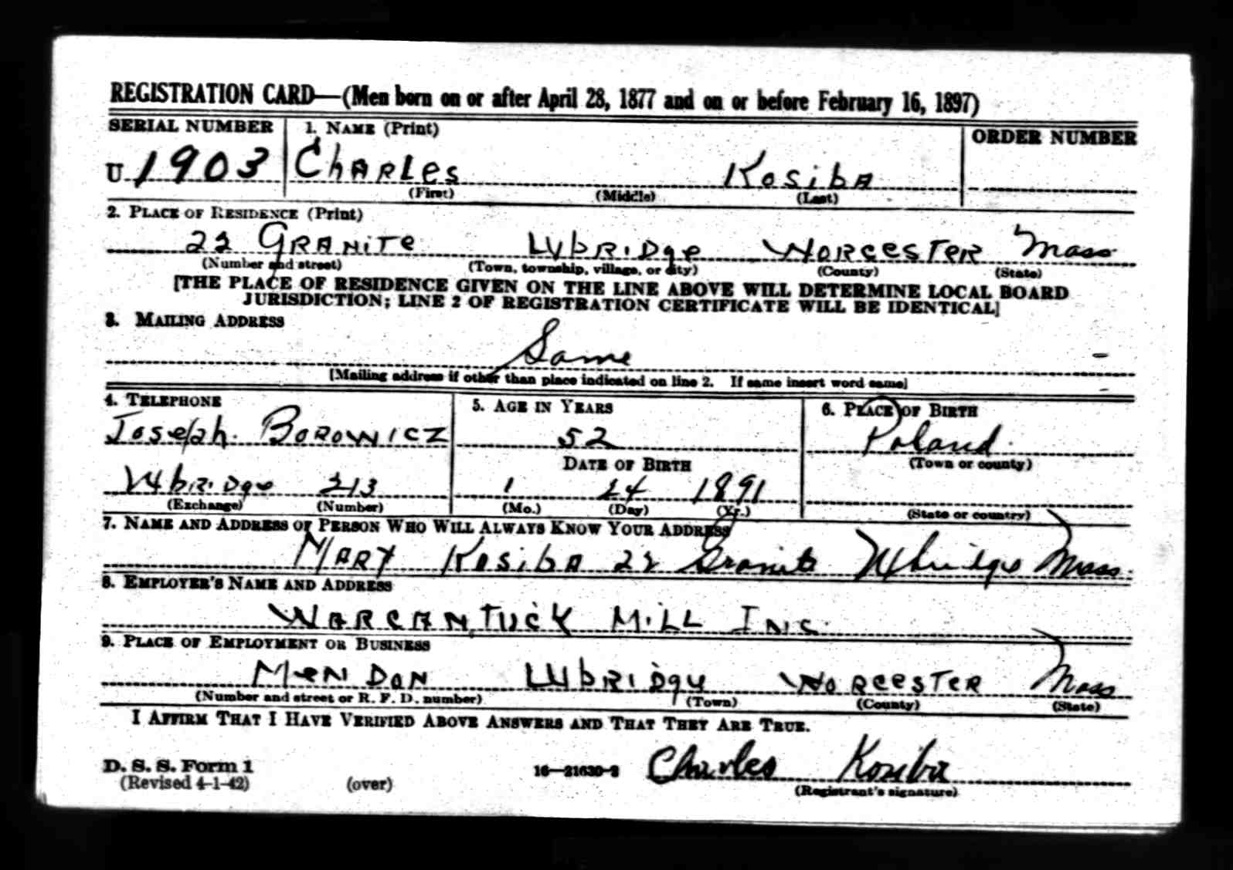
http://www.adamhistory.com/KOSIBA%20FAMILY/Census%20Recs/Charles%20Kosiba%20-%20WWII%20Draft%20Card%20Pg%201.jpg
The draft registration of Charles Kosiba showing his name, age, birth date, etc. The second part of his registration can be found on the next slide.

Slide 4
This second part of Charles Kosiba’s registration card gives his physical description. It shows that he was a white man with brown hair and eyes and a dark complexion.
http://www.adamhistory.com/KOSIBA%20FAMILY/Census%20Recs/Charles%20Kosiba%20-%20WWII%20Draft%20Card%20Pg%202.jpg

Slide 5
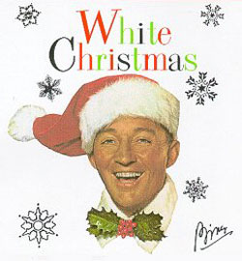
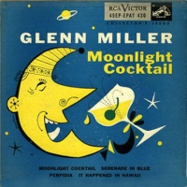
Music
Most Popular Songs of 1942
White Christmas-- Bing Crosby (A)
Moonlight Cocktail-- Glenn Miller (B)
Jingle, Jangle, Jingle-- Kay Kyser
Kalamazoo-- Glenn Miller
Tangerine-- Jimmy Dorsey
A
http://www.fakesteve.net/tag/borg
http://www.jimflora.com/gallery/notflora.html
B

Slide 6
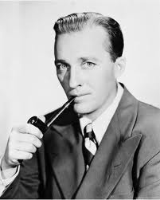
Harry “Bing” Crosby
His song, “White Christmas”, is the only single to have made it on the American pop charts 20 times
Was given the nickname “Bing” because his large ears were very much like those of a character in “The Bingville Bugle”, popular comic strip.
Suffered a massive heart attack while playing golf
and died on
the course on October 14, 1977
http://www.originaloldradio.com/bing_crosby.html
May 3, 1903 – October 14, 1977

Slide 7
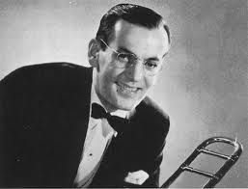
ALTON GLENN MILLER
Enlisted in the US Air Force during WWII
Formed an army band to keep up the spirits of his fellow soldiers
After he and his band had planned a tour of Europe, the plane in which he was a passenger was lost over the English Channel on December
14, 1944
http://www.wisgrove.com/famous-jazz-musicians.htm
March 1, 1904 – December 15, 1944

Slide 8
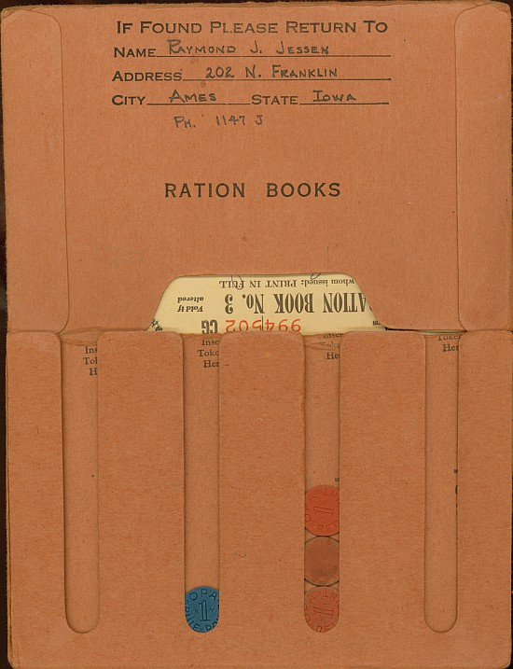
Rationing
From 1940 to 1952, ration books were assigned to each and every person. These books contained coupons that people used to buy everyday items such as food and clothing. A small ration of food was given to each person per week. Clothing coupons, however, were assigned on a yearly basis.
http://warnerbros.pbworks.com/Now-Voyage-(1942)

Slide 9
Fashion
From 1940 to 1952, all clothes were rationed.
People were given only 66 coupons to last the entire year. During the middle of the war, this number was shortened to 48, and in 1945, the number was again reduced to 36.
The system of clothing coupons was ended in 1949
Because clothing material was scarce during WWII, most teenage boys wore simple clothes that were made of synthetic materials and styled much like the clothing of adults
If mending was required, a pillow case, drapes, sheets, etc. were used instead of buying new clothes

Slide 10
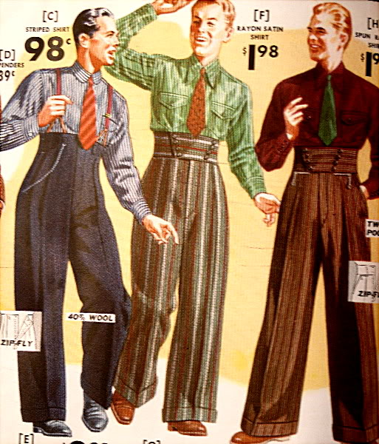
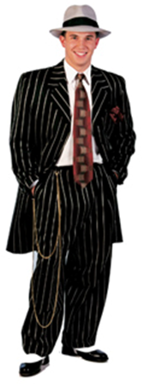
Zoot Suits
http://fancy-dress-costumes.jn34.com/fancy-dress.php?id=465259490&p=Zoot-Suit-Adult&c=Mens-Costumes
One of the most popular fashion trends of the early 1940s was the “zoot suit”. This suit consisted of high-waisted , wide pants and an extremely oversized jacket.
http://www.thefedoralounge.com/showthread.php?t=45668&page=2

Slide 11
Military Duct Tape
First manufactured by the Johnson and Johnson Permacel Division
Used to keep ammunition cases dry and repair guns, aircrafts, etc.
People referred to it as “Duck Tape” because of it was waterproof and made of cotton duck (also called canvas)
The color was soon changed from Army green to the silver we’re familiar with today
After the war, was used in homes to repair air conditioning ducts

Slide 12
Dwight D. Eisenhower
October 14, 1890 – March 28, 1969
Accepted into the military school West Point in 1911
Had no wish to be a soldier, but wanted a college education
Became a captain in WWI in 1917
Was appointed as the WWII senior war planner for the American Army in 1941
Well known for his organizational skills, trait that would gain him fame and many further promotions
Promoted to major general in March 1942 and lieutenant general of the US Army’s European Theatre of Operations in June of that same year
Appointed to Supreme Commander of the Allied Expeditionary Forces in December 1943
Served as chief of staff for the American army after WWII
Elected president in 1952 and was re-elected in 1956

Slide 13
WWII Battles in the Pacific
Theatre- specific area of land, sea, or air that is involved in war
Started early December 1941 with the Japanese bombings of Malaya (December 8) and Pearl Harbor (December 7).
Japanese were aiming to control eastern Asian and the western Pacific
Were hoping that the Allies would surrender
Allies responded to Pearl Harbor with angry force
August 6, 1945- Allies attack Hiroshima and Nagasaki using a devastating atomic bomb
After Hiroshima and Nagasaki, the Soviet Union joins the fight against Japan
August 15, 1945- Japanese Emperor Hirohito surrenders "in order to save mankind from nuclear oblivion”, effectively ending WWII
After the Emperor declared his surrender, many Japanese soldiers refused to accept it
Many committed suicide, lived in denial for several days, or mutinied against their leaders rather than accept the shame

Slide 14
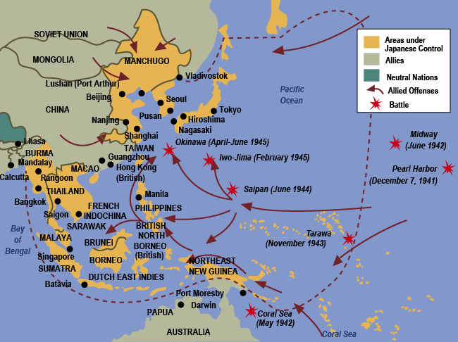
Map of the Pacific battles of WWII
http://www.hbhs.k12.nh.us/kirbyk/photo.htm

Slide 15
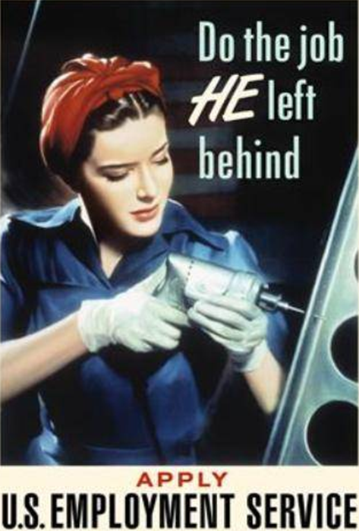
Women and factory life
Propaganda posters made factory life seem “glamorous”, but factories were actually extremely dangerous and unhealthy places to work.
http://socyberty.com/history/fighting-females-women-and-propaganda-in-world-war-two/3/

Slide 16
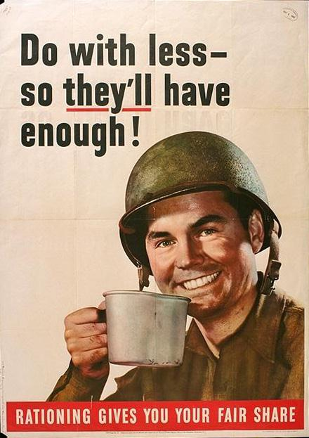
Rationing
Americans were encouraged to ration their food and clothing needs in an effort to help the many soldiers fighting in the war.
http://questgarden.com/76/43/9/090210160434/

Slide 17
Works Cited
Ancestry.com. U.S. World War II Draft Registration Cards, 1942 [database on-line].
Provo, UT, USA: Ancestry.com Operations, Inc., 2010.
"A World War II Summary: Page 1." The Pacific War. The War Times Journal, 2004.
Web. 15 Sep 2010.
<http://www.wtj.com/articles/pacific_summary/index.htm
"A World War II Summary: Page 3." The Pacific War. The War Times Journal, 2004.
Web. 15 Sep 2010.
<http://www.wtj.com/articles/pacific_summary/index_03.htm
Giddins, Gary. "Biography." The Official Home of Bing Crosby. BCE, Inc., 2008. Web.
10 Sep 2010. <http://bingcrosby.com/welcome.html>.
Haberman, Barbara, and Molly Anthony. "Biography (page 2)." The Official Site of
Glenn Miller. CMG Worldwide, n.d. Web. 12 Sep 2010.
<http://www.glennmiller.com/about/bio2.htm>.
"Men's from 20s to Present." Fashions and Clothes Styles from 50 years what do you
remember. The People History: Where People Memories and History Join ,
2004. Web. 15 Sep 2010. <http://www.thepeoplehistory.com/fashions.html>.

Slide 18
Works Cited (cont.)
Nolan, Carol. "Mens Fashions of the 1940s." Mens Fashions of the 1940s - Fourties
Fashion. Men's Vintage Fashions by Carol Nolan, 2001. Web. 15 Sep 2010.
<http://www.murrayonhawaii.com/nolan/fashionhistory_1940mens.html
Thomas, Pauline. "Clothing, Cloth, and Footwear Rationing." C20th Fashion History
1940s- Utility Clothing 1940s. Fashion-Era.com, 2010. Web. 14 Sep 2010.
<http://www.fashion-era.com/utility_clothing.htm#Rationing Of Goods>.
Trueman, Chris. "Dwight Eisenhower." Military Commanders of World War Two.
History Learning Site, 2005. Web. 15 Sep 2010.
<http://www.historylearningsite.co.uk/dwight_eisenhower.htm
When was Duct Tape Invented? Who invented Duct Tape?." Welcome to Duct Tape
101 with Jim and Tim, the Duct Tape Guys. The Duct Tape Guys, n.d. Web.
15 Sep 2010. <http://www.octanecreative.com/ducttape/DT101/>.

Slide 19
I HOPE YOU ENJOYED MY PRESENTATION!

