Slide 1
Electronic Time Capsule
Scott Heavilon

Slide 2
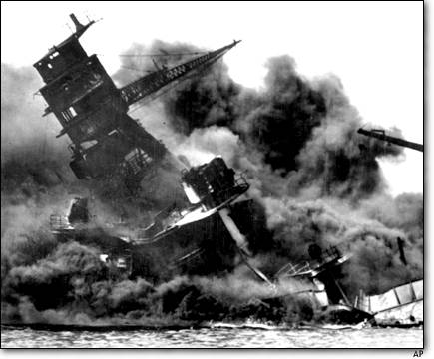
Beginning of the War
Pearl Harbor was a surprise attack on the Americans by the Japanese on December 7, 1941 in Pearl Harbor, Hawaii
4 American battleships were sunk and over 3000 men were killed or wounded and led to a major victory for the Japanese
After the devastation of the surprise attack the U.S. officially declared war on Japan throwing them into WWII

Slide 3
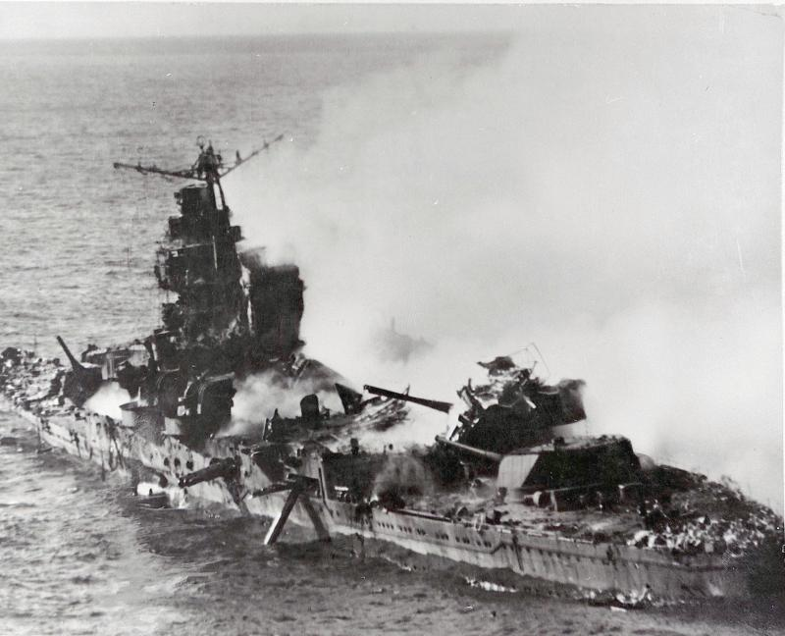
Turning Point of the War
The Battle of Midway was the largest naval battle of WWII a
It was fought between Americans and Japanese forces in the Pacific Ocean and was the turning point of the war for American forces
After this battle the Japanese forces were on the defenses

Slide 4
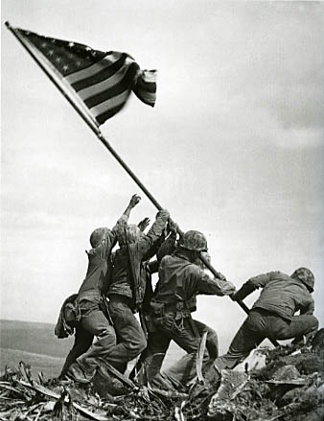
End of the War
The Battle of Iwo Jima was the last major American operation of the war in the Pacific Ocean
The Americans seized two large airfield on the island but were met with tenacious Japanese troops who resorted to suicide attacks to try and stop the American forces over only 271 Japanese troops were taken prisoner. The other 10,000 were KIA or presumed dead
The U.S. won the battle and led to the end of the war in the Pacific

Slide 5
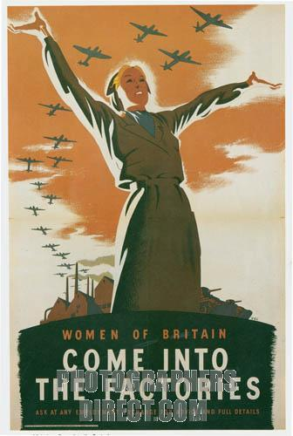
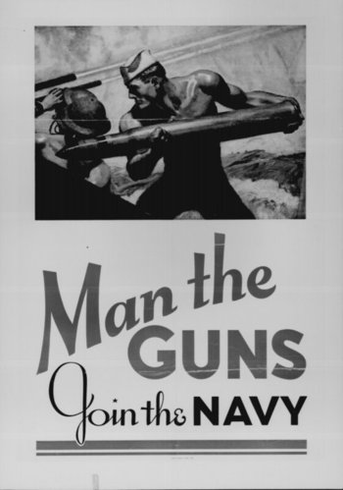
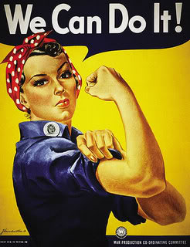
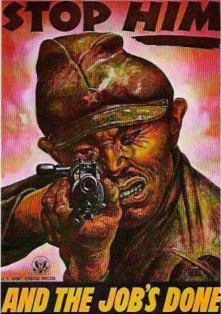
America During the War
During the war the government needed people to use less goods and work in factories to help the war effort. Posters like these were seen everywhere to persuade Americans to help the cause. During this time mostly everything was affected by the war.

Slide 6
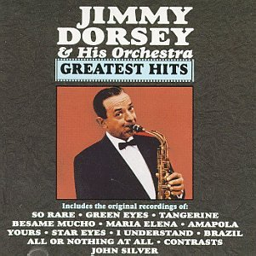
Music in the 1940’s
1940,In the Mood-Glenn Miller
1940, When you Wish Upon a Star-Cliff Edwards
1941,Ampolaa-Jimmy Dorsey Orchestra
1941,Frenesi-Artie Shaw
1942,White Christmas-Bing Crosby
1943, Sentimental Lady-Duke Ellington
The Jimmy Dorsey Orchestra was one of the most popular artists in the 1940’s with three of the their songs in the top twenty in 1941

Slide 7
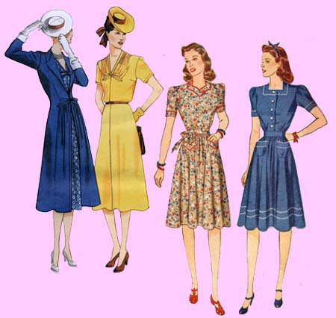
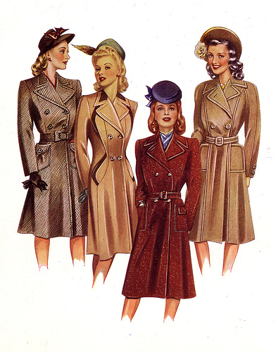
Fashion in the 1940’s
Fabric rations changed the fashion trends before the war and during the war
When these rations were given most the styles went from glamorous and exciting to dark and basic
Even during weddings women wore what would be considered a normal office skirt because wedding dresses were very rare and expensive
Fabric Rations

Slide 8
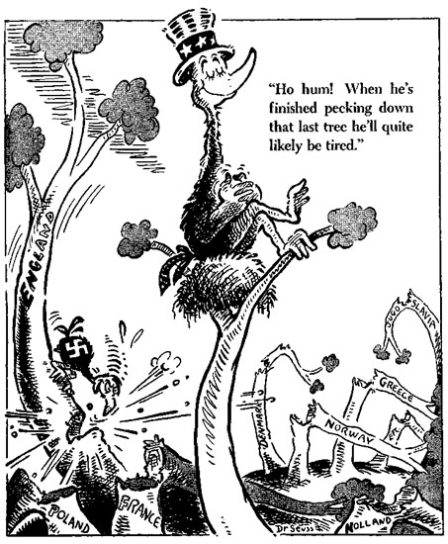
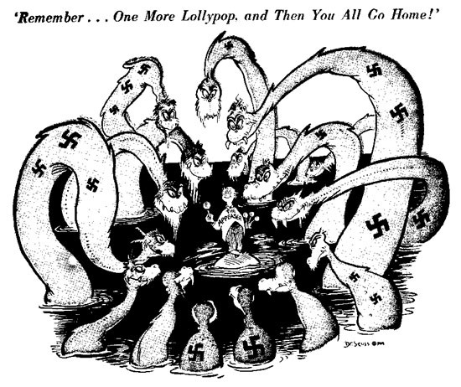
Political View with the War
The war brought a new sense of patriotism to the American public but a select few Americans didn’t like the actions of the government during this time
Political cartoons that bashed the war weren’t uncommon

Slide 9
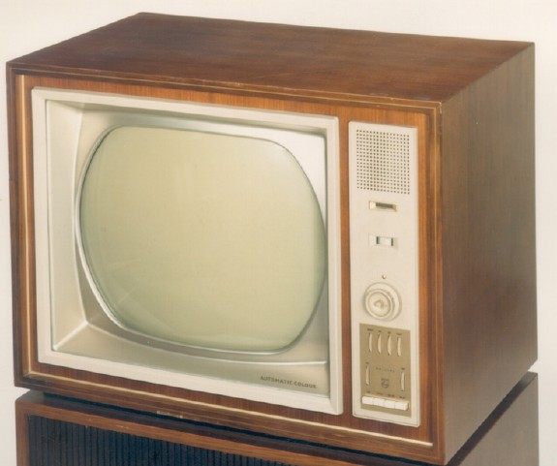
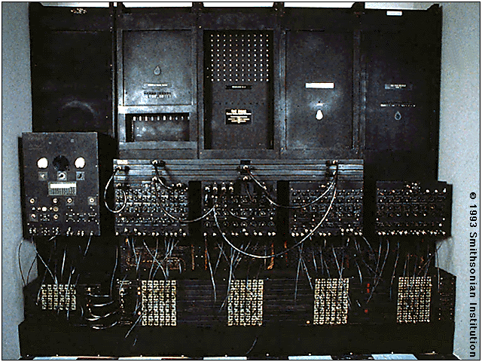
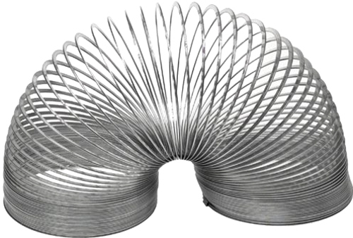
Inventions of the 1940’s
Research did not stop during the war, many inventions like the new TVs, the slinky, and the first basic calculator were all invented in 1940-1943

Slide 10
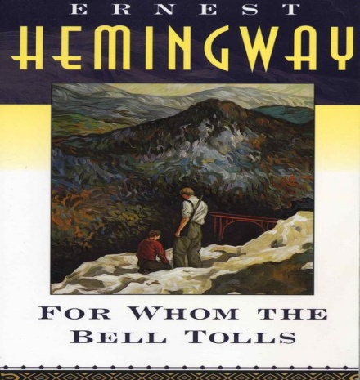
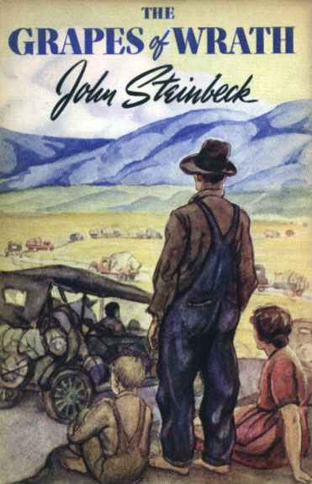
Popular Books in the 1940’s
For Whom the Bell Tolls-Ernest Hemingway
The Grapes of Wrath-John Steinbeck
Both of the novels, which are now considered classics, were written and published in the 1940’s
He lay flat on the brown, pine-needled floor of the forest, his chin on his folded arms, and high overhead the wind blew in the tops of the pine trees.- The first line of For Whom the Bell Tolls

Slide 11
Works Cited
http://www.historylearningsite.co.uk/battle_of_midway.htm
http://www.sligocameraclub.org/2006/10/28/photo-icons-the-story-of-iwo-jima/
http://www.popularsong.org/1943.html
http://www.wwwk.co.uk/culture/inventions/40s/index.htm
http://www.caderbooks.com/best40.html

