Slide 1
My Remembrance of World War II
By Gene Forrester
1942
Katie Wolfert
9/19/10
3W

Slide 2
I wrote this journal to remember the time when World War II was going on. I wanted to remember the popular things and the world news, so in 40 years when I have my own family I can show them this to help jog my memory. I have enclosed pictures, information, and memories that will never leave my mind.
-Gene Forrester, 17

Slide 3
World War II Battles
Battle of Normandy or D-Day or Operation Overload
Battle of Dunkirk “Dynamo”
Battle of Stalingrad
Battle of Monte Cassino
First and Second Battles of El Alamein
Battle of Britain

Slide 4
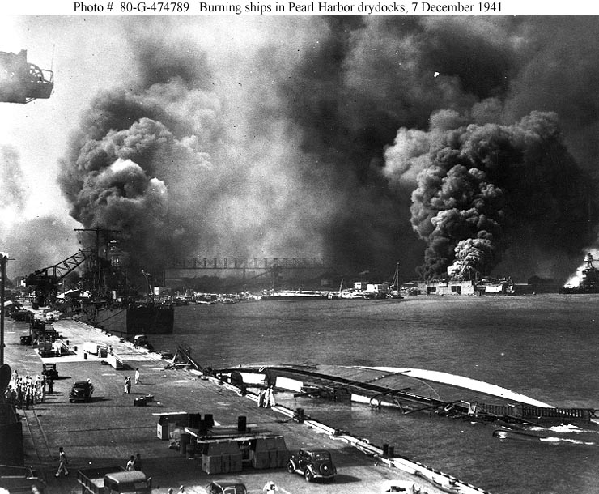
South Pacific Battles
The Japanese bomb Pearl Harbor, Hawaii.
The Japanese also attack the Philippines, Wake Island, Guam, Malaya, Thailand, Shanghai, and Midway.
22.
The intensity of the war was felt in every country like a never ending thunderstorm with bolts that would lights up the sky and shake the ground. The Japanese were one of the biggest causes of this terror in the Pacific region.

Slide 5
The draft
On June 30, 1942, men the ages 18-20 years old could register.
President Roosevelt passed a law stating all men between the ages of 18 and 65 were required to register for the draft.
Although this doesn’t mean all of the men have to go to war.
I fall under these categories but I don’t know if I’m ready to go into the war. Especially after what happened to Leper after he went into the war.

Slide 6
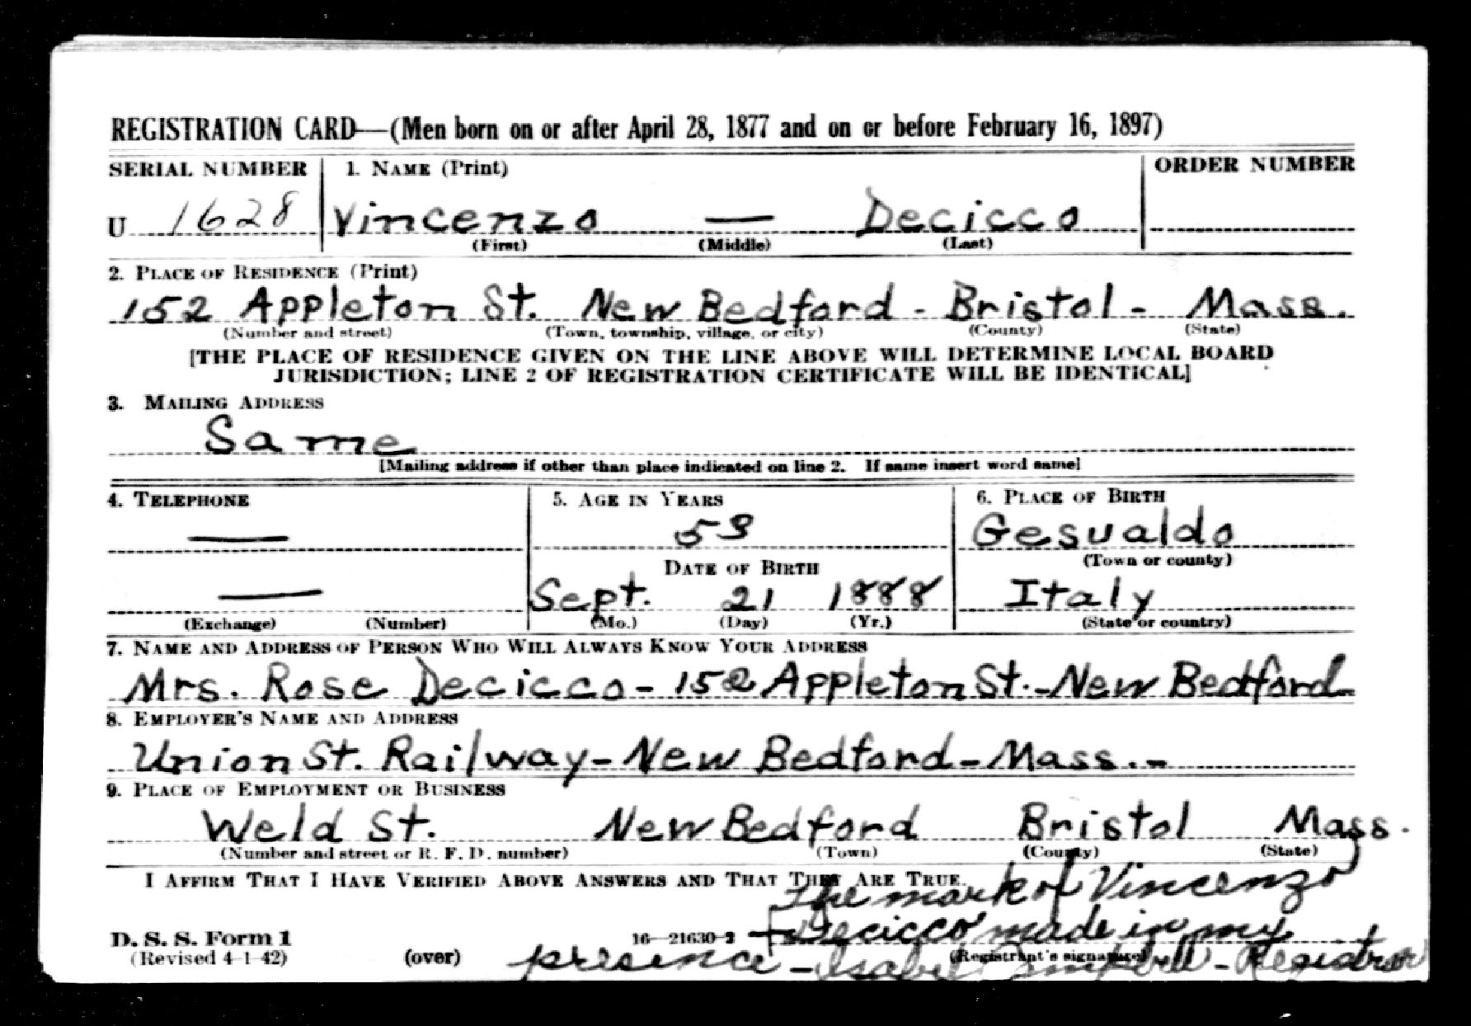
7.
I found this registration card on the ground. This was a man’s registration card to go into the war.

Slide 7
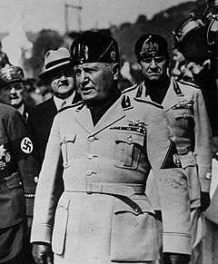
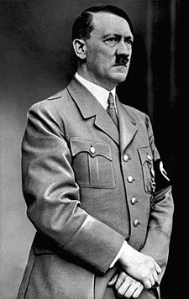
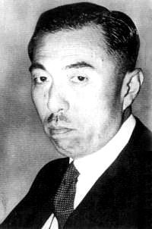
Political Leaders
-Axis Leaders-
Fumimaro Konoe
3.
Benito Mussolini
1.
4.
Adolf Hitler

Slide 8
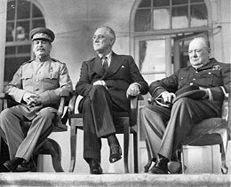
Political Leaders- Allied Leaders “The Big Three”
Joseph Stalin
Winston Churchill
5.
Franklin D. Roosevelt

Slide 9
Top Songs
White Christmas by Bing Crosby.
Moonlight Cocktail by Glenn Miller.
Chattanooga Choo Choo by Glenn Miller.
I loved to listen to these songs on the radio
but I was pulled back to reality when Adolf
Hitler would interrupt the songs for an
announcement.

Slide 10
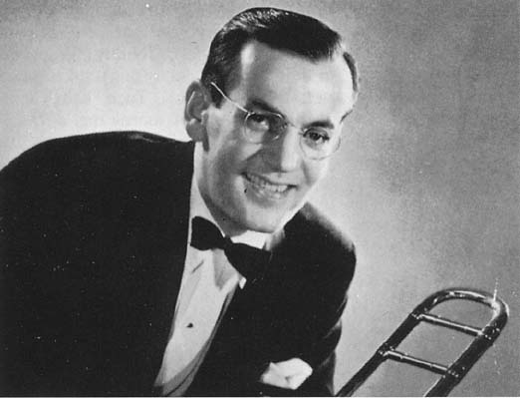
Glenn Miller 1904-1944
8.
Miller’s music had unreal
popularity and success in the 1940s.
He had an influence on the history of jazz music.
-Some of his songs-
Chattanooga Choo Choo
In the mood
Tuxedo Junction
American Patrol
Moonlight Serenade
In 1944, he went missing at age 40.

Slide 11
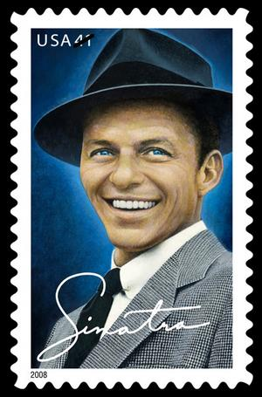
Frank Sinatra 1915-1998
Frank Sinatra began his career in the swing age.
Started with Harry James an Tommy Dorsey.
Began successful solo artist in mid-1940s.
His career was stalled in the 50’s.
But it caught back on in 1954 when he won the Academy Award for Best Supporting Actor.
-Popular Songs-
Fly Me to the Moon
Theme from New York New York
My Way
Summer Wind
Night and Day
9.

Slide 12
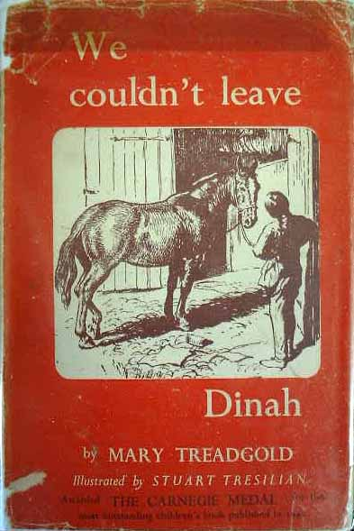
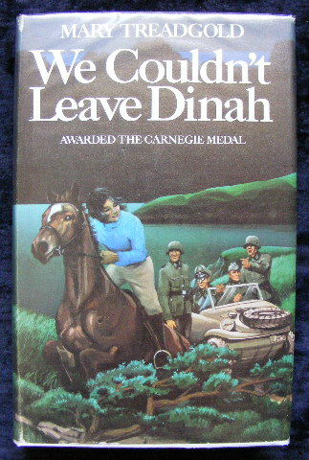
Popular Authors
~Mary Treadgold~
Won the Carnegie Medal in 1942 for Best Novel.
19.
1.
“We Couldn’t Leave Dinah” won the medal.
I never got the chance to read her book, but I heard that it was an all time classic.

Slide 13
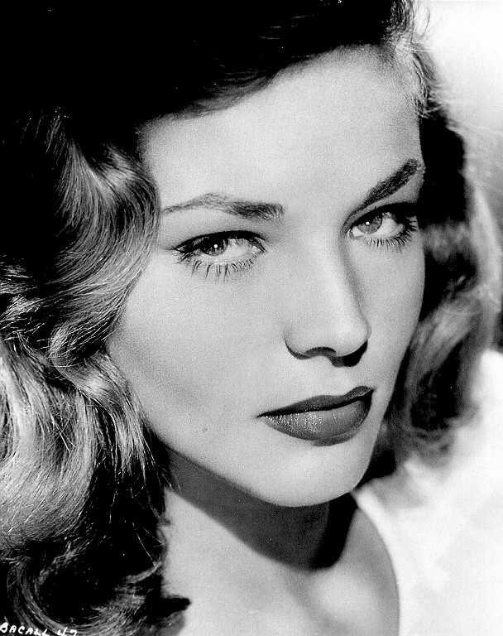
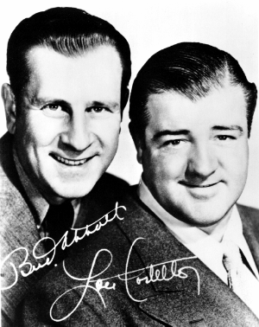
Popular Actors/Actresses
Actors
Actresses
Bud Abbott & Lou Costello
Humphrey Bogart
John Garfield
Lauren Bacall
Ingrid Bergman
Joan Fontaine
15.
14.
Bud Abbott & Lou Costello
Lauren
Bacall

Slide 14
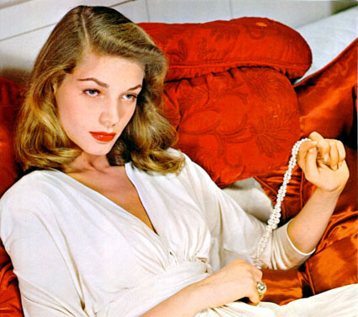
Lauren Bacall
21.
Her real name is Betty Joan Perske.
Born in N.Y.C on September 16, 1924.
Her first film was “To Have and Have Not” in 1944.
She ended up marrying her costar Humphrey Bogart after the movie “The Big Sleep”.
I remember seeing her first film “To Have and Have Not” and being in awe of her beauty.

Slide 15
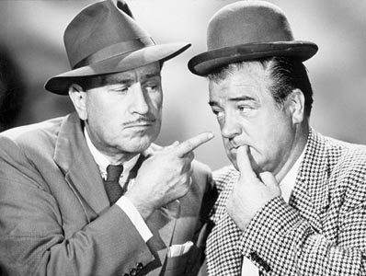
Bud Abbott & Lou Costello
Abbott’s real name is William A Abbott.
Costello’s real name is Louis Francis Cristillo.
They started off with a spot on Kate Smith’s radio show.
Then, because of their sudden popularity, led to “The Streets of Paris”.
Next they were in “One Night in the Tropics”.
In 1941 they were in “Buck Privates” which was their best known film.
I loved these guys!
20.

Slide 16
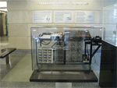
New Inventions
1942 Electronic Digital Computer
It was made by John Vincent Atansoff and Clifford Berry.
The computer was made at Iowa State University.
16.

Slide 17
Medical Discoveries
1940- Howard Florey and Ernst Chain develop a method to make a functional form of penicillin.
1944- Selman Waksman discovered streptomycin, which is an antibiotic effective against tuberculosis.
18.
I drew this myself.

Slide 18
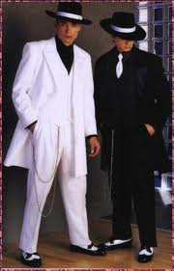
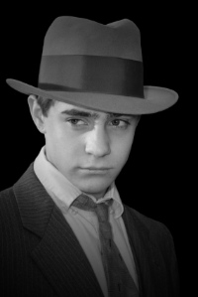
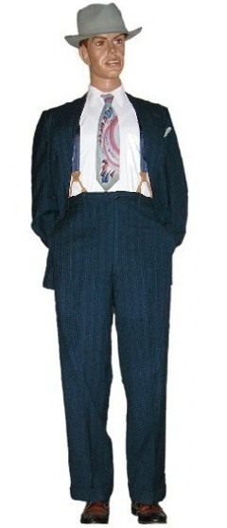
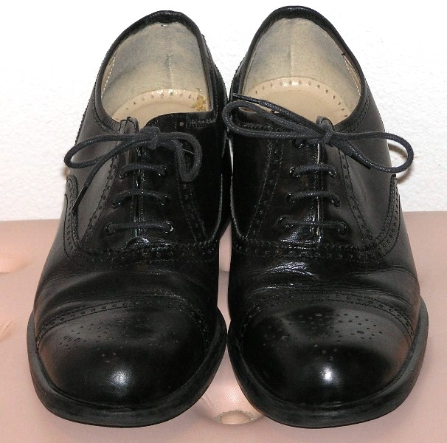
Fashion Young Men 1942
Fedora hats
11.
10.
Fedora
Zoot Suits
13.
Bright colorful ties
12.
Wingtip Spectator Shoes

Slide 19
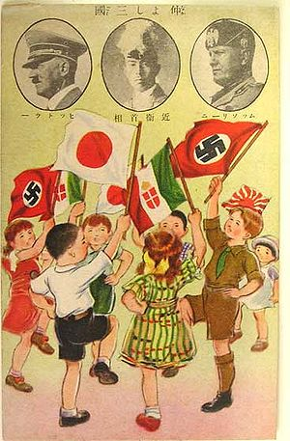
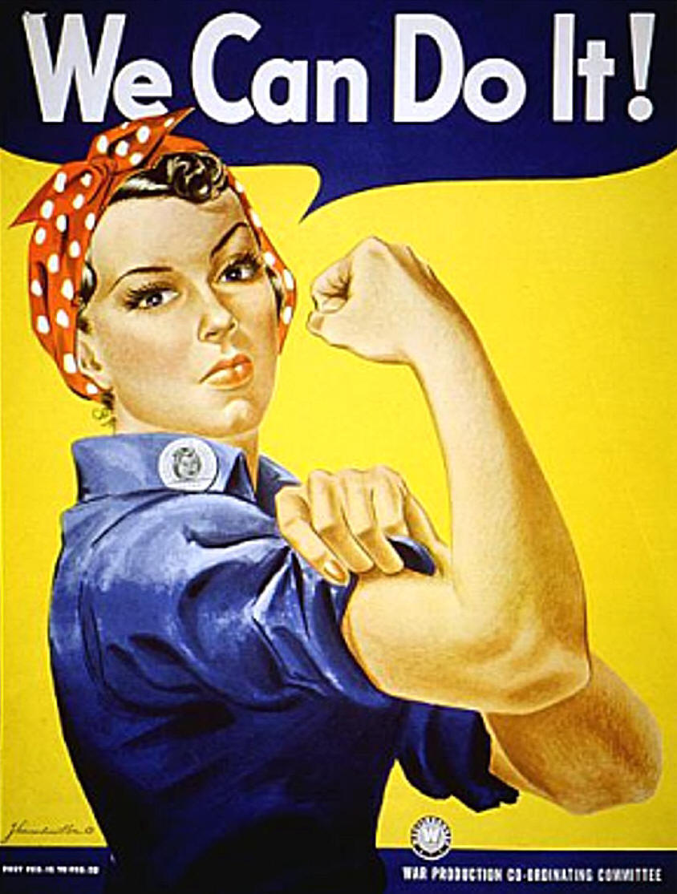
Propaganda Posters
17.
6.
I remember seeing these posters around town. I hated that they kept reminding me that there was a war going on. It was scary stuff to keep being reminded about.

Slide 20
After looking through this journal I hope to remember all of the ups and downs of the 1940’s and to always look back on this as a positive way to remember such a negative time around the world.
-Gene Forrester, 17

Slide 21
Work Cited- Pictures
http://janebadgerbooks.co.uk/misc/_wp_generated/wp00e05bf0_0f.jpg
http://en.wikipedia.org/wiki/Adolf_Hitler
http://en.wikipedia.org/wiki/Benito_Mussolini
http://en.wikipedia.org/wiki/Fumimaro_Konoe
http://en.wikipedia.org/wiki/Allies_of_World_War_II
http://en.wikipedia.org/wiki/Axis_leaders_of_World_War_II
http://www.google.com/images?hl=en&q=draft+registration+cards&wrapid=tlif12846839724742&um=1&ie=UTF-8&source=og&sa=N&tab=wi&biw=1419&bih=680
http://www.google.com/images?rlz=1T4TSNA_enUS359US359&q=glenn%20miller&um=1&ie=UTF-8&source=og&sa=N&hl=en&tab=wi&biw=848&bih=392
http://www.google.com/images?um=1&hl=en&rlz=1T4TSNA_enUS359US359&biw=1345&bih=561&tbs=isch%3A1&sa=1&q=frank+sinatra&aq=f&aqi=g10&aql=&oq=&gs_rfai
http://www.google.com/images?um=1&hl=en&rlz=1T4TSNA_enUS359US359&biw=1345&bih=561&tbs=isch%3A1&sa=1&q=zoot+suit&aq=f&aqi=&aql=&oq=&gs_rfai
http://mens-fashion.lovetoknow.com/Mens_Fashion_in_the_1940's
http://www.google.com/images?um=1&hl=en&rlz=1T4TSNA_enUS359US359&tbs=isch:1&q=1940s+mens+shoes&revid=2113355389&sa=X&ei=Z3uWTPXFF8njnQeelOC7Bw&ved=0CCMQ1QIoAA&biw=1345&bih=561
http://www.google.com/images?um=1&hl=en&rlz=1T4TSNA_enUS359US359&biw=1345&bih=561&tbs=isch%3A1&sa=1&q=men%27s+ties+1940&aq=f&aqi=&aql=&oq=&gs_rfai
http://www.google.com/images?um=1&hl=en&rlz=1T4TSNA_enUS359US359&biw=1345&bih=561&tbs=isch%3A1&sa=1&q=bud+abbott+and+lou+costello&aq=f&aqi=g1&aql=&oq=&gs_rfai

Slide 22
Work Cited- Pictures
http://www.google.com/images?um=1&hl=en&rlz=1T4TSNA_enUS359US359&biw=1345&bih=561&tbs=isch%3A1&sa=1&q=lauren+bacall&aq=f&aqi=g10&aql=&oq=&gs_rfai
http://www.wwwk.co.uk/culture/inventions/40s/index.htm
http://www.google.com/images?um=1&hl=en&rlz=1R2TSNA_enUS359&biw=848&bih=440&tbs=isch%3A1&sa=1&q=propaganda+poster+wwii+we+can+do+it&btnG=Search&aq=f&aqi=&aql=&oq=&gs_rfai
http://www.google.com/images?um=1&hl=en&rlz=1R2TSNA_enUS359&biw=848&bih=440&tbs=isch%3A1&sa=1&q=medicine+symbol&aq=f&aqi=g10&aql=&oq=&gs_rfai
http://janebadgerbooks.co.uk/misc/we%20couldn't%20hb.JPG
http://www.google.com/images?um=1&hl=en&rlz=1R2TSNA_enUS359&biw=1345&bih=561&tbs=isch%3A1&sa=1&q=bud+abbott+and+lou+costello&aq=f&aqi=g1&aql=&oq=&gs_rfai
http://www.google.com/images?um=1&hl=en&rlz=1R2TSNA_enUS359&tbs=isch:1&&sa=X&ei=g36WTOrGHeOfnwfX1cyUBw&ved=0CCMQBSgA&q=lauren+bacall&spell=1&biw=1345&bih
http://www.google.com/images?hl=en&rlz=1R2TSNA_enUS359&q=pearl%20habor&um=1&ie=UTF-8&source=og&sa=N&tab=wi&biw=1345&bih=522

Slide 23
Work Cited
http://www.popularsong.org/1942.html
http://www.teacheroz.com/WWIILeaders.htm
http://en.wikipedia.org/wiki/Allied_leaders_of_World_War_II
http://www.glennmiller.com/
http://en.wikipedia.org/wiki/Glenn_Miller
http://www.montgomeryschoolsmd.org/schools/tildenms/mediacenter/pathfinders/social_studies/1940/famousnames_index.htm
http://en.wikipedia.org/wiki/Frank_Sinatra
http://www.aolradioblog.com/2010/03/18/best-frank-sinatra-songs/
http://en.wikipedia.org/wiki/1930%E2%80%931945_in_fashion
http://en.wikipedia.org/wiki/Fedora_(hat)
http://genealogy.about.com/od/records/p/wwii_draft.htm
http://search.ancestry.com/search/db.aspx?dbid=1002
http://www.sbxandmore.com/legends/frame2_left.html
http://www.sbxandmore.com/legends/actress_40_50.html#fontaine
http://www.fantasticfiction.co.uk/years/1942.htm
http://library.duke.edu/digitalcollections/mma/timeline.html
http://janebadgerbooks.co.uk/misc/treadgold.html
http://techcenter.davidson.k12.nc.us/spring4/battles/dday.htm
http://www.world-war-2.info/facts/
http://www.world-war-2.info/battles/
http://www.historyplace.com/unitedstates/pacificwar/timeline.htm

