Slide 1
Devon in the Forties
Kirsten Linder
3W

Slide 2
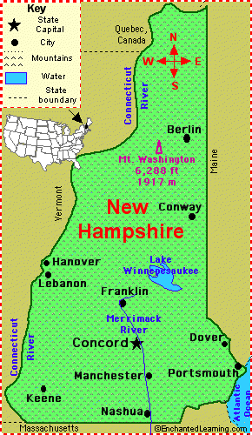
New Hampshire
One of the Original 13 States
Capital is Concord
Largest City Manchester
State Motto is “Live Free or Die”
Robert Frost, Alan Shepard Jr., Adam Sandler
Devon

Slide 3
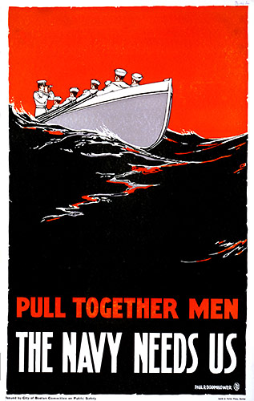
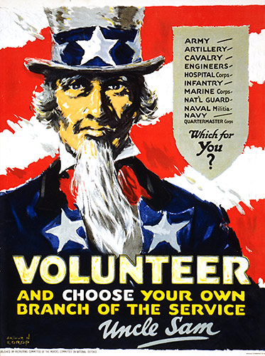
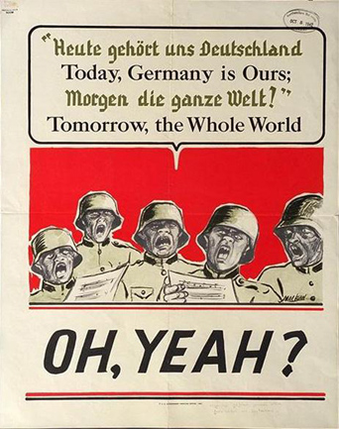
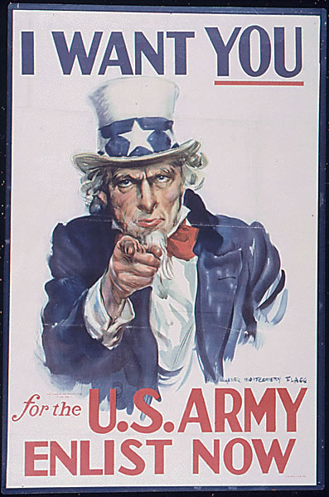
Almost everywhere I go, the war follows. Recruiters are always coming to Devon and trying to get us to enlist. Many times their presentations can be quite persuading. Take Leper for instance: He had no plans of enlisting before he saw that ski troop video. Posters are everywhere, advertising for the war. Here are just some examples…
http://www.world-war-pictures.com/war-poster/warusa015
http://www.digitalhit.com/posters/p/2893644
http://www.world-war-2.info/posters/poster_4.php
http://blogs.riverfronttimes.com/dailyrft/2009/11/remembering_veterans_day_through_jingoistic_posters_of_wwii.php?page=3

Slide 4
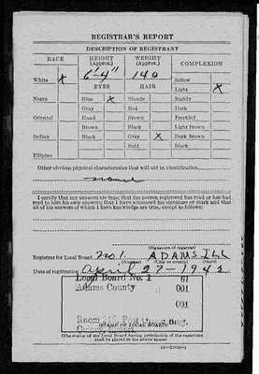
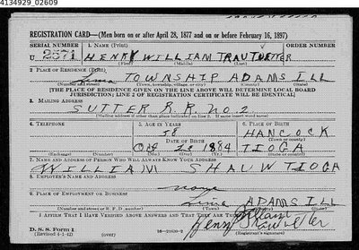
It’s pretty much inevitable. I’m eventually going to be drafted into this never-ending war. The only way I won’t be is if I get injured like Finny. About 540,000 men were in the armed forces in 1940 and in 1941, 1,620,000 were. It more than doubled! It’s also more common for an 18 year old to be drafted rather than a father. Men who are between the ages of 42 and 64 have to fill out an “Old Man’s Draft” card that includes their name, birth date, height, and lots of other personal information. Should I enlist or just let the unavoidable draft come to me?
Front of a draft card
Back of a draft card
http://www.rootdig.com/labels/draft.html

Slide 5
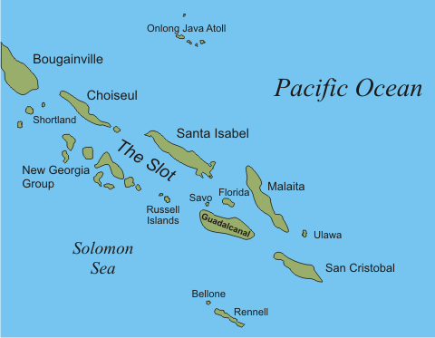
http://www.battlesforguadalcanal.com/Story/Solomons/solomons.html
January 1: Mass gassing of Jews begins at Auschwitz
Battles of 1942
May 6: The last American troops in the Philippians surrender
January 27: First Japanese warship is sunk by a U.S. submarine
June 4-5: Four Japanese carriers, a Japanese cruiser, and two Japanese destroyers are destroyed. This is often called the turning point in the war.
Savo Island
August 8/9: Just off of Savo Island, eight Japanese warships wage a night attack and sink three U.S. heavy cruisers, an Australian cruiser, and one U.s. destroyer I n less than one hour. Over 1500 Allied men were killed.
October 18: Hitler orders the execution of all captured British commanders
December 31: Germany fights Britain at the Battle of the Barents Sea

Slide 6
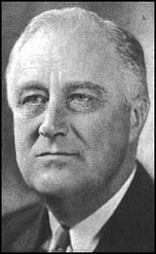
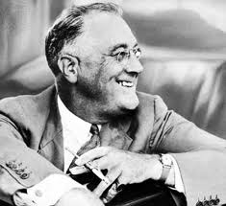
Political Figures
Franklin Delano Roosevelt
Born January 30, 1882
Died April 12, 1945
Became President of the U.S. March 4, 1933
Only American President to be elected for more than two terms
Paralyzed from the waist down
Immediately began working to solve the economic depression
Died of a stroke at age 63
Consistently referred to as one of the greatest U.S. Presidents
http://www.spartacus.schoolnet.co.uk/USArooseveltF.htm
http://www.britannica.com/EBchecked/topic-art/509263/3388/Franklin-D-Roosevelt-1937

Slide 7
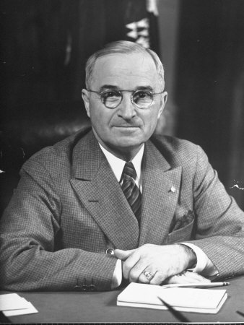
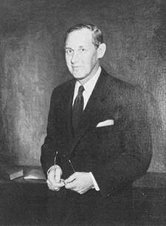
Political Figures
Harry S. Truman
Born: May 8, 1884 in Lamar Missouri
Died: December 6, 1972
Joined the Democratic Party in 1922
Elected to the Senate 1834
Became Vice President to FDR in 1944
When FDR died, Trueman became president and promised Congress he would carry on FDR’s policies
July 1945, authorized the dropping of the atom bomb on Hiroshima and Nagasaki
Harry L. Hopkins
Born: August 17, 1980 in Sioux City, Iowa
Died: January 29, 1946
One of FDR’s closest advisors
Helped create programs to fix the economic depression
Part of the democratic party
Roosevelt’s special assistant
Figure 1: Harry S. Truman
Figure 2: Harry L. Hopkins
Figure 1: http://www.art.com/products/p13882686-sa-i2771624/marie-hansen-harry-s-truman-sitting-at-desk.htm
Figure 2: http://en.wikipedia.org/wiki/Harry_Hopkins#World_War_II

Slide 8
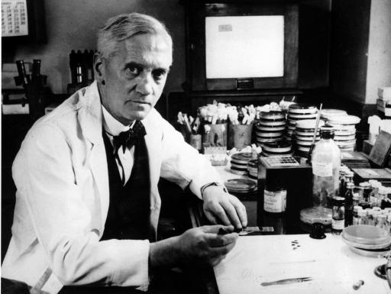
Penicillin: The Miracle Drug
In 1928, Sir Alexander Fleming discovered that the bacteria stapholycocci had an antibacterial element
He named this antibacterial element Penicillin
Penicillin could cure pneumonia, diphtheria, meningitis, and more!
However, the medical community didn’t like the idea of curing bad bacteria with more bacteria, so Fleming’s work was deemed not important
Sir Alexander Fleming
http://herbarium.usu.edu/fungi/funfacts/penicillin.htm

Slide 9
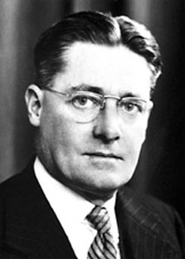
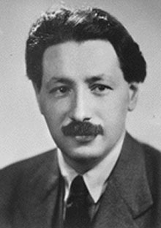
Penicillin: The Miracle Drug
Howard Florey and Ernst Chain took an interest in Fleming’s research in the early 1940’s
They were able to refine Penicillin into a powder
In 1941 the first human was successfully treated with penicillin!
In 1945, Fleming, Florey, and Chain received the Nobel Prize for Medicine
Howard Florey
Ernst Chain

Slide 10
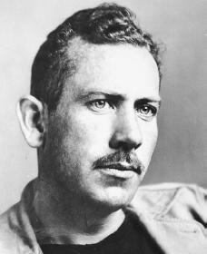
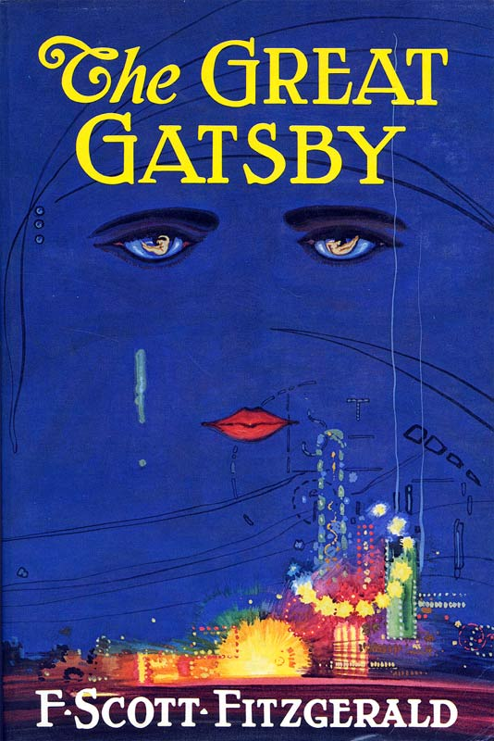
My Favorite Authors
John Steinbeck
1902-1968
Born in Salinas California
American writer
Greatest works included Grapes of Wrath (1939) and Of Mice and Men (1937)
Ernest Hemingway
1899-1961
Born in Oak Park, Illinois
American journalist and author
Greatest works included A Farewell to Arms(1929) To Have and Have Not (1937) For Whom the Bell Tolls (1942)
F. Scott Fitzgerald
1896-1940
Born in St. Paul Minnesota
American author of novels and short stories
Greatest works include The Great Gatsby (1925) Tender is the night
(1934)
http://www.neilpeterson.com/index.php/2008/11/finding-sandy-and-something-more/
John Steinbeck
http://thegreatgatsbywiki.pbworks.com/

Slide 11
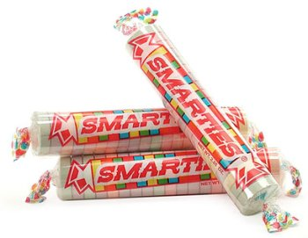
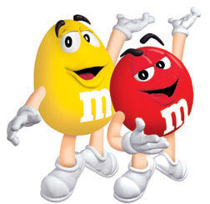
Sweets & Treats of the 40’s
1939: First mini Hershey’s chocolate bar
1949: Junior Mints are introduced
1941: M&Ms are created
1949: The invention of Smarties!

Slide 12
MUSIC
My mama done tol’ me, When I was in kneepants, My mama done tol’ me, Son! A women’ll sweet talk, and give ya the big eye, but
Lyrics to, Blues in the Night
Top Songs of 1940
Blues in the Night by Johnny Mercer in 1941
White Christmas by Bing Crosby in 1940
In the Mood by Glenn Miller in 1940
Woo-ee! A clickety clack’s a echoing back! My mama was right, there’s blues in the night!
Other top songs included:
Only Forever, Bing Crosby
Frenesi, Arti Shaw
Tuxedo Junction, Glenn Miller
Woodpecker Song, Glenn Miller
Trade Winds, Bing Crosby
when the sweet talkin’s done, A women’s a two-face, A worrisome thing who’ll leave ya t’ sing about
http://www.answers.com/topic/in-the-mood-with-glenn-miller-collectables-2005-album-by-glenn-miller
the blues in the night. Now the rain’s a fallin, Hear the train a callin’ Woo-ee! Hear that lonesome whistle, blow’n ‘cross the trestle,

Slide 13
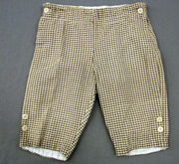
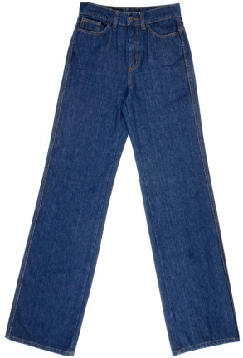
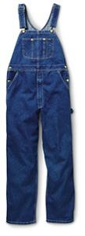
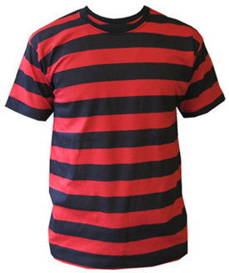
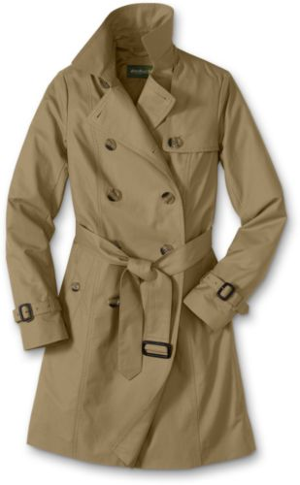
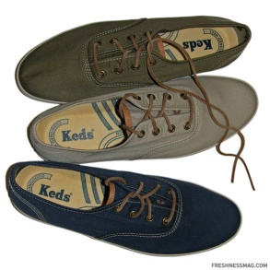
Boys
Fashion
Knickers were so last season by 1945!
Going casual? You can never go wrong with a pair of overall’s and sneakers! Wanna be bold? Try the trend that was just introduced in 1942: The T-shirt!
If you’re dressing up, but don’t have a suit, slip on the trench coat!
http://www.nickevery.com/blog/2010/07/28/keds-%E2%80%93-%E2%80%9C
http://www.cybermonday.com/sr____.htm?cat=666&cat=666&fields=merchant_id-1
http://www.planetboo.com/tshirts.htm
http://www.worthpoint.com/worthopedia/1940s-boy-scout-uniform-with-knickers-knoxville
http://www.icity.se/artikel/263/Filippa_tipsar.html
http://workwearsavings.sportsmansguide.com/net/cb/29-key-industries-denim-bib-overalls.aspx?a=644797

Slide 14
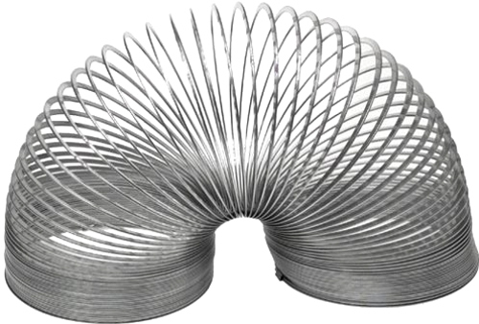
The Slinky
http://mattogno.com/MattognoGirls/?p=146
Invented by Richard T. James in 1943
James was a naval engineer
Thought of the idea when a tension spring fell onto the steps
He told his wife, Betty, “I think I can make a toy out of this.”
His wife named the toy after finding that ‘Slinky’ means graceful and sleek in Swedish
Slinky debuted at the Gimbles Department store in Philadelphia in 1945
The best kind of gift to give or get, the favorite of all over town,
The hit of the day when you’re ready to play,
Everyone knows it’s Slinky!
It’s Slinky, it’s Slinky!
It’s fun it’s a wonderful toy!
It’s Slinky, it’s Slinky!
The favorite of girls and boys!
http://www.youtube.com/watch?v=EZL6RGkPjws
Check it out!

Slide 15
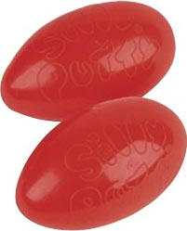
Silly Putty
Created by James Wright in 1943
First called “Nutty Putty”
It can bounce, stretch, snap, pop, and copy the image of printed materials such as newspaper
Name changed to “Silly Putty” in 1949
http://makeyourownstore.com/index.php?main_page=product_info&cPath=5&products_id=21

Slide 16
Works Cited
Neill, Michael. "Accessing World War II Draft Cards; Old Man's Draft.“RootDig.com. N.p., 5/6/2008. Web. 14 Sep 2010.
"World War II in Europe." The History Place. The History Place, n.d. Web. 14 Sep 2010.
"World War Two History." 6 ppsWorld-war-2.info. Worldwar2info, 2010. Web. 14 Sep 2010.
"Harry Lloyd Hopkins." Spartacus Educational. SpartacusUS, n.d. Web. 14 Sep 2010.
"Franklin D. Roosevelt." Spartacus Educational. SparatcusUS, n.d. Web. 14 Sep 2010.
"Harry S. Truman." Spartacus Educational. SpartacusUS, n.d. Web. 14 Sep 2010.
Bellis, Mary. "Silly Putty-The History of Silly Putty." Ask.com. The New York Times Company, 2010. Web. 15 Sep 2010.
Bellis, Mary. "History of the Slinky Toy." Ask.com. New York Times Company, 2010. Web. 15 Sep 2010.
Ament, Phil. "Slinky." ideafinder.com. TheGreatIdeaFinder, n.d. Web. 15 Sep 2010.
Nolan, Carol. "Men's Fashions of the 1940's." Men's Vintage Fashions. CarolNolan, n.d. Web. 15 Sep 2010
Wagner, Christopher. "Boys' Clothing during th e1940's." Historical Boys' Clothing. N.p., 1/26/2001. Web. 15 Sep 2010
Ivins, Fogel. "Penicillin: the first miracle drug." Fun facts about fungi. N.p., 12/6/2008. Web. 15 Sep 2010.
"The History of Penicillin." essortment.com. Google, n.d. Web. 15 Sep 2010.
Bellis, Mary. "History of Penicillin." Ask.com. New York Times Company, n.d. Web. 15 Sep 2010.

