Slide 1
A Separate Peace Time Capsule
By: Michael Stewart

Slide 2
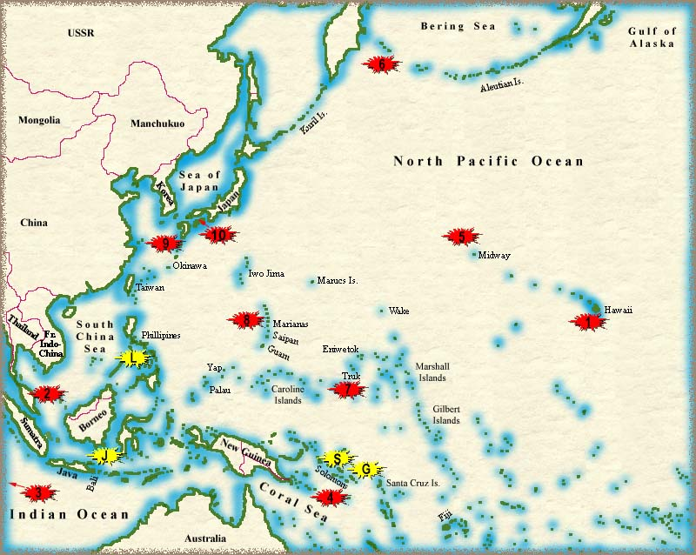
WWII Battles in Pacific
Some naval battles in the Pacific include the attack on Pearl Harbor, the battle of the Coral Sea, the sinking of the Yamato, the battle of Midway, and the Final Destruction.
www.ww2pacific.com

Slide 3
WWII Naval Transports and Fighters
Some aircraft carriers used by the United States included Wasp II, Hancock, Yorktown, Intrepid, and Saratoga.
Some battleships used by the United States included Arkansas, Texas, Nebraska, New York, Indiana, and Arizona.
Some cruisers used included Concord, Trenton, Philadelphia, Phoenix, and Quincy.

Slide 4
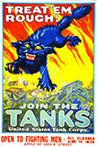
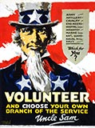
American War Posters
www.world –war-pictures.com/american-war-posters.htm
Text: Treat ‘em Rough! Join The Tanks
Meaning: This poster is urging you to
join the Tanks Corps and pound the
enemy.
Text: Volunteer And Choose Your
Own Branch of Service
Meaning: This poster is giving you
the opportunity to choose what branch
of the military you serve in if you
volunteer.
www.world –war-pictures.com/american-war-posters.htm

Slide 5
Aggressors of WWII
Germany: Adolf Hitler
Nazi Dictator of Germany who planned and started WWII, and committed suicide at the end of the war.
Japan: General Hideki Tojo
Aggressive Prime Minister of Japan who resigned when Japan was losing the war and was executed for his crimes.
Italy: Benito Mussolini
Ally to Germany who attacked smaller neighbors and was eventually defeated, arrested, kidnapped, and executed.

Slide 6
The Allied Leaders
Britain: Winston Churchill
Prime Minister of Britain who excelled as a wartime leader, raising the morale of his people. He allied with the U.S and Russia.
United States: Franklin Roosevelt
President of U.S. who remained neutral in the war until the attack on Pearl Harbor. He then allied with Russia and Britain to defeat Germany, Japan, and Italy.
Russia: Joseph Stalin
Dictator of Russia who weakened Russia allowing Hitler to attack them. He created political terror in his country until his death.

Slide 7
Discoveries Part One
Penicillin
Scottish Scientist Sir Alexander Fleming discovered the antibiotic penicillin accidentally in 1928.
He was culturing bacteria and one day left the Petri dish lid ajar. When he returned a mold had killed the bacteria in the same dish. It took 10 years for scientists to extract the penicillin from the mold.
The drug was still rare during WWII but when administered, it saved lives.

Slide 8
Discoveries Part Two
The Slinky
Invented in 1943 by Richard and Betty James.
Richard was inspired by observing tension springs.
400 Slinkys were sold in the first 90 minutes of its demonstration to the Gimbel’s Department Store.
Betty James took over the construction of the Slinky after Richard suffered a mid-life crisis.

Slide 9
Popular Songs and Singers
A few popular songs in 1940 were “I’ll Never Smile Again” by Tommy Dorsey and Frank Sinatra, and “Sierra Sue” by Bing Crosby.
Bing Crosby was born on the 2 of May in 1903 in Tacoma, Washington, and died on the 14 of October 1977. He died of a heart attack in Madrid, Spain.
One of his favorite things to do besides music was golfing.

Slide 10
Sienna Sue Lyrics
Sierra Sue, I`m sad and lonely The rocks and rills are lonely too Sierra Sue, I want you only No one but you, Sierra Sue The roses weep, their tears are falling The gentle doves no longer coo Oh, can`t you hear my sad heart calling Calling for you, Sierra Sue

Slide 11
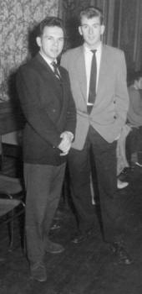
Typical Clothes for Young Men
Clothing for teenage boys was simpler in the early 1940’s as they were rationed for the war.
After the war and the rations, men started to dress more extravagantly in items such as suits and trousers.
This picture is what Gene would have worn at Devon.

Slide 12
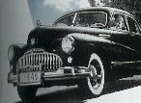
Cars
Austin A40 1949: Had everything you needed in a small car and also saved gasoline at every turn.
Buick 1946 The engine decreased in power due to stopping compound carburetion, but still had 144 HP.
http://www.thepeoplehistory.com/40scars.html

Slide 13
Bibliography
"Bing Crosby." The Internet Movie Database. IMDb.com, I nc., 1990. Web. 15 Sep 2010. <http://www.imdb.com/name/nm0001078/>.
"Choose Your Own Branch of Service." American World War II Posters. Web. 12 Sep 2010. <http://www.world-war- pictures.com/american-war-posters.htm>.
"Medical Discoveries." 20th Century Major Innovations. N.p., Feb 2009. Web. 15 Sep 2010. <http://www.fashion- era.com/20th_century_major_innovations.htm>.
"Menu to The Early Years." World War II in the Pacific. N.p., May 25, 2010 . Web. 13 Sep 2010. <http://www.ww2pacific.com/>.

Slide 14
Bibliography cont.
"More than Seventy Years of History of Fashion." The People History: . The People History Where People Memories and History Join, 2004. Web. 13 Sep 2010.
"1940's Collector Cars." The People History. The People History Where People Memories and History Join , 2004. Web. 15 Sep 2010. <http://www.thepeoplehistory.com/40scars.html>.
"The Slinky." When We Were Kids. When We Were Kids, 2003. Web. 15 Sep 2010. <http://www.wwwk.co.uk/culture/inventions/40s/slinky.h tm>.

Slide 15
Bibliography cont.
"World War 2 Leaders." World War 2. N.p., n.d. Web. 15 Sep 2010. <http://www.2worldwar2.com/leaders.htm>.

