Slide 1
A Separate Peace
Electronic Time Capsule
By Taylor Zwickl 4W

Slide 2
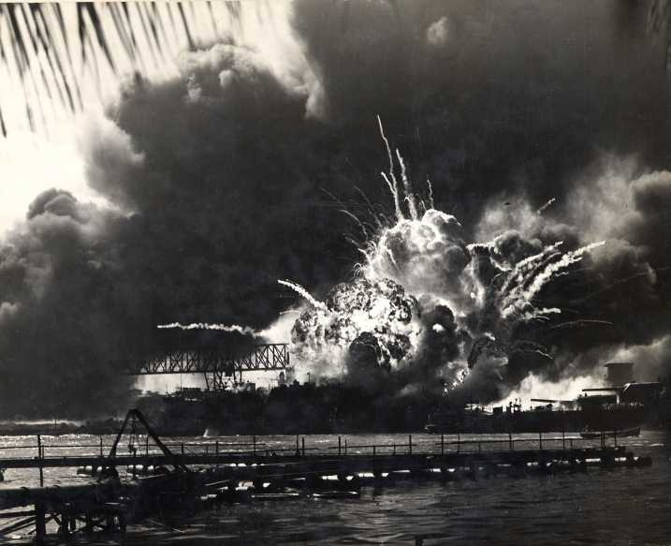
South pacific battles
The bombing of Pearl Harbor started the involvement of the United States in Pacific battles
Major Battles the U.S. was involved in
  Battle of Coral Sea
  Battle of Midway- U.S. sunk four Japanese carriers
  Battle of Saipan
Bombing of Pearl Harbor
http://www.apfn.org/apfn/image014.jpg

Slide 3
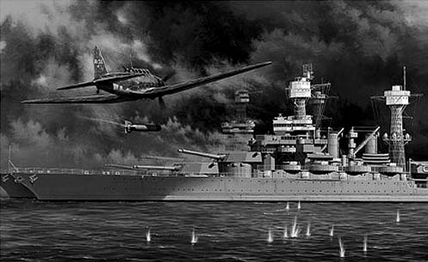
Pearl harbor
December 7, 1941
Japanese bombers attacked Pearl Harbor
2,403 people died
188 planes and ships were destroyed
U.S. declared war on Japan the next day
http://www.rememberingpearlharbor.org/images/pearlharborattack.jpg

Slide 4
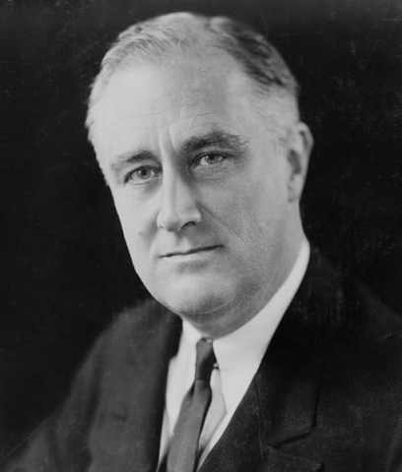
Franklin D. Roosevelt
Democratic President 1933-1945
Paralyzed waist down from polio
Created the New Deal and Social Security Act
Took part in most war decisions
Worked with Great Britain’s prime minister, Winston Churchill
Formed a closer alliance with Great Britain
http://gardenofpraise.com/images/roos.jpg

Slide 5
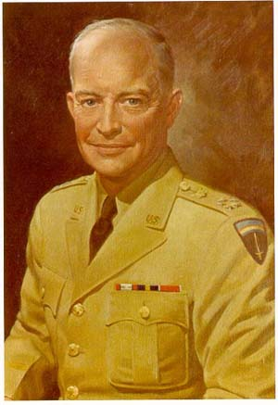
Dwight David eisenhower
Led the Allied forces during the war
Named Commander of U.S. forces
Planned Operation Overlord and the D-Day invasion of Normandy
Became General of the army
Elected President in 1952
http://ehistory.osu.edu/world/library/books/wwii/army/ike/images/001.jpg

Slide 6
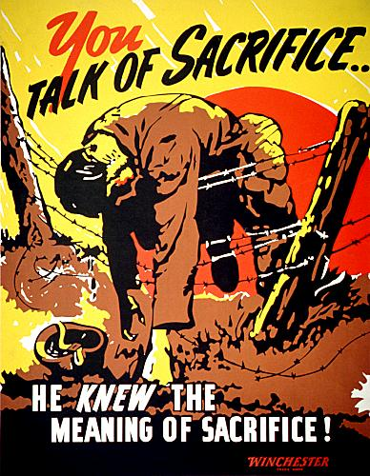
Poster from WWII
Most men wanted to be in the war
Some would get too scared to enlist
Others weren’t afraid of anything
They would die for the country
http://www.crestock.com/uploads/blog/2008/propagandaposters/us_propaganda-33.jpg

Slide 7
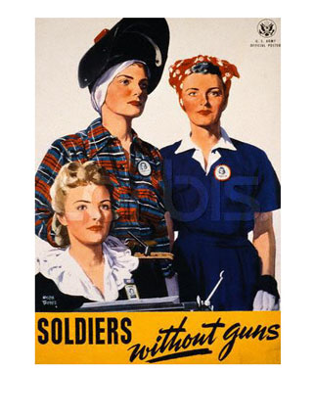
Poster from WWII
Shows women had to do a lot of hard work
Women were the soldiers at home
Took care of family
Had to make money
Wasn’t sure if husband would ever come home
http://www.allposters.com/-sp/Soldiers-Without-Guns-Posters_i1370826_.htm

Slide 8
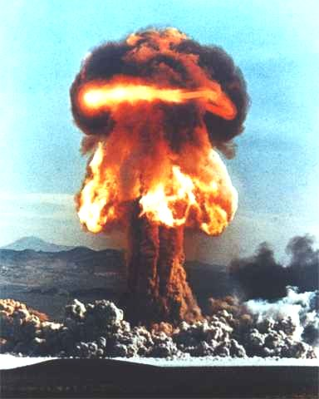
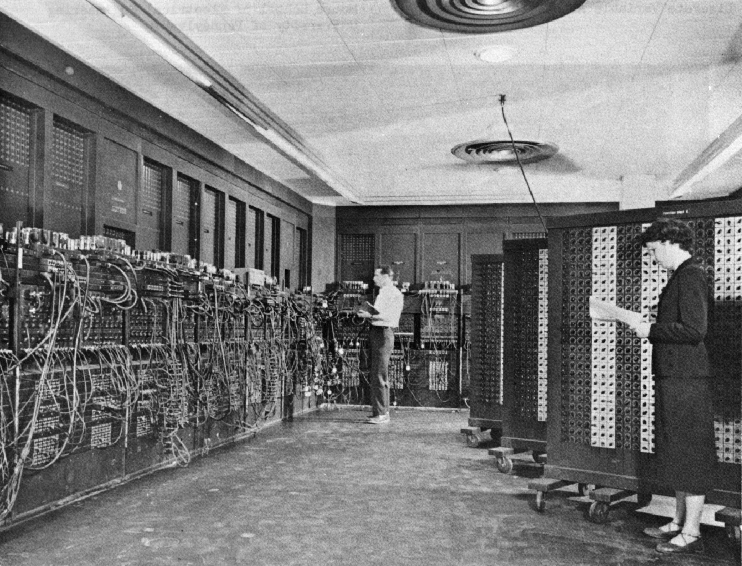
inventions
Many inventions during WWII
Improved and helped with war
Guided missile
Atom bomb
Computer
Penicillin
http://blog.adw.org/wp-content/uploads/2009/04/atombomb.jpg
http://upload.wikimedia.org/wikipedia/commons/4/4e/Eniac.jpg

Slide 9
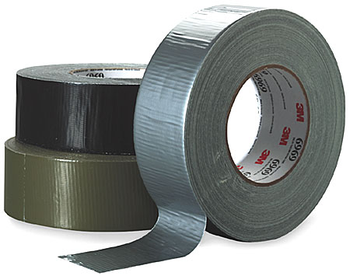
Duct Tape
First manufactured in 1942 for the war
Was used to keep moisture out of ammunition
Fixed supplies, guns, and vehicles
Helped fix household items after war
http://2.bp.blogspot.com/_ZhOxxbFUEzU/TGrhvLyNxWI/AAAAAAAAAHM/uHHtquOBBEQ/s1600/duct+tape.jpg

Slide 10
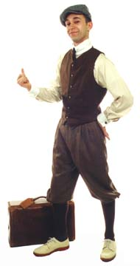
Clothing
Fairly relaxed and less formal
Slacks for work
Neckties with bold designs
Elastic-waisted knickers for sports
http://2.bp.blogspot.com/_OEoWXhjJ6nI/S_ye8mBJ31I/AAAAAAAADys/lvrwYbCU-iM/s1600/knickerbocker_knickers_1920s_mens_fashion_jazz_age.jpeg

Slide 11
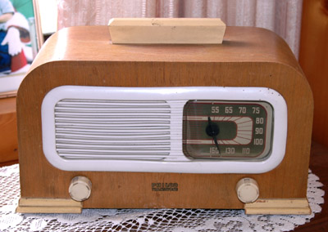
Radio
Lifeline for Americans
Had all of their entertainment
Provided-
    News
    Music
    Entertainment
    Shows
    Sports
http://www.antiqueradiomuseum.org/Philco%2042-PT95%201942.jpg

Slide 12

Top songs
White Christmas- Bing Crosby
Moonlight Cocktail- Glenn Miller
Chattahooga Choo Choo- Glenn Miller
Click to play White Christmas

Slide 13
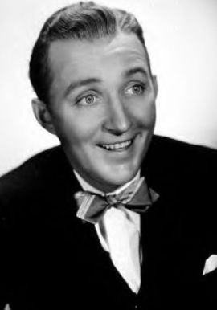
Bing Crosby
White Christmas sold 100 million copies
Most recorded performer in history
Was on commercial and radio recordings
Had film and television appearances
http://freepages.genealogy.rootsweb.ancestry.com/~smason/photos/crosby.jpg

Slide 14
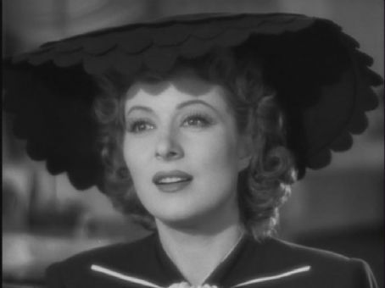
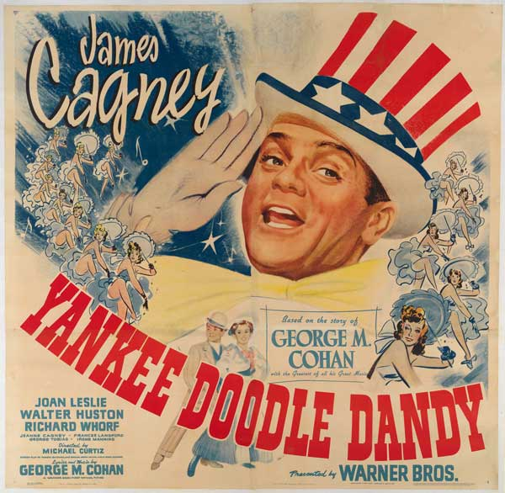
Top actors/actresses
James Cagney- Yankee Doodle Dandy
Ronald Colman- Random Harvest
Greer Garson- Mrs. Miniver
Bette Davis- Now, Voyager
http://www.npg.si.edu/exhibit/ballyhoo/images/lessons_cagney.jpg
http://content7.flixster.com/photo/12/05/26/12052669_gal.jpg

Slide 15
Bestselling Books in 1942
The Song of Bernadette by Franz Werfel
The Moon is Down by John Steinbeck
Dragon Seed by Pearl S. Buck
And Now Tomorrow by Rachel Field
The Robe by Lloyd C. Douglas

Slide 16
Sports
World Series- Cardinals vs. Yankees (4-1)
Stanley Cup- Toronto vs. Detroit (4-3)
NCAA Basketball Championship- Stanford vs. Dartmouth (53-38)
NCAA Football Champions- Ohio State

Slide 17
How much things cost in 1942
Average cost of new house- $3,770.00
Average cost for house rent- $35.00 per month
Average wages per year- $1,880.00
Average price for a new car- $920.00
Cost of a galloon of gas- $0.15
Bottle of Coca Cola- $0.05
1942

Slide 18
Works Cited
1940s Bestsellers. 14 September 2010 <http://www.caderbooks.com/best40.html>.
1942. 13 September 2010 <http://www.infoplease.com/year/1942.html#axzz0zeTQAAIA>.
1942 Academy Award Winners and History. 13 September 2010 <http://www.filmsite.org/aa42.html>.
Ament, Phil. Duct Tape. 12 September 2010 <http://www.ideafinder.com/history/inventions/ducttape.htm>.
Biographies of Major Military and Political Leaders in World War II. 15 September 2010 <http://library.thinkquest.org/10927/leadww2.htm>.
Franklin D. Roosevelt. 12 September 2010 <http://www.historycentral.com/bio/presidents/f_roosevelt.html>.
Goodwin, Susan. American Cultural History. 12 September 2010 <http://kclibrary.lonestar.edu/decade40.html>.
McGeehan, John. Major WWII Battles in the South Pacific. 15 September 2010 <http://www.everything.com/Major-WWII-Battles-in-the-South-Pacific/#axzz0zd4Ewk58>.

Slide 19
Works Cited Continued
More Than Seventy Years of History of Fashion. 12 September 2010 <http://www.thepeoplehistory.com/fashions.html>.
Most Popular Books Published in 1942. 14 September 2010 <http://www.goodreads.com/book/popular_by_date?year=1942>.
Pearl Harbor. 15 September 2010 <http://www.pearl-harbor.com/>.
The Official Home of Bing Crosby. 14 September 2010 <http://bingcrosby.com/>.
The Year 1942. 12 September 2010 <http://www.thepeoplehistory.com/1942.html>.
Top Actors by Decade 1940. 14 September 2010 <http://movies.toptenreviews.com/actors/list_d1940_actor.htm>.
Top Popular Songs of 1942. 12 September 2010 <http://www.popularsong.org/1942.html>.
World War II. 13 September 2010 <http://www.u-s-history.com/pages/h1661.html>.

