Slide 1
A Separate Peace Time Capsule
By:
Noah Kinghorn
A Separate Piece book-15

Slide 2
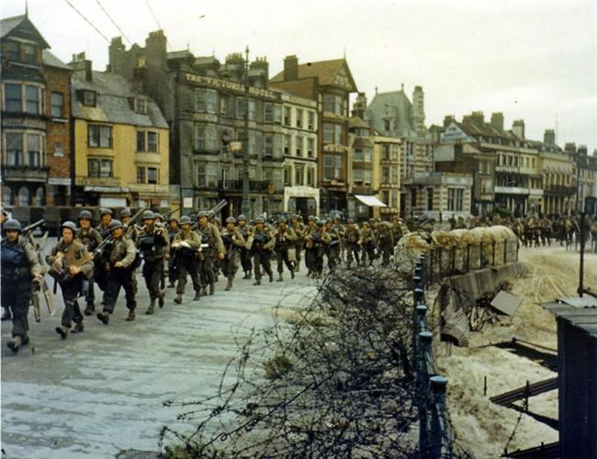
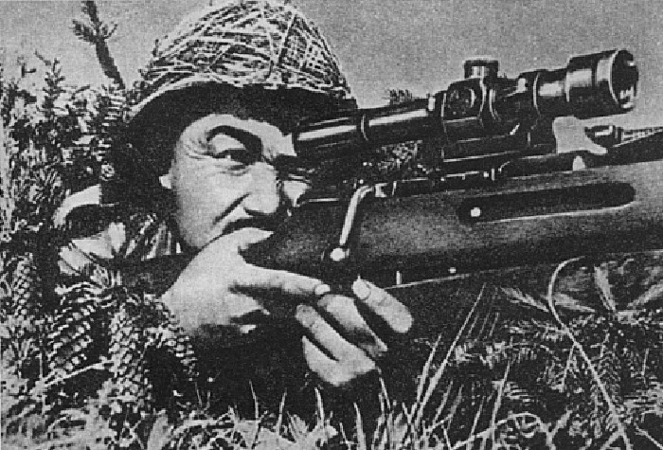
South Pacific battles in WWll-1
December 7, 1941 - Japanese bomb Pearl Harbor, Hawaii.
December 8, 1941 - U.S. and Britain declare war on Japan.
Marching Soldiers-16 Soldier-16
Gene would want to know this because he would be interested in the war

Slide 3
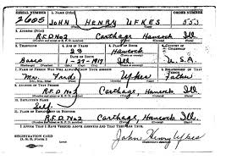
The draft-2
During the war, nobody was deferred from the draft. All sorts of people, from the rich to the poor, went into the army with great excitement and courage.
What made the draft go well during WWll was that many people wanted to fight and almost all were accepted.
There were special cases for the mentally handicapped and the psychotic where they would refuse them or give them a section 8 discharge.
Gene would want to see this because he was thinking about enlisting
Draft card- 17

Slide 4
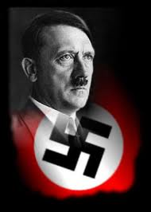
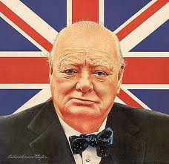
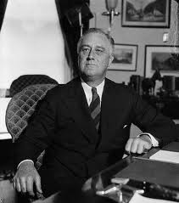
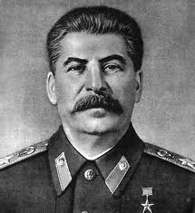
Political leaders in 1942-3
Winston Churchill- Lead Great Britain for most of WWll and bulldog spirit summarized the mood of the British people.
Adolf Hitler- Leader of the Germans, called the Nazi’s in WWll and led the Nazi’s into WWll by the mass killing of Jews.
F D Rosevelt- was the president of America for WWll and used an effective technique to better the economic depression.
Joseph Stalin- was the leader of Russia during WWll and it was his army that launched the final assault on Germany in the Battle of Berlin in the spring of 1945.
Gene would want to know this because he would want to know the leaders of the nations in the war
Hitler-18 Churchill-19 Rosevelt-20 Stalin-21

Slide 5
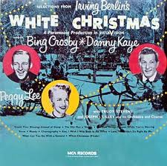
Top songs-4
1.White Christmas-- Bing Crosby 2.Moonlight Cocktail-- Glenn Miller 3.Kalamazoo-- Glenn Miller 4.Jingle, Jangle, Jingle-- Kay Kyser 5.Tangerine-- Jimmy Dorsey 6.Jersey Bounce-- Benny Goodman 7.Sleepy Lagoon-- Harry James 8.Blues In the Night-- Woody Herman 9.He Wears a Pair of Silver Wings-- Kay Kyser 10.Somebody Else Is Taking My Place-- Benny Goodman
Cover of album-22
Gene would be interested in this because he would probably have listened to this song

Slide 6
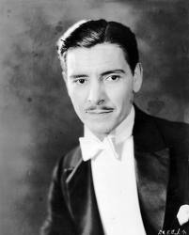
Popular authors and actors-5
Ronald Colman (Random Harvest)
Gary Cooper (Pride of the Yankees)
James Cagney (Yankee Doodle Dandy)
Walter Pidgeon (Mrs. Miniver)
Monty Woolley (The Pied Piper)
Ronald Coleman-23
Gene would have probably seen a movie with Coleman in it.

Slide 7
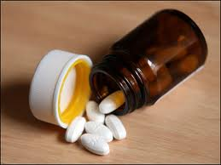
Popular inventions and medical breakthroughs-6
ANEMOMETER- measured wind speed
CARAVEL- light sailing ship
SCREWDRIVER- tool to screw screws in.
Penicillin- medicine used to treat wounds
Gene would be interested in this because it was a major Medical Breakthrough.
Penicillin pills-24

Slide 8
New Hampshire-7
Gene would be interested in this because this is the state where he attended the preparatory school
Capitol is Concord
Became the 9th state on June 21, 1788
Population is about 1,275,000 (2002 estimates)
Motto is “Live Free or Die”
Four nicknames are:
Granite State- for expensive granite quarry’s
Mother of Rivers- for the rivers that come in from the mountains.
White Mountain State- for white mountain range.
Switzerland of America- beautiful mountain scenery.

Slide 9
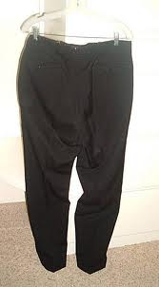
Fashion-8
In 1942 some boys still wore knickers. Mostly, smaller boys wore shorts, but most older boys wore pants. Those who wore shorts usually wore ankle socks.
Because of the war, most fabric was limited and was conserved. It limited all that could be done with the clothing so that the clothing was simple, easy and fast to make, and took less fabric.
A bunch of fabric was taken for the army and made into the uniforms they wore.
A pair of knickers-25
Gene would like this because he probably wore something like this.

Slide 10
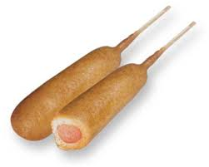
Food-9
Corn dogs were invented
Every other day milk delivery was started
Coffee rationing began
US military started using K-rations
War-time food rationing began
Corn dogs-26
Gene would like this because he probably had a corn dog when they first came out.

Slide 11
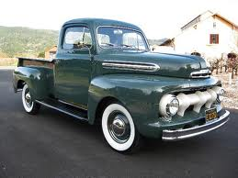
Automobiles(cars)-10
Ford F-1
Willies Street Rod
Ford 2-Dr Coupe
Alfa Romeo 6c
Lincoln Continental
Chevrolet Special Deluxe
Ford F-1
Gene would like this because he probably wanted a car similar to these.

Slide 12
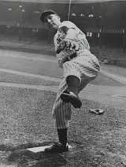
World Series in 1942-11
Back in the 1940’s and up baseball was a huge thing.
The world series was between the New York Yankees and the St. Louis Cardinals.
The Cardinals won with only five games, their first championship since 1934 and their fourth overall.
The Cardinals set a record for victories with, 106 wins.
The Yankees won the first game.
The loss was the Yankees' first since the 1926 World Series!
Baseball player-27
Gene would be interested in this because he most likely missed out on the baseball games while at Devon.

Slide 13
Economy-12
With the Great Depression going on the economy was in a bad state, that is until WWll ended it.
With all the spending the nation had to do to survive the war, the Great Depression slowly evaporated and the economy returned to normal. It was shaky and hanging on a limb, but it was normal.
But everything was not good. Every day many people lost their life's fighting for our nation. The war was so far-reaching it was killing people inside of America too. Food was rationed and often people could not get the food they needed to survive. The war was good and bad. It ended the depression, but it also caused many to lose their life.
Gene would want to know the state of the economy.

Slide 14
Facts about 1940's decade-13
Population 132,122,000
Many people were unemployed with a number of 8,120,000
The US National Debt was $43 Billion
Minimum wage was $.43 per hour
The average salary was $1,299
Antarctica is discovered to be a continent
The Life expectancy was 68.2% female and 60.8% male
These are nice facts that Gene would most likely like to read.

Slide 15
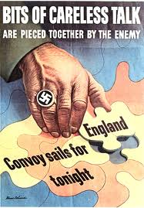
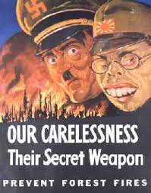
Propaganda posters
- 28

Slide 16
Works Cited
http://www.historyplace.com/unitedstates/pacificwar/timeline.htm -1
http://en.allexperts.com/q/Military-History-669/Military-Draft-WWII.htm-2
http://www.historylearningsite.co.uk/political_leaders_of_world_war_t.htm-3
http://www.dzentertainment.com/topsongs.html#1942-4 top songs
http://www.trivia-library.com/a/oscar-history-academy-award-winning-movies-and-actors-of-1942.htm - 5
http://www.enchantedlearning.com/inventors/1400.shtml -6
http://www.historylearningsite.co.uk/medicine_and_world_war_two.htm -6
http://www.visitnh.gov/welcome-to-nh/state-facts.aspx -7
http://histclo.tripod.com/c1940.html -8
http://www.foodreference.com/html/html/food-history-1941.html -9
http://cars.mitula.us/cars/ford-1942-sedan -10
http://timelines.com/1942/9/30/1942-world-series -11
http://eh.net/encyclopedia/article/tassava.WWII -12
http://www.wvonline.com/efhs/1940%27sHomePage.HTML -13

Slide 17
Works Cited (pictures)
Google.com/images/aseparatepeace -15
Google.com/images/WorldWar2 -16
Google.com/images/WorldWar2drarft -17
Google.com/images/Hitler -18
Google.com/images/Churchill -19
Google.com/images/F.D.Rosevelt -20
Google.com/images/Stalin -21
Google.com/images/awhitechristmassoundtrackcover -22
Google.com/images/RonaldColeman -23
Google.com/images/Penicillin -24
Google.com/images/Corndog -25
Google.com/images/Ford F-1 -26
Google.com/images/1942 Baseball player -27
Google.com/images/Propaganda posters in 1942 -28

