Slide 1
A separate Peace Time Capsule
Picture of book.
http://www.goodreads.com/book/show/5148.A_Separate_Peace
By Austin Young WB4 9/15/10

Slide 2
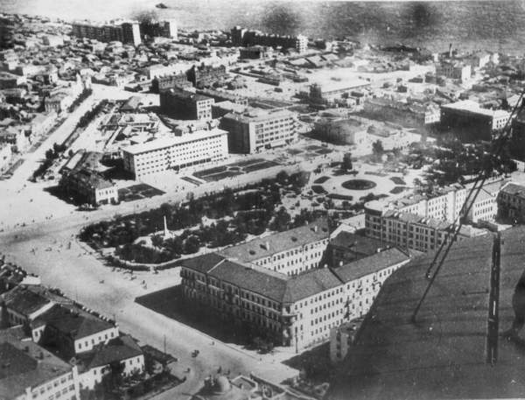
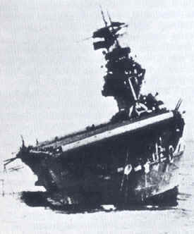
World War 2 Battles
*Battle of Stalingrad was one of the deadliest war known to man, had an estimated of 1 to 2
million deaths.
*Battle of Berlin was marked by the
of the end of the war.
*Battle of Midway was fought June of ‘42 and Americans had destroyed the strength of Japan’s navy.
2
Picture of Stalingrad
3 sinking battle ship

Slide 3
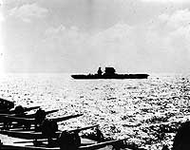
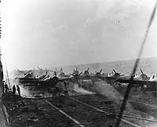
World War 2
Pic of battle ship
Pic of planes taking off
These are pictures from the Battle of Coral Sea
http://www.history.navy.mil/photos/events/wwii-pac/coralsea/coralsea.htm

Slide 4
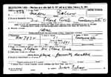
Draft
http://fialco.dumes.net/FamilyDocuments.html
Is a picture of a draft form

Slide 5
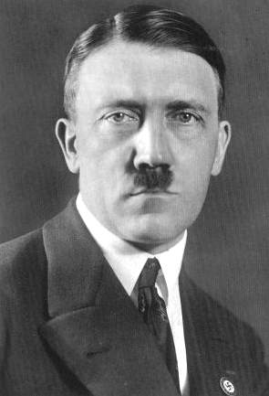
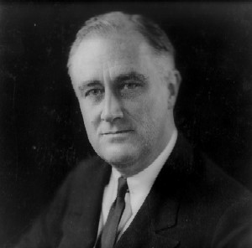
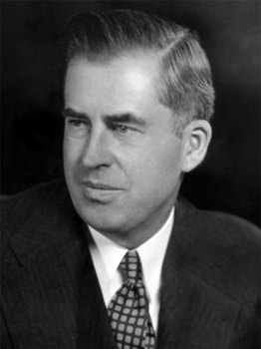
Political Leaders
Adolf Hitler – evil man, dict- ator of Germany
Franklin Roosevelt- becomes president
Henry Wallace- becomes vice-president
Pic of Adolf Hitler
http://adolfhitlerinterestingfacts.com/
http://www.livinghistoryfarm.org/farminginthe40s/worldevents_01.html
Pic of Franklin Roosevelt
http://listverse.com/2008/10/15/5-worst-presidential-candidates-who-lost/
Pic of Henry Wallace

Slide 6
Song
1- ‘Round Midnight by Sister Swing
2- 42nd Street by Sister Swing
3- A Gall in Cilco by Glenn Miller Orchestra
4- ‘Till Reveille by Kay Kyser
Can find these songs and more at http://www.nutsie.com/playlist/1940's/3792525

Slide 7
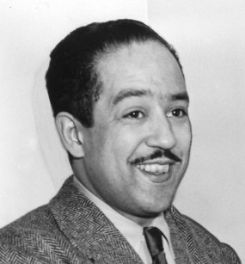
Famous Author
Langston Hughes first Black American writer.
http://langstonhughesfacts.com/
Langston Hughes

Slide 8
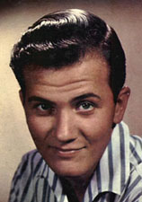
Famous Singer
Pat Boone was a very famous singer and only one person outranked him: Elvis Presley.
http://www.joegirardmusic.com/jazz_singers.htm
Pat Boone

Slide 9
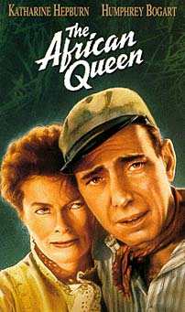
Famous Actor
Humphrey Bogart played in several movies and became very famous in Hollywood.
Bogart is the man in this picture.
http://www.movieactors.com/superstars/humphrey_bogart.htm

Slide 10
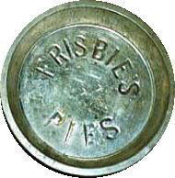
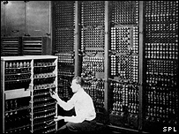
Inventions
Frisbee-1948
First Computer-1946
http://www.catchthespirit.co.uk/cat/about-disc-sports/history-of-frisbee
http://news.bbc.co.uk/2/hi/health/6233631.stm

Slide 11
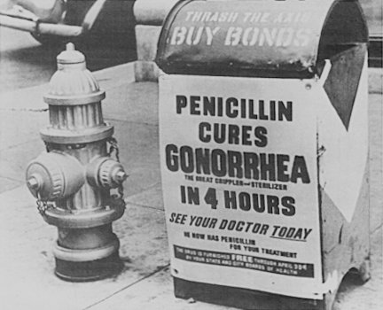
Medical Breakthroughs
Penicillin-came out during the 1940’s was huge because it cured lots of diseases.
Mailbox containing an ad for the new Penicillin.
http://c-lab.co.uk/default.aspx?id=8&eventid=80

Slide 12
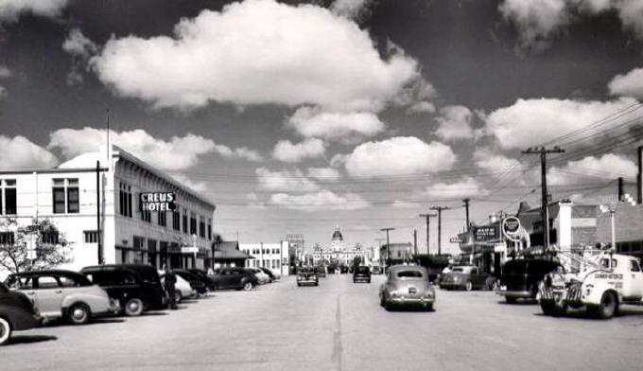
New Hampshire
Road in New Hampshire
http://www.familyoldphotos.com/tx/2h/highland_street_marfa_texas.htm

Slide 13
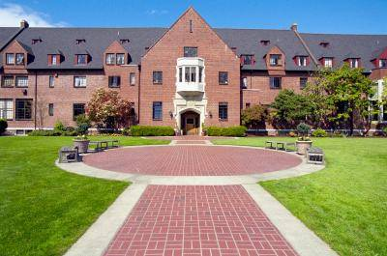
Preparatory Schools
http://privateschool.about.com/od/seattl1/ss/seattletour_4.htm
This is a picture of a Preparatory School

Slide 14
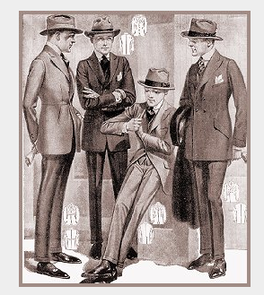
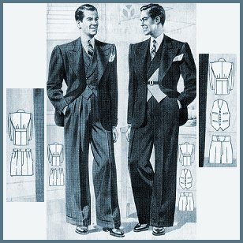
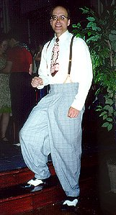
Fashion
Men’s Fashion of the 1940’s
http://www.murrayontravel.com/carolnolan/

Slide 15
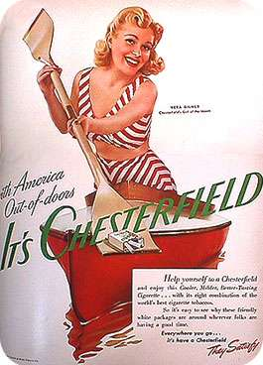
Advertisements
Advertisement for Coffee
Advertisement for Cigarettes
http://courses.washington.edu/hypertxt/cgi-bin/book/contexts/satire3.html

Slide 16
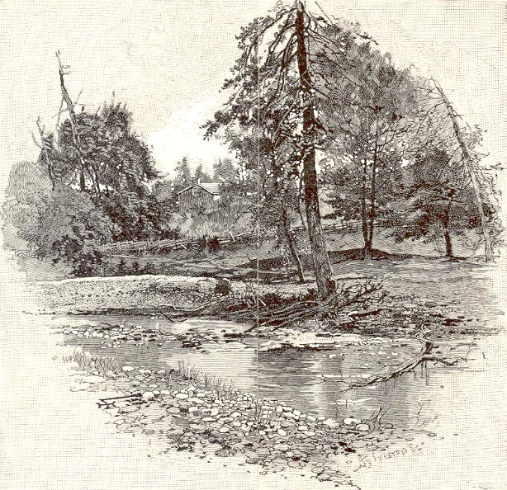
The Tree
This slide was just to help Gene remember Finny, by putting in a picture of a tree over a river to signify what they liked to jump off of, before the accident.
A design with a tree, next to a river, with it’s limb broken off.
http://www.rugreview.com/cw/cwe1.htm

Slide 17
Citations
"World Records." Farming in the 40's. N.p., n.d. Web. 15 Sep 2010. <http://www.livinghistoryfarm.org/farminginthe40s/worldevents_01.html
Holocaust Education & Archive Research Team. H.E.A.R.T, 2008. Web. 15 Sep 2010. <http://www.holocaustresearchproject.org/nazioccupation/opbarb.html
"History of World War 1939-1945." The History War Online. Decades Ago by, 2006. Web. 15 Sep 2010. <http://www.historyofwaronline.com/WW2MP.html>. (both picture of Stalingrad and information on slide 2)
"Battle for Berlin." Famous Battles of World War 2. historylearningsite.co.uk, 2000-10. Web. 15 Sep 2010. <http://www.historylearningsite.co.uk/battle_for_berlin.htm
3 "Battle for Midway." Famous Battles of World War 2. historylearningsite.co.uk, 2000-10. Web. 15 Sep 2010. <http://www.historylearningsite.co.uk/battle_of_midway.htm ( both picture of sinking ship and info. from Battle of Midway on slide 2)
Flippen, Rod. "1940's." nuTsie. Melodeo Inc., 2007-10. Web. 15 Sep 2010.<http://www.nutsie.com/playlist/1940's/3792525>
"Langston Hughes." Books and Writers. N.p., 2008. Web. 15 Sep 2010. <http://kirjasto.sci.fi/lhughes.htm>.
Flippen, Rod. "Famous Jazz Singers and Entertainers from the Rat Pack and the Middle of the Road." Famous Jazz Singers. N.p., n.d. Web. 15 Sep 2010. <http://www.joegirardmusic.com/jazz_singers.htm>.
"The Decade of War." The 1940's. N.p., n.d. Web. 15 Sep 2010. <http://www.kyrene.org/schools/brisas/sunda/decade/1940.htm>.

