Slide 1
A Separate Peace Electronic Time Capsule Project
By Ryan Tucker

Slide 2
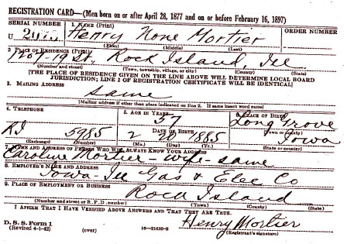
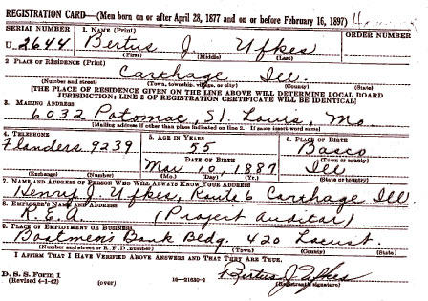
The Draft
The draft was made a law on September 16, 1940.
Men between the ages of 24 and 35 were required to register.
On October 16, 1940, the first registration occurred.
25
A WWII draft card
25
WWII draft card
(26)

Slide 3
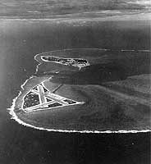
WWII Pacific Battle- Midway
Fought July 4-7, 1942
Fought over and around the U.S. base
on the island of Midway
Japan wanted to destroy the U.S. Pacific Fleet.
Pacific Fleet set an ambush for the Japanese
9
(9)

Slide 4
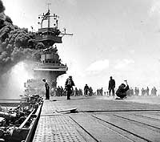
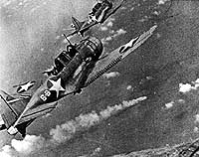
WWII Pacific Battle- Midway
U.S. naval aviators sunk or severely damaged 4 Japanese carriers.
Only 1 U.S. carrier lost
9
9
(9)

Slide 5
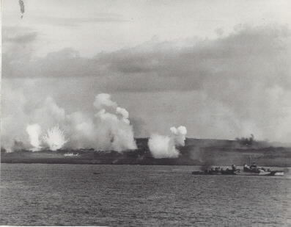
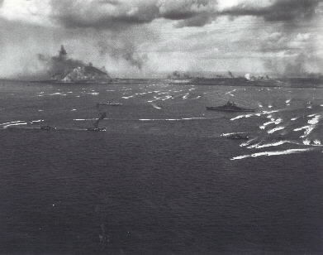
WWII Pacific Battle- Iwo Jima
Attack started February 19, 1945
The island was strategically important to the U.S.
On March 26, after over a month of heavy fighting, the Marines declared the island secure.
8
8
(8)

Slide 6
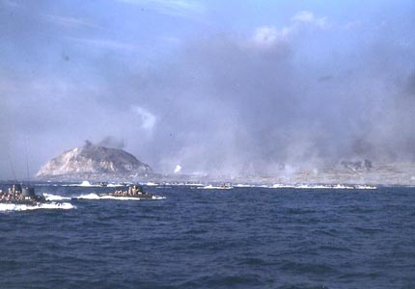
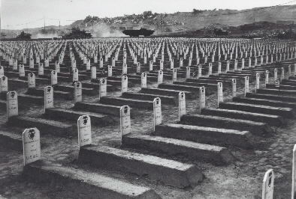
WWII Pacific Battle- Iwo Jima
U.S.- suffered 26,000 casualties, including 6,800 dead Marines
Japan- only 1,083 of the original 20,000 defenders survived
8
8
(8)

Slide 7
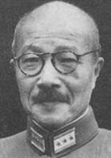
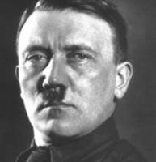
Political Leaders
7
7
Hideki Tojo- Axis
Prime Minister of Japan
Responsible for the attack on Pearl Harbor
Very aggressive military leader
Executed after WWII for war crimes
Adolf Hitler- Axis
Became German Prime Minister in 1933
Later became dictator of Germany
Invaded Poland, starting WWII
(7)

Slide 8
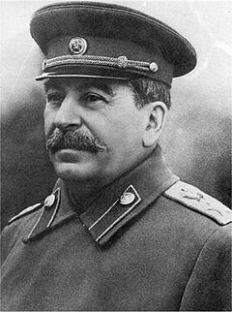
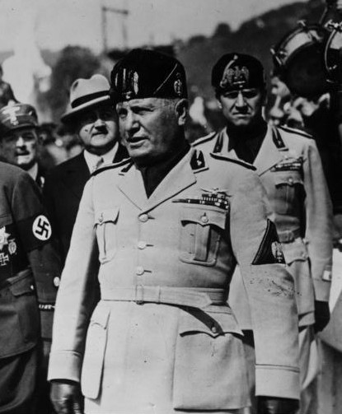
Political Leaders
14
Joseph Stalin- Allies
Communist dictator of the Soviet Union from 1928 to 1953
Murdered many military officers before the start of WWII
Initially made a deal with Hitler, but the Germans still attacked the Soviet Union
Benito Mussolini- Axis
Prime Minister of Italy from 1922 to 1943
Invaded weaker neighbors during WWII
Allied himself with Hitler
15
(7)

Slide 9
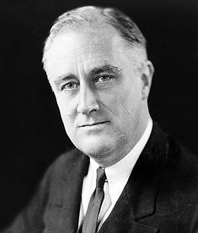
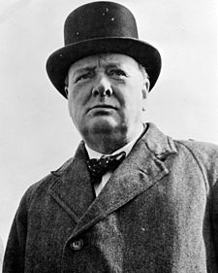
Political Leaders
7
Franklin D. Roosevelt-Allies
President of the U.S. from 1933 to 1945
Tried to remain neutral in WWII
Because of the attack on Pearl Harbor, the U.S. entered WWII.
Died in April 1945, shortly before the end of the war
16
Winston Churchill-Allies
Prime Minister of Great Britain starting May 10, 1940
Spirit and charm raised morale of British people
Strong alliance with U.S.
One of the most famous leaders of WWII
(7)

Slide 10
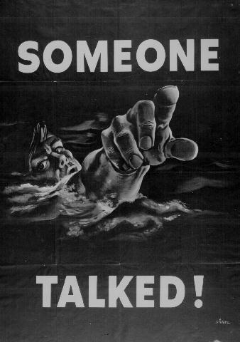
American Propaganda Posters
Encouraged people to save gas by carpooling
Gas was rationed for normal people.
Gas was rationed to 3 gallons a week.
18
Reminded Americans of possible enemy spies
Made the war a reality
People realized that talking could get troops killed.
18
(19)

Slide 11
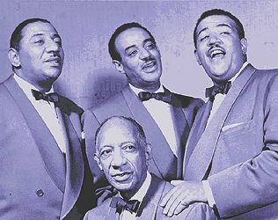
Popular Song
“Till Then”
By the Mills Brothers
The song was about a soldier singing to his girlfriend back home.
It told her to wait for him to return from the war.
4
(5)

Slide 12
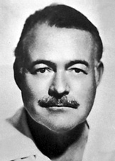
Popular Author
Ernest Hemingway
Born July 21, 1899
For Whom the Bell Tolls published in 1940
Considered one of Hemingway’s best books
Committed suicide with a shotgun on July 2, 1961
1
(2,3)

Slide 13
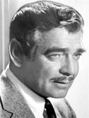
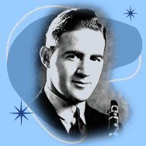
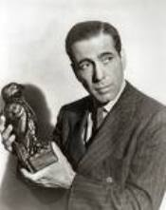
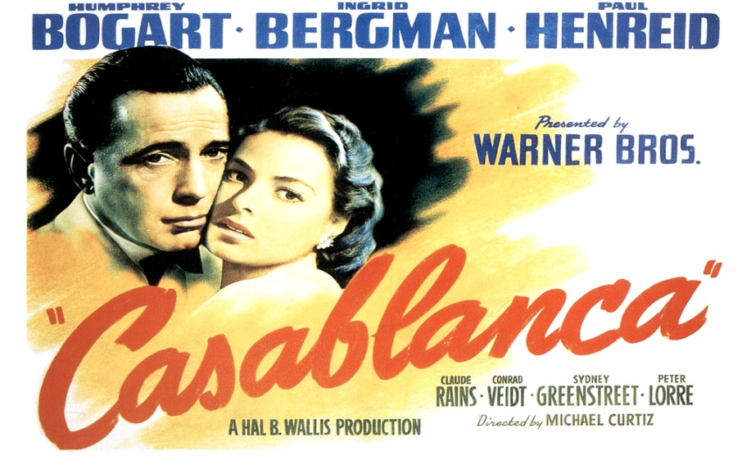
Other Popular People and Entertainment
Clark Gable, a popular actor who enlisted
13
10
Benny Goodman, a popular jazz musician
12
Humphrey Bogart, an actor who starred in “Casablanca”
11
The movie “Casablanca” was made in 1942.

Slide 14
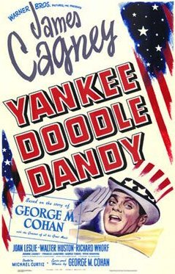
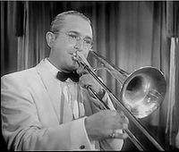
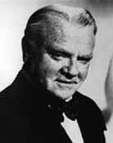
More Popular People and Entertainment
Tommy Dorsey was another popular jazz musician.
James Cagney starred in “Yankee Doodle Dandy” in 1942.
24
“Yankee Doodle Dandy” was made in 1942.
23
22

Slide 15
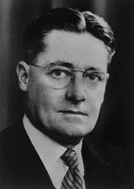
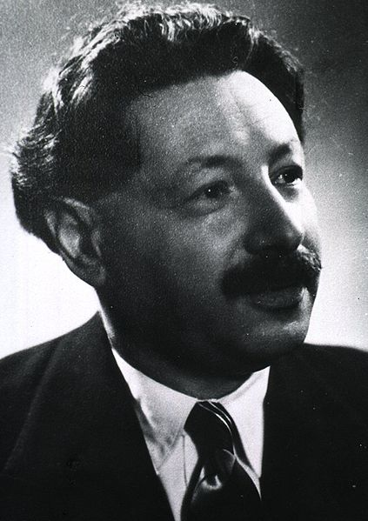
Medical Discovery
Penicillin
1940- method to produce usable form of penicillin developed by Howard Florey and Ernst Chain
1941- 1st clinical tests prove drug can cure many life-threatening infections
Howard Florey
27
Ernst Chain
28
(17)

Slide 16
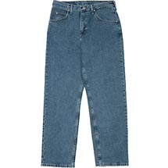
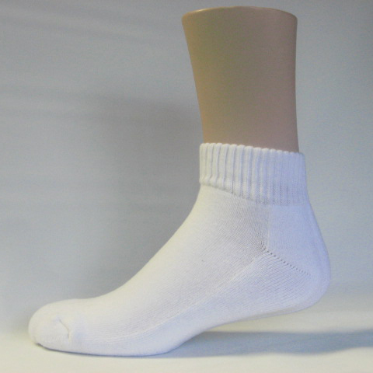
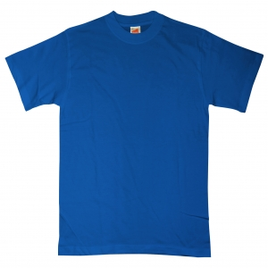
Teenage Boys’ Fashion
Fabric was needed for soldiers’ uniforms.
Fabrics were in short supply, including silk and nylon.
21
Jeans were worn outside of school.
Ankle socks were popular.
T-shirts started to come into style.
(20)

Slide 17
Works Cited
http://nobelprize.org/nobel_prizes/literature/laureates/1954/hemingway-bio.html
http://www.ernesthemingway.org.uk/
http://www.lostgeneration.com/childhood.htm
http://www.singers.com/jazz/vintage/millsbrothers.html
http://www.last.fm/music/The+Mills+Brothers/_/Till+Then
http://www.metrolyrics.com/till-then-lyrics-the-mills-brothers.html
http://www.2worldwar2.com/leaders.htm
http://www.history.navy.mil/library/online/battleiwojima.htm
http://www.history.navy.mil/photos/events/wwii-pac/midway/midway.htm
http://pbskids.org/jazz/nowthen/goodman.html
http://www.filmsite.org/casa.html
http://en.wikipedia.org/wiki/Humphrey_Bogart
http://www.biography.com/articles/Clark-Gable-9304376
http://en.wikipedia.org/wiki/Joseph_Stalin

Slide 18
Works Cited
http://en.wikipedia.org/wiki/Benito_Mussolini
http://en.wikipedia.org/wiki/Winston_churchill
http://library.duke.edu/digitalcollections/mma/timeline.html
http://www.propagandaposters.us/poster10.html
http://library.thinkquest.org/C0111500/ww2/american/amerprop.htm
http://histclo.tripod.com/c1940.html
http://www.walmart.com/ip/Wrangler-Men-s-Relaxed-Fit-Jeans/892584?sourceid=1500000000000003260430&ci_src=14110944&ci_sku=892584
http://www.kennedy-center.org/explorer/artists/?entity_id=3702&source_type=A
http://en.wikipedia.org/wiki/Tommy_Dorsey#His_own_band
http://en.wikipedia.org/wiki/Yankee_Doodle_Dandy
http://www.rootdig.com/draft/worldwartwo.html
http://www.nebraskastudies.org/0800/frameset_reset.html?http://www.nebraskastudies.org/0800/stories/0801_0106.html
http://en.wikipedia.org/wiki/Howard_Florey
http://en.wikipedia.org/wiki/Ernst_Chain

