Slide 1
A Separate Peace Electronic Time Capsule
Logan Campbell

Slide 2
WWII Battles in The Pacific -1
Pacific War was the largest naval conflict in history
Fought between the two most powerful navies in the world
Was fought in the coldest and hottest conditions

Slide 3
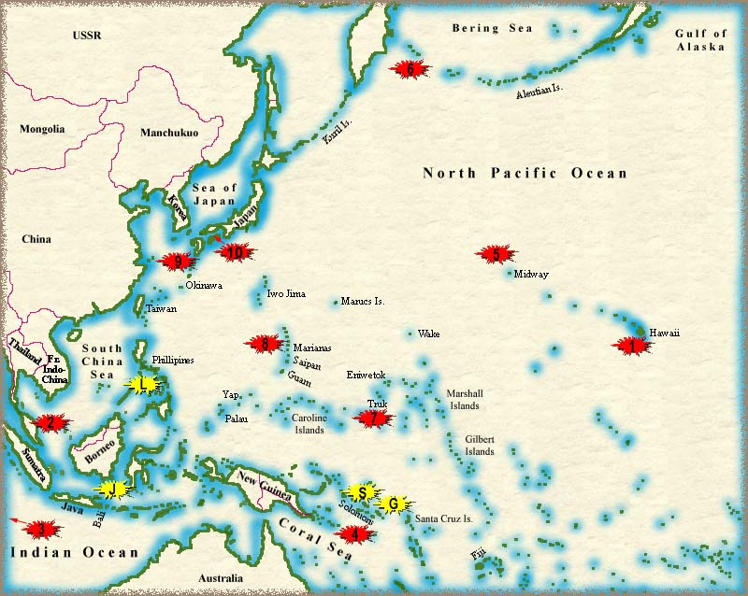
Map of Pacific Naval Battles - 1
1.
Combinedfleet.com

Slide 4
Leaders/Aftermath - 1
Chester W. Nimitz, Douglas MacArthur, George C. Marshall – USA
Kotohito Kan’in & Hideki Tojo –Japan
Resulted in the fall of the Japanese empire
The Americans and it’s allies occupied Japan for almost a year until the war ended

Slide 5
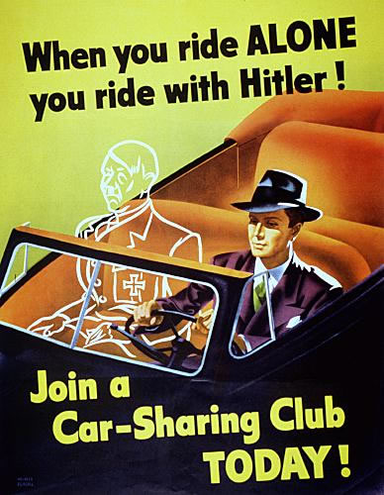
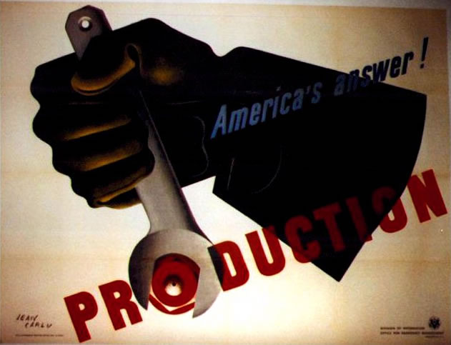
Propaganda Posters - 4
http://www.2worldwar2.com/leaders.htm
http://www.2worldwar2.com/leaders.htm

Slide 6
Popular Songs - 2
1. Harvest Moon Oh, shine on, shine on harvest moon up in the sky I ain't had no lovin since January, February, June or July. Snow time ain't no time to sit outdoors and spoon So shine on, shine on harvest moon for me and my gal.
3. Its a Grand Old Flag Its a grand old flag, Its a high flying flag and forever in peace may it wave, Its the emblem of the land I love, the home of the free-and the brave. Every heart beats true for the Red, White and Blue And with never a boast or brag, Should old acquaintance be forgot, Keep your eye on the grand old flag
2. Working on the R.R. I've been workin' on the railroad all the live-long day; I've been workin' on the railroad just to pass the time away; Doan' you hear de whistle blowin ? Rise up so early in do morn; Doan't yo hear de captain shoutin' "Dinah blow your horn."
4. Beer Barrel Polka Roll out the barrel We'll have a barrel of fun Roll out the barrel We've got the blues on the run Zing! Boom! Tararre! Ring out a song of good cheer Now's the time to roll the barrel For the Gang's all here.

Slide 7
Popular Songs - 2
Harvest Moon - credited to Nora Bayes and Jack Norworth; still continues today to be performed and recorded
Working On The Railroad – American folk song; earliest know recording of this song is by the Sandhills Sixteen in 1927
It’s A Grand Old Flag – American patriotic song written by George M. Cohan
Beer Barrel Polka – is also known as Roll Out the Barrel, is a song which became popular worldwide during World War II. The music was originally composed by the Czech musician Jaromír Vejvoda in 1927

Slide 8
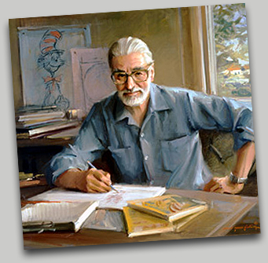
Popular Author: Dr. Seuss - 3
Known as Theodor Seuss Geiselor Dr. Seuss
Published over 60 children’s books
Published over 200 million copies
Received two Emmy awards, a Peabody award and the Pulitzer Prize.
His works have provided eleven children's television specials, a Broadway musical and a feature-length motion picture

Slide 9
Inventions and Medical Discovery - 5
Synthetic rubber
Radar and ASDIC (sonar)
Penicillin was used to treat wounds and bacterial diseases
Frisbee
Plastic
ENIAC – first computer

Slide 10
Fashion – Women/Young Men - 5
Sweaters were extremely popular for women in the 1940’s
People thought that sweaters were dangerous because they could get caught in machinery
American designers responded with designs of great luxury and dresses like the evening dress.
One of the cool kinds of sandals were called the “Naked Sandal”
Young men usually wore cover-alls, T-shirts, and plain old running shoes or plain shoes with very hard toes on them. Good clothes were kept for Sunday church or for an outing

Slide 11
American Political Leaders: Roosevelt - 4
Franklin D. Roosevelt – was the president during World War II
Wanted to remain neutral and isolate the country from foreign war
Changed his mind when realizing that the Nazis were a global threat

Slide 12
American Ally Political Leader: Stalin - 4
Joseph Stalin – the very brutal communist dictator of Russia
Dictator from 1928-1953
Murdered/imprisoned almost all of Russia's senior military officers, and millions of other Russian citizens
After the war ended, Stalin returned to his political power until his death.

Slide 13
American Ally Political Leader: Churchill - 4
Winston Churchill – prime minister of Great Britain
Formed strong alliance with U.S.
Was one of the two main World War II leaders
One of the most prominent national leaders in history

Slide 14
Work Cited
1. John, Reagan. "Pacific War Maps." combinedfleet.com. N.p., n.d. Web. 12 Sep 2010. <http://combinedfleet.com/battles/>.
2. "Popular Songs During WWII.." www.b26.com. N.p., n.d. Web. 12 Sep 2010. <http://www.b26.com/page/popular_songs.htm>.
3. Technology, Tortus. "Theodor Seuss Giesel." catinthehat.org. Dr.Seuss Enterprises, 2004. Web. 12 Sep 2010. <http://www.catinthehat.org/history.htm>.

Slide 15
Work Cited Continued..
4. "World War 2 Leaders." 2worldwar2.com. N.p., 2001. Web. 12 Sep 2010. <http://www.2worldwar2.com/leaders.htm>.
5. Bryan, Jason. "The 1940's." kyrene.org. N.p., n.d. Web. 12 Sep 2010. <http://www.kyrene.org/schools/brisas/sunda/decade/1940.htm>.
6. All portraits are from Google Images

