Slide 1
A Separate Peace Electronic Time Capsule
Tyler Langdon

Slide 2
General Life
1
Life for a junior in high school in the year 1942 was centered around World War II. Teenagers at this time wanted to join the war effort to show their patriotism. Kids could not wait to graduate high school so they could enlist in the war. When juniors at Devon High School were not thinking about the war, they were either focusing on their studies or playing sports.

Slide 3
Top 5 Movies of 1942
2
#1 Casablanca – starring Claude Rains & Ingrid Bergman
#2 Cat People – starring Simone Simon & Kent Smith
#3 Yankee Doodle Dandy - starring Richard Whorf & Joan Leslie
#4 Bambi - starring Sterling Holloway & Hardie Albright
#5 Road To Morocco - starring Anthony Quinn & Dorothy Lamour
Gene should include these movies in his time capsule because they are the top movies of the time and one of his only sources of entertainment.
1
2
3
4
5

Slide 4
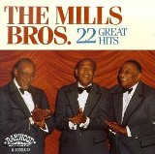
Top Songs of 1942
10
#1 White Christmas - Bing Crosby
#2 Paper Doll - The Mills Brothers
#3 Salt Peanuts – Dizzy Gillespie
#4 (I’ve Got A Gal In) Kalamazoo - Glenn Miller
#5 A String Of Pearls - Glenn Miller
Gene would include these songs in his capsule because he could listen to them to free his mind.
6
8
9
10
7

Slide 5
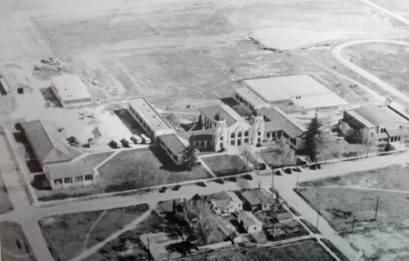
Preparatory School
11
Gene attended the Devon Preparatory school, which was for above average male students, in New Hampshire. Students attended a winter session and a summer session. Devon Preparatory school was centered around academics and sports. The school was set up like a University, the students lived on campus and did not see their families while classes were in session. Students who graduated from Devon could obtain a good job or enlist in the military.

Slide 6
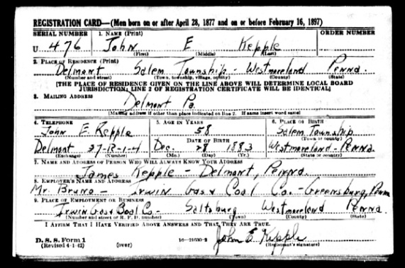
The Draft
3
Millions of men in the United States completed a draft registration card in 1942.
Six million draft cards were sent in.
A typical draft card would include the following information:
Full name
Address
Physical Characteristics
Date and Place of Birth
I believe Gene would include a draft card in his time capsule because the war played a major role in his life.
12

Slide 7
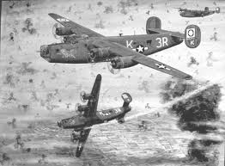
WW II and the South Pacific Battles
Battle of Pearl Harbor
Battle of the Coral Sea
Battle of Guadalcanal
Battle Batann
Naval Battle of Midway
In order to represent these important battles in his life, I think Gene should put a bullet casing in his time capsule.
13

Slide 8
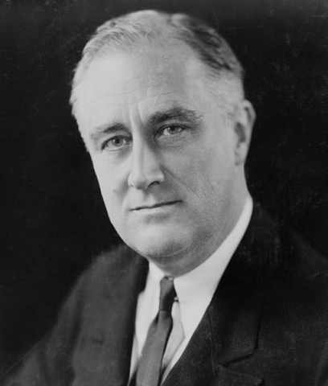
Political Leaders
Franklin Delano Roosevelt – American President
Harry S. Truman - American Vice President
Adolf Hitler - German Dictator
Benito Mussolini – Italian Dictator
Tojo - Emperor of Japan
Gene would include a newspaper or magazine article from a political leader during this time. This would help people have an understanding of World War II and learn the history of the war.
14
Franklin D. Roosevelt

Slide 9
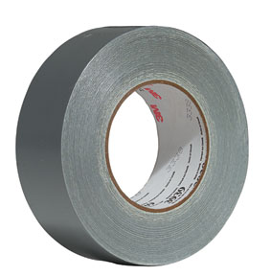
New Inventions
7
8
9
Bell P-63 King Cobra Fighter Aircraft
Duck Tape - Used to keep moisture out of ammunition cases
Guided Missile
US Nuclear Reactor
Electronic Digital Computer
Gene would include these inventions in his capsule because they were the most important inventions of 1942.
15

Slide 10
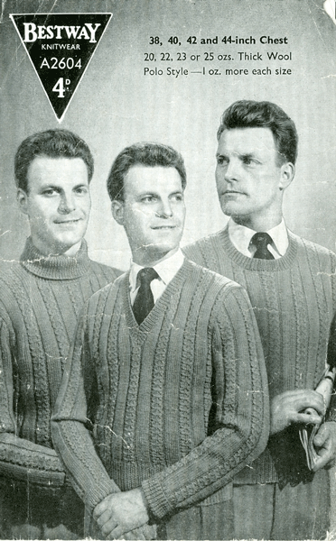
Fashion in 1942
4
Artificial fibers were used from wood pulp. For example: viscose and rayon
There was a limited supply of wool
Women wore a Kangaroo Cloak, which was a piece that had a huge pocket in the front for stuffing household items into while running for shelter after the siren.
Men wore suits and v-neck sweaters.
Military outfits were simple with little or no pockets or vests.
Gene would most likely take one of his favorite sweaters or suits in his time capsule to represent the fashion for men.
16

Slide 11
Food in 1942
5
Coupon books were used during the war to buy household items like meat, sugar and butter. People had to have a coupon to buy something. Some people even traded coupons through a process called Rationing.
People grew their own vegetable and fruit gardens to help.
A bottle of Coca Cola was only 5 cents.
A typical lunch for a student included milk, bread, spaghetti, potatoes and salad. Candy was offered for extra money as a treat.
I believe Gene would add his favorite candy or candy bar in his time capsule since candy was seen as a highly valued treat.
17

Slide 12
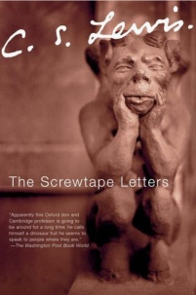
The Top 5 Books of 1942
6
The Stranger by Albert Camus
The Screwtape Letters by C.S. Lewis
Mythology by Edith Hamilton
The Boxcar Children by Gertrude Chandler Warner
Old Yeller by Fred Gipson
Gene would add his favorite book to his time capsule to represent his taste in literature.
18
19
20
21
22

Slide 13
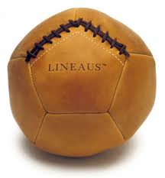
Blitz Ball
Blitz ball was a game created by Phineas. It allowed him and his friends to play around in between lunch and dinner. The first time they played, Phineas made the rules up as they went along. The game was an instant hit and they continued to play it for the remainder of the summer session.
23

Slide 14
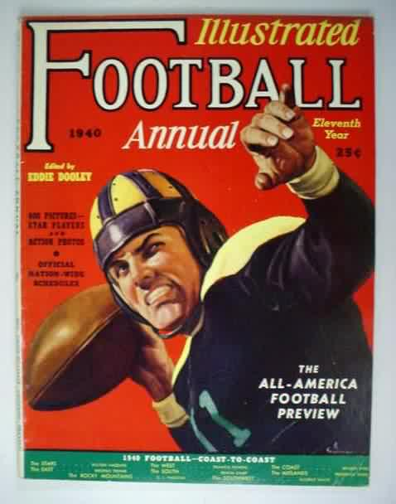
Sports in 1942
Baseball
Boxing
Football
Horse Racing
Track and Field
Sports were really popular during this time. Gene would include a ticket to an event or maybe a picture of an athlete in his time capsule.
24

Slide 15
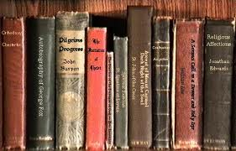
Academics
Gene’s toughest subject in the summer session of 1942 was trigonometry.
Gene was having difficulty in trigonometry because Finny was always asking him to do things with him and he felt obliged to do so.
He excelled in all of his other classes.
Gene’s goal was to be head of his class and give a speech at the end of the year.
I believe Gene would include his highest trigonometry test in his time capsule because he would be very proud of this test score.
25

Slide 16
Work Cited
PICTURES
1.)http://www.google.com/imgres?imgurl=http://fusedfilm.com/wp-content/uploads/2009/05/casablanca-poster.jpg&imgrefurl=http://www.fusedfilm.com/2009/05/retro-review-casablanca/&usg=__9paG8Hh9MqAylyE19cqyL9bBPdM=&h=358&w=338&sz=26&hl=en&start=0&zoom=1&tbnid=ZZGseZte5E-3-M:&tbnh=147&tbnw=139&prev=/images%3Fq%3Dcasablanca%26hl%3Den%26biw%3D1268%26bih%3D792%26gbv%3D2%26tbs%3Disch:1&itbs=1&iact=hc&vpx=127&vpy=425&dur=140&hovh=231&hovw=218&tx=117&ty=134&ei=4l6NTOOtFamfnwehm-itCQ&oei=4l6NTOOtFamfnwehm-itCQ&esq=1&page=1&ndsp=25&ved=1t:429,r:13,s:0
2.)http://www.google.com/imgres?imgurl=http://delirium-vault.com/nekoneko/wp-content/uploads/2009/10/cat_people_1942.preview.jpg&imgrefurl=http://delirium-vault.com/nekoneko/category/reviews/american-films/&usg=__YjGrzsPJ1nH9ybhT3tsGI0KDXcY=&h=640&w=321&sz=50&hl=en&start=0&zoom=1&tbnid=qKDRfB9E_aaaPM:&tbnh=130&tbnw=65&prev=/images%3Fq%3Dcat%2Bpeople%2Bmovie%2Bof%2B1942%26hl%3Den%26biw%3D1268%26bih%3D792%26gbv%3D2%26tbs%3Disch:1&itbs=1&iact=hc&vpx=119&vpy=261&dur=94&hovh=317&hovw=159&tx=88&ty=142&ei=rF6NTMjpMamfnwehm-itCQ&oei=rF6NTMjpMamfnwehm-itCQ&esq=1&page=1&ndsp=27&ved=1t:429,r:7,s:0
3.)http://www.google.com/imgres?imgurl=http://midlifemanifesto.com/wp-content/uploads/2009/12/98_yankee_doodle_dandy.jpg&imgrefurl=http://awayfromherdesk.blogspot.com/&usg=__sNareM9Dy0QnhKTusnRoQQUkSr4=&h=429&w=300&sz=33&hl=en&start=0&zoom=1&tbnid=jZRcYNFxNyc2oM:&tbnh=143&tbnw=100&prev=/images%3Fq%3Dyankee%2Bdoodle%2Bdandy%26hl%3Den%26biw%3D1268%26bih%3D792%26gbv%3D2%26tbs%3Disch:1&itbs=1&iact=hc&vpx=122&vpy=78&dur=188&hovh=269&hovw=188&tx=91&ty=148&ei=Tl6NTLKYA5KUnAeJr-SrCQ&oei=Tl6NTLKYA5KUnAeJr-SrCQ&esq=1&page=1&ndsp=27&ved=1t:429,r:0,s:0
4.)http://www.google.com/imgres?imgurl=http://www.boxofficereport.com/images/posters/254bambi.jpg&imgrefurl=http://www.boxofficereport.com/media/my100fposters.shtml&usg=__X2I1EUH1Fjehp9AQS1kiv5Q9zIU=&h=425&w=275&sz=42&hl=en&start=0&zoom=1&tbnid=UZST-WJY0b1wiM:&tbnh=147&tbnw=95&prev=/images%3Fq%3Dbambi%2Bof%2B1942%26hl%3Den%26biw%3D1268%26bih%3D792%26gbv%3D2%26tbs%3Disch:1&itbs=1&iact=hc&vpx=478&vpy=143&dur=3657&hovh=279&hovw=180&tx=123&ty=131&ei=rV2NTITSPMiRnwe4h_2YCQ&oei=rV2NTITSPMiRnwe4h_2YCQ&esq=1&page=1&ndsp=29&ved=1t:429,r:3,s:0
5.)http://www.google.com/imgres?imgurl=http://api.ning.com/files/UoeFoayJL1N561OYaWsoy3E*KAOtwoDfz8HPPGYAQR4zK*sSE-mqiYu4D3DM6LlvJMqcseJgpyPHFSt6i4Vs-yG1MFGW8FHD/BobHopeRoadtoMorocco.jpeg&imgrefurl=http://netflixcommunity.ning.com/profiles/blogs/my-movie-collection&usg=__OR9vfKC1nXe7yOuMjC5k10gksjg=&h=383&w=259&sz=27&hl=en&start=0&zoom=1&tbnid=MI0Kz8X6lrdoDM:&tbnh=150&tbnw=102&prev=/images%3Fq%3Droad%2Bto%2Bmorocco%26hl%3Den%26biw%3D1268%26bih%3D792%26gbv%3D2%26tbs%3Disch:1&itbs=1&iact=hc&vpx=441&vpy=80&dur=562&hovh=273&hovw=185&tx=102&ty=131&ei=Jl6NTOwC1-udB4GK2LQJ&oei=Jl6NTOwC1-udB4GK2LQJ&esq=1&page=1&ndsp=24&ved=1t:429,r:2,s:0
6.)http://www.google.com/imgres?imgurl=http://0.tqn.com/d/top40/1/0/4/S/1/bingcrosbychristmas.jpg&imgrefurl=http://top40.about.com/od/holidaymusic/tp/Top-100-Christmas-Songs.htm&usg=__leedxZeO6of6DRWofCmKMH-sRZI=&h=296&w=296&sz=24&hl=en&start=0&zoom=1&tbnid=XcV3p_-4v45rVM:&tbnh=137&tbnw=133&prev=/images%3Fq%3Dtop%2B5%2Bsongs%2Bof%2B1942%26hl%3Den%26biw%3D1268%26bih%3D792%26gbv%3D2%26tbs%3Disch:1&itbs=1&iact=hc&vpx=807&vpy=305&dur=2829&hovh=225&hovw=225&tx=104&ty=97&ei=Xl2NTLLuCZfrnQfdqtCvCQ&oei=Xl2NTLLuCZfrnQfdqtCvCQ&esq=1&page=1&ndsp=27&ved=1t:429,r:11,s:0
7.)http://www.google.com/imgres?imgurl=http://static.songlyrics.com/album_covers/190/the-mills-brothers/the-mills-brothers-19825.jpg&imgrefurl=http://www.songlyrics.com/the-mills-brothers/paper-doll-lyrics/&usg=__oamrOQK6LvI5-RkFkEs5VzDGa5I=&h=159&w=160&sz=10&hl=en&start=0&zoom=1&tbnid=Ujyml85sWx9g2M:&tbnh=127&tbnw=128&prev=/images%3Fq%3Dpaper%2Bdall%2Bthe%2Bmills%2Bbros%2Bof%2B1942%26hl%3Den%26sa%3DG%26biw%3D1268%26bih%3D792%26gbv%3D2%26tbs%3Disch:1&itbs=1&iact=hc&vpx=379&vpy=259&dur=47&hovh=127&hovw=128&tx=69&ty=62&ei=Fl-NTLXTFYGsnAewndjoCQ&oei=Fl-NTLXTFYGsnAewndjoCQ&esq=1&page=1&ndsp=18&ved=1t:429,r:1,s:0
8.)http://www.google.com/imgres?imgurl=http://img.maniadb.com/images/album/280/280048_1_f.jpg&imgrefurl=http://www.maniadb.com/search.asp%3Fsr%3DLO%26q%3DMidnight%2BWalk&usg=__08E5WpmG9hxdf7C4fDUUtn61iHE=&h=460&w=460&sz=48&hl=en&start=0&zoom=1&tbnid=78SapqGdjGFZnM:&tbnh=159&tbnw=168&prev=/images%3Fq%3Ddizzy%2Bgillespie%2Bsalt%2Bpeanut%26hl%3Den%26biw%3D1268%26bih%3D792%26gbv%3D2%26tbs%3Disch:1&itbs=1&iact=hc&vpx=857&vpy=77&dur=79&hovh=225&hovw=225&tx=88&ty=118&ei=gl-NTN6KGMKcnwf5zajOCQ&oei=gl-NTN6KGMKcnwf5zajOCQ&esq=1&page=1&ndsp=24&ved=1t:429,r:4,s:0

Slide 17
Work Cited (continued)
9.)http://www.google.com/imgres?imgurl=http://images.uulyrics.com/cover/g/glenn-miller/album-the-essential-glenn-miller.jpg&imgrefurl=http://www.uulyrics.com/music/glenn-miller/song-string-of-pearls-glenn-miller-his-orchestra/&usg=__bZtbwM30nx7lLlKmXS8v5ylxrMQ=&h=455&w=455&sz=36&hl=en&start=0&zoom=1&tbnid=6uOdAdgBarrEWM:&tbnh=132&tbnw=142&prev=/images%3Fq%3Dglenn%2Bmiller%2Bstring%2Bof%2Bpearls%26hl%3Den%26biw%3D1268%26bih%3D792%26gbv%3D2%26tbs%3Disch:1&itbs=1&iact=hc&vpx=125&vpy=159&dur=328&hovh=225&hovw=225&tx=143&ty=119&ei=Ol-NTOCAII7Engf88si7CQ&oei=Ol-NTOCAII7Engf88si7CQ&esq=1&page=1&ndsp=28&ved=1t:429,r:0,s:0
10.)http://www.google.com/imgres?imgurl=http://images.uulyrics.com/cover/g/glenn-miller/album-the-essential-glenn-miller.jpg&imgrefurl=http://www.uulyrics.com/music/glenn-miller/song-string-of-pearls-glenn-miller-his-orchestra/&usg=__bZtbwM30nx7lLlKmXS8v5ylxrMQ=&h=455&w=455&sz=36&hl=en&start=0&zoom=1&tbnid=6uOdAdgBarrEWM:&tbnh=132&tbnw=142&prev=/images%3Fq%3Dglenn%2Bmiller%2Bstring%2Bof%2Bpearls%26hl%3Den%26biw%3D1268%26bih%3D792%26gbv%3D2%26tbs%3Disch:1&itbs=1&iact=hc&vpx=125&vpy=159&dur=328&hovh=225&hovw=225&tx=143&ty=119&ei=Ol-NTOCAII7Engf88si7CQ&oei=Ol-NTOCAII7Engf88si7CQ&esq=1&page=1&ndsp=28&ved=1t:429,r:0,s:0
11.)http://www.google.com/imgres?imgurl=http://www.oldchesterpa.com/images/Larkin_School.jpg&imgrefurl=http://www.oldchesterpa.com/schools_larkin.htm&usg=__5pfIRED-ItbDXZbmfYgB2JLcwVA=&h=388&w=527&sz=36&hl=en&start=455&zoom=1&tbnid=TM6j6PL2Pgwi3M:&tbnh=134&tbnw=167&prev=/images%3Fq%3D1942%2Bpreparatory%2Bschools%26hl%3Den%26biw%3D1268%26bih%3D792%26gbv%3D2%26tbs%3Disch:10%2C12305&itbs=1&ei=Ll2NTJGEGeXsnQeDk4GcCw&iact=hc&vpx=512&vpy=335&dur=2844&hovh=165&hovw=225&tx=157&ty=87&oei=61yNTK_HENOmnQfMv-ydCQ&esq=36&page=19&ndsp=24&ved=1t:429,r:14,s:455&biw=1268&bih=792
12.)http://www.google.com/imgres?imgurl=http://www.benkepple.com/Images/draftcard.jpg&imgrefurl=http://www.benkepple.com/archives/2007_06.html&usg=__anh7jB8mOcHZFTLvIGWiVNqopcY=&h=397&w=600&sz=115&hl=en&start=0&zoom=1&tbnid=8Y4txHM1xnBoDM:&tbnh=142&tbnw=215&prev=/images%3Fq%3Dworld%2Bwar%2B2%2Bdraft%2Bcard%26hl%3Den%26sa%3DX%26gbv%3D2%26biw%3D1251%26bih%3D792%26tbs%3Disch:1&itbs=1&iact=rc&dur=641&ei=YPmPTLedDKrc4wbxsY2ZDQ&oei=YPmPTLedDKrc4wbxsY2ZDQ&esq=1&page=1&ndsp=22&ved=1t:429,r:6,s:0&tx=120&ty=86
13.)http://picsdigger.com/keyword/world%20war%202%20plane/
14.)http://www.google.com/imgres?imgurl=http://gardenofpraise.com/images/roos.jpg&imgrefurl=http://gardenofpraise.com/ibdfdr.htm&usg=__92ZExAafLeSdVqonACS3w7bO18U=&h=480&w=408&sz=10&hl=en&start=0&zoom=1&tbnid=Z6N70xgS0a7UzM:&tbnh=149&tbnw=127&prev=/images%3Fq%3DFranklin%2BDelano%2BRoosevelt%26hl%3Den%26gbv%3D2%26biw%3D1251%26bih%3D792%26tbs%3Disch:1&itbs=1&iact=hc&vpx=126&vpy=94&dur=2860&hovh=244&hovw=207&tx=112&ty=165&ei=L_uPTIH5HcqV4gbY392yDQ&oei=L_uPTIH5HcqV4gbY392yDQ&esq=1&page=1&ndsp=27&ved=1t:429,r:0,s:0
15.)http://www.google.com/imgres?imgurl=http://gracethespot.com/wp-content/uploads/2008/06/duct-tape-3m.jpg&imgrefurl=http://gracethespot.com/%3Fp%3D293&usg=__1dJbxLTi5iK4mUnLZuzvpGi8uv0=&h=288&w=283&sz=14&hl=en&start=0&zoom=1&tbnid=ZEqZCOOi8b_uXM:&tbnh=167&tbnw=166&prev=/images%3Fq%3Dduck%2Btape%26hl%3Den%26gbv%3D2%26biw%3D1251%26bih%3D792%26tbs%3Disch:1&itbs=1&iact=hc&vpx=138&vpy=215&dur=750&hovh=226&hovw=223&tx=122&ty=137&ei=kvyPTJi-IcyN4gaF9oyrDQ&oei=kvyPTJi-IcyN4gaF9oyrDQ&esq=1&page=1&ndsp=17&ved=1t:429,r:0,s:0
16.)http://www.google.com/imgres?imgurl=http://www.theretroknittingcompany.co.uk/images/21feb09/bestwayA2604a.gif&imgrefurl=http://www.theretroknittingcompany.co.uk/menspatterns.html&usg=__qaWhtcDIFkj6sOJpIwMiVLp357Q=&h=600&w=372&sz=219&hl=en&start=0&zoom=1&tbnid=P7qGeWhqLBT8vM:&tbnh=126&tbnw=96&prev=/images%3Fq%3D1940%2Bv%2Bneck%2Bsweaters%26hl%3Den%26gbv%3D2%26biw%3D1251%26bih%3D792%26tbs%3Disch:1&itbs=1&iact=hc&vpx=126&vpy=144&dur=2390&hovh=285&hovw=177&tx=89&ty=151&ei=h_2PTMz9B8vg4Ab-3bCkDQ&oei=h_2PTMz9B8vg4Ab-3bCkDQ&esq=1&page=1&ndsp=30&ved=1t:429,r:0,s:0

Slide 18
Work Cited (continued)
17.)http://www.google.com/imgres?imgurl=http://www.ilovemygrub.com/files/imagecache/articlenode_mainimage/images/news/dig_vic1.jpg&imgrefurl=http://www.ilovemygrub.com/news/2010/ministry-food-exhibition.html&usg=__gpgdqQ6zwSxR8Exih0VjKJfanqw=&h=350&w=520&sz=74&hl=en&start=317&zoom=1&tbnid=Jg_FvyXw8ak26M:&tbnh=131&tbnw=195&prev=/images%3Fq%3Dfood%2Bof%2B1942%26hl%3Den%26biw%3D1268%26bih%3D792%26gbv%3D2%26tbs%3Disch:10%2C8671&itbs=1&iact=hc&vpx=282&vpy=249&dur=5281&hovh=184&hovw=274&tx=159&ty=113&ei=GFqNTPDFGoPMnAfatMHvCg&oei=i1mNTKjmDMKgnAfp1cHlCQ&esq=8&page=14&ndsp=24&ved=1t:429,r:1,s:317&biw=1268&bih=792
18.)http://www.google.com/imgres?imgurl=http://bookcoverarchive.com/images/books/The_Stranger.large.jpg&imgrefurl=http://bookcoverarchive.com/book/The_Stranger&usg=__wA022rh3mXwpszIl_KSNFxPfAPk=&h=500&w=324&sz=44&hl=en&start=0&zoom=1&tbnid=HOrExUDNdhzv_M:&tbnh=154&tbnw=111&prev=/images%3Fq%3Dthe%2Bstranger%26hl%3Den%26biw%3D1268%26bih%3D792%26gbv%3D2%26tbs%3Disch:1&itbs=1&iact=rc&dur=500&ei=VlmNTOS6M8qTnQeQ06S8CQ&oei=VlmNTOS6M8qTnQeQ06S8CQ&esq=1&page=1&ndsp=26&ved=1t:429,r:1,s:0&tx=85&ty=97
19.)http://www.google.com/imgres?imgurl=http://www.broadwayworld.com/columnpic/the-screwtape-letters-csl.jpg&imgrefurl=http://broadwayworld.com/article/THE_SCREWTAPE_LETTERS_Celebrates_Its_125th_Performance_32_20090304&usg=__CEl6OoJt7b0D3uzkSmrXJl2KuG0=&h=500&w=333&sz=32&hl=en&start=0&zoom=1&tbnid=FOXA5S2DsV5J3M:&tbnh=165&tbnw=115&prev=/images%3Fq%3DThe%2Bscrewtape%2Blettes%26hl%3Den%26biw%3D1268%26bih%3D792%26gbv%3D2%26tbs%3Disch:1&itbs=1&iact=hc&vpx=132&vpy=192&dur=766&hovh=275&hovw=183&tx=87&ty=123&ei=LFmNTIP1I8WbnAedn8y1CQ&oei=LFmNTIP1I8WbnAedn8y1CQ&esq=1&page=1&ndsp=22&ved=1t:429,r:0,s:0
20.)http://www.google.com/imgres?imgurl=http://www.littlebrown.co.uk/assets/images/EAN/Large/0316341517.jpg&imgrefurl=http://www.littlebrown.co.uk/Title/9780316341516&usg=__LkpgMut6SuNrAg9-uEZLv-N7GS4=&h=500&w=328&sz=24&hl=en&start=0&zoom=1&tbnid=aLcvnsBz1bFT6M:&tbnh=174&tbnw=108&prev=/images%3Fq%3Dmythology%2Bby%2Bedith%2Bhamilton%26hl%3Den%26biw%3D1268%26bih%3D792%26gbv%3D2%26tbs%3Disch:1&itbs=1&iact=rc&dur=562&ei=DFmNTJd5gs-cB66_yLYJ&oei=DFmNTJd5gs-cB66_yLYJ&esq=1&page=1&ndsp=20&ved=1t:429,r:1,s:0&tx=54&ty=91
21.)http://www.google.com/imgres?imgurl=http://img1.fantasticfiction.co.uk/images/n35/n178109.jpg&imgrefurl=http://www.fantasticfiction.co.uk/w/gertrude-chandler-warner/boxcar-children.htm&usg=__sv5Er2FmsXc-tRwo3CsgSgpainM=&h=464&w=316&sz=37&hl=en&start=0&zoom=1&tbnid=plVsT_yP2E_v2M:&tbnh=134&tbnw=105&prev=/images%3Fq%3Dthe%2Bboxcar%2Bchildren%26hl%3Den%26biw%3D1268%26bih%3D792%26gbv%3D2%26tbs%3Disch:1&itbs=1&iact=hc&vpx=231&vpy=143&dur=1047&hovh=272&hovw=185&tx=101&ty=142&ei=dViNTMqmLtiAnAf90MzDCQ&oei=dViNTMqmLtiAnAf90MzDCQ&esq=1&page=1&ndsp=32&ved=1t:429,r:1,s:0
22.)http://www.google.com/imgres?imgurl=http://www.usedbooks.co.nz/images/Book/0060935472.jpg&imgrefurl=http://www.usedbooks.co.nz/yeller-perennial-classics-pi-14988.html&usg=___67uUXQCBiwzEov339lcivRgHR8=&h=475&w=315&sz=48&hl=en&start=25&zoom=1&tbnid=FjcGVV6cOGR3mM:&tbnh=149&tbnw=100&prev=/images%3Fq%3Dold%2Byeller%26hl%3Den%26biw%3D1268%26bih%3D792%26gbv%3D2%26tbs%3Disch:10%2C356&itbs=1&iact=hc&vpx=340&vpy=396&dur=359&hovh=276&hovw=183&tx=83&ty=129&ei=UViNTMKXBcq7ngeujMS3DA&oei=P1iNTLqOFeqfnwez-9HfCQ&esq=2&page=2&ndsp=24&ved=1t:429,r:1,s:25&biw=1268&bih=792
23.)http://www.google.com/imgres?imgurl=http://www.lineausathletic.com/images/12-ball.jpg&imgrefurl=http://www.lineausathletic.com/medicineballs12.html&usg=__n4SzI_tjNT6ccYuCcXJrdkmrtBY=&h=358&w=332&sz=20&hl=en&start=191&zoom=1&tbnid=FCJV6xbDnJ7KlM:&tbnh=136&tbnw=136&prev=/images%3Fq%3Dmedicine%2Bball%26hl%3Den%26biw%3D1268%26bih%3D792%26gbv%3D2%26tbs%3Disch:10%2C5665&itbs=1&iact=hc&vpx=869&vpy=175&dur=782&hovh=233&hovw=216&tx=128&ty=133&ei=IFiNTJmgFMSFnAfn0P3oCw&oei=CliNTLHoOMiPnAf8i5HXCQ&esq=16&page=9&ndsp=25&ved=1t:429,r:17,s:191&biw=1268&bih=792

Slide 19
Work Cited (continued)
24.)http://www.google.com/imgres?imgurl=http://www.gasolinealleyantiques.com/sports/football/images/books/1942.JPG&imgrefurl=http://www.gasolinealleyantiques.com/sports/football/books.htm&usg=__ZvQj2eJ3H7MYMIZCdwxCiz9Dldk=&h=595&w=460&sz=28&hl=en&start=0&zoom=1&tbnid=iglgXNiflHGnuM:&tbnh=140&tbnw=108&prev=/images%3Fq%3Dsports%2Bin%2B1942%26hl%3Den%26biw%3D1268%26bih%3D792%26gbv%3D2%26tbs%3Disch:1&itbs=1&iact=hc&vpx=122&vpy=294&dur=62&hovh=255&hovw=197&tx=109&ty=112&ei=v1uNTLvrOIWgnwf6nvi4CQ&oei=v1uNTLvrOIWgnwf6nvi4CQ&esq=1&page=1&ndsp=28&ved=1t:429,r:7,s:0
25.)http://www.google.com/imgres?imgurl=http://messytrainland.files.wordpress.com/2009/12/books.jpeg&imgrefurl=http://messytrainland.wordpress.com/2009/12/03/wimbledon-station-bookswap/&usg=__zrPdmX10TFYrO0Lhp9hvcwSpoig=&h=343&w=535&sz=47&hl=en&start=0&zoom=1&tbnid=acP36Sp256ZS-M:&tbnh=154&tbnw=206&prev=/images%3Fq%3Dbooks%26hl%3Den%26biw%3D1268%26bih%3D792%26gbv%3D2%26tbs%3Disch:1&itbs=1&iact=hc&vpx=473&vpy=128&dur=1891&hovh=180&hovw=281&tx=126&ty=88&ei=0lWNTMClKcSWnAea8ry0CQ&oei=0lWNTMClKcSWnAea8ry0CQ&esq=1&page=1&ndsp=24&ved=1t:429,r:2,s:0
Content
1.)http://en.wikipedia.org/wiki/1942
2.) http://www.filmsite.org/1942.html
3.)http://genealogy.about.com/od/records/p/wwii_draft.htm
4.)http://www.thepeoplehistory.com/40sclothes.html
5.)http://myamericannewspaper.com/Stories/Food%20rationed%20during%20the%20war.htm
6.)http://www.goodreads.com/book/popular_by_date?year=1942
7.)http://corporate.britannica.com/press/inventions.html
8.)http://storiesofusa.com/industrial-revolution-inventions-timeline-1712-1942/
9.)http://www.ideafinder.com/history/inventions/ducttape.htm
10.) http://www.musicimprint.com/Chart.aspx?id=C000110

