Slide 1
A Separate Peace: time capsule
Addie Linegar
9/11/10
4W Paschall
http://photo.goodreads.com/books/1165517852l/5148.jpg

Slide 2
The Draft
Young men wanted to be drafted into the military as soon as they came of age.
Millions of men filled out registration cards to be drafted into the military during WWII from 1940 and 1943.
There were seven draft registrations:
1. October 16, 1940: all men 21-31 years residing in the U.S.
2. July 1, 1941: men who had reached age 21 since the first registration.
3. February 16, 1942: men 20-21 and 35-44 years of age.
4. April 27, 1942: men 45-64 years of age that weren’t liable for military service. *these cards have been lost for good in some southern states because of an error*
5. June 30, 1942 : men 18-20 years of age.
6. December 10-31, 1942: men who reached the age of 18 since the previous registration.
7. November 16, December 31, 1943: American men living abroad, aged 18-44.

Slide 3
The Draft (2)
On the registration cards, an aspiring soldier would have to fill out the following information:
registrant's full name and signature
address (both mailing and residence)
phone number
date and place of birth and age
occupation and employer, and the employers name and address
the name and address of the nearest contact or relative
race, height, weight, eye and hair color, complexion and other physical characteristics
Not all registered men served in the military and not all men that served in the military filled out a registration card.

Slide 4
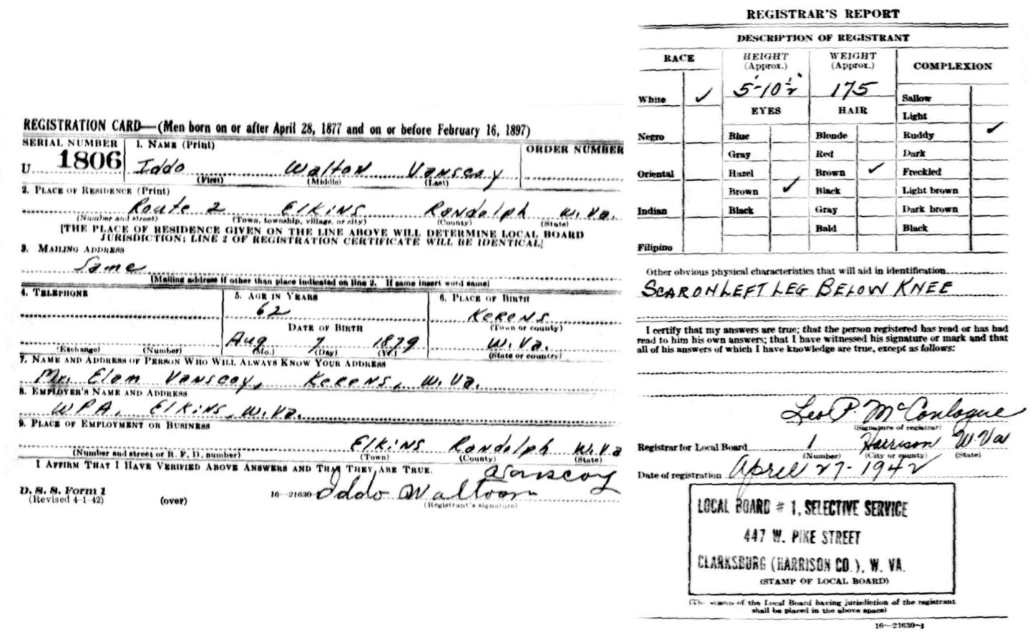
WWII Registration Card
http://www.laurellynn.com/genealogy/images/vanscoy/Iddo_Walton_Vanscoy_WWII_Registration_Card.jpg
Iddo Vansesy’s WWII Registration Card

Slide 5
WWII: Battles in the South Pacific
The Pacific war was the largest naval conflict in history.
Various types of battles in arctic or tropical conditions were fought in carrier aviation battles, surface engagements, bitterly fought night-fights, the largest amphibious landings of the war, and the brutal battles waged by and against submarines.
The United States got into the war after the bombing of Pearl Harbor on December 7, 1941.
The most important battles after Pearl Harbor were
*Battle of Midway
*Battle of Guadalcanal
*Battle for Saipan
*Battles in the Philippine Seas
*Iwo Jima
*Okinawa
Okinawa was the last battle of the Pacific War, won by the United States on July 2, 1945.

Slide 6
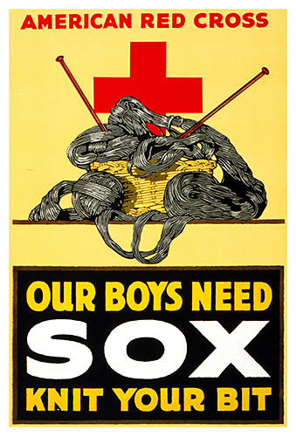
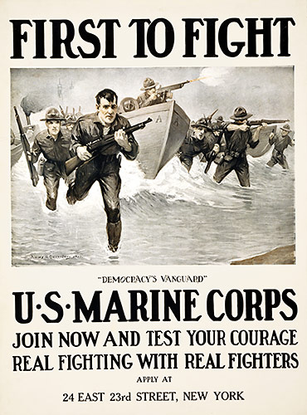
War Posters
Since the men in WWII needed clothing, the American Red Cross displayed this poster to try and get women in the United States to help the men in the war.
http://world-war-pictures.com/war-poster/warusa006
This war poster is telling men in the United States to join the Marine Corps to help in the war effort.
http://world-war-pictures.com/war-poster/warusa021

Slide 7
Weapons in WWII
M1 Garand
-This was a standard American rifle of the war.
MP43 or Sturmgewehr 44 (assault rifle 44)
-This was the world's first modern assault rifle.
Colt M1911
-This pistol is one of the best pistols ever produced.
Bazooka
-This is a rocket-propelled anti-tank weapon.
Panzerfaust (tank fist)
-This anti-tank weapon was capable of destroying any tank.

Slide 8
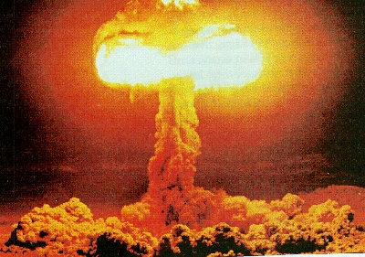
Invention
A major invention central to the American military was the atomic bomb.
Scientists started working on the bomb in 1939, but it was tested in 1945. Robert Oppenheimer invented this weapon, but Albert Einstein was a notable scientist who helped in the development of this bomb.
The atomic bomb was called “The Gadget” while it was being developed to keep the bomb a secret.
The bomb was tested on July 16, 1945 in the basin of the Jemez Mountains in northern New Mexico.
This began the Atomic Age, named for worldwide curiosity and creation of these deadly weapons.
Atomic Bomb
http://macaulay.cuny.edu/eportfolios/bernstein08/files/2008/12/atomic-bomb.jpg

Slide 9
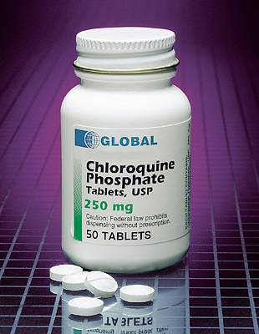
Medical Discovery
Malaria in South Pacific islands and North Africa was an enormous problem the American soldiers faced when they fought.
Captured Italian soldiers possessed white pills that the Americans took and sent to the United States to be investigated.
The white pills ended up to be an antimalarial drug called chloroquine.
The effective drug was able to be distributed by the end of WWII.
http://mount-kinabalu-borneo.com/blog/wp-content/uploads/2006/12/chloro250mg.jpg

Slide 10
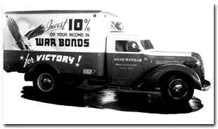
Life on the Home Front
http://us.history.wisc.edu/hist102/photos/html/1182.html
This is a truck advertising war bonds.
The federal government encouraged Americans to conserve and recycle materials such as metal, paper, and rubber, which factories could then use for wartime production.
-Every bit of material could be used towards the war effort.
Americans were encouraged to buy war bonds to create capital for the military.
A system was developed to ration American’s consumption of meat, sugar, gasoline, coffee, and many other goods.
-Citizens were given a ration card and carded every time they bought these goods.
Many young men yearned to join the military, as it was their life goal.
Since the men were at war, six million women took wartime jobs in factories or filling in for men on farms, three million women volunteered with the Red Cross, and over 200,000 women served the military.

Slide 11
Political Leaders of the United States
Franklin D. Roosevelt
-32nd President of the United States.
-Declared war on Japan after the bombing of Pearl Harbor on December 7, 1941 (this is how we entered WWII).
-He kept connections between the United Nations, hoping to ally with Russia.
-He died on April 12, 1945, while in Warm Springs, Georgia.
Harry Truman
-33rd President of the United States after being Franklin D. Roosevelt’s Vice President and sworn in after he died.
-Truman sent a peace treaty to the Japanese asking them to surrender and they refused. Then, he ordered bombs to be dropped on Japanese cities, Hiroshima and Nagasaki. The Japanese surrendered shortly afterwards.

Slide 12
Popular Public Figures in1942-1945
Ella Fitzgerald
She was an African American jazz and scat singer and hit her solo career by the mid 1940s.
Hit songs were "I've Got You Under My Skin" and "Anything Goes."
She was in the film, Ride ‘Em Cowboy, in 1942.
Rosie the Riveter
This character helped get the women involved and excited in helping out WWII in the United States.
She was featured in many advertisements, but the most famous one features her wearing a red bandana and blue coveralls, flexing her bicep. The poster read "We Can Do It!“, and this became the slogan for the women involved in WWII.

Slide 13
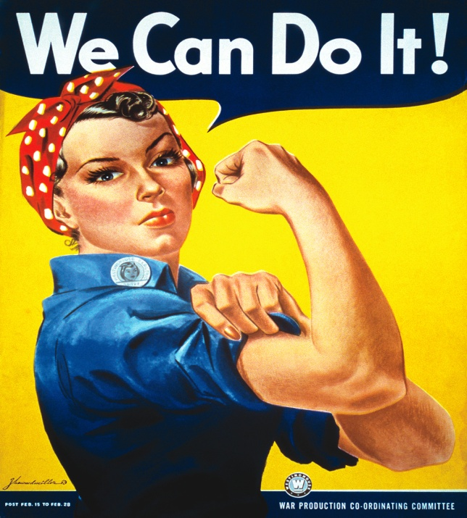
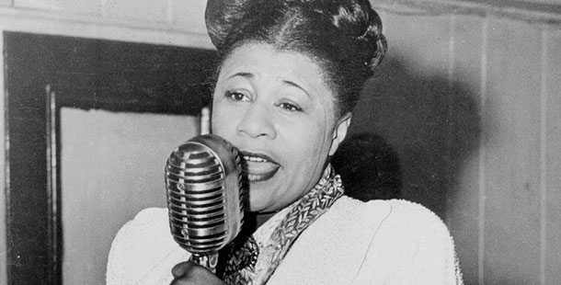
Ella Fitzgerald and Rosie the Riveter
Ella Fitzgerald
http://www.pbs.org/wnet/americanmasters/episodes/ella-fitzgerald/something-to-live-for/590/
Rosie the Riveter
http://www.whenourmotherswenttowar.com/downloads/rosie300.jpg

Slide 14
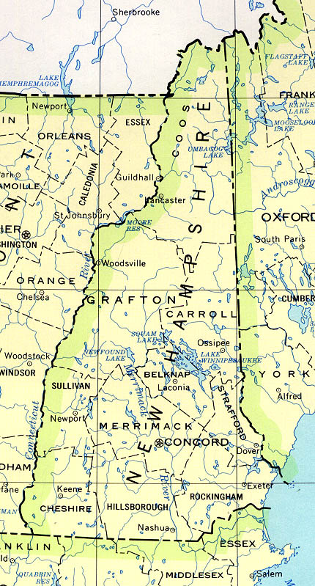
New Hampshire in the 1940s
New Hampshire was hit hard with the war just like every other state in the United States.
This state housed a number of preparatory school students, waiting to go into war.
Record Weather
Temperature dropped in February to -37°F in 1943.
Temperature dropped in April to 0°F in 1945.
New Hampshire
http://images.statemaster.com/images/maps/NH.jpg

Slide 15
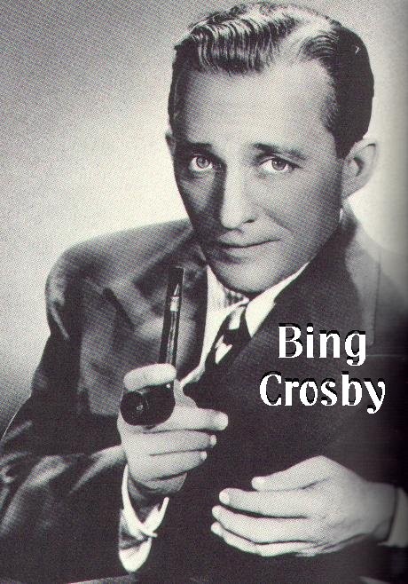
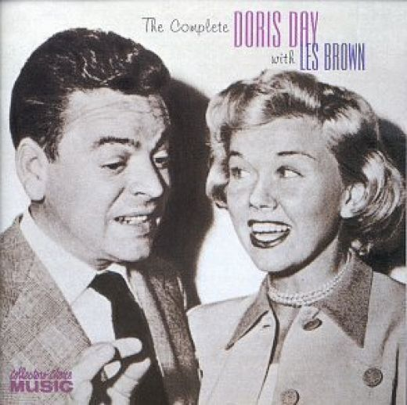
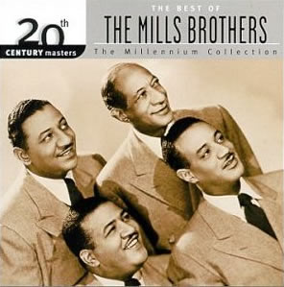
#1 Top Songs of 1942-1945
1942
White Christmas - Bing Crosby
1943
Paper Doll - Mills Brothers
1944
Swinging On A Star - Bing Crosby
1945
Sentimental Journey - Les Brown with Doris Day
Bing Crosby
http://fusedfilm.com/wp-content/uploads/2008/12/00aa-ss-bing-crosby.jpg
Doris Day & Les Brown
http://s1.hubimg.com/u/2199640_f520.jpg
The Mills Brothers
http://millennium-thisiswhoweare.net/cmeacg/img/music/profile_image/51/cover_large.jpg

Slide 16
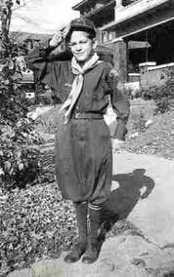
Fashion in the 1940s
WWII influenced fashion by its dictating styles for civilian apparel that would conserve cloth and metal for the war effort.
-Men’s clothing freed itself of vests, elbow patches on jackets, and cuffs on pants.
-Women's clothing contained fewer materials, resulting in skirts being shorter and narrower.
Young men wore knickers, button down shirts, corduroy pants, and cordovan shoes.
This boy is displaying knickers and cordovan shoes.
http://histclo.com/youth/youth/org/sco/country/us/scoutuscub.htm

Slide 17
Popular Baby Names in the 1940s
Boys
Girls
James
Robert
John
William
Richard
David
Charles
Thomas
Michael
Ronald
Mary
Linda
Barbara
Patricia
Carol
Sandra
Nancy
Sharon
Judith
Susan

Slide 18
Works Cited
"Atomic Bomb : The Manhattan Project (1945) ." When We Were Kids. N.p., n.d. Web. 15 Sep 2010. <http://www.wwwk.co.uk/culture/inventions/40s/atomic-bomb.htm>.
"Ella Fitzgerald." PBS, n.d. Web. 15 Sep 2010. <http://www.pbs.org/wnet/americanmasters/episodes/ella-fitzgerald/something-to-live-for/590/>.
"Franklin D. Roosevelt." www.whitehouse.gov. the WHITE HOUSE, n.d. Web. 14 Sep 2010. <http://www.whitehouse.gov/about/presidents/franklindroosevelt>.
"Harry S. Truman." www.whitehouse.gov. the WHITE HOUSE, n.d. Web. 14 Sep 2010. <http://www.whitehouse.gov/about/presidents/harrystruman>.
Kimberly, Powell. "WWII Draft Registration Records." about.com. N.p., n.d. Web. 15 Sep 2010. <http://genealogy.about.com/od/records/p/wwii_draft.htm>.
McGeehan, John. "Major WWII Battles in the South Pacific :: The World War II Era." everything.com. N.p., n.d. Web. 14 Sep 2010. <http://www.everything.com/Major-WWII-Battles-in-the-South-Pacific/#axzz0zXcq2xIx>.
"NH Climate." newhampshire.com. N.p., n.d. Web. 15 Sep 2010. <http://www.newhampshire.com/about-nh/nh-climate-info.aspx>.

Slide 19
Works Cited (2)
Olsen, Chris, Kelly Mack, Josh Blackwelder, and Taylor Glenn. "Women during WWII." WWII Weapons. DmarK Designs, 24 September 2004. Web. 14 Sep 2010. <http://www.womeninwwii.com/>.
"Pacific Naval Battles in World War II." N.p., n.d. Web. 14 Sep 2010. <http://combinedfleet.com/battles/>.
"Popular Songs 1942." popularsong.org. N.p., n.d. Web. 14 Sep 2010. <http://www.popularsong.org/1942.html>.
"Popular Songs 1941." popularsong.org. N.p., n.d. Web. 14 Sep 2010. <http://www.popularsong.org/1941.html>.
"Popular Songs 1943." popularsong.org. N.p., n.d. Web. 14 Sep 2010. <http://www.popularsong.org/1943.html>.
"Popular Songs 1944." popularsong.org. N.p., n.d. Web. 14 Sep 2010. <http://www.popularsong.org/1944.html>.
"Popular Songs 1945." popularsong.org. N.p., n.d. Web. 14 Sep 2010. <http://www.popularsong.org/1945.html>.
"Quinine." Medical Discoveries. N.p., n.d. Web. 14 Sep 2010. <http://www.discoveriesinmedicine.com/Ni-Ra/Quinine.html>.
Schultz, Stanley, and William Tishler. "Quinine." Medical Discoveries. N.p., n.d. Web. 14 Sep 2010. <http://www.discoveriesinmedicine.com/Ni-Ra/Quinine.html>.
"Top Names of the 1940s." Social Security Online. N.p., 18 May 2010. Web. 13 Sep 2010. <http://www.ssa.gov/OACT/babynames/decades/names1940s.html>.
"Women during WWII." DmarK Designs, n.d. Web. 14 Sep 2010. <http://www.womeninwwii.com/>.

