Slide 1
A separate peace 1942 electronic time capsule
Quinn Hurley

Slide 2
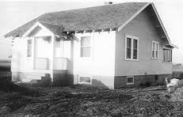
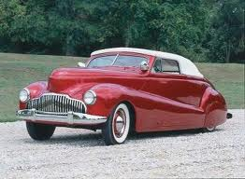
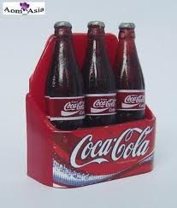
Average Prices in 1942
New House: $3,770
Wages: $1,880
Gallon of Gas: 15 cents
House Rent: $35
Bottle of Coca Cola: 5 cents
New Car: $920
A 1942 house
A 1942 Westward Mercury
Coca Cola bottles

Slide 3
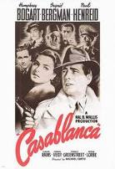
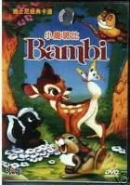
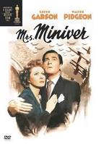
Popular Movies
Starring: Humphrey Bogart and Ingrid Bergman http://www.impawards.com/1942/posters/casablanca.jpg
Casablanca
Bambi
Mrs. Miniver
Starring: Bobby Stewart http://www.logoi.com/pastimages/img/bambi_4.jpg
Starring: Greer Garson and Walter Pidgeon http://christiankocinski.files.wordpress.com/2010/04/mrsminiver1.jpg

Slide 4
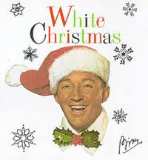
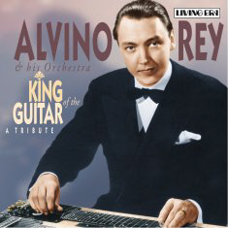
Popular Music
“White Christmas” by: Bing Crosby
“Deep in the Heart of Texas” by: Alvino Ray
http://www.fakesteve.net/wp-content/uploads/2009/12/bing-crosby-white-christmas-794163_4791.jpg
http://www.pelstream.co.uk/aja5581%20alvino%20rey.jpg

Slide 5
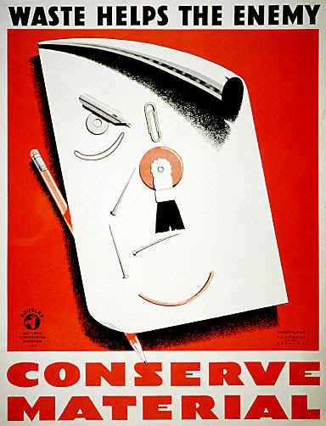
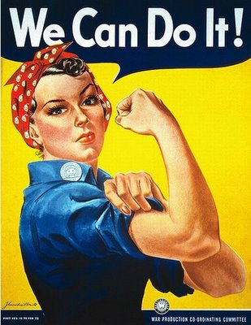
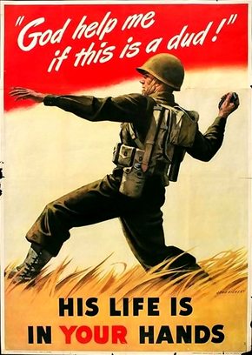
War Propaganda
Many signs were put up to try to get people to either join the military or conserve materials.
Other posters were for the active role of women in the war.
http://4.bp.blogspot.com/_orkXxp0bhEA/SkqhLCxXQHI/AAAAAAAATsY/w-2LW2lg41Q/s400/propaganda_wwiii_08.jpg
http://sas.guidespot.com/bundles/guides_0d/assets/widget_cDMAvueiPoGyBzSzzWw5ZE.jpg
http://www.diggerhistory.info/images/posters2/usa03.jpg

Slide 6
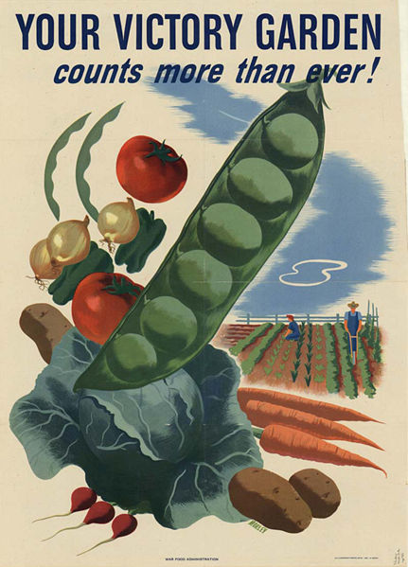
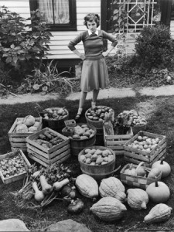
Victory Gardens
Victory Gardens were gardens that the government encouraged people to grow so they could send more food to the troops in the war.
http://www.gardensofthewildwildwest.com/wp-content/uploads/2009/03/victory-gardens-photo-in-yard-225x300.jpg
http://www.electricitybook.com/victory-gardens/victory-garden2.jpg

Slide 7
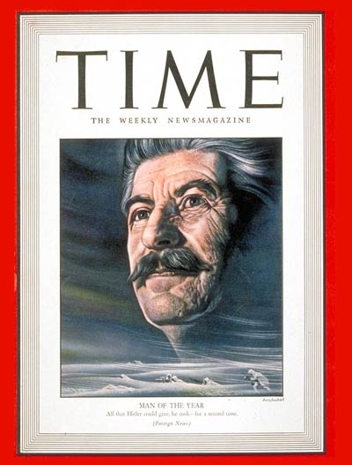
Time’s Man of the Year
In 1942, Joseph Stalin was Time’s Man of the Year. He first received the award in 1939 and was again honored with it in 1942.
Just a year before Stalin first received the award, Adolf Hitler was presented the award.
http://img.timeinc.net/time/magazine/archive/covers/1943/1101430104_400.jpg

Slide 8
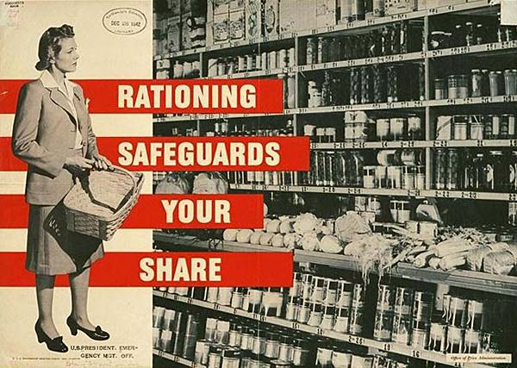
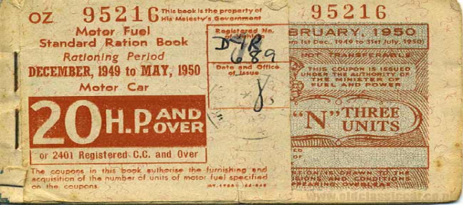
Rationing
Rationings were a major part of American life in the time of World War II. People were given ration coupons with which they could get food and gasoline.
http://www.oldclassiccar.co.uk/classic-car-images/ration.jpg
http://arcweb.sos.state.or.us/exhibits/ww2/images/services/ratsafe.jpg

Slide 9
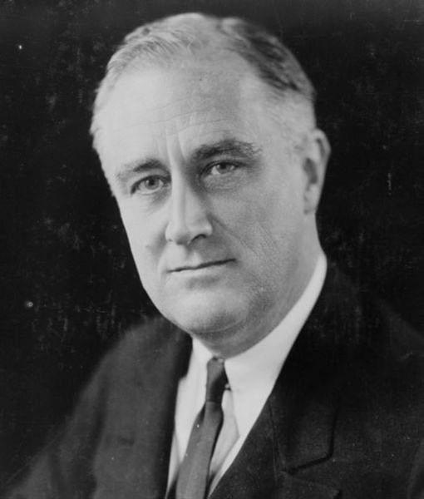
Franklin Delano Roosevelt
In 1942, Franklin Delano Roosevelt was the president of the United States of America.
He signed the declaration of war toward Nazi Germany on December 11, 1941.
His Vice President was John Nance Garner.
http://franklindrooseveltfacts.com/images/franklin_d_roosevelt_1632775744.JPG

Slide 10
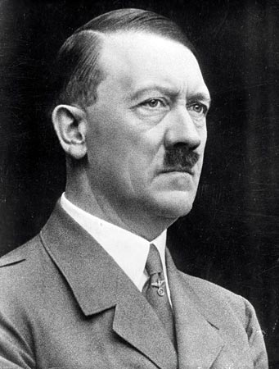
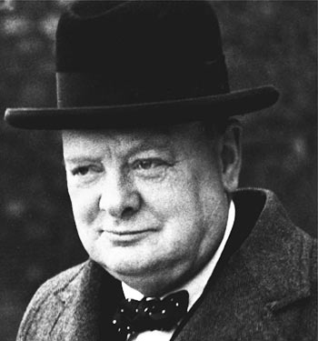
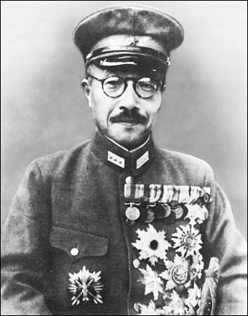
World Leaders
Adolf Hitler
http://ofwnow.com/wp-content/uploads/image/_2010/august/adolf%20hitler.jpg
In World War II there were many key world leaders such as Adolf Hitler, Winston Churchill, Franklin D. Roosevelt, Hideki Tojo, and Joseph Stalin.
Winston Churchill
http://queuemagazine.co.uk/images/winston%20churchill.jpg
Hideki Tojo
http://www.wpclipart.com/famous/political/Hideki_Tojo.png

Slide 11
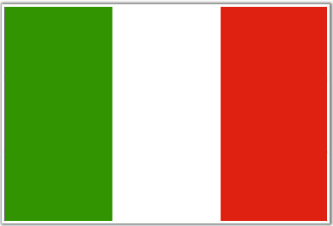
The Axis
Enemies to America during World War II were known as the “Axis”.
The Axis included Germany, Italy, and Japan.
Nazi Germany’s Flag
Japanese Flag
Italian Flag
http://images3.wikia.nocookie.net/althistory/images/7/7a/Flag_of_Nazi_Germany.png
http://blitzkrieg-es.net/wp-content/uploads/2009/05/japanese-flag.gif
http://www.mapsofworld.com/images/world-countries-flags/italy-flag.gif

Slide 12
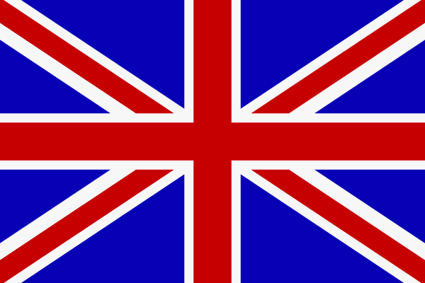
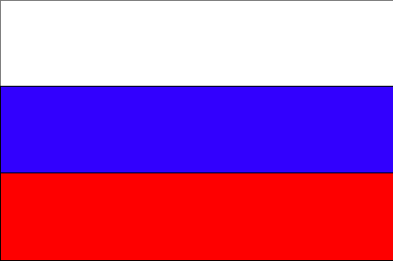
The Allies
The Allies were a group of countries fighting against the Axis.
They consisted of the United States of America, Great Britain, China, and Russia.
Great Britain’s Flag
Russian Flag
http://www.studentsoftheworld.info/sites/country/img/19679_Great-Britain-flag.gif
http://69.36.11.139/pics/Russia-flag.gif

Slide 13
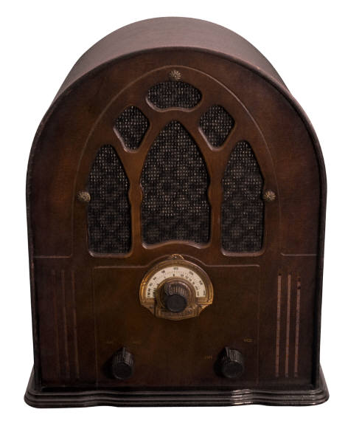
Popular Radio Programs
In the 40’s, T.V. was not very popular so most people turned to the Radio. Some well known radio programs were: The Adventures of the Thin Man, Dragnet, and Suspense.
There were also many news programs that brought people the news through radio.
http://ckxu.com/wp-content/uploads/2009/11/OldTimeRadio.jpg

Slide 14
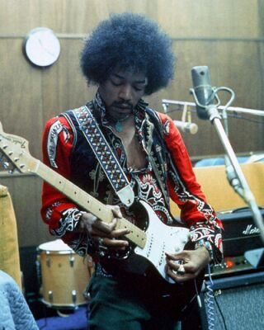
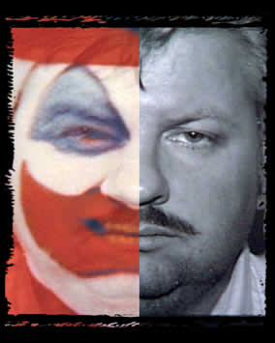
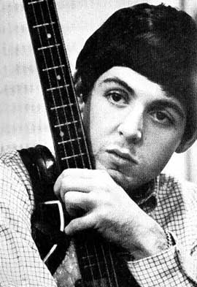
Famous Births of 1942
http://1.bp.blogspot.com/_9qGE3OfMNkQ/THPYqmUZMjI/AAAAAAAACgc/bCwet6btMjM/s1600/Jimi-Hendrix-strat.jpg
Jimi Hindrix (November 27th)
John Wayne Gacy (March 17th)
Paul McCartney (June 18th)
http://www.unlicensedcemetery.com/images/gacy_home2.jpg
http://3.bp.blogspot.com/_wWWrYsIEI0s/RjLhV7Lf16I/AAAAAAAACcI/zemcHorUtNM/s400/Paul%2BMcCartney.jpg

Slide 15
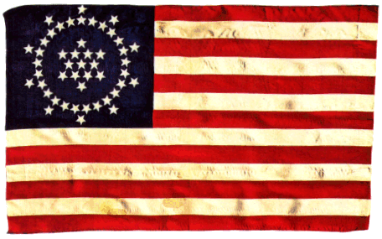
Number of States
In 1942 both Hawaii and Alaska were not states.
This of course meant the flag only had 48 stars, as there were only 48 states.
http://www.whipple.org/images/whippleflag.gif

Slide 16
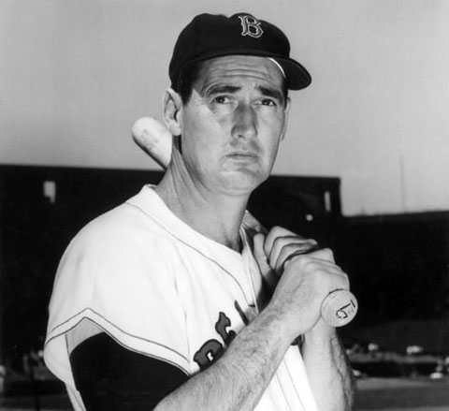
Sports
Many professional sports were not played in 1942 because of World War II.
Some professional sports that still occurred were Baseball, Football, and Golf.
Ted Williams
http://c.complex.com/blogs/wp-content/uploads/2008/03/ted-williams.jpg

Slide 17
Works Cited
“1942.” The People History. Copyright 2004/2010. The People History. 15 Sept. 2010
<http://www.thepeoplehistory.com/1942.html>.
“1942 in Sports.” Wikipedia. 22 Aug. 2010. Wikipedia. 15 Sept. 2010.
<http://en.wikipedia.org/wiki/1942_in_sports>.
Genco, C. Lewis. Old-Time. “Famous Weekly Shows.” Copyright 1994/2010. The Original Old Time Radio. 15 Sept. 2010. <http://www.old-time.com/weekly/>.
“Franklin D. Roosevelt.” Wikipedia. 14 Sept. 2010. Wikipedia. 15 Sept. 2010.
<http://en.wikipedia.org/wiki/Franklin_D_Roosevelt>.
“Time’s Man of the Year” About.com. Copyright 2010. The New York Times Company. 15 Sept. 2010. <http://history1900s.about.com/library/weekly/aa050400a.htm>.

