Slide 1
A Separate Peace
By Mackenzie Clinger

Slide 2
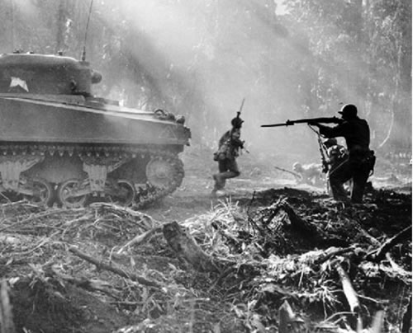
World War II
World War II started on September 1, 1939 with no warning when Germany invaded Poland. Countries involved in the war include the United Kingdom, Hungary, USSR, Yugoslavia, Italy, Poland, Australia, Japan, China, Greece, Germany, Canada, Finland, France, Untied States, Romania, South Africa, and New Zealand. It was every young man’s dream to fight for the country. The war lasted until 1945.

Slide 3
South Pacific Battles
The South Pacific battles were the start of American involvement in the war. The bombing of Pearl Harbor was when the United States entered the war. The United States was fought in the Battle of the Coral Sea which was a turning point in May of 1942.
parks.ca.gov

Slide 4
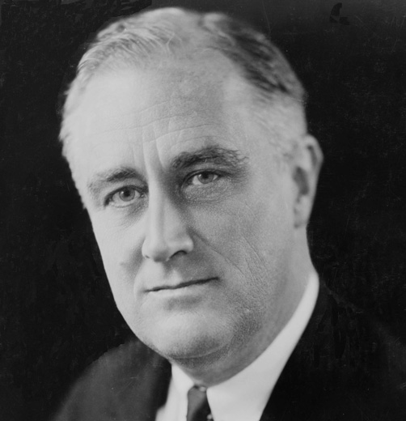
Roosevelt
Democratic President of the United States from 1933-1945
Led the New Deal campaign
The New Deal was suppose to get us out of the depression by bring relief to the unemployed or those at risk of losing their job, help recover businesses and agriculture, and bring reform the Tennessee Valley Authority
visitingdc.com

Slide 5
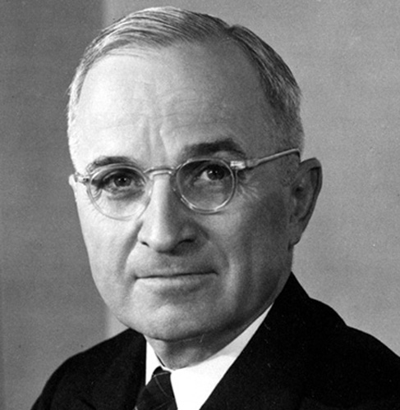
Harry Truman
Democratic President of the United States after Roosevelt
August 6, 1945- dropped an atomic bomb on Hiroshima, Japan
August 9, 1945- dropped an atomic bomb on Nagasaki, Japan
After bombing Japan Truman said, "The Japanese began the war from the air at Pearl Harbor. They have been repaid many fold."
visitingdc.com

Slide 6
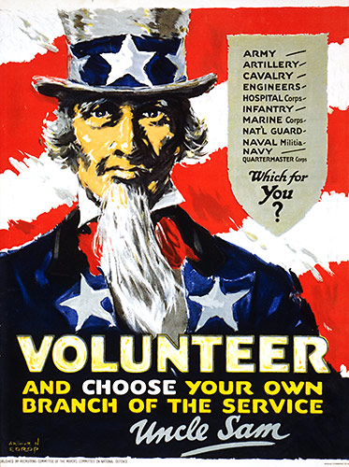
American Propaganda
This advertisement is make young men think about what the are getting into when the enter war. They have to be serious about the task at hand and even then fatality is still a factor.
Advertisements such as this were created to draw the attention of young men to enlist and have a say in what branch they go into. If you didn’t enlist and were drafted you were assigned a branch.
www.world-war-pictures.com/american-war-posters.htm

Slide 7
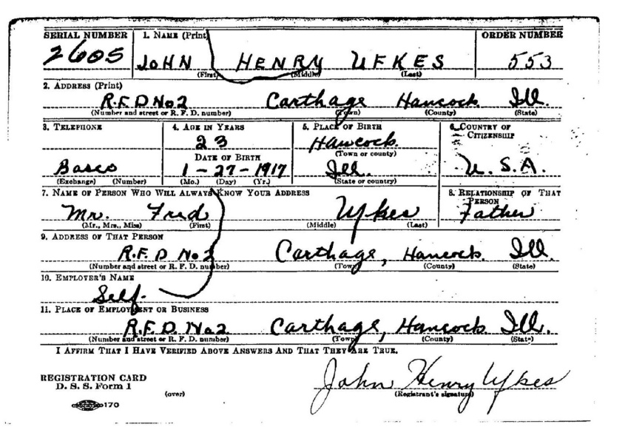
The Draft
Roosevelt sign the first peace-time draft in to affect in 1940
Must register at age 18
Lottery to see who was drafted
Draft was held when spots needed to be filled
No choice of the branch you were drafted into
rootdig.com

Slide 8
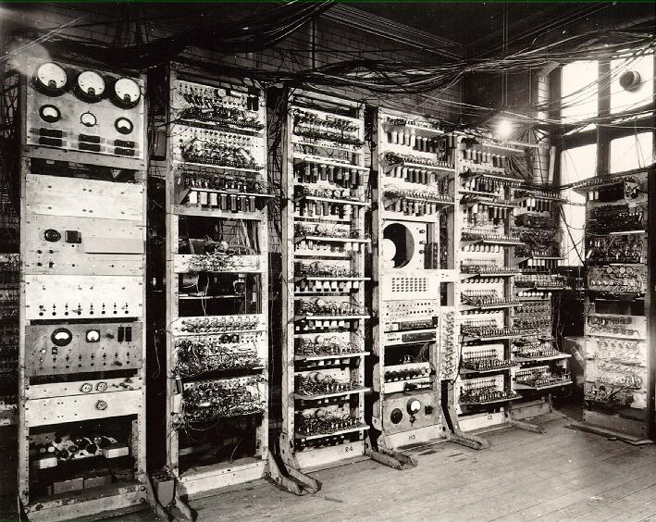
Inventions
Walter Morris invented the frisbee in 1948 to give kids a recreational activity during the war.
The world’s first computer was invented in 1946 at the University of Pennsylvania.
freshpromotions.com.au
reaktorplayer.wordpress.com

Slide 9
Medical Discoveries
Howard Florey discovered penicillin could be used as a practical antibiotic. It would kill germs in the body and could be used to treat battle wounds.
itech.dickinson.edu

Slide 10
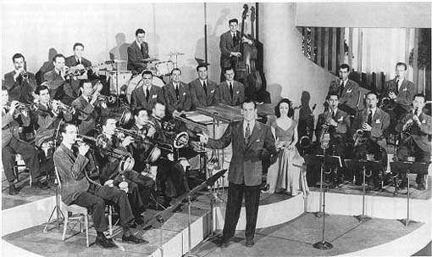
Music
Popular songs-Harvest Moon, Working on the Railroad, I want a Girl, Beer Barrel Polka, Caissons Go Rolling Along, and Sentimental Journey
Glenn Miller Orchestra
The first Glenn Miller Orchestra fell apart
The second Glenn Miller Orchestra broke attendance and recording records
Popular songs- Tuxedo Junction, In the Mood, and Chattanooga Choo Choo
papertastebuds.com

Slide 11
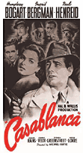
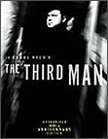
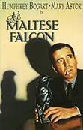
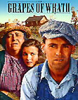
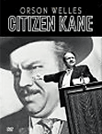
Popular Movies
Casablanca
The Third Man
The Maltese Falcon
Grapes of Wrath
Citizen Kane
Digitaldreamdoor.nutsie.com/pages/movie-pages/movie_40s.html

Slide 12
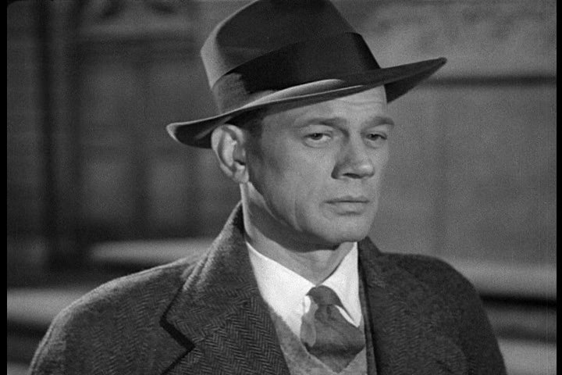
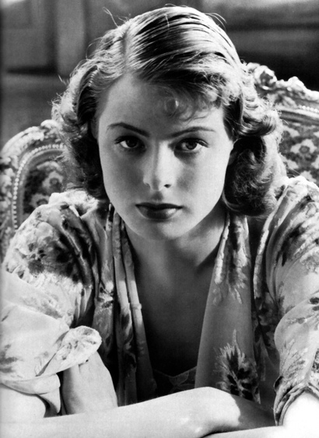
Actors/Actresses
Joseph Cotten
Many Broadway productions
1940- Citizen Kane
Ingrid Bergman
Stared in Casablanca
Regretted this although it
greatly improved her career
davidicke.com
drx.typepad.com

Slide 13
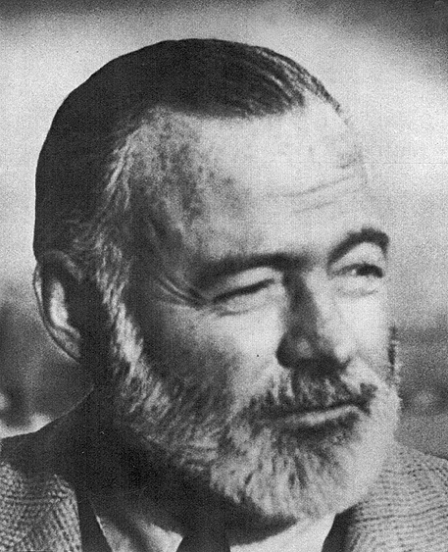
Famous Author
Ernest Hemingway
The Sun Also Rises was his most famous book
Wrote it at age twenty in Paris
Started out focused on content and not money
With more fame money became more important
His books lost content
http://www.americanlegends.com/authors/index.html

Slide 14
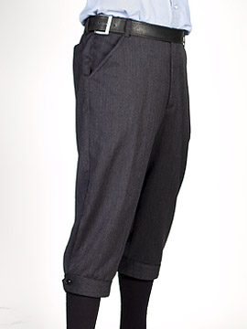
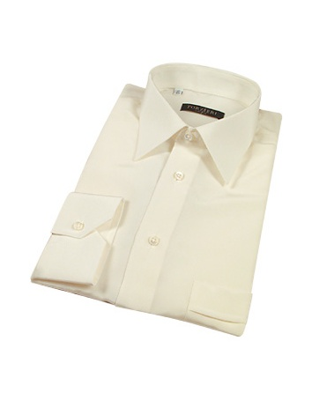
Fashion For Men
Young men wore knickers and dress shirts most of the time. The knickers were navy, black, or brown and the shirts were normally white or ivory. During the colder months sweater or suit jackets weren't uncommon.
living-room.org
luxboss.com

Slide 15
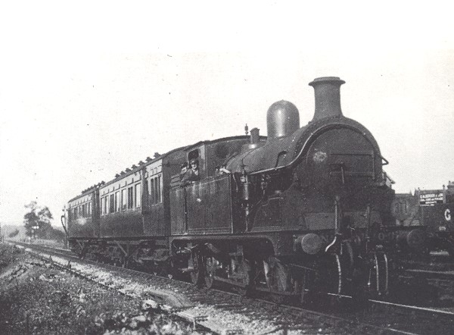
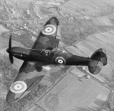
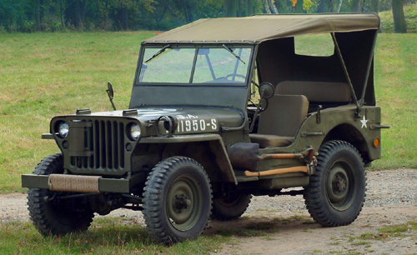
Transportation
Common people
Train
Car
Boat
In the war
Helicopters
Planes
Jets
Submarines
Ships
Jeeps
Tanks
bullfinchclose.co.uk
galaxy.bedfordshire.gov.uk
handfulofdust.net

Slide 16
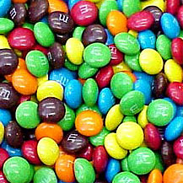
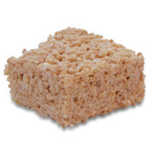
New Foods Introduced at Home
M&M’s
Cheerios
Rice Krispie Treats
Sugarless Sponge Cake
Carpetbag Steak
Corn Dogs
Spice Cake
sharkride.com
paultrader.com
istockphoto.com

Slide 17
Works Cited
100 Greatest Movies of the 1940s. 24 February 2005. 11 September 2010 <http://digitaldreamdoor.nutsie.com/pages/movie- pages/movie_40s.html>.
Background of Selective Service. 2010. 10 September 2010 <usmilitary.about.com>.
Food of the Home Front. 15 September 2010 <http://www.newberry.k12.sc.us/mchs/home_front_food.htm>.
Highlights of the Glenn Miller Orchestra & A Short Biography. 13 September 2010<http://www.glennmillerorchestra.com/history.ht ml>.
Ingrid Bergman Regretted Her 'Casablanca' Role. 2010. 15 September 2010<www.starpulse.com/news/index.php/2007/02/20/ingrid_b ergman_regretted_her_casablanca>.
Introduction. 2006. 13 September 2010 <www.worldwar-2.net>.

Slide 18
Works Cited Continued
Joseph Cotten Biography. 2010. 15 September 2010 <http://www.starpulse.com/Actors/Cotten,_Joseph/Biography/>.
Long, Doug. President Harry S. Truman . 14 September 2010 <http://www.doug-long.com/truman.htm>.
Technology Advancements of World War 2. 2010. 8 September 2010 <http://www.bukisa.com/articles/85094_technology- advancements-of-world-war-2>.
The 1940s The Decade of War. 14 September 2010 <http://www.kyrene.org/schools/brisas/sunda/decade/1940.htm>.
The Nobel Prize in Physiology or Medicine 1945. 16 September 2010. 10 September 2010<http://nobelprize.org/nobel_prizes/medicine/ laureates/1945/florey-bio.html>.
World War 2. 2010. 12 September 2010 <http://www.historylearningsite.co.uk/>.

