Slide 1
A Separate Peace Time Capsule
By: Makayla Clanin
goodreads.com

Slide 2
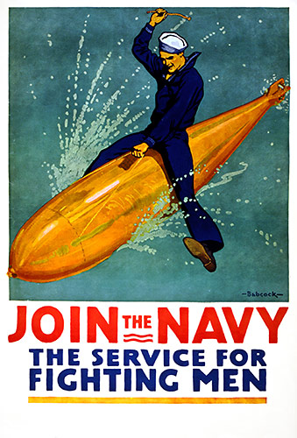
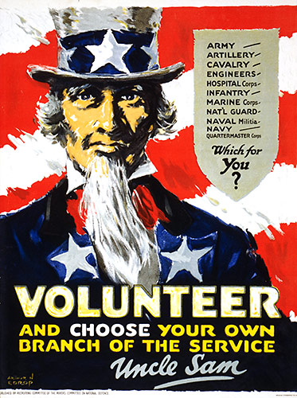
#1
This poster is telling people to join the navy.
This propaganda poster is trying to persuade people to join the army.

Slide 3
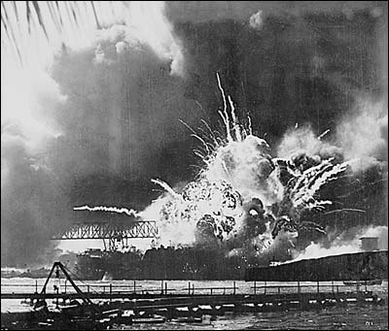
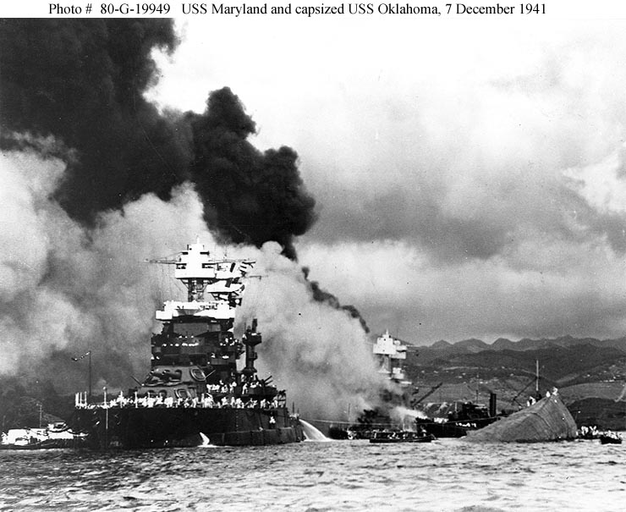
#2
Pearl Harbor
December 7, 1941 the Japanese attack on Pearl Harbor.
The next day the United States declared war on Japan resulting in the start of WWII.
188 American aircraft was destroyed along with 2,402 lives taken.

Slide 4
#3
In the Mood
#1song in 1940.
By Glenn Miller
YouTube - In The Mood
(click to hear song)

Slide 5
Who's the lovin' daddy with the beautiful eyes What a pair o' lips, I'd like to try 'em for size I'll just tell him, "Baby, won't you swing it with me" Hope he tells me maybe, what a wing it will be So, I said politely "Darlin' may I intrude" He said "Don't keep me waitin' when I'm in the mood" First I held him lightly and we started to dance Then I held him tightly what a dreamy romance And I said "Hey, baby, it's a quarter to three There's a mess of moonlight, won't-cha share it with me" "Well" he answered "Baby, don't-cha know that it's rude To keep my two lips waitin' when they're in the mood" In the mood, that's what he told me In the mood, and when he told me In the mood, my heart was skippin' It didn't take me long to say "I'm in the mood now" In the mood for all his kissin' In the mood his crazy lovin' In the mood what I was missin' It didn't take me long to say "I'm in the mood now" So, I said politely "Darlin' may I intrude" He said "Don't keep me waitin' when I'm in the mood" "Well" he answered "Baby, don't-cha know that it's rude To keep my two lips waitin' when they're in the mood" Who's the lovin' daddy with the beautiful eyes What a pair o' lips, I'd like to try 'em for size I'll just tell him, "Baby, won't you swing it with me" Hope he tells me maybe, what a wing it will be So, I said politely "Darlin' may I intrude" He said "Don't keep me waitin' when I'm in the mood" First I held him lightly and we started to dance Then I held him tightly what a dreamy romance And I said "Hey, baby, it's a quarter to three It's a mess of moonlight, won't-cha share it with me" "Well" he answered "Baby, don't-cha know that it's rude To keep my two lips waitin' when they're in the mood"
In the Mood lyrics
http://www.lyricsdepot.com/glenn-miller/in-the-mood.html

Slide 6
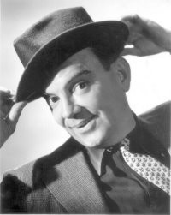
#4
When You Wish Upon a Star
-#2 song in 1940
- By Cliff Edwards
YouTube - Cliff Edwards - When You Wish Upon A Star
(click to hear song)

Slide 7
When you wish upon a star Makes no difference who you are Anything your heart desires Will come to you If your heart is in your dream No request is too extreme When you wish upon a star As dreamers do Fate is kind She brings to those to love The sweet fulfillment of Their secret longing Like a bolt out of the blue Fate steps in and sees you through When you wish upon a star Your dreams come true
When you Wish Upon a Star
Lyrics
http://www.stlyrics.com/lyrics/pinocchio/whenyouwishuponastar.htm
Cliff
Edwards

Slide 8
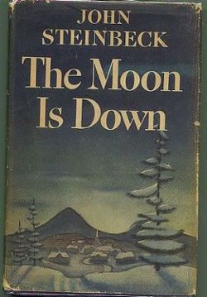
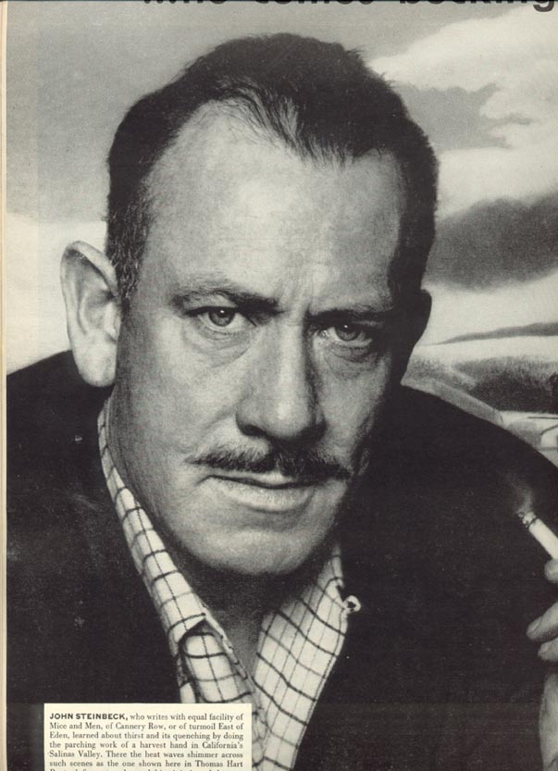
#5
The Moon is Down is a popular fictional story about war that was written in 1942 by John Steinbeck.

Slide 9
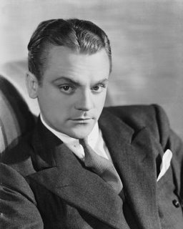
#6
James Cagney
Won the Oscar for Best Actor in 1942.
Best known for playing tough guy roles.

Slide 10
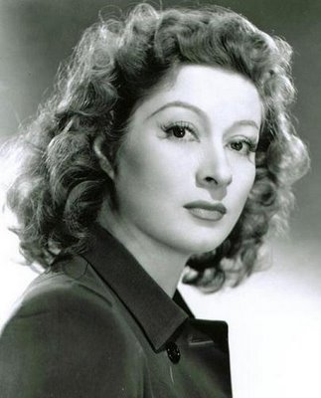
#7
Greer Garson
Won Oscar for Best Actress in 1942
Holds the record for longest Oscar acceptance speech

Slide 11
#8
Silly Putty
Was invented in 1943
James Wright was the inventor
Was a mistake finding while trying to create synthetic rubber.

Slide 12
Medical Advances
#9
1944:
Selman Waksman discovered Streptomycin. It is a remedy for tuberculosis, TB.

Slide 13
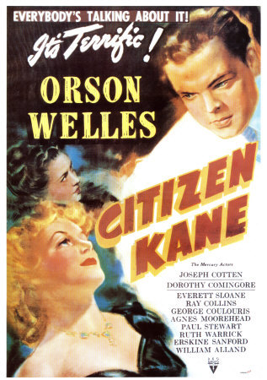
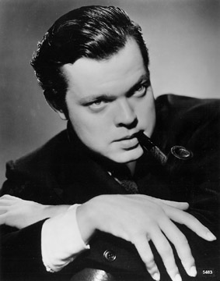
#10
Orson Welles
Citizen Kane
#1 on The 100 Greatest Movies of the 1940s
Directed by Orson Welles
He also starred in the film

Slide 14
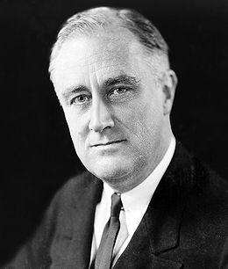
#11
Franklin D. Roosevelt
Was the 32nd President of the U.S.
March 4, 1933 – April 12, 1945
Led Allies against Germany and Japan during World War II
Died on April 12, 1945

Slide 15
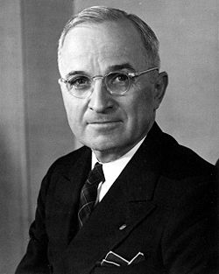
#12
Harry Truman
Roosevelt’s Vice President
33rd President of the U.S.
April 12, 1945- January 20, 1953
Even though Vice President, Roosevelt never told Truman about his plans.
After 82 days in office, the Allies got a victory in Europe

Slide 16
Works Cited
#1
http://www.world-war-pictures.com/american-war-posters.htm
http://www.world-war-pictures.com/american-war-posters.htm
#2
http://www.greatdreams.com/war/pearl-harbor-three.htm
http://www.historyofwar.org/Pictures/pictures_pearl_04.html
http://en.wikipedia.org/wiki/Attack_on_Pearl_Harbor
#3
http://www.examiner.com/images/blog/EXID2623/images/glennmiller1.jpg
http://www.popularsong.org/1940.html
#4
http://1.bp.blogspot.com/_thlFYTjJbmQ/SPvLGUEaeOI/AAAAAAAAHwY/kRs0GLicN-s/s400/Photo-Photographer+-+Ted+Allen.jpg
http://www.popularsong.org/1940.html
#5
http://classiclit.about.com/od/steinbeckjohn/fr/aa_jstein3.htm
http://stmarksgreenlibrary.pbworks.com/f/1201108610/steinbeck1.jpg
http://www.moesbooks.net/pics/22531.jpg
#6
http://www.cdpl.lib.in.us/blog/uploaded_images/James-Cagney-794757.jpg
http://www.filmsite.org/aa42.html
#7
http://www.filmsite.org/aa42.html
http://3.bp.blogspot.com/_Qzd9HIsRWeA/ShzvWTZDcPI/AAAAAAAAXKQ/sJCjuannCko/s400/Greer+Garson.jpg
http://en.wikipedia.org/wiki/Greer_Garson#Career

Slide 17
Works Cited (continued)
#8
http://www.wwwk.co.uk/culture/inventions/40s/silly-putty.htm
http://www.brandchannel.com/images/FeaturesProfile/profile_img1_sillyputty.jpg
#9
http://library.duke.edu/digitalcollections/mma/timeline.html
http://en.academic.ru/pictures/enwiki/83/Streptomycin_structure.png
#10
http://digitaldreamdoor.nutsie.com/pages/movie-pages/movie_40s.html
http://onanimation.com/weblog/wp-content/uploads/2009/05/orson-welles-1939.jpg
http://filmsnoir.net/wp-content/uploads/2008/01/citizen-kane-poster-c10047715.jpeg
#11
http://www.teacheroz.com/WWIILeaders.htm
http://en.wikipedia.org/wiki/Franklin_D._Roosevelt
#12
http://www.teacheroz.com/WWIILeaders.htm
http://en.wikipedia.org/wiki/Harry_S._Truman

