Slide 1
A Separate Peace
By Beth Carpenter

Slide 2
Index
INTRO
1. World War II
2. South Pacific Battles
3. Drafting
4. Political Leaders
5. Top Song/Artist
6. Popular Authors/Books
7. Popular Shows/Actors
8. Medical Discoveries
9. New Inventions
10. Preparatory Schools
11. Common Fashion
12. Works Cited
13. Works Cited Continued
CONCLUSION

Slide 3
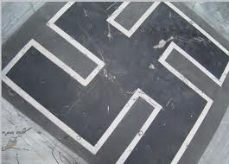
1. World War II
Swastika symbol of the war
Symbol of Nazism
Used in Hinduism, Buddhism, and Jainism
People wore these at the time do decipher from Hitler’s men and the Jews
Major part of the war

Slide 4
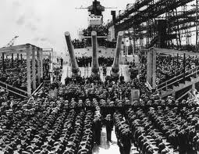
2. South Pacific Battles
April 9, 1941, the (Picture of) USS North Carolina was commissioned
Greatest sea weapon at the time
Participated in every major Naval defense
Destroyed at least 24 enemy air crafts, & shot down many more
Now in Raleigh, N.C in the N.C Museum of History

Slide 5
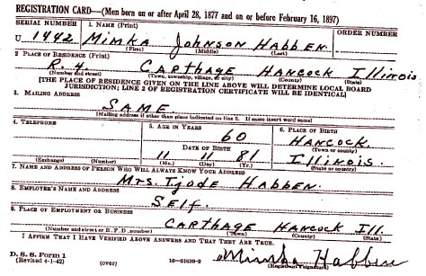
3. Drafting
War drafting card (similar to that or Brinker)
Information for enlisting into the army
Valid to anyone born between April 82, 1877 and February 16, 1897
Organized and filed in alphabetical order by entire state

Slide 6
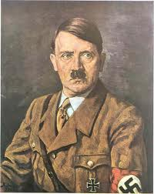
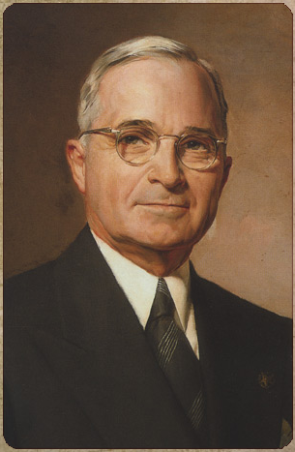
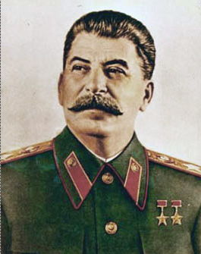
4. Political Leaders
(Pictures of) Famous political leaders at the time were:
Neville Chamberlain
Winston Churchill
Charles de Gaulle
Adolf Hitler
F D Roosevelt
Joseph Stalin
Hideki Tojo
Harry Truman

Slide 7
5. Top Songs/Artists
CHATTANOOGA CHOO CHOO Glenn Miller - from "Sun Valley Serenade" - words by Mack Gordon, music by Harry Warren Pardon me, boy Is that the Chattanooga choo chooWhen you hear the whistle blowin' eight to the bar Then you know that Tennessee is not very far Shovel all the coal in Gotta keep it rollin' Woo, woo, Chattanooga there you are There's gonna be A certain party at the station Satin and lace I used to call "funny face" She's gonna cry Until I tell her that I'll never roam So Chattanooga choo choo Won't you choo-choo me home?
Chattanooga choo choo Won't you choo-choo me home? Track twenty-nine Boy, you can gimme a shine I can afford To board a Chattanooga choo choo I've got my fare And just a trifle to spare You leave the Pennsylvania Station 'bout a quarter to four Read a magazine and then you're in Baltimore Dinner in the diner Nothing could be finer Than to have your ham an' eggs in Carolina

Slide 8
6. Popular Authors/Books
Books to remember the war.

Slide 9
7. Popular Show/Actors
Bugs Bunny cartoon to remember the easy coming of children

Slide 10
8. Medical Discoveries
Sulphonamides and Penicillin were tow major medical discoveries that began to work on humans and saved many lives

Slide 11
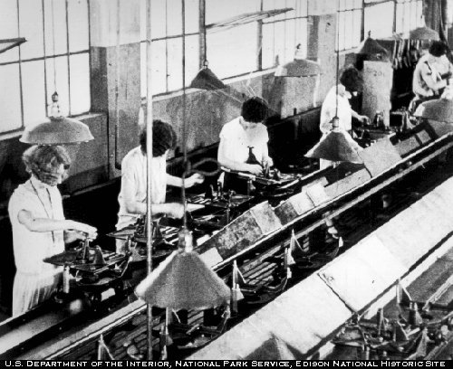
9. New Inventions
Used for making car parts and other army machinery and weapons
Quicker production of items
More jobs/money

Slide 12
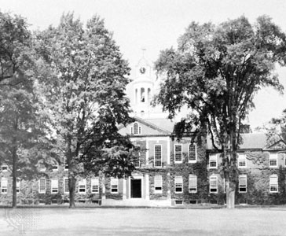
10. Preparatory Schools
Picture of Phillips Exeter Academy
To remember the tree, accident, and summer there
To look back on 15 MORE years down the road

Slide 13
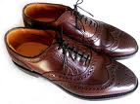
11. Common Fashion
Pieces of clothing to remember how we dressed

Slide 14
Works Cited
1a.http://gallery.hd.org/_c/memes/_more2007/_more01/swastika-black-with-white-border-Nazi-symbol-from-tail-of-WWII-World-War-2-warplane-undergoing-restoration-1-DHD.jpg.html
1b.http://en.wikipedia.org/wiki/Swastika
2.http://www.ncdcr.gov/news/2007/events/showboat.asp
3.http://www.rootdig.com/draft/worldwartwo.html
4a.http://thevillageheathen.wordpress.com/2010/08/02/who-would-you-vote-for/
4b. http://www.historylearningsite.co.uk/political_leaders_of_world_war_t.htm
4c. http://www.flash-pack.com/wp-content/uploads/2008/01/detail-presidents-truman.png
4d. http://www.fullissue.com/wp-content/uploads/joseph-stalin.jpg

Slide 15
Works Cited
5. http://www.lyricsdepot.com/glenn-miller/chattanooga-choo-choo.html
6. www.google.com/imghp/
7. www.google.com/imghp/
8. http://www.google.com/images?hl=en&source=imghp&q=sulphonamides&gbv=2&aq=f&aqi=g1&aql=&oq=&gs_rfai=
9. https://honors.rit.edu/amitraywiki/images/8/8f/Assembly.jpg
10. http://media-2.web.britannica.com/eb-media/90/11990-004-FF733365.jpg
11. www.google.com/imghp/

Slide 16
Conclusion
I would add these pictures, descriptions, and items in the time capsule because they would be important to remember and would be nice to look back on years down the road and for other people.

